Slide 1
Unit 4-3 Operating Systems

Slide 2
Unit 4-3 Operating Systems
4-3 Learning Objective Standards
1. Identify the operating system used by a computer.
2. Identify the parts of the Windows 10 interface (desktop, taskbar, etc.).
4-3 Vocabulary
Dock
Firmware (chip)
Hardware
Mac OS
Operating system
Peripherals
Software
Task Bar
Utilities
Windows

Slide 3
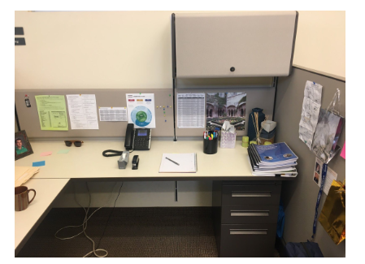
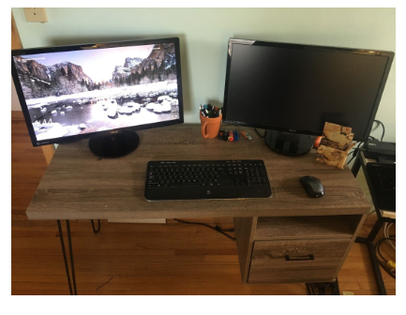
Unit 4-3-A Reference DESKS: (Compare)
DESK 1
DESK 2

Slide 4
Unit 4-3-B Reference Hardware and Software
Printer
Scanner
Camera
Speakers
Keyboard
Hard Drive
Virtual Reality
Robotics

Slide 5
Unit 4-3-B Reference Hardware and Software

Slide 6
Unit 4-3-D Reference Operation Systems
#1 Windows or Mac

Slide 7
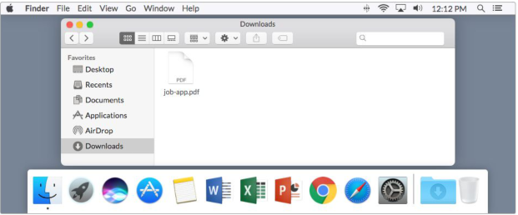
Unit 4-3-D Reference Operation Systems
#2 Windows or Mac

Slide 8
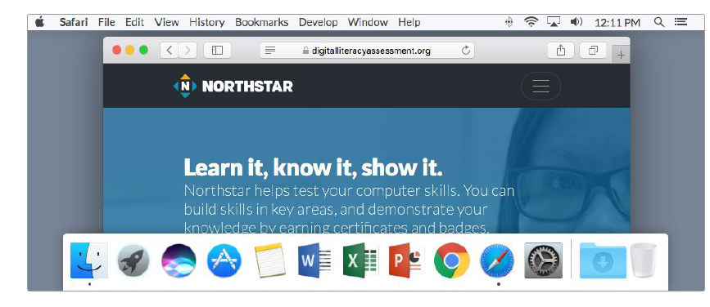
Unit 4-3-D Reference Operation Systems
#3 Windows or Mac

Slide 9
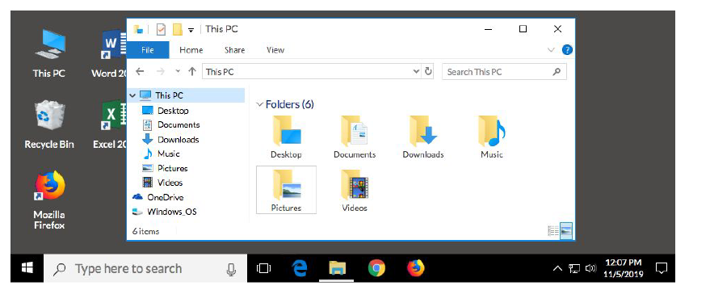
Unit 4-3-D Reference Operation Systems
#4 Windows or Mac

Slide 10
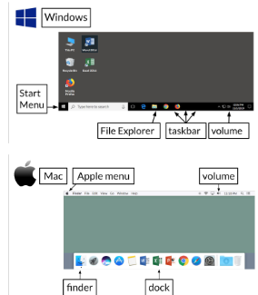
Unit 4-3-C Reference Key

Slide 11
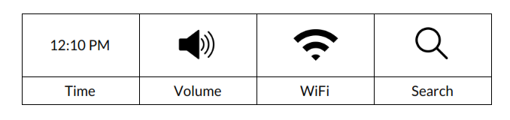
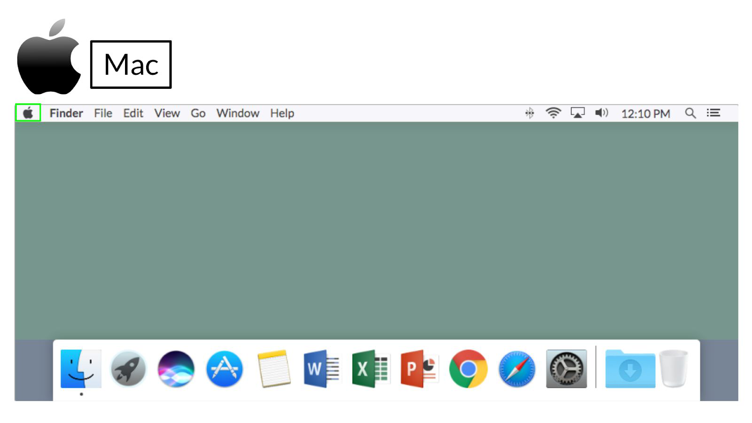
Unit 4-3-A Handout (Icons)

Slide 12
4-3 Windows and Mac (Same and Different)

Slide 13
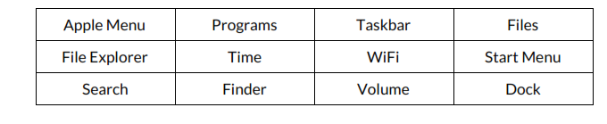
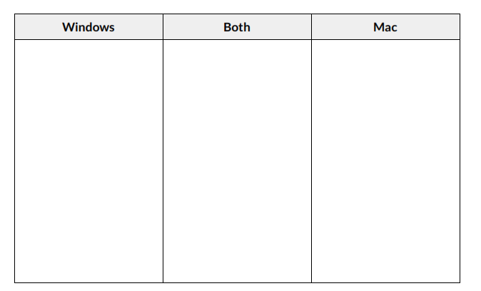
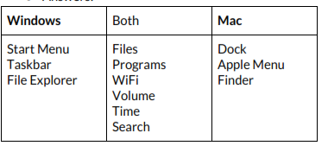
Unit 4-3-B Handout (Compare Windows and Mac)
KEY

Slide 14
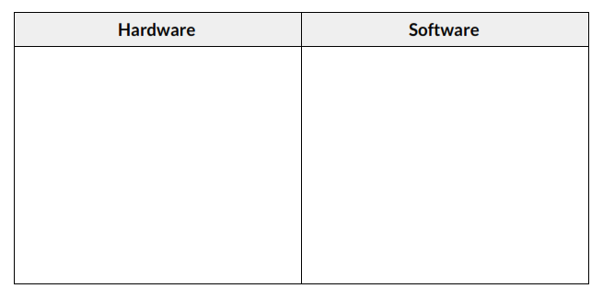
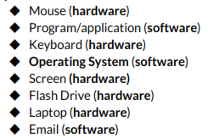
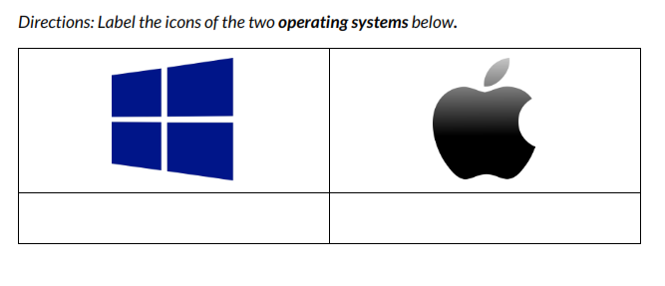
Unit 4-3-C Handout (Software and Hardware)
mouse
keyboard
Operating System
Program
Screen
Application
Email
Laptop
KEY

