Slide 1
TABE Math-E PAXEN Unit-5 Measurement and Data Lesson 32 Standard Units Estimate Feet and Inches
Revised: October 16, 2023
Nolan Tomboulian
Some graphics may not have copied well during the scan process.

Slide 2
Math-E - Lesson 32 – Estimate Measures

Slide 3
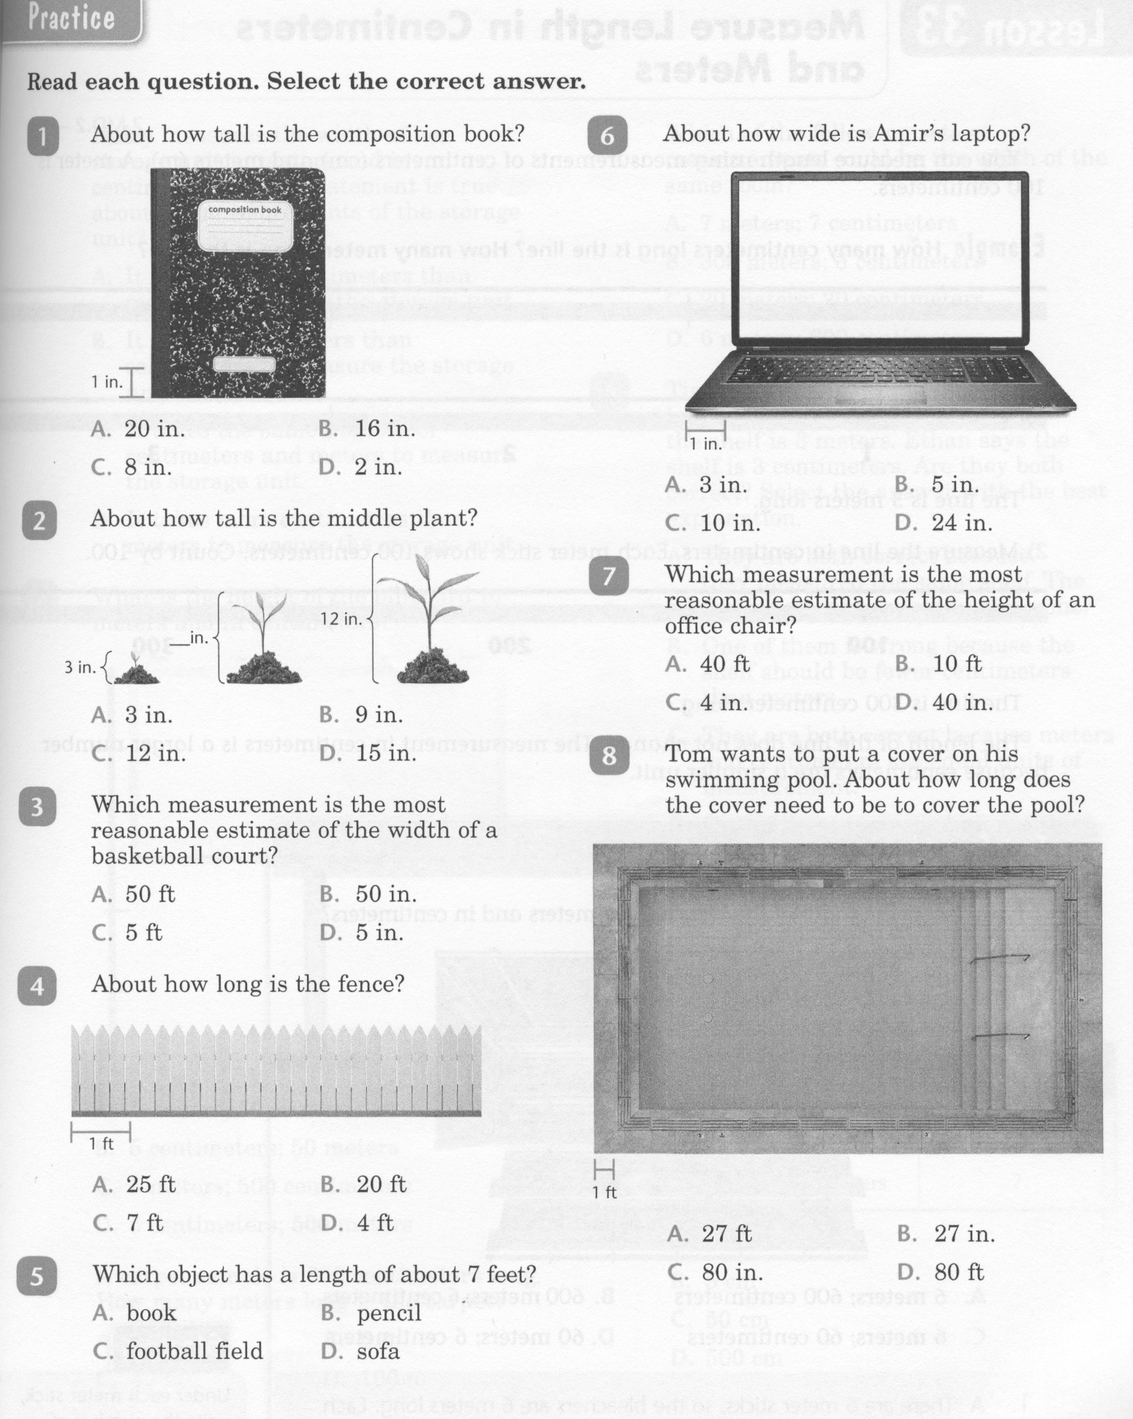
Math-E - Lesson 32 – Estimate Measures

Slide 4
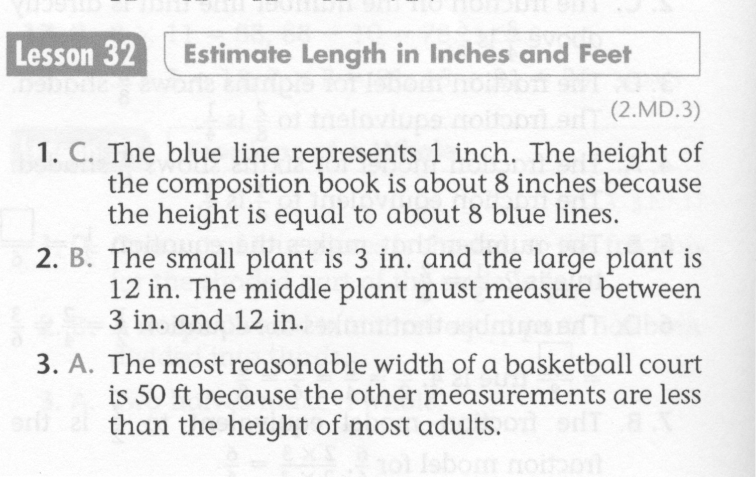
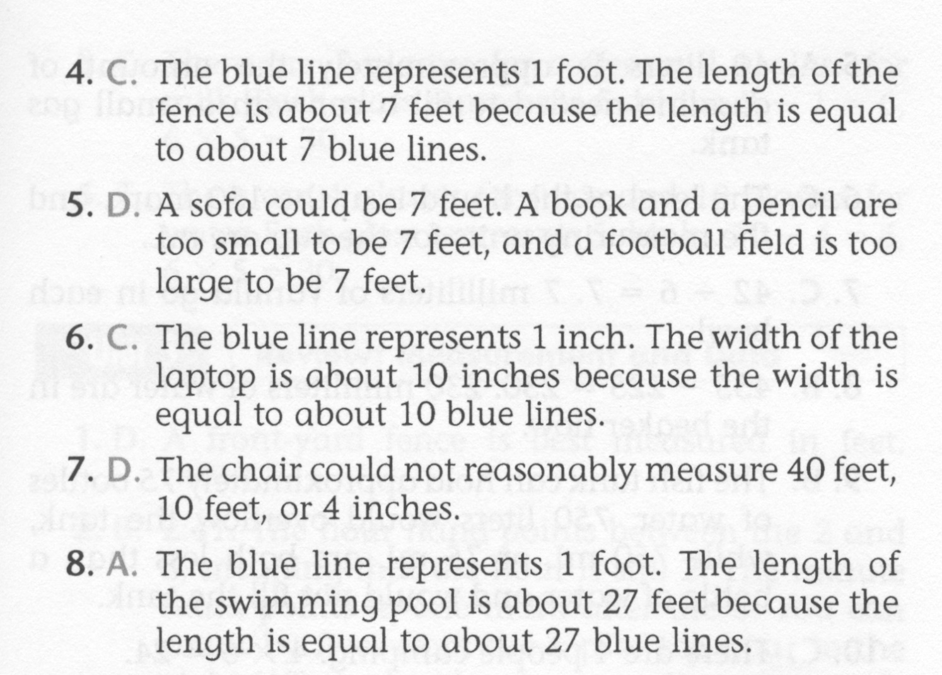
Math-E - Lesson 32 – Estimate Measures

Slide 5
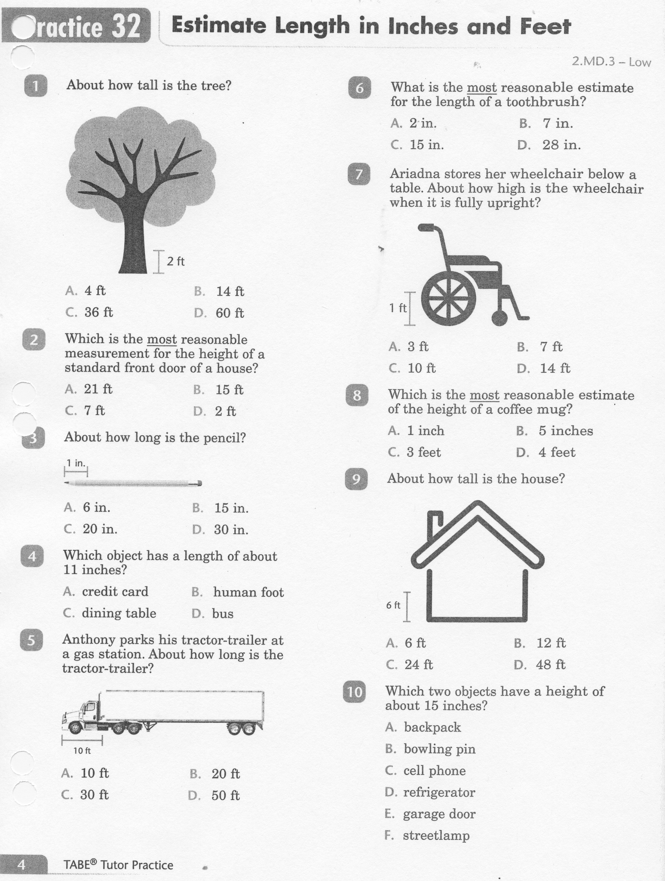
Math-E - Practice 32 – Estimate Measures

Slide 6
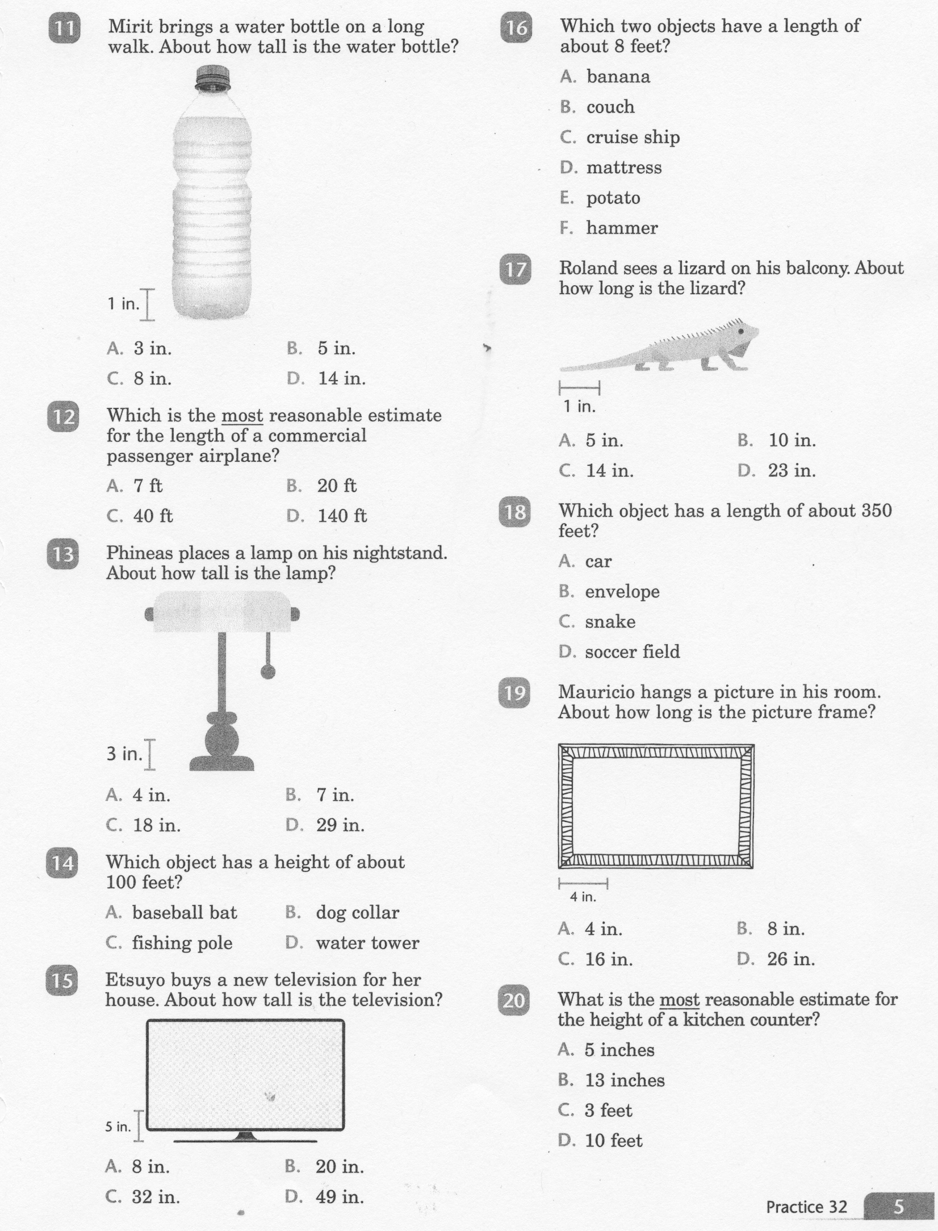
Math-E - Practice 32 – Estimate Measures

Slide 7
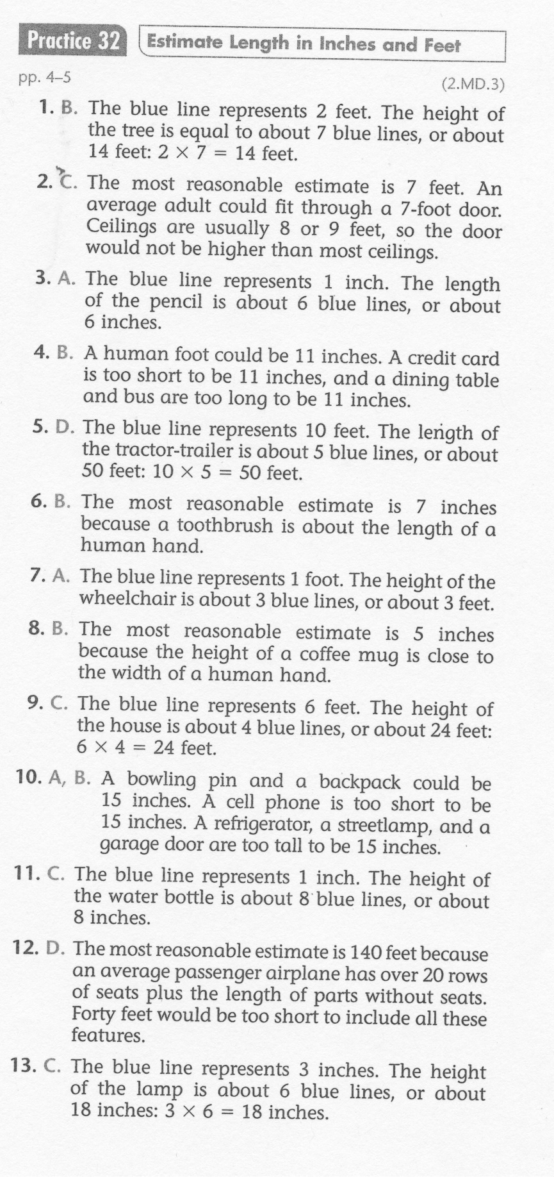
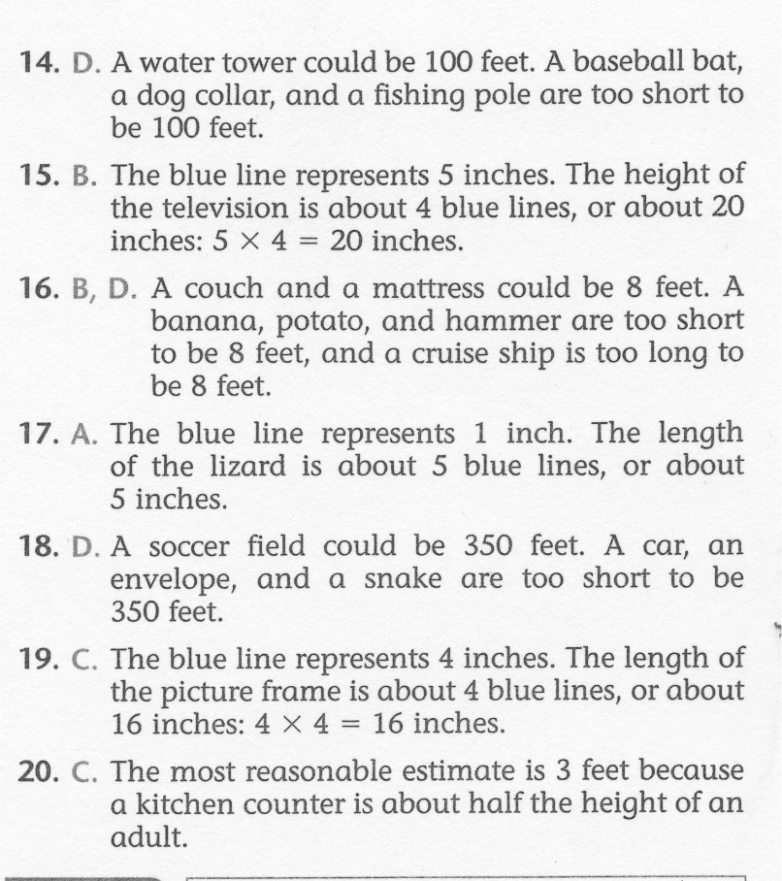
Math-E - Practice 32 – Estimate Measures

