Slide 1
TABE Math-E PAXEN Unit-4 Fractions Lesson 29 Compare Fractions
Revised: October 16, 2023
Nolan Tomboulian
Some graphics may not have copied well during the scan process.

Slide 2
Math-E - Lesson 29 – Compare Fractions

Slide 3
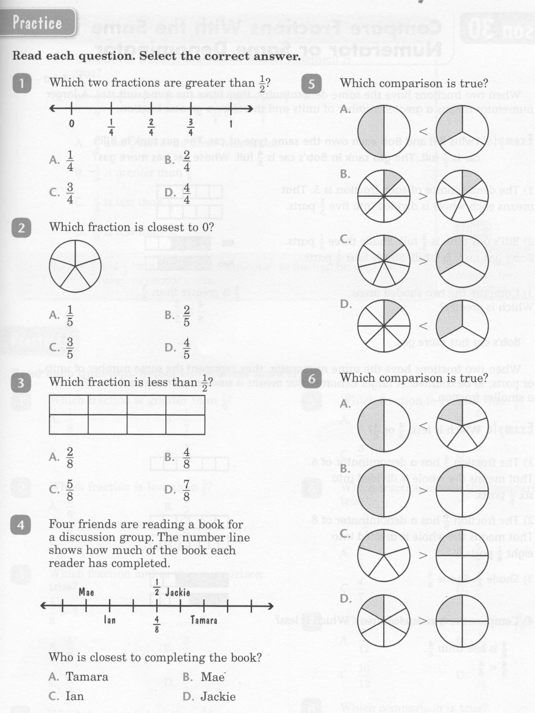
Math-E - Lesson 29 – Compare Fractions

Slide 4
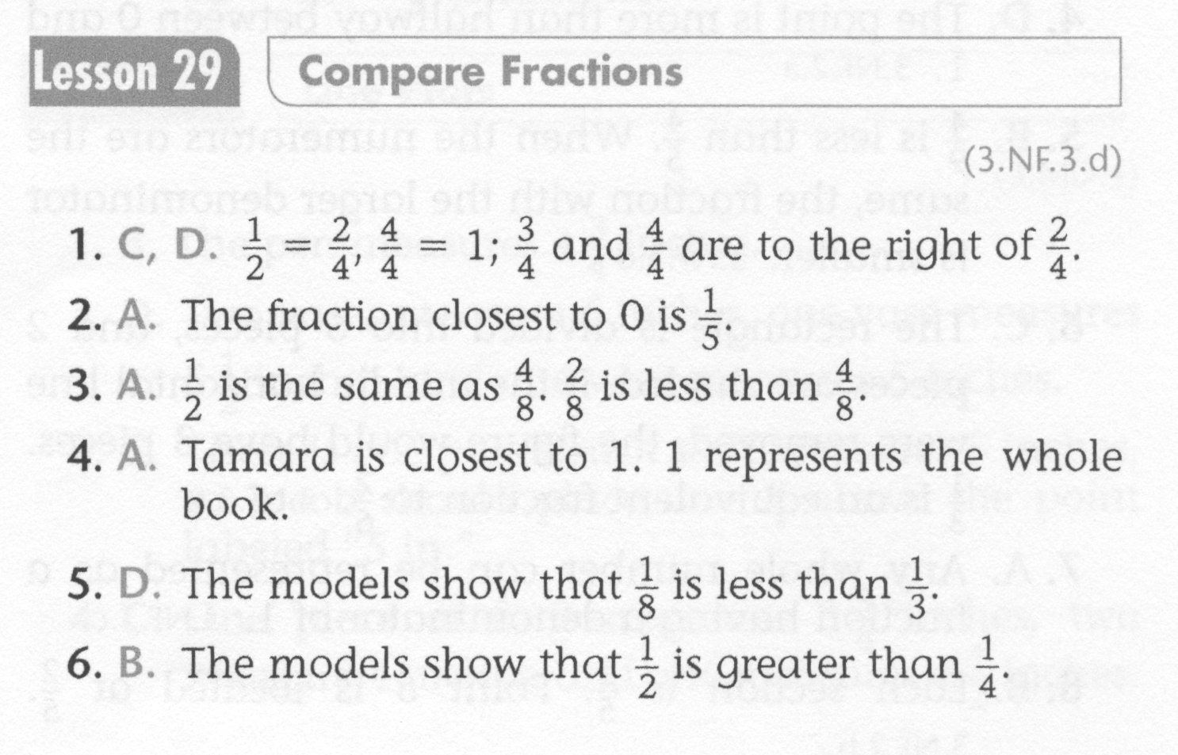
Math-E - Lesson 29 – Compare Fractions

Slide 5
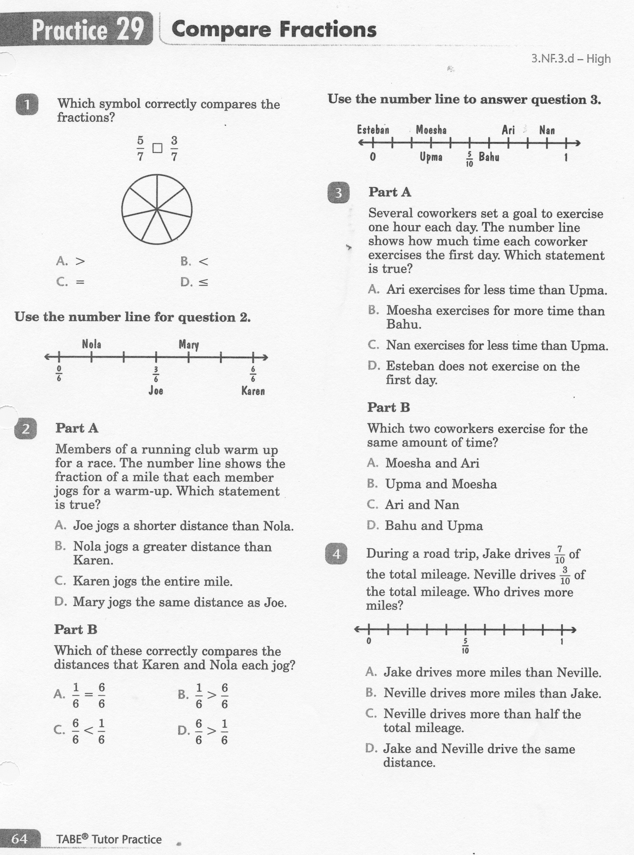
Math-E - Lesson 29 – Compare Fractions

Slide 6
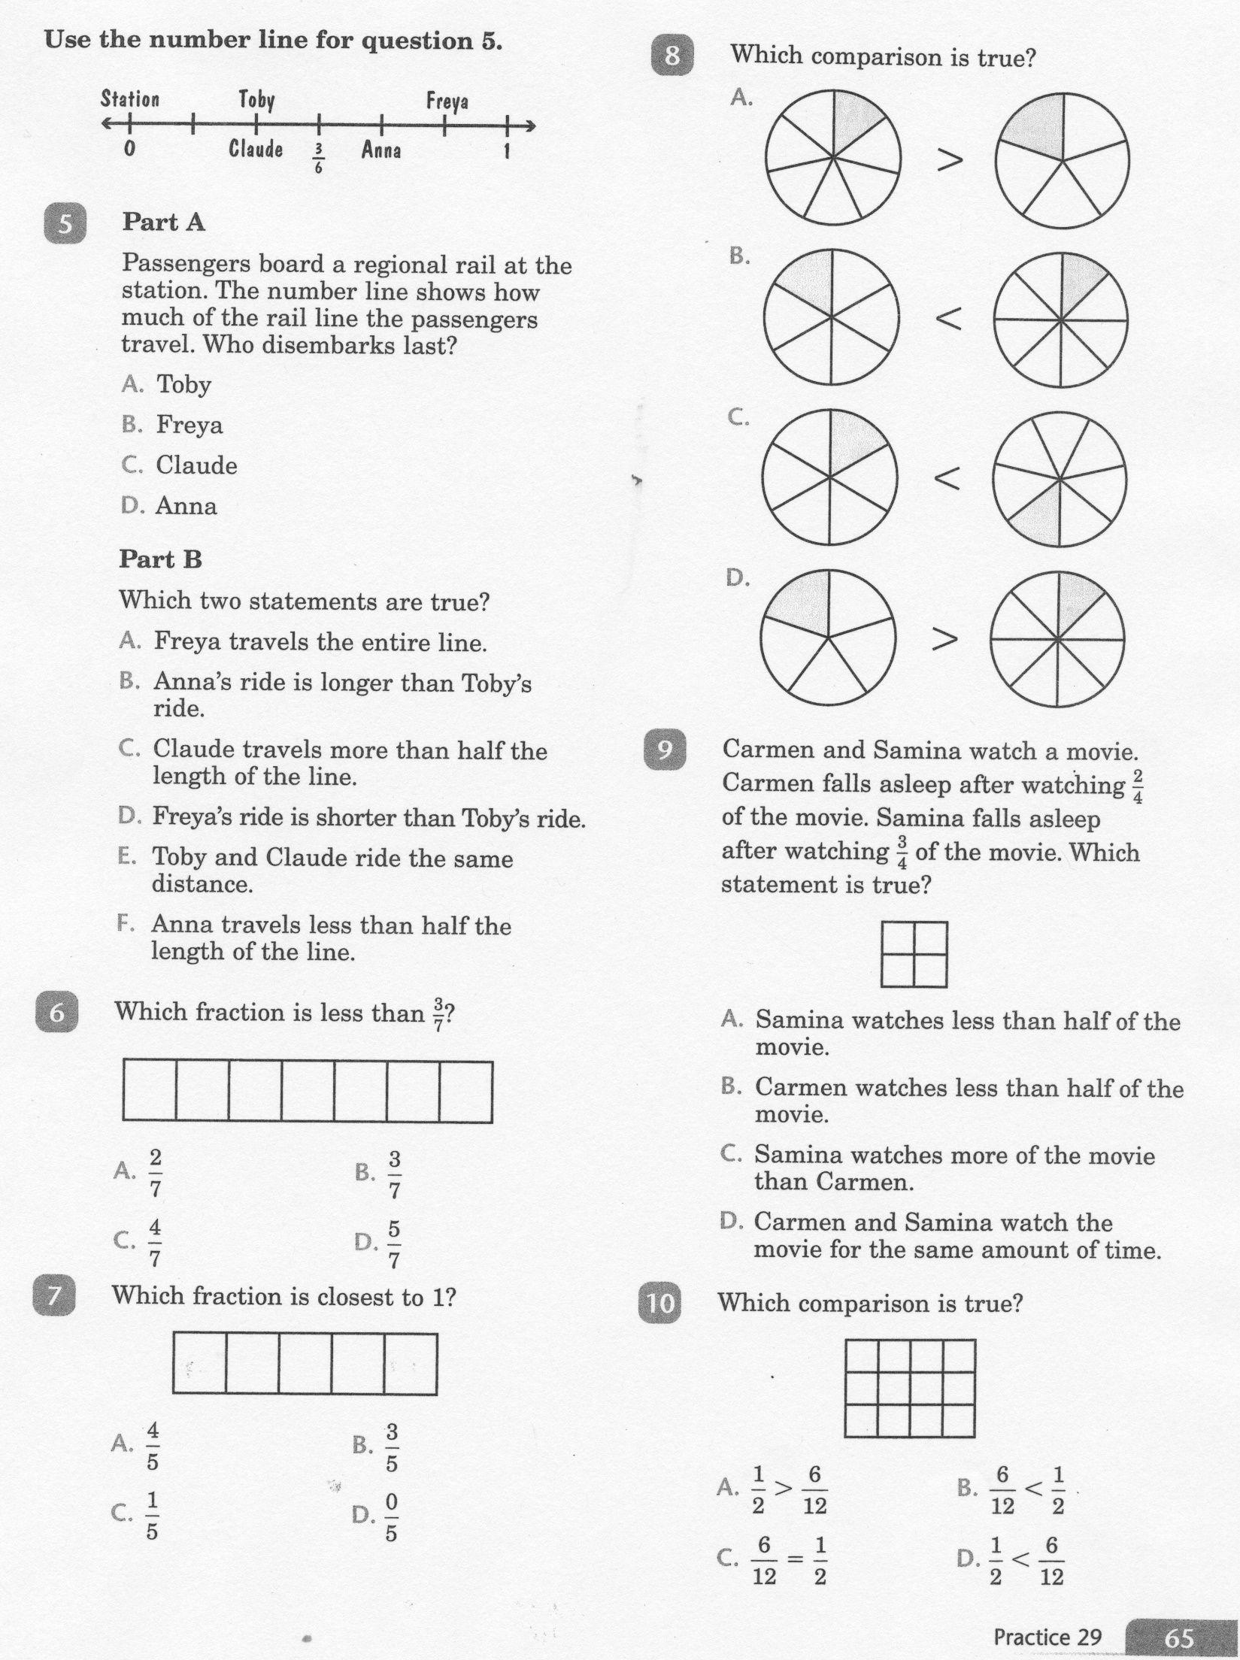
Math-E - Lesson 29 – Compare Fractions

Slide 7
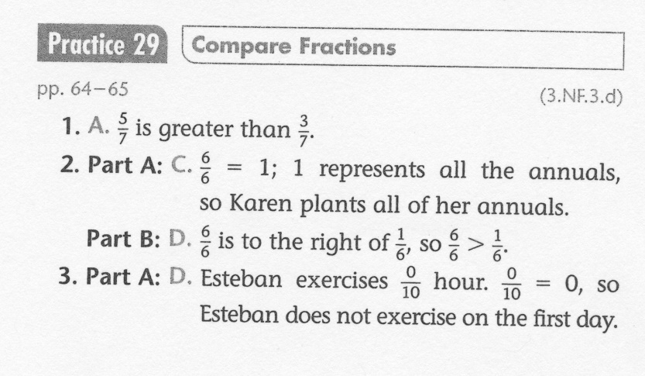
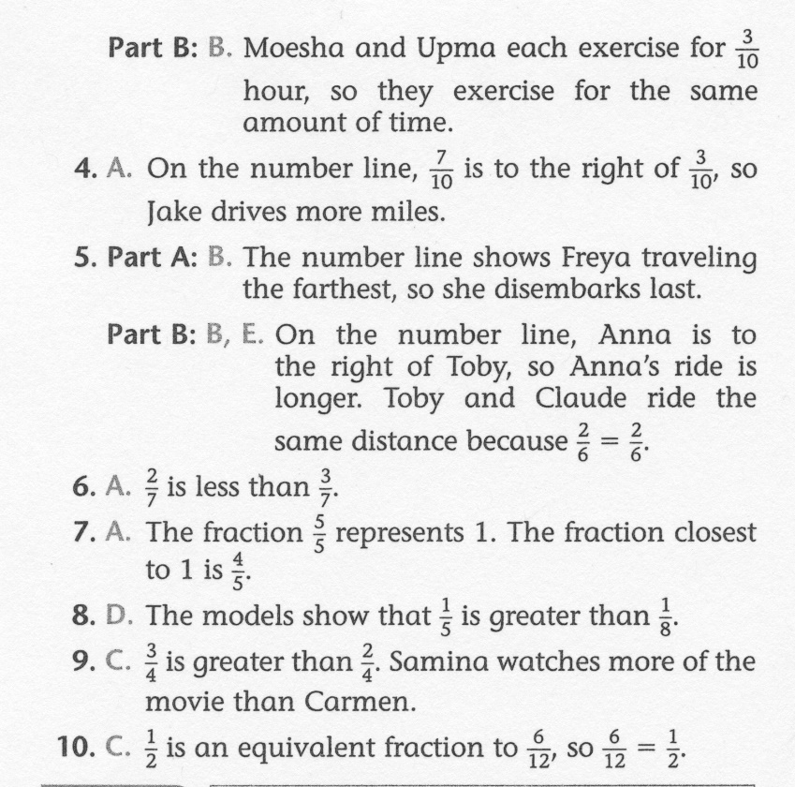
Math-E - Lesson 29 – Compare Fractions

