Slide 1
TABE Math-E PAXEN Unit-3 Multiply and Divide Whole Numbers Lesson 17 Multiplication With DISTRIBUTIVE PROPERTY
Revised: October 16, 2023
Nolan Tomboulian
Some graphics may not have copied well during the scan process.

Slide 2
Math-E - Lesson 17 – Distributive

Slide 3
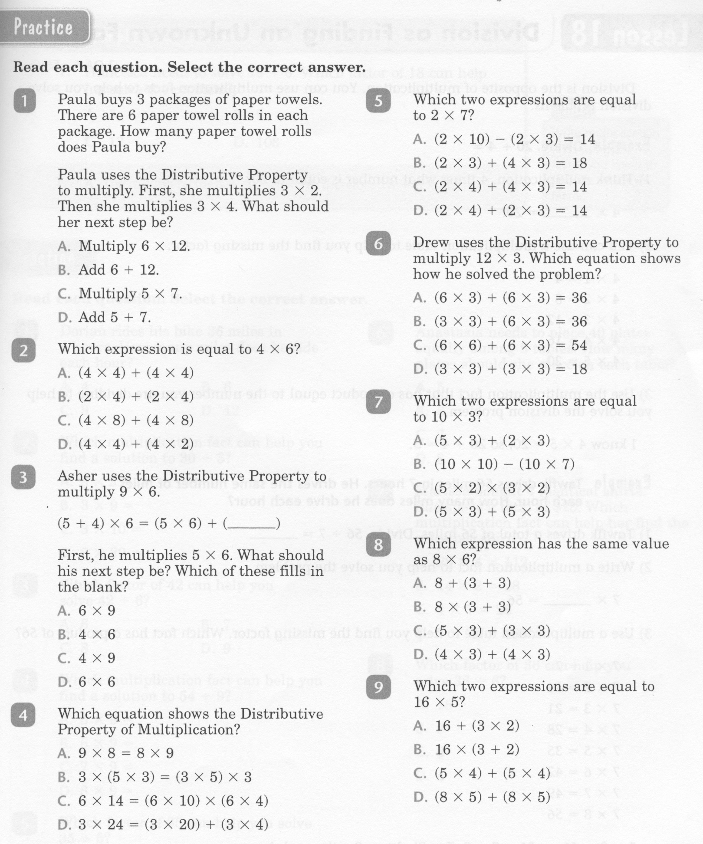
Math-E - Lesson 17 – Distributive

Slide 4
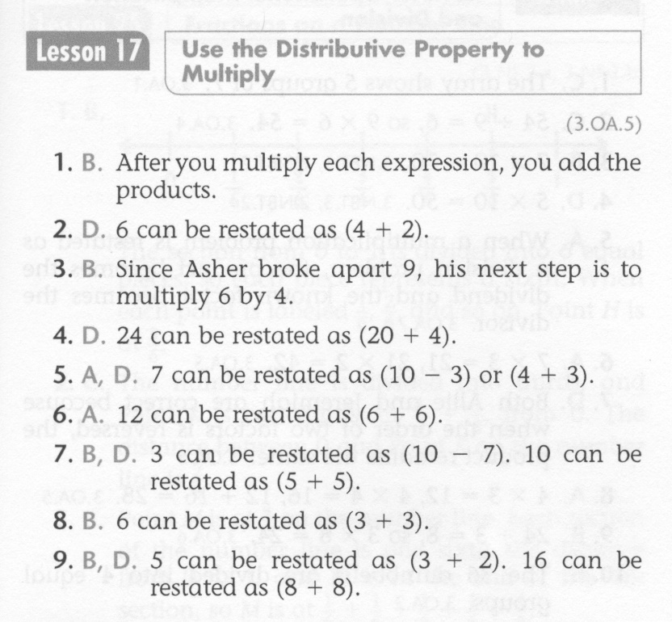
Math-E - Lesson 17 – Distributive

Slide 5
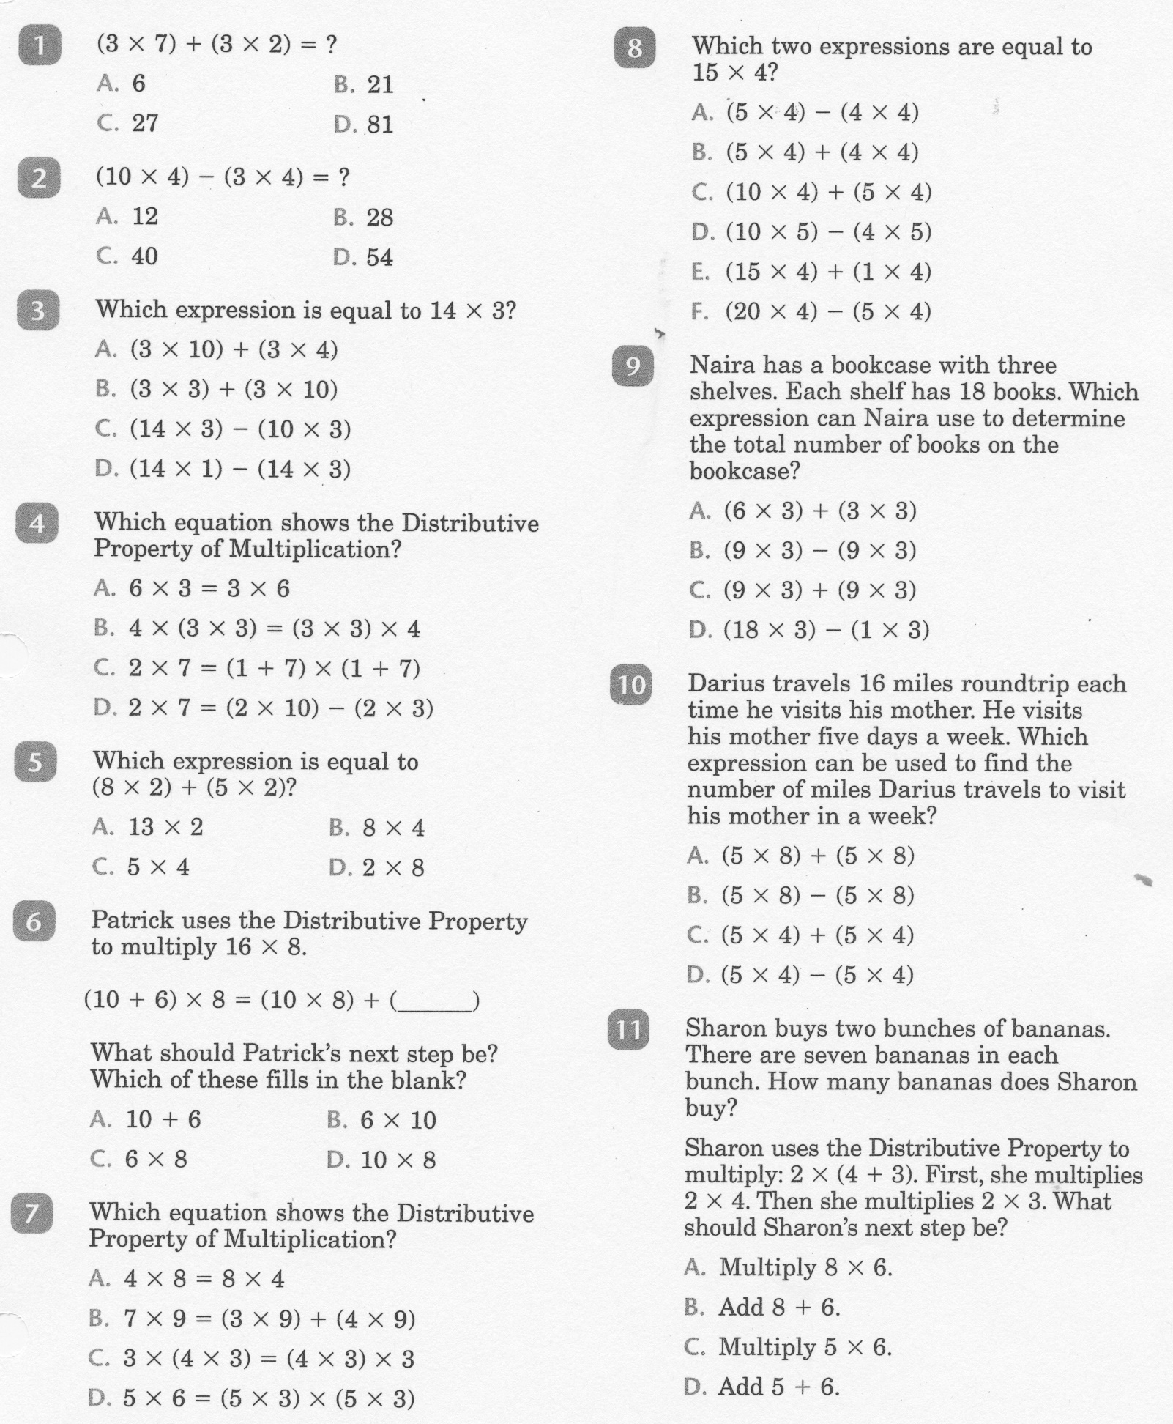
Math-E - Practice 17 – Distributive

Slide 6
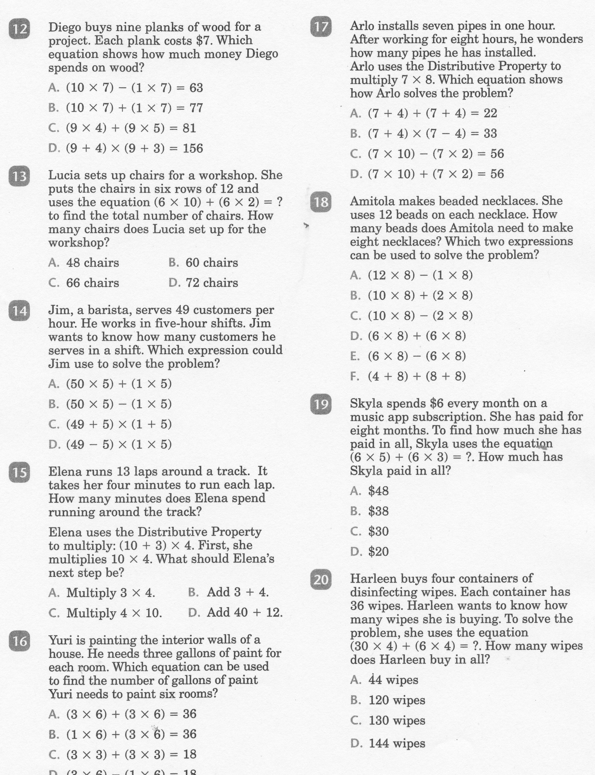
Math-E - Practice 17 Distributive

Slide 7
Math-E - Practice 17 – Distributive

