Slide 1
TABE Math-E PRAXEN Unit-2 Add and Subtract Whole Numbers Lesson-09 Use Drawings
Revised: October 16, 2023
Nolan Tomboulian
Some graphics may not have copied well during the scan process.

Slide 2
Math-E - Lesson-09 – Use Drawings

Slide 3
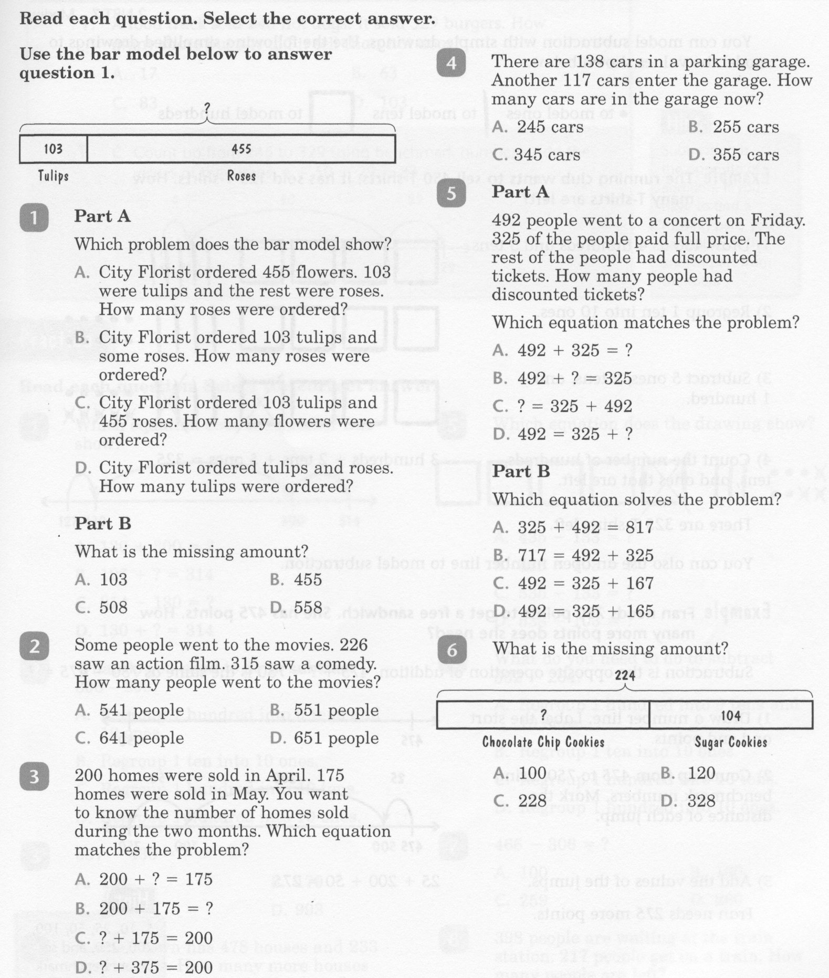
Math-E - Lesson-09 – Use Drawings

Slide 4
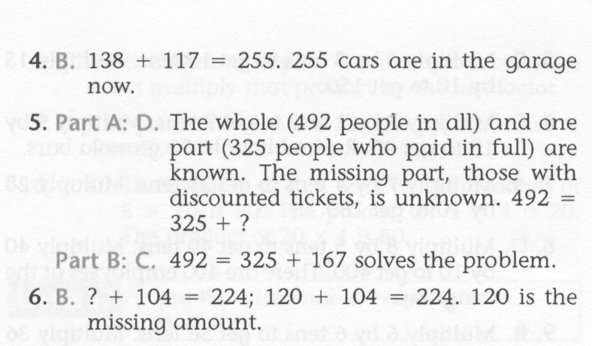
Math-E - Lesson-09 – Use Drawings

Slide 5
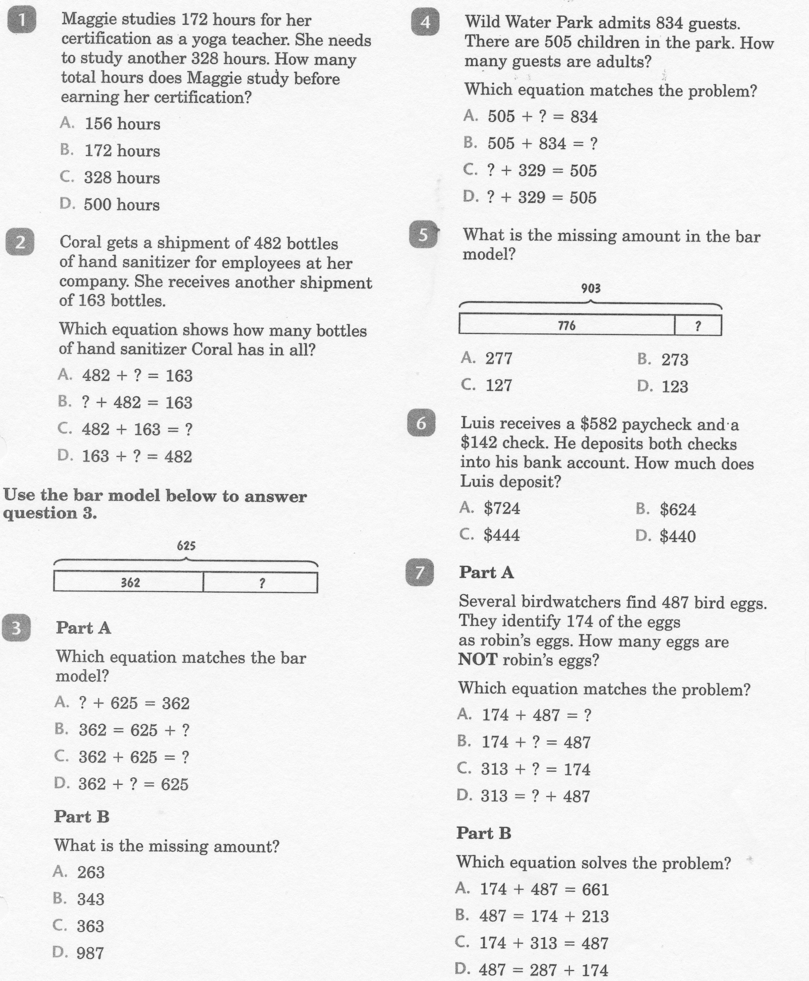
Math-E - Practice-09 – Use Drawings

Slide 6
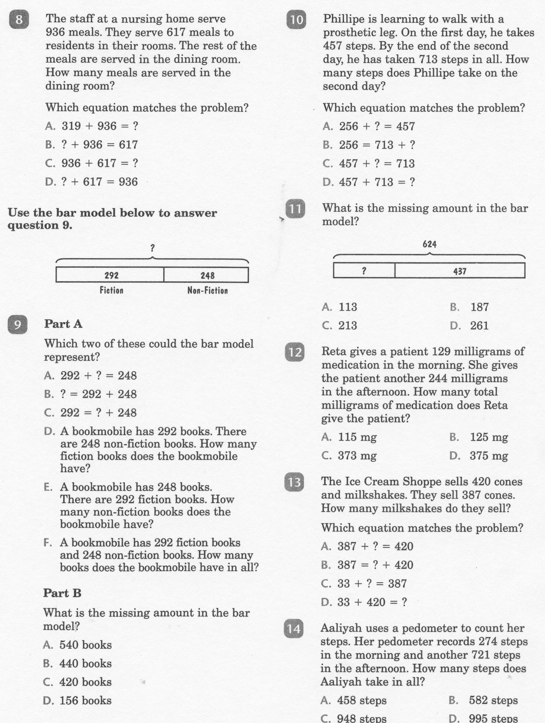
Math-E - Practice-09 – Use Drawings

Slide 7
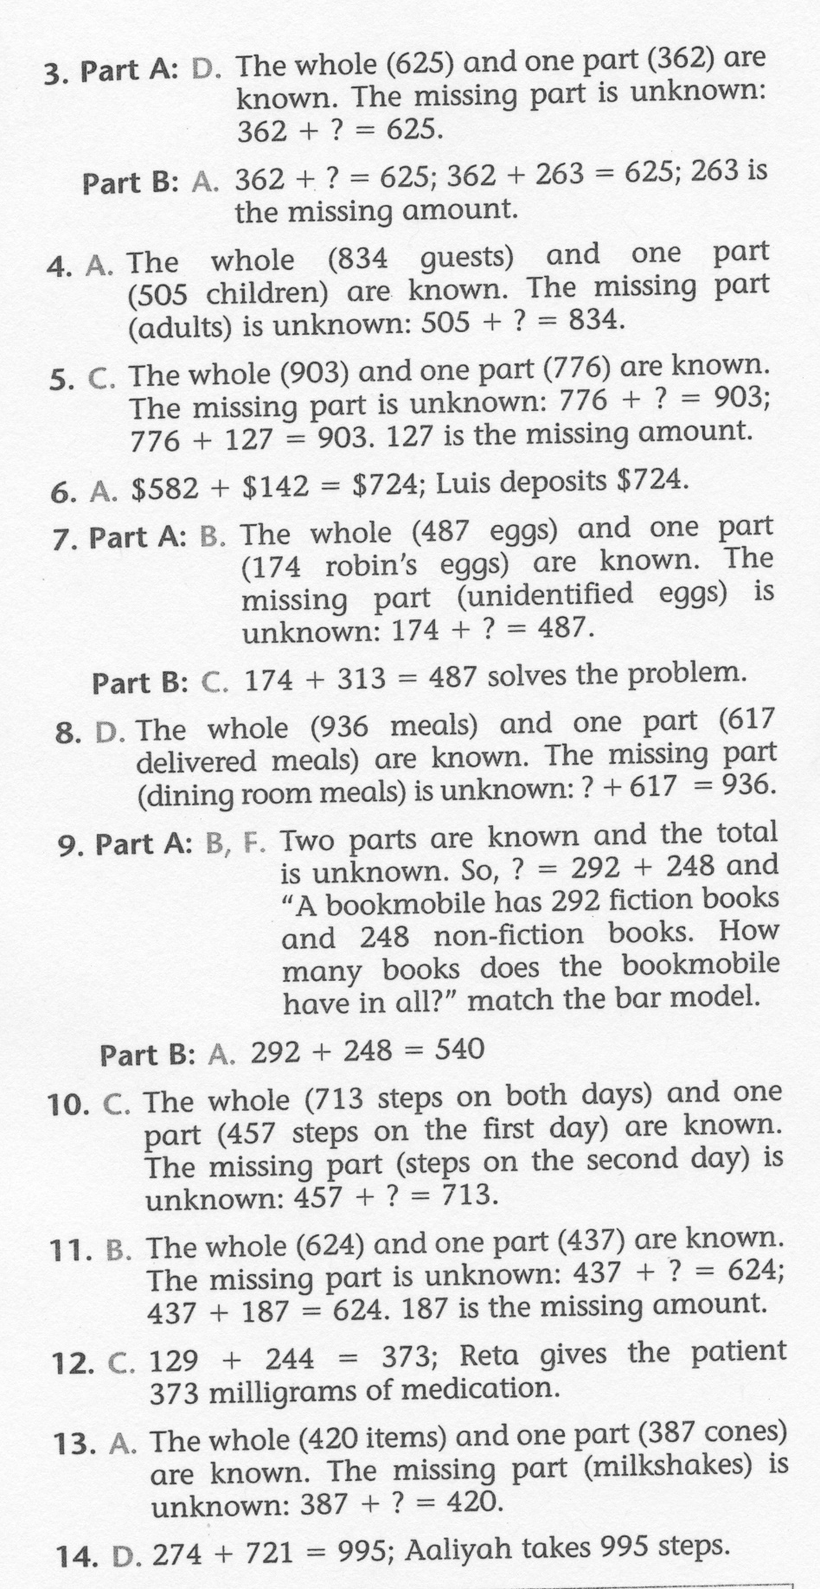
Math-E - Practice-09 – Use Drawings

