Slide 1
TABE Math-E PAXEN Unit-2 Add and Subtract Whole Numbers Lesson-07 3-Digit Addition
Revised: October 16, 2023
Nolan Tomboulian
Some graphics may not have copied well during the scan process.

Slide 2
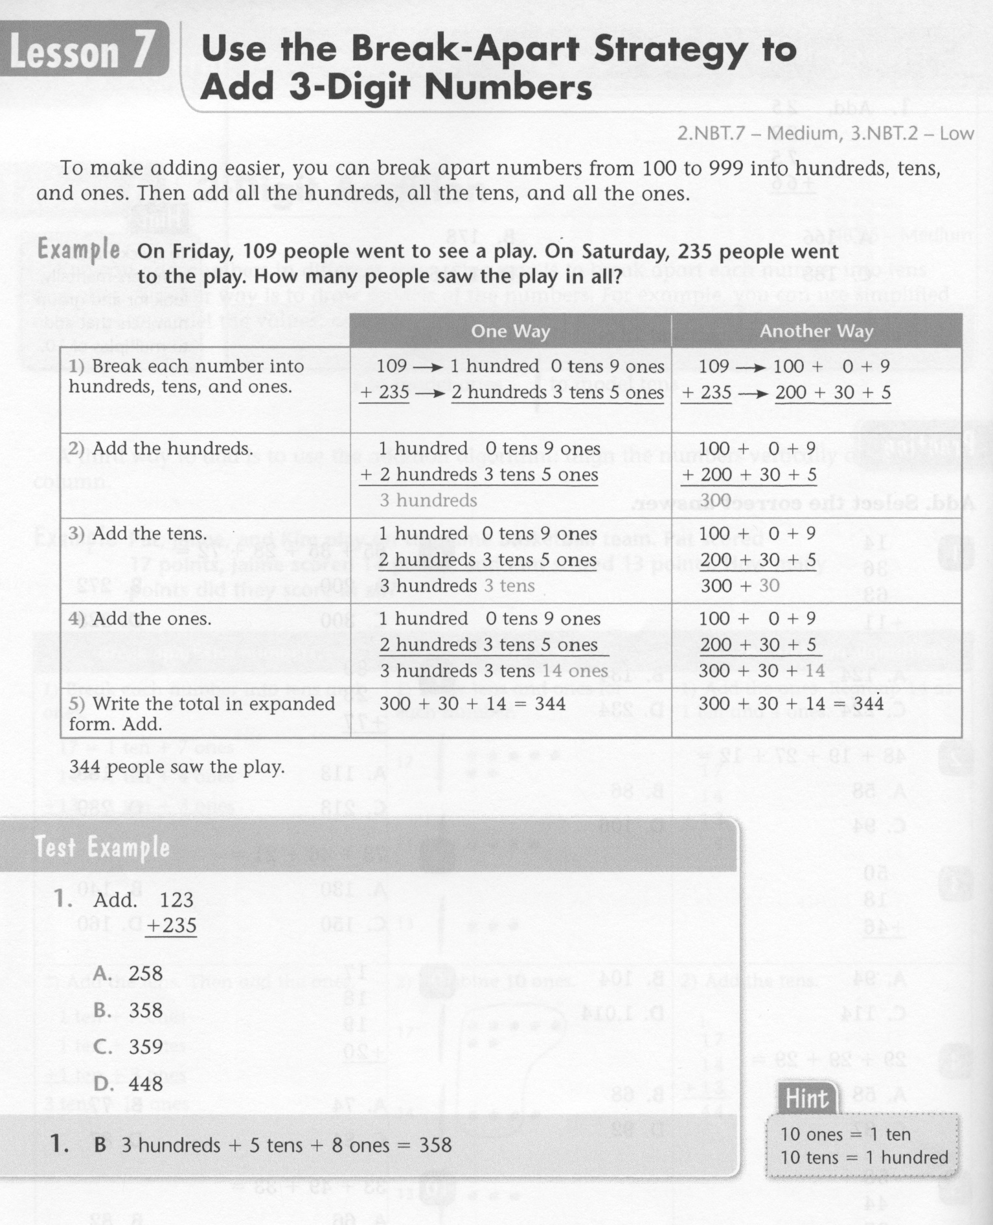
Math-E - Lesson-07 – 3-Digit Addition

Slide 3
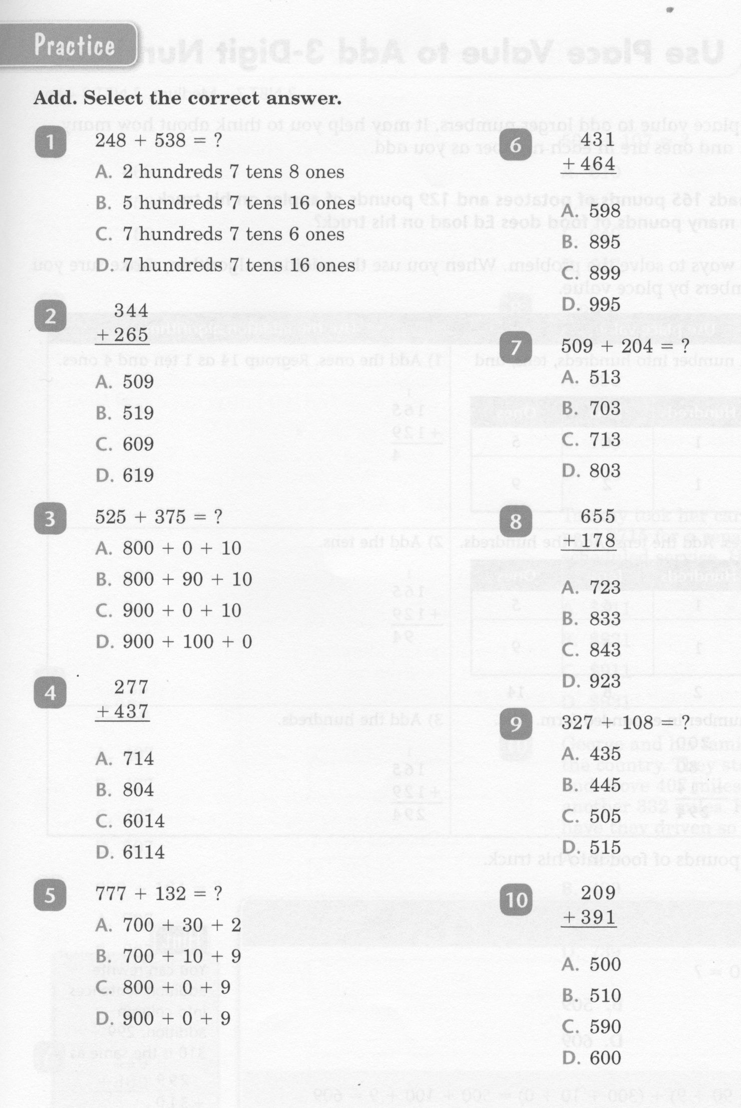
Math-E - Lesson-07 – 3-Digit Addition

Slide 4
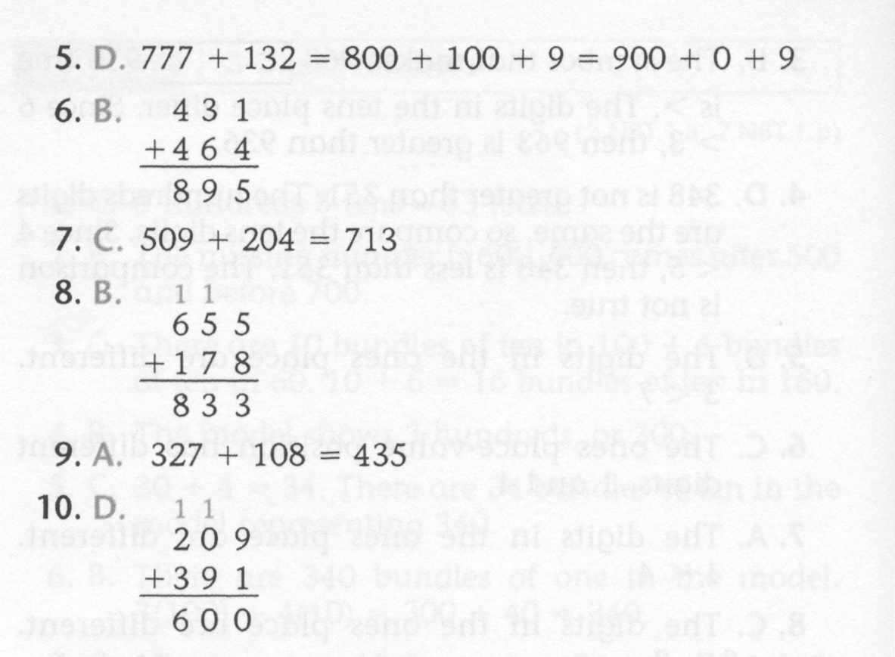
Math-E - Lesson-07 – 3-Digit Addition

Slide 5
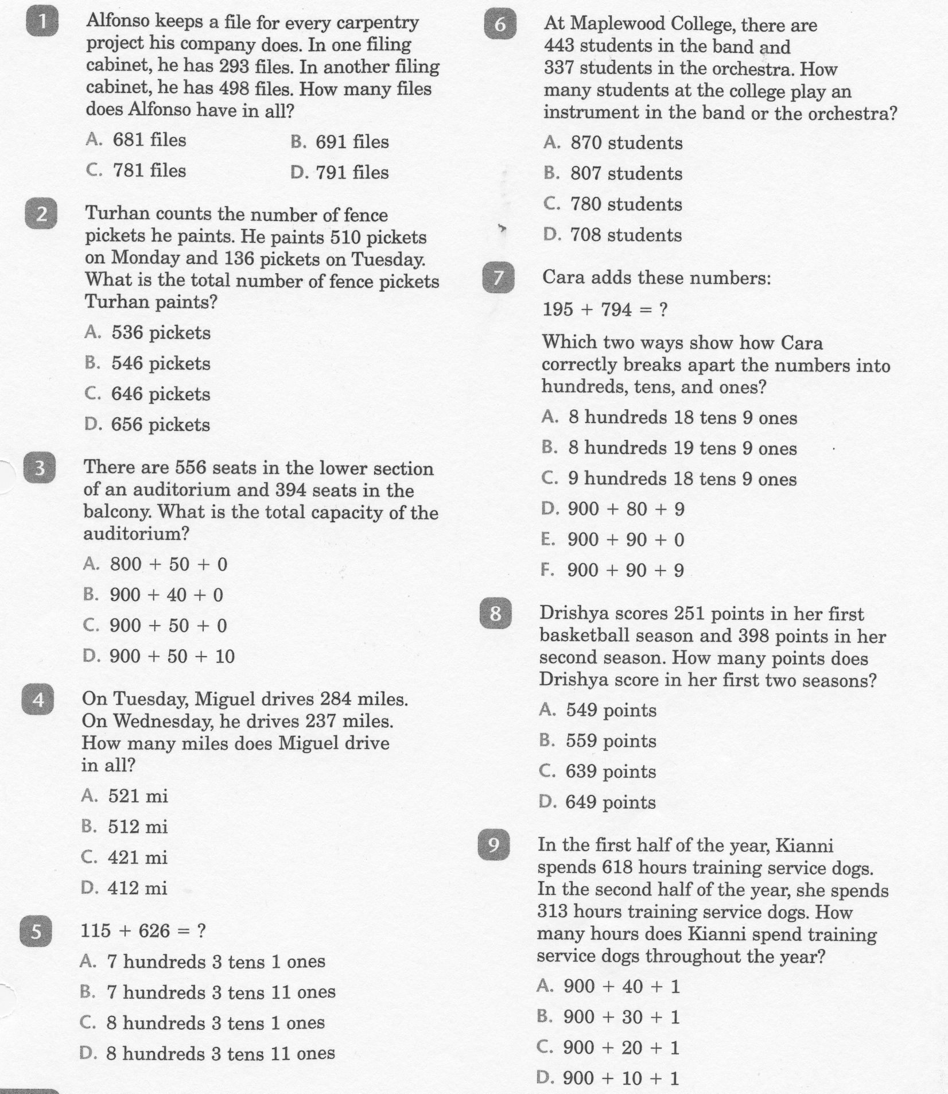
Math-E - Practice-07 – 3-Digit Addition

Slide 6
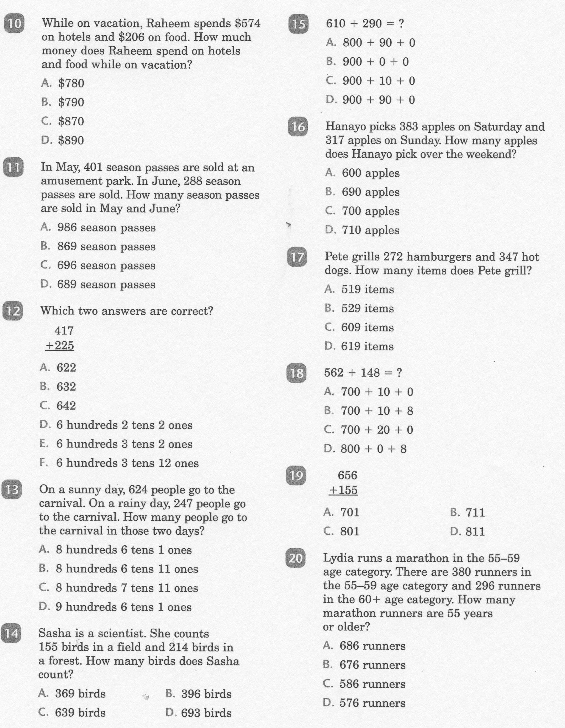
Math-E - Practice-07 – 3-Digit Addition

Slide 7
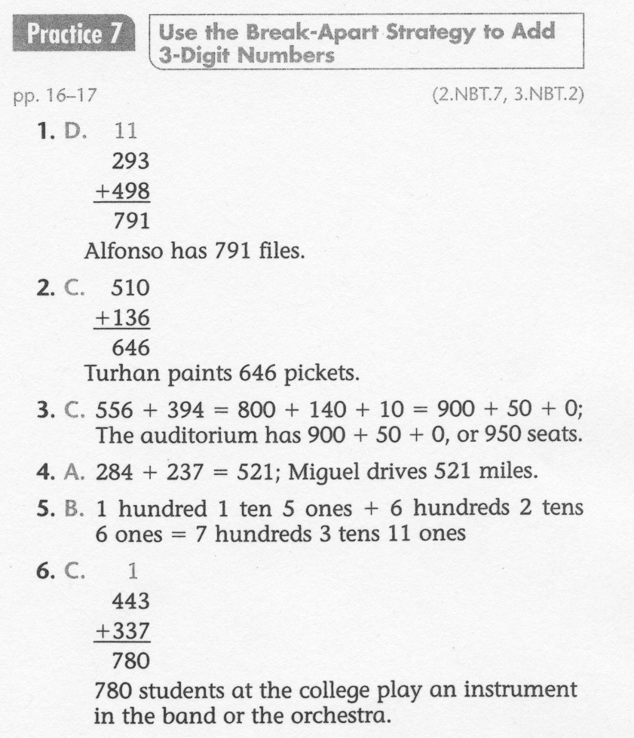
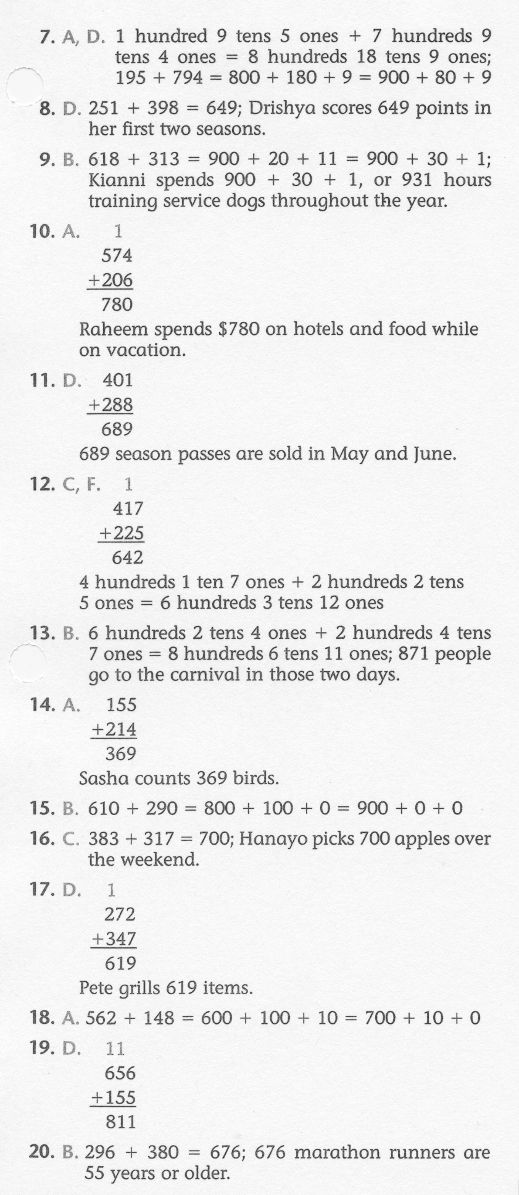
Math-E - Practice-07 – 3-Digit Addition

