Slide 1
TABE Math-E PRAXEN Unit-2 Add and Subtract Whole Numbers Lesson-06 2-Digit Addition
Revised: October 16, 2023
Nolan Tomboulian
Some graphics may not have copied well during the scan process

Slide 2
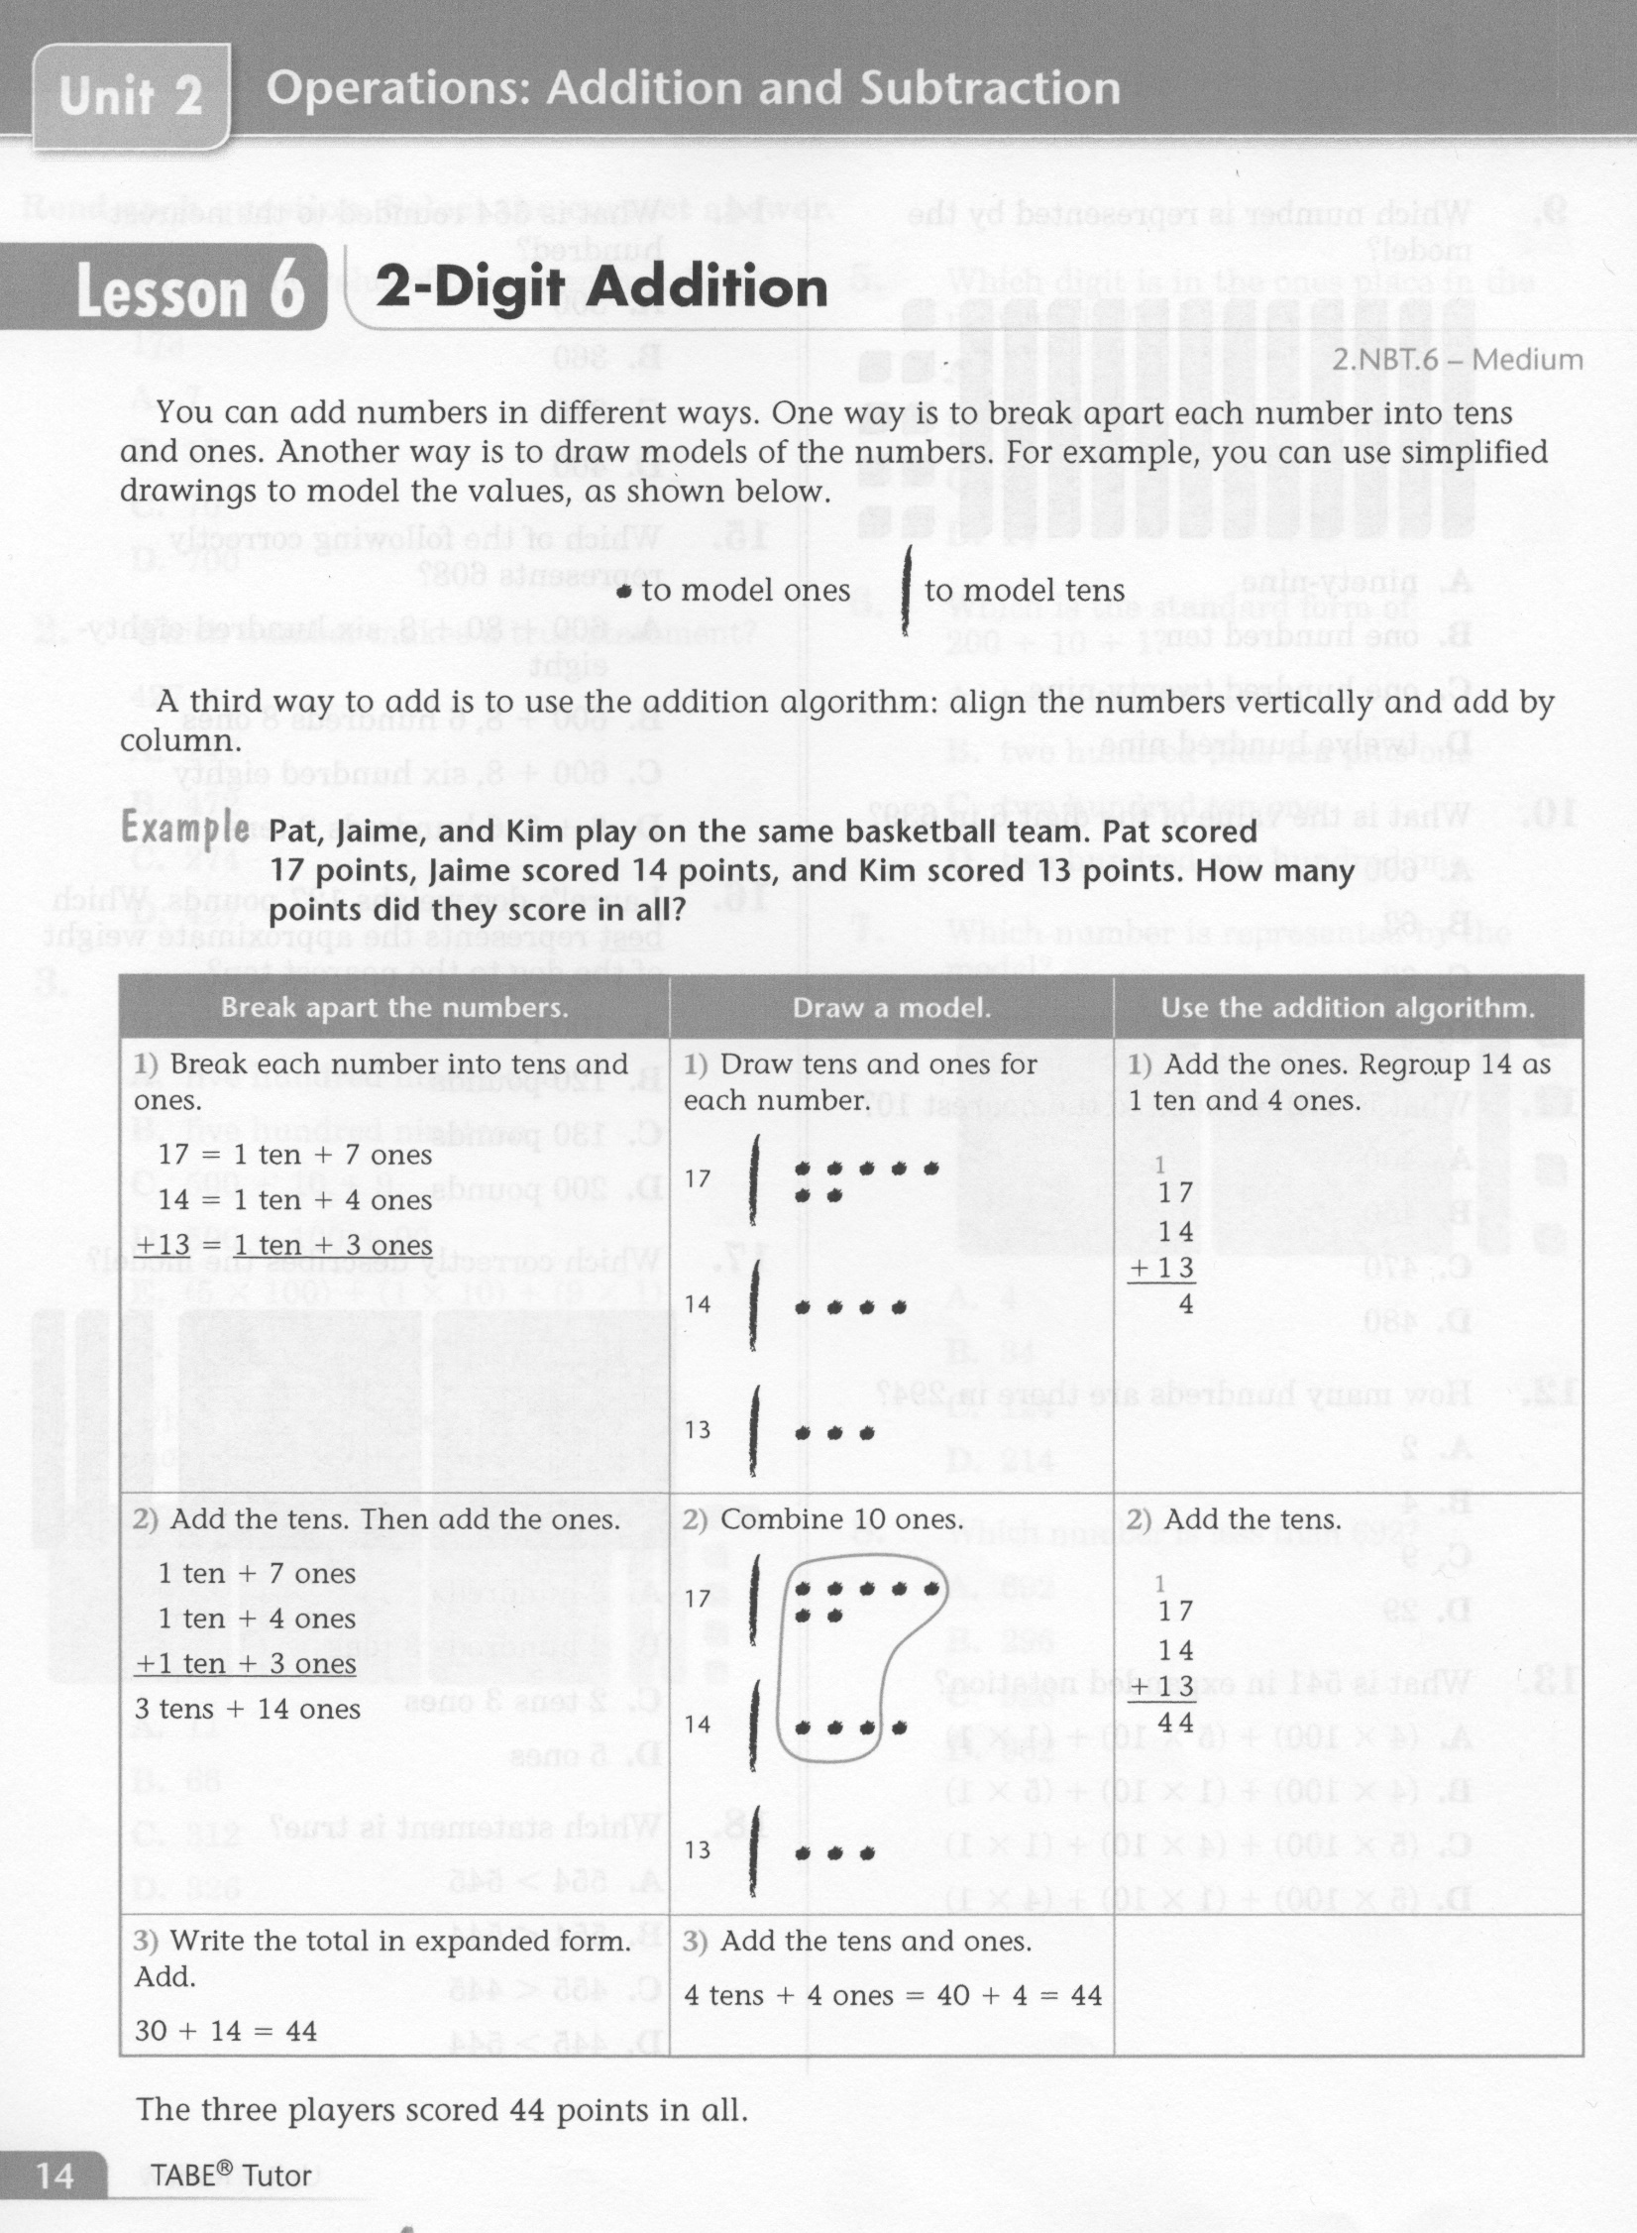
Math-E - Lesson-06 – 2-Digit Addition

Slide 3
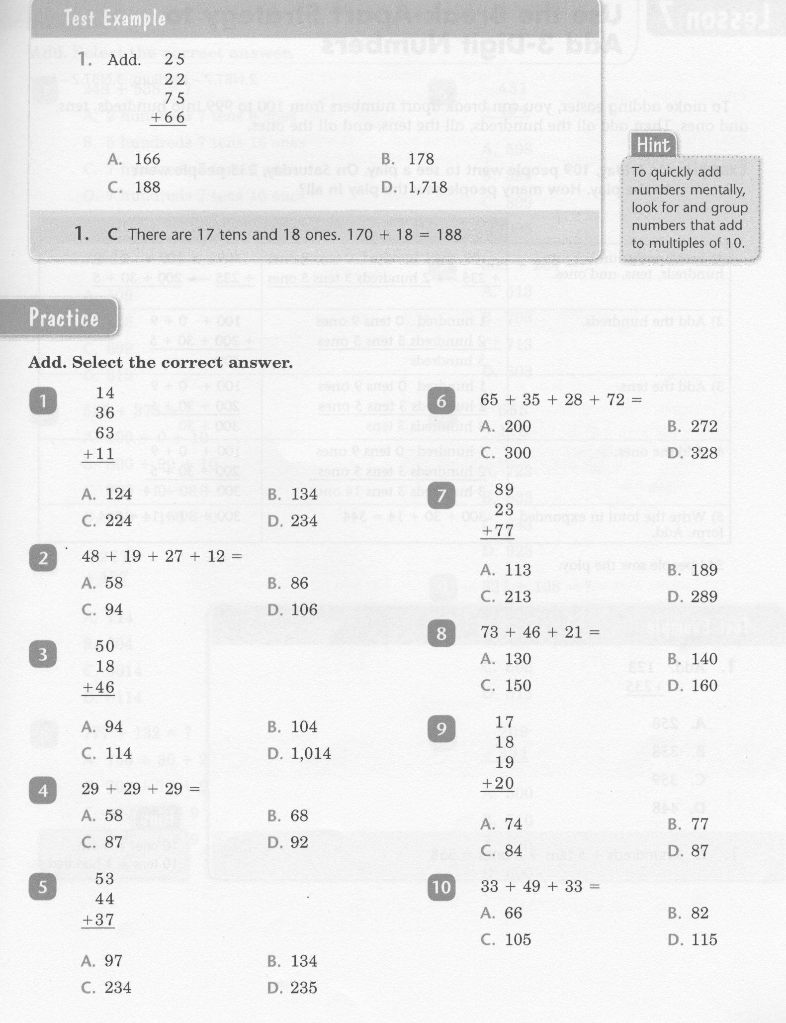
Math-E - Lesson-06 – 2-Digit Addition

Slide 4
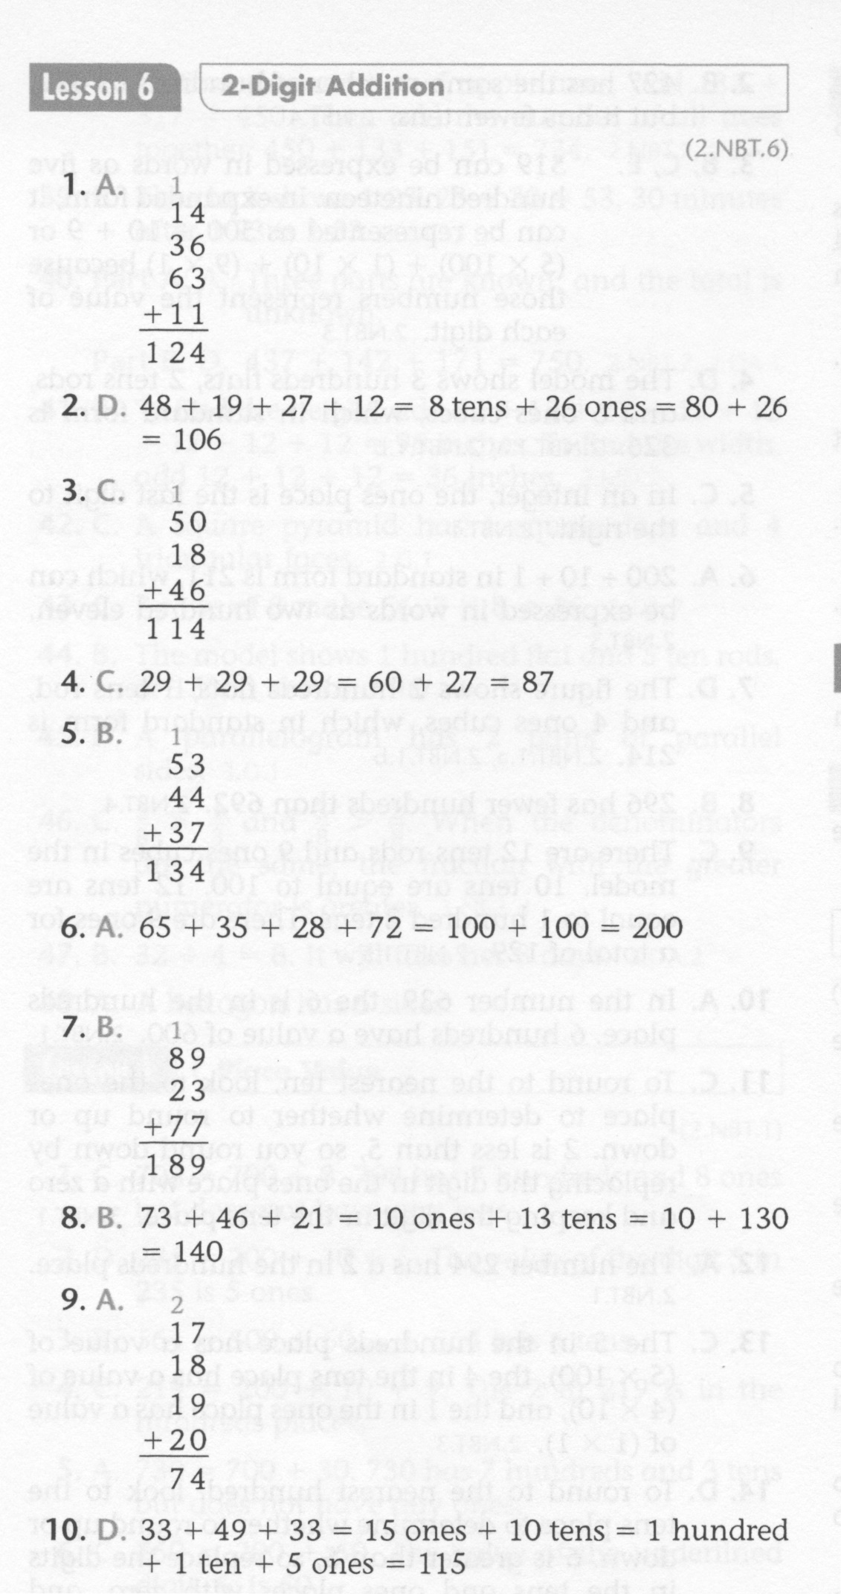
Math-E - Lesson-06 – 2-Digit Addition

Slide 5
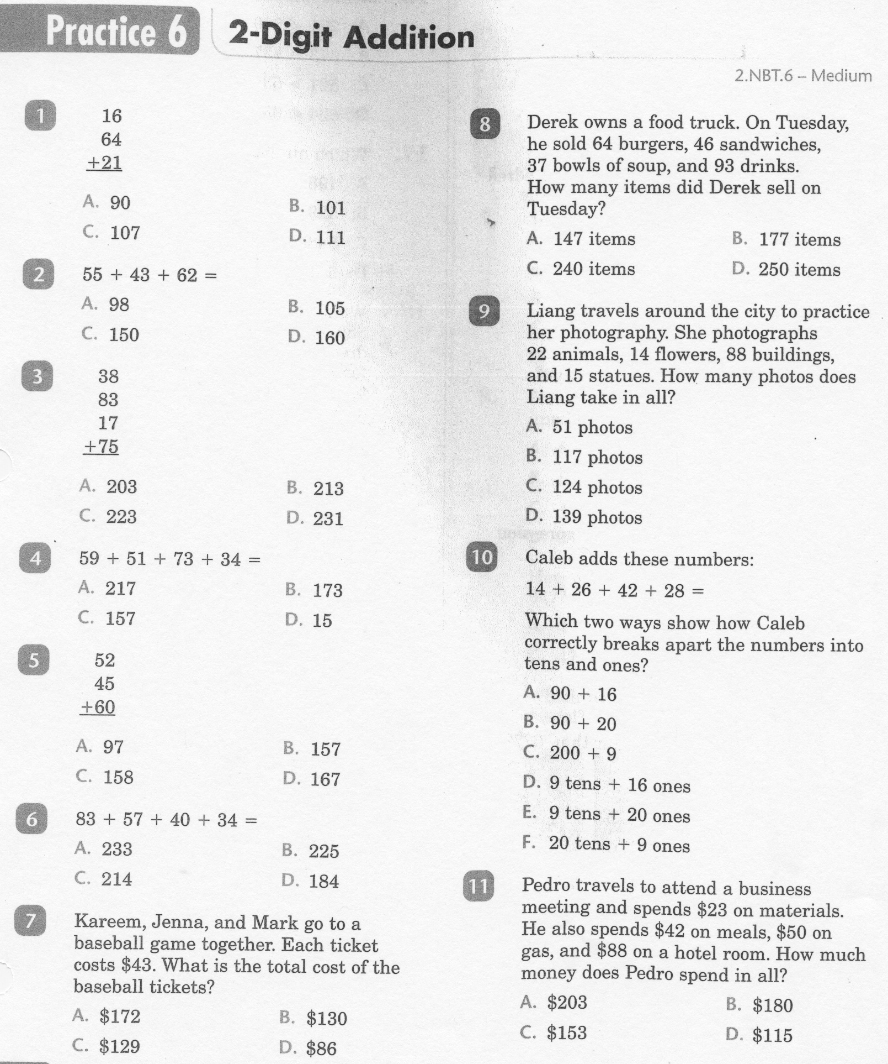
Math-E - Practice-06 – 2-Digit Addition

Slide 6
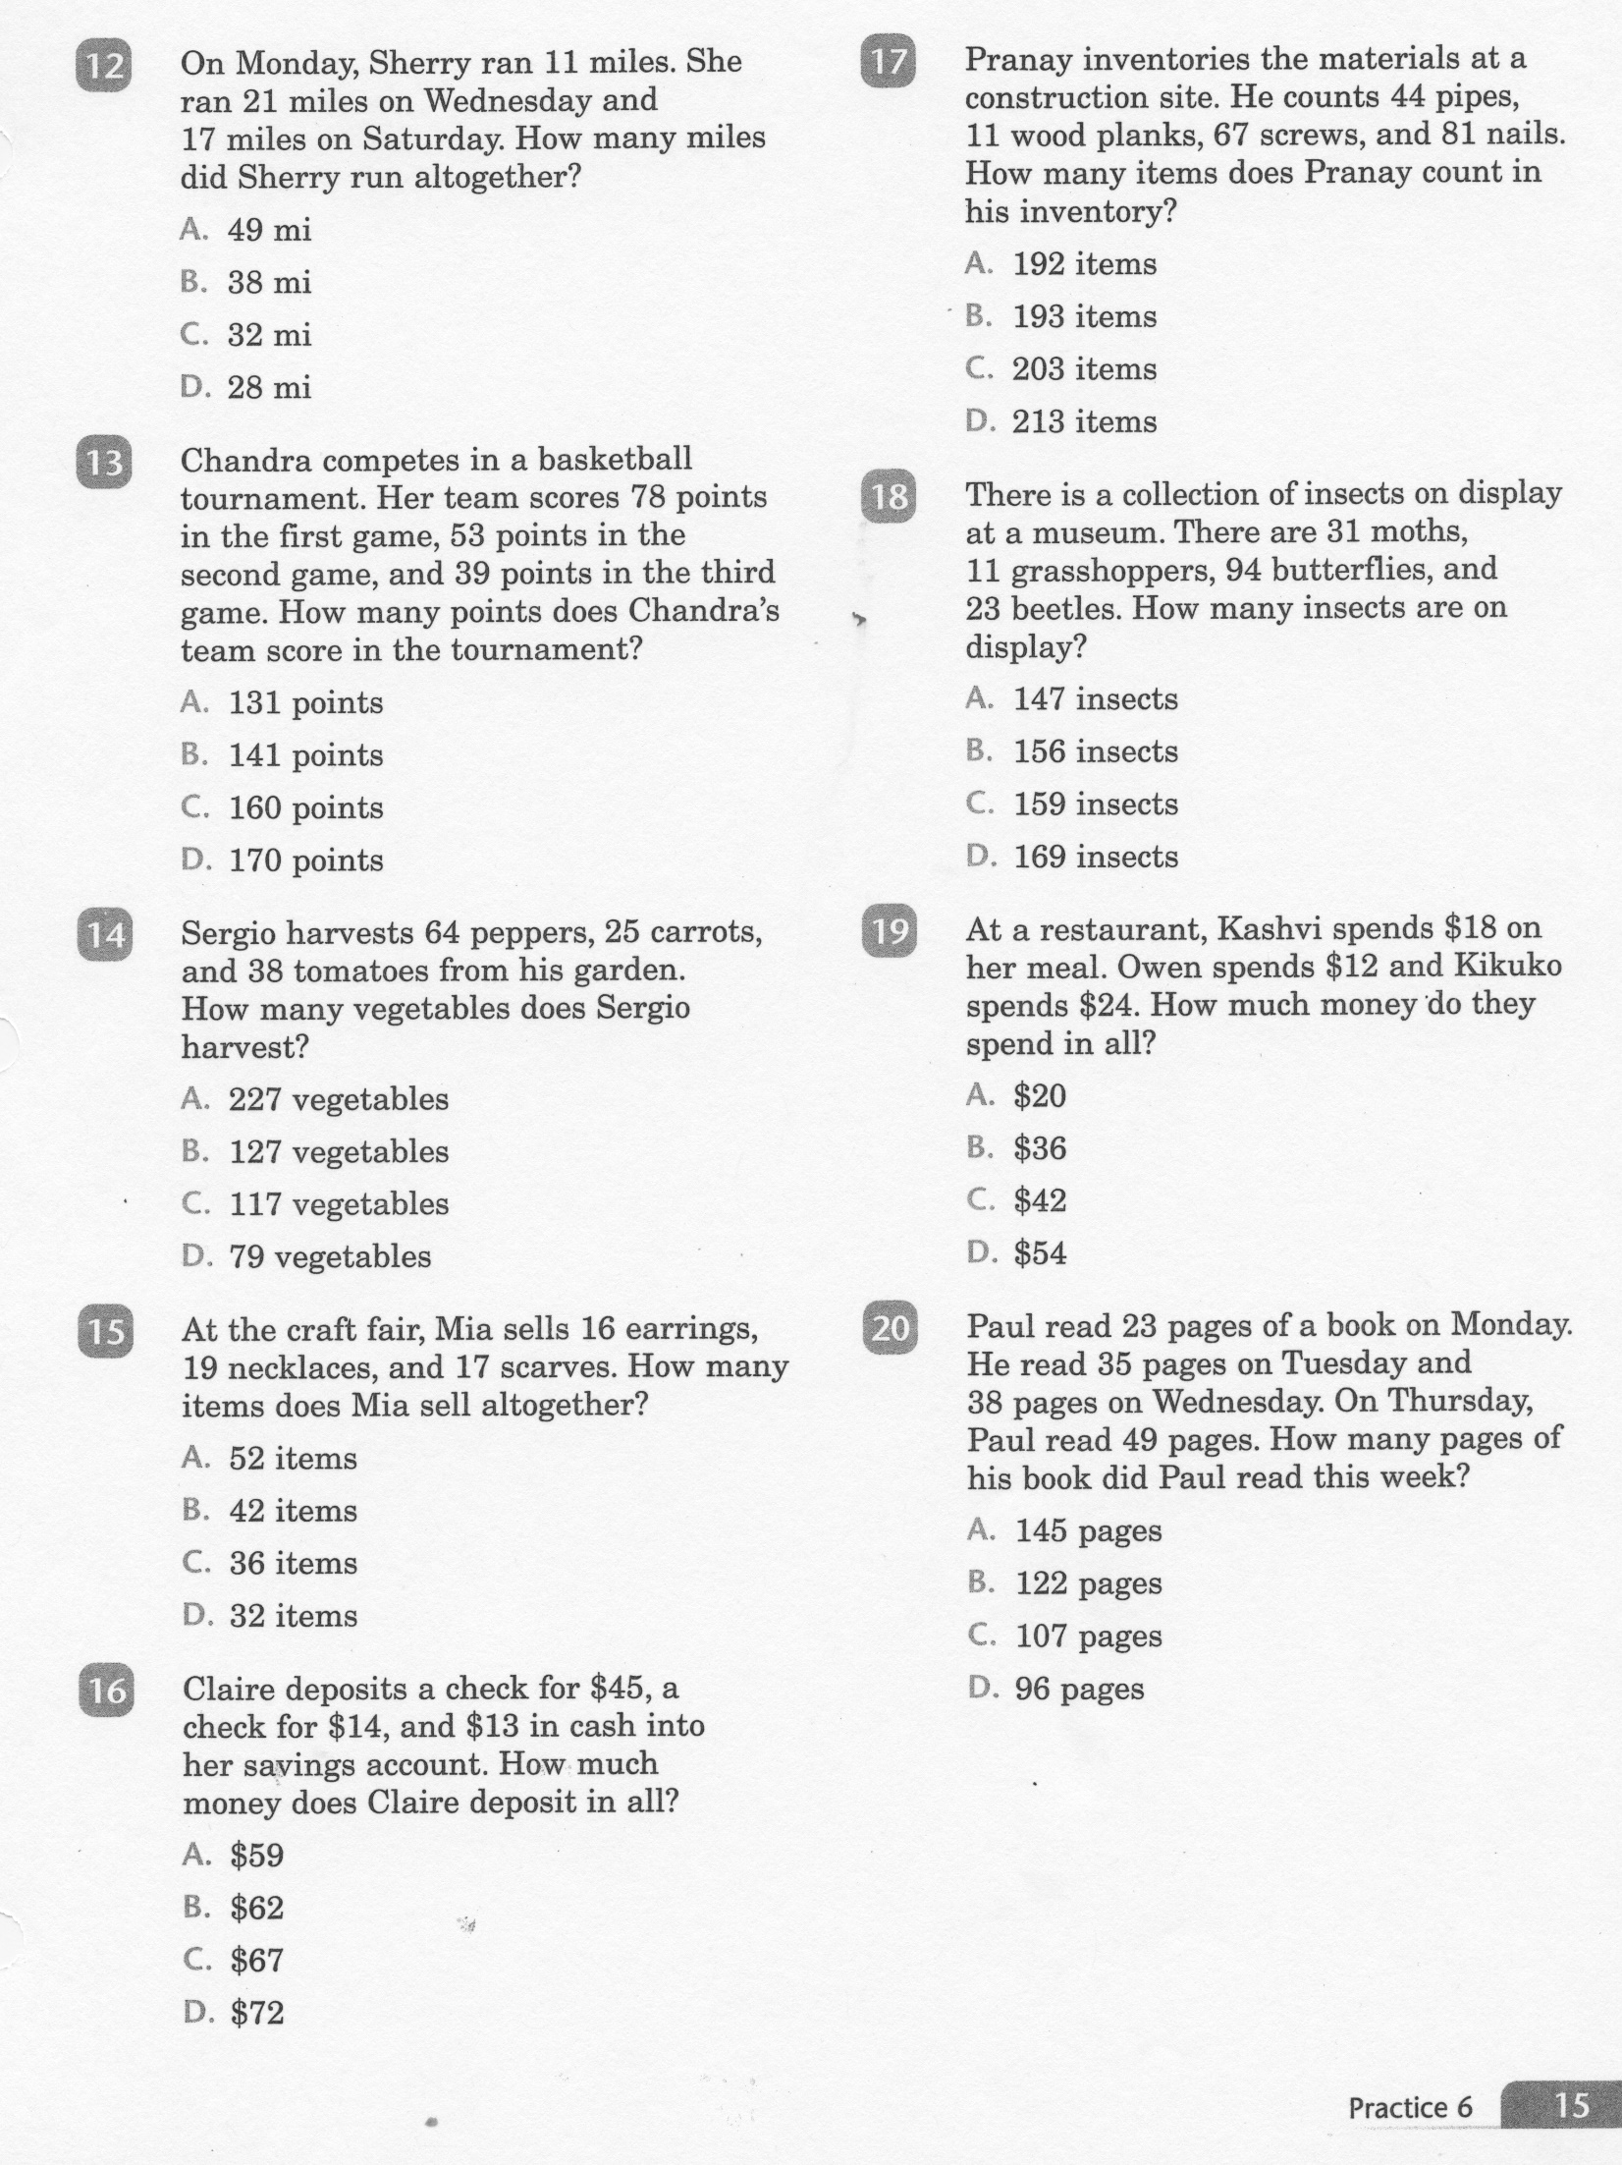
Math-E - Practice-06 – 2-Digit Addition

Slide 7
Math-E - Practice-06 – 2--Digit Addition

