Slide 1
TABE Math-E PRAXEN Unit-2 Add and Subtract Whole Numbers REVIEW
Revised: October 16, 2023
Nolan Tomboulian
Some graphics may not have copied well during the scan process.

Slide 2
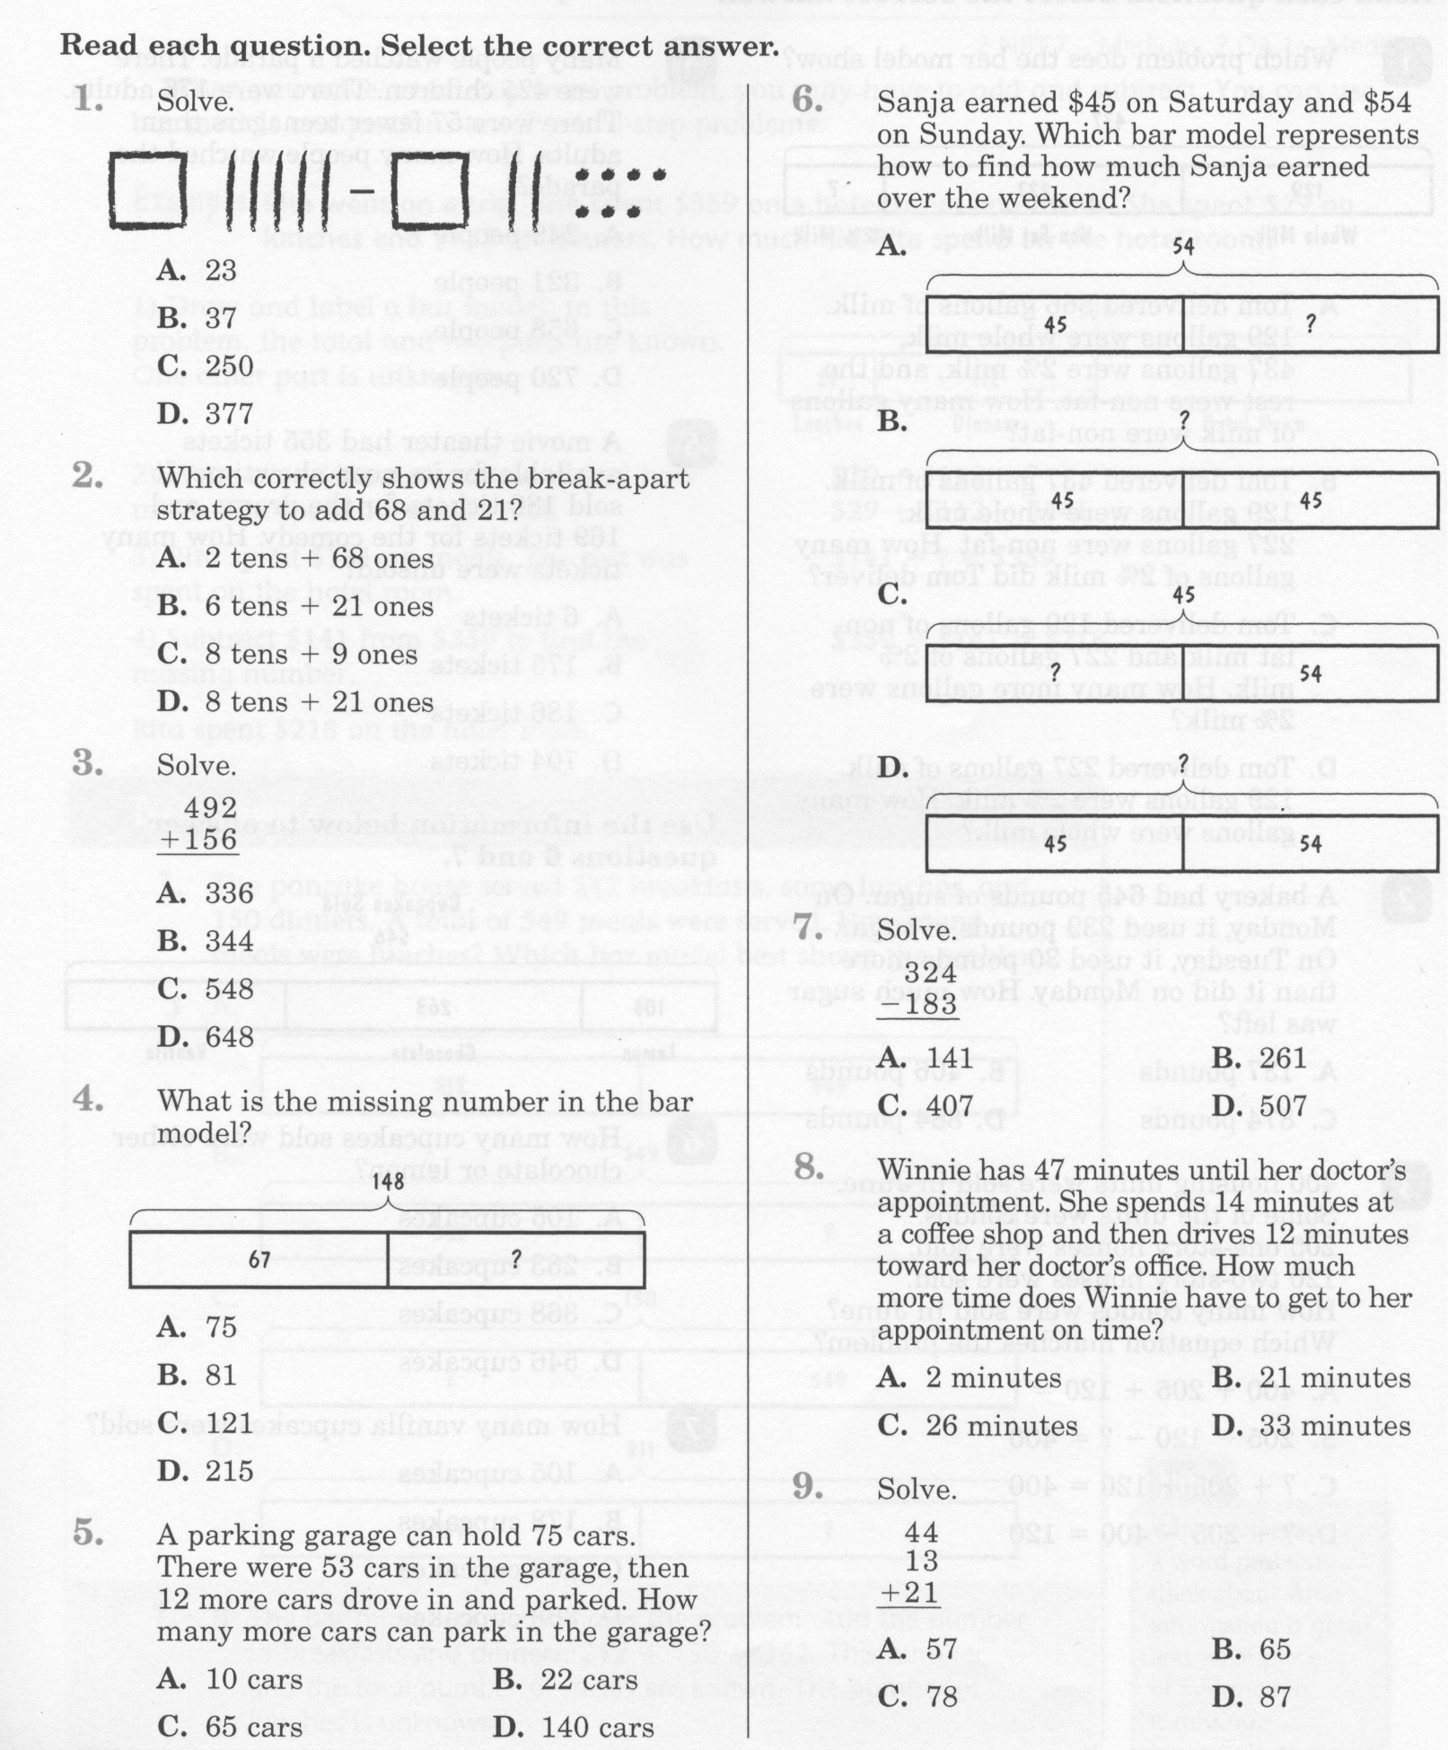
Math-E - Unit-2 - Review

Slide 3
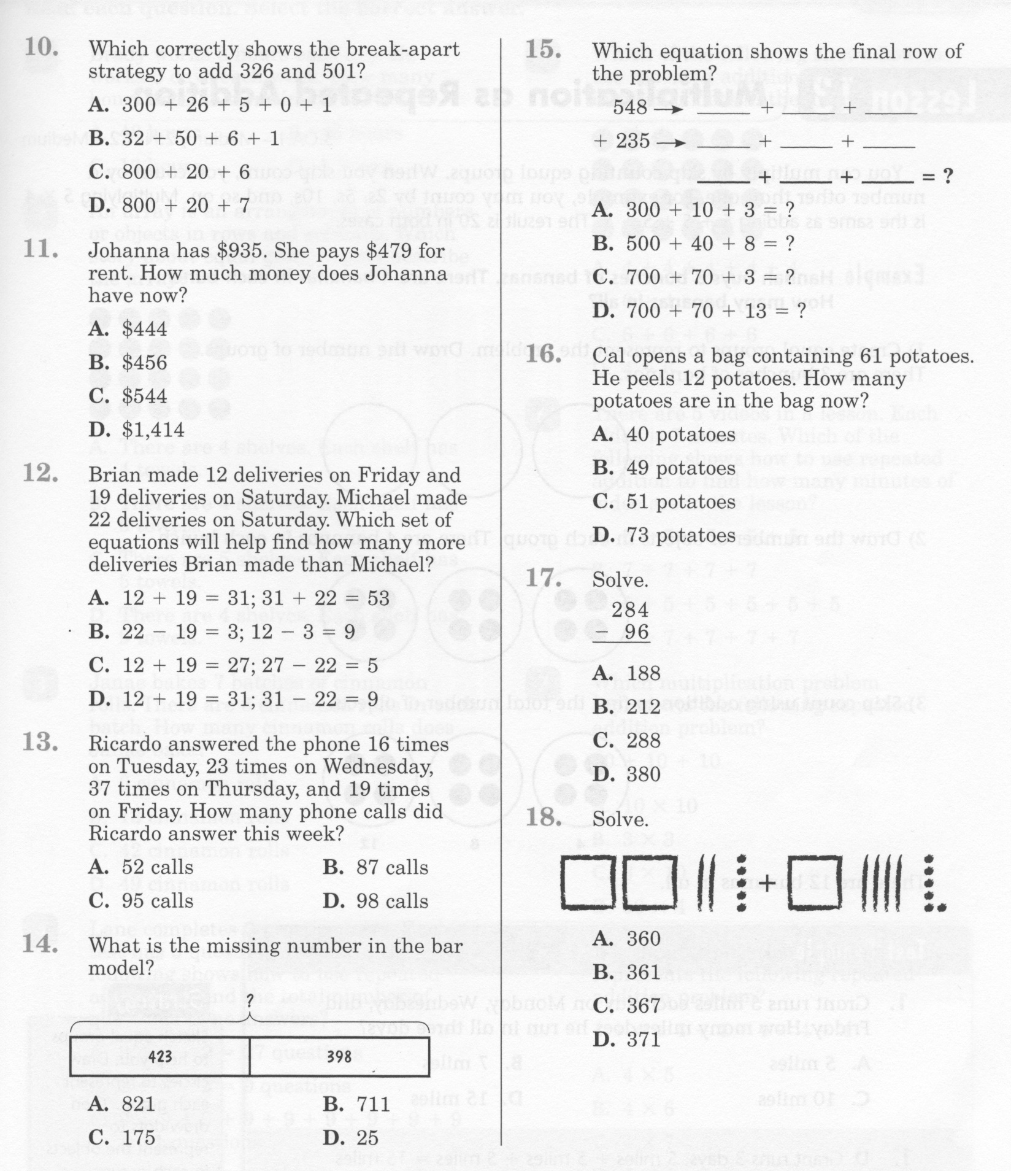
Math-E - Unit-2- Review

Slide 4
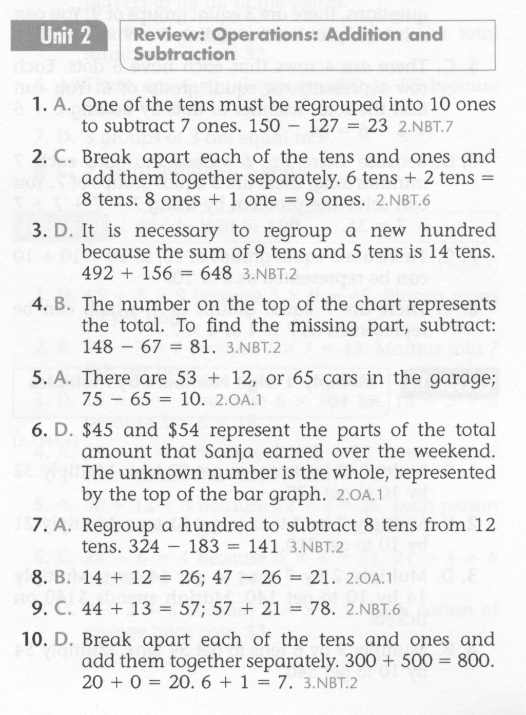
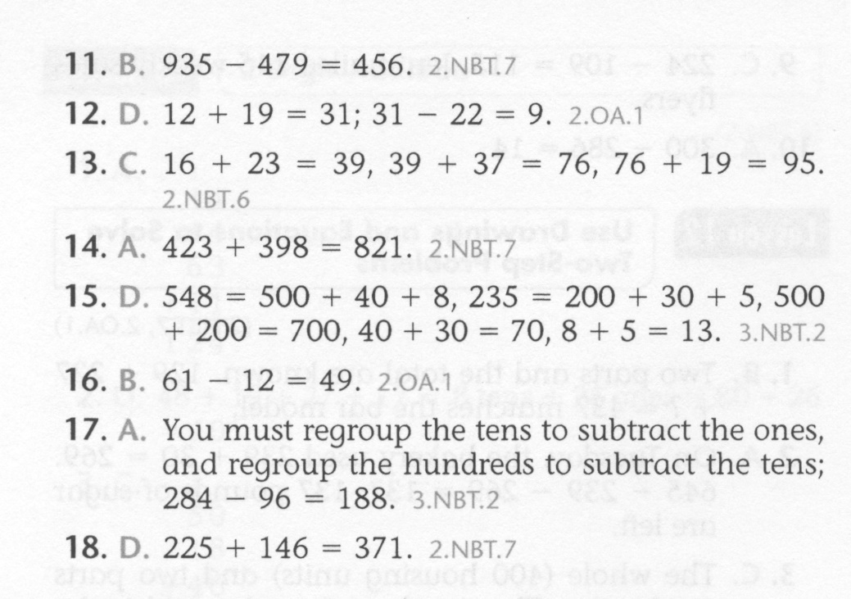
Math-E - Unit-2- Review

Slide 5
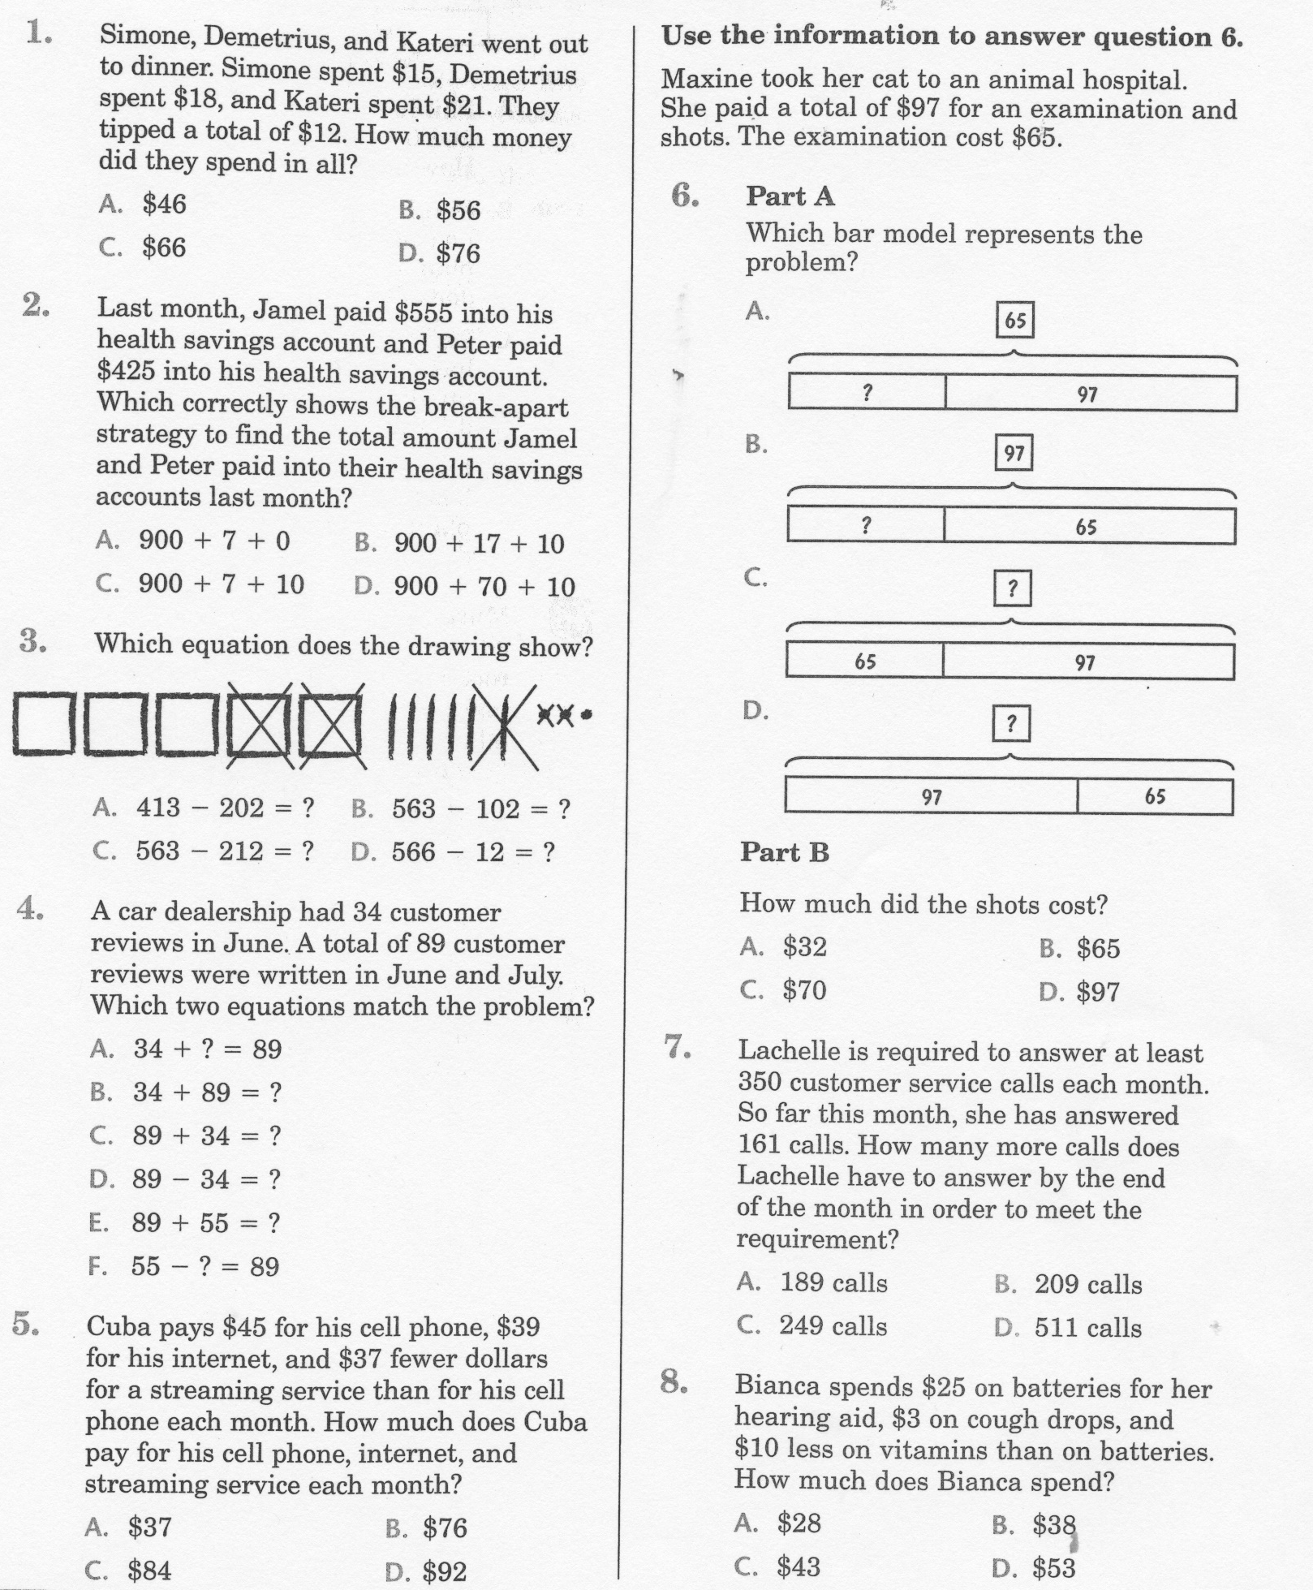
Math-E - Practice- Unit-2 Review

Slide 6
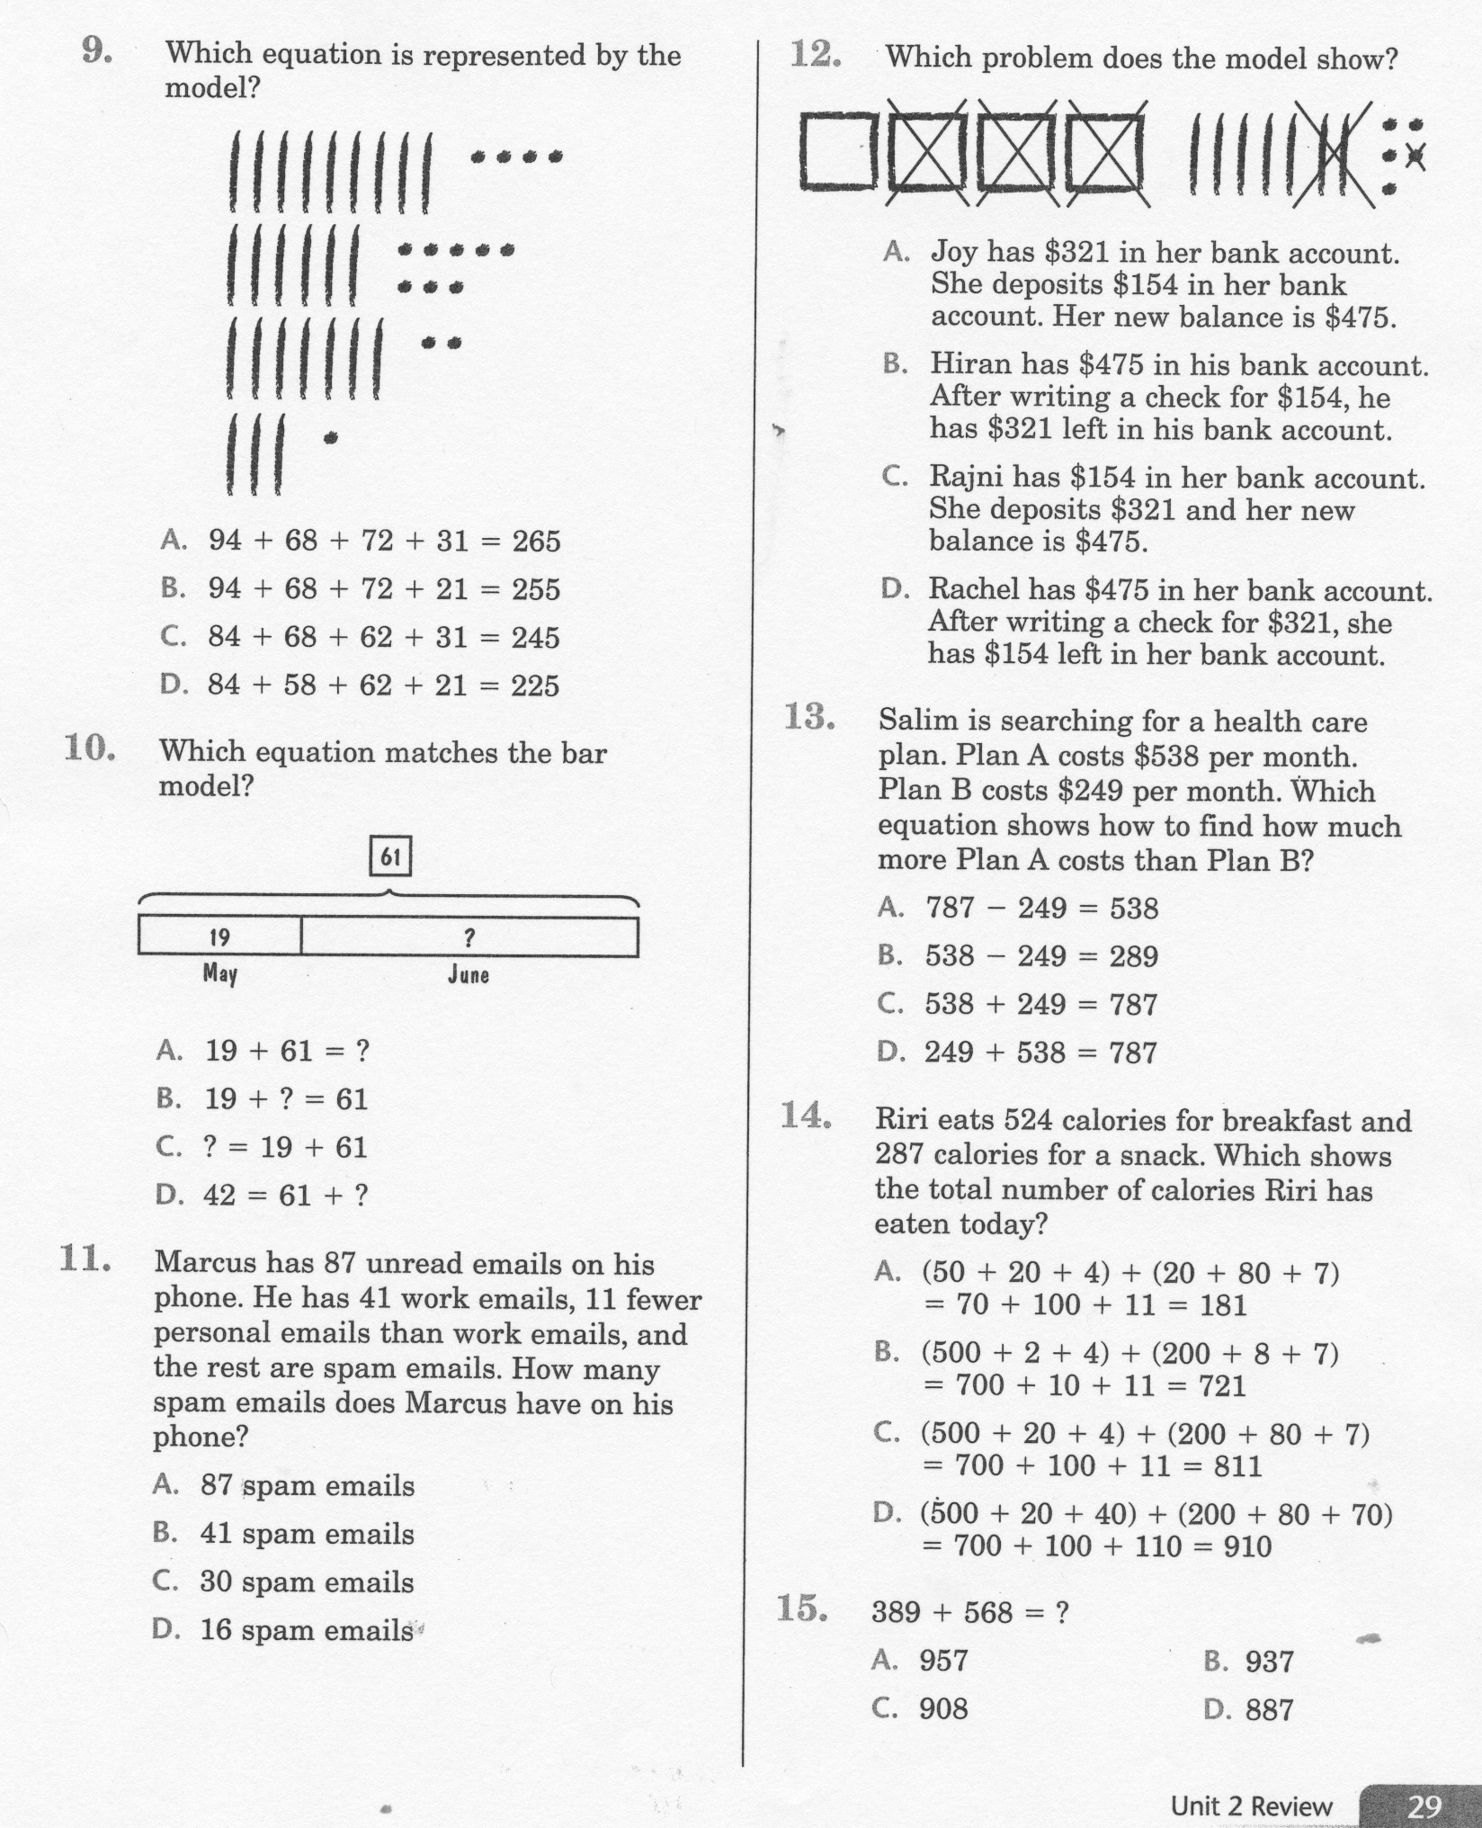
Math-E - Practice - Unit-2 Review

Slide 7
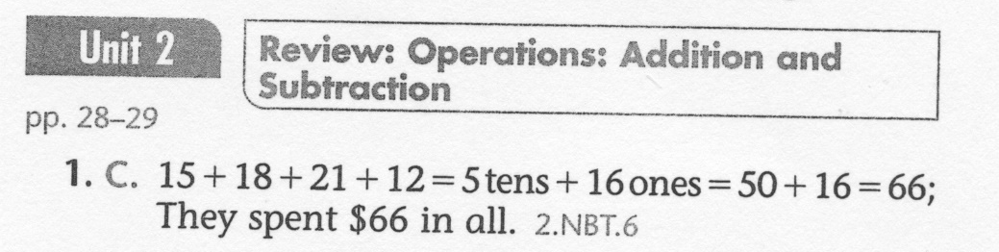
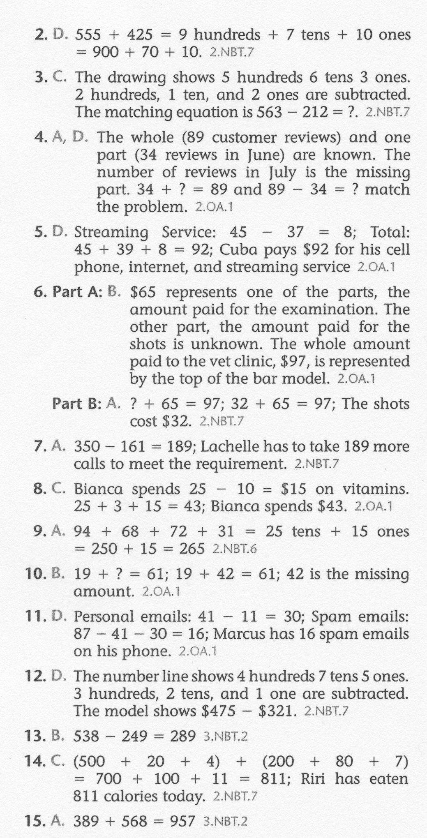
Math-E - Practice - Unit-2 Review

