Slide 1
TABE MATH - D
Unit - 1
Lesson - 7
Rational Numbers
Any number that can be written as a Fraction:
R = $\frac{a}{b} where \left(a\right) and \left(b\right) are integers and b ≠zero$
Revised: March 10, 2024
Nolan Tomboulian

Slide 2
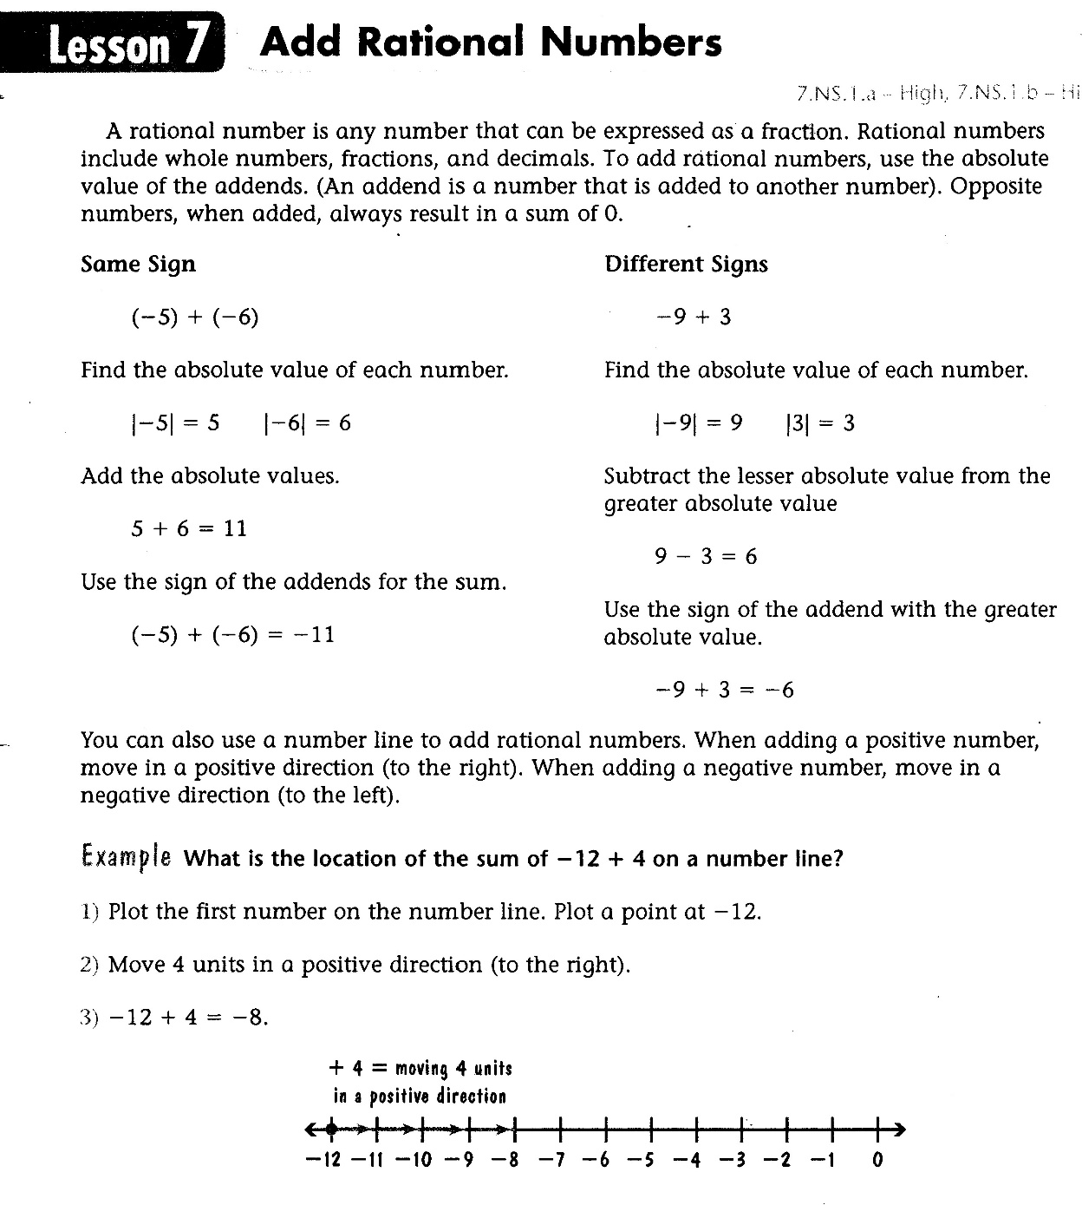

Slide 3
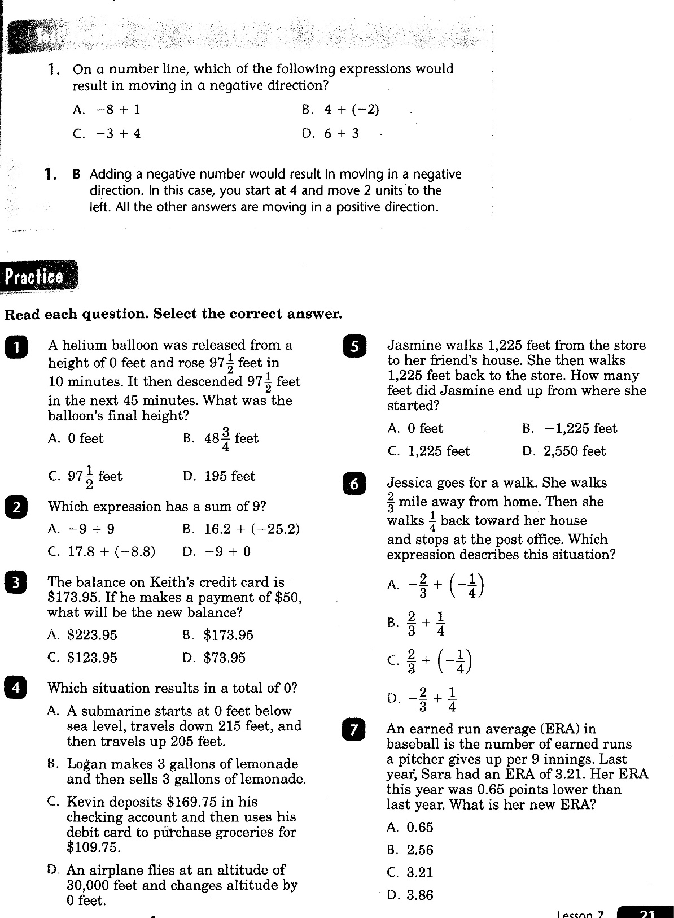

Slide 4
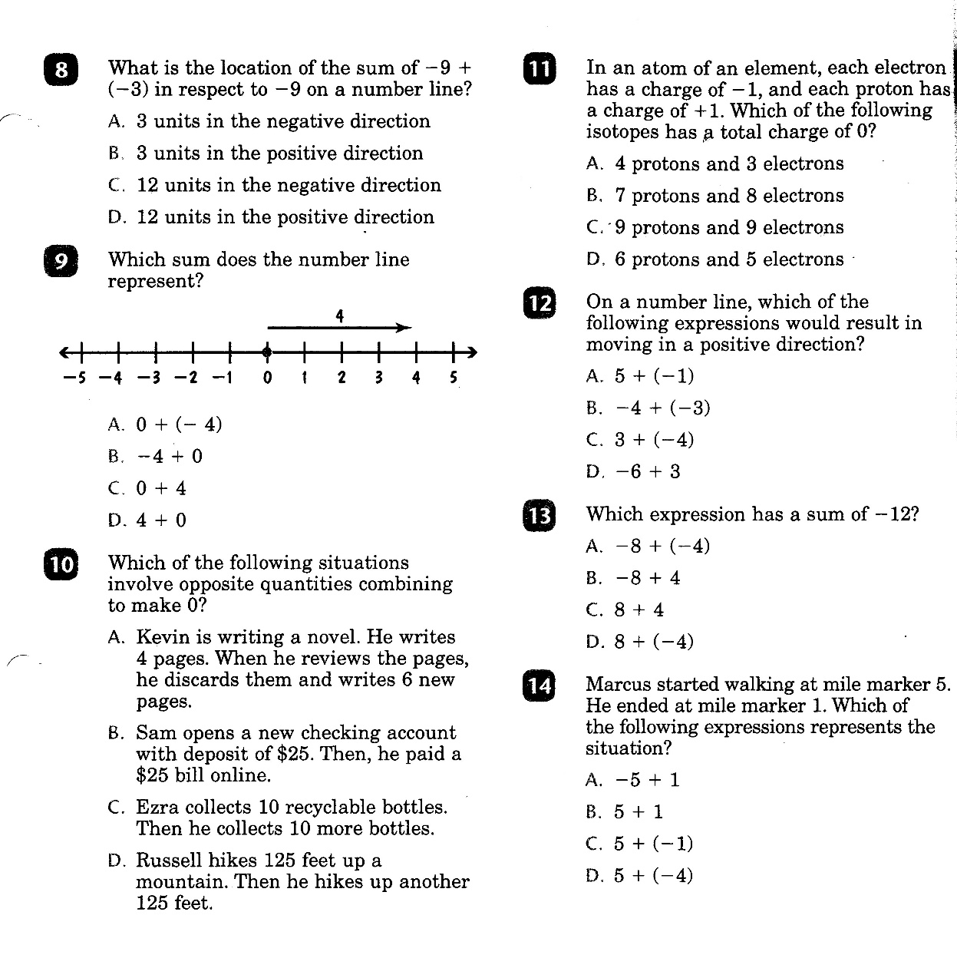

Slide 5
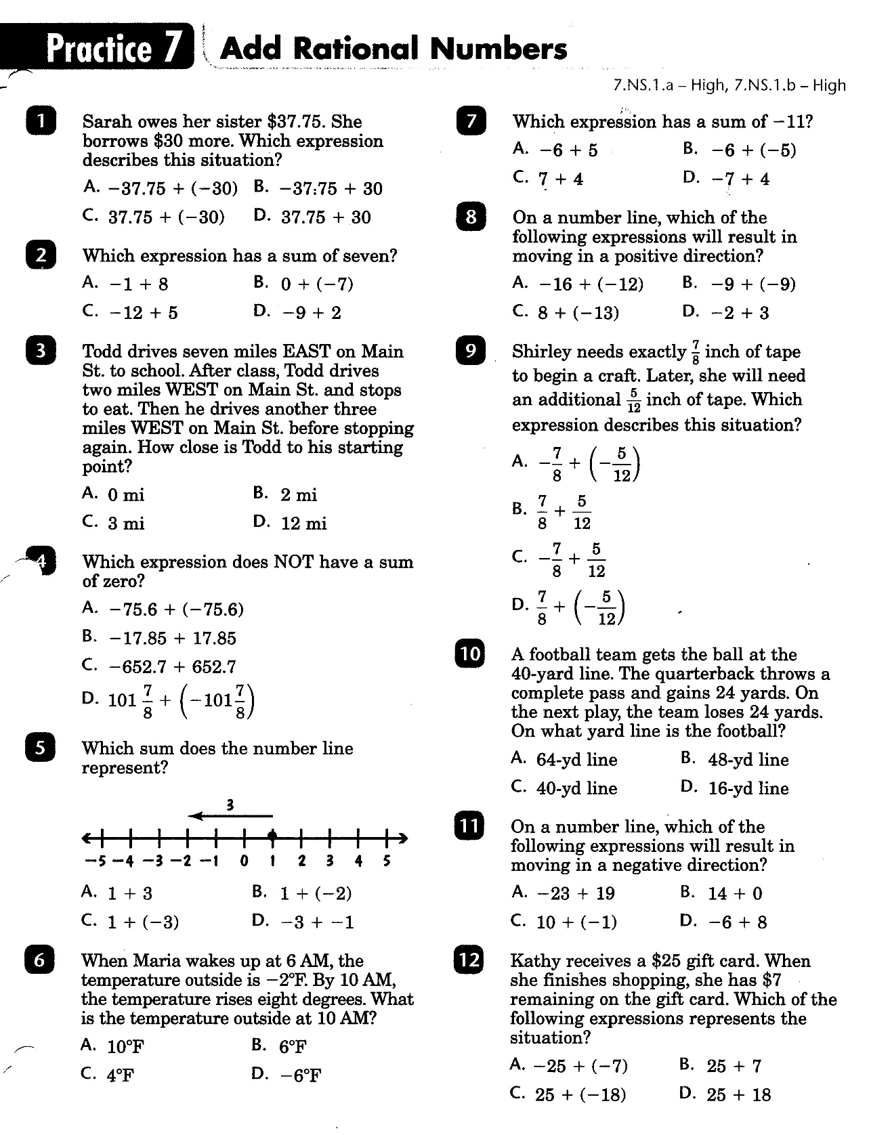

Slide 6
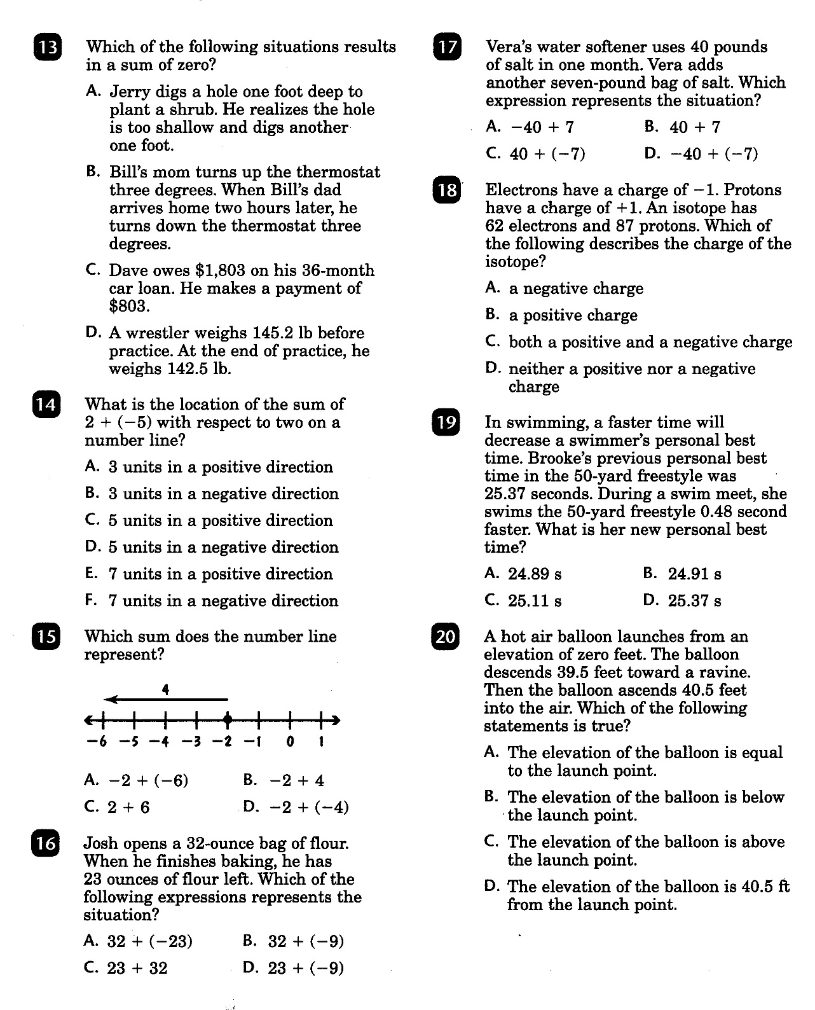

Slide 7
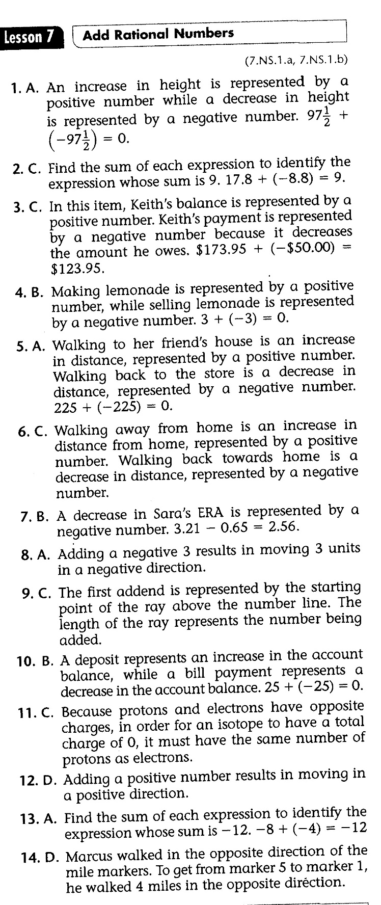
Math-D Lesson-7 Key

Slide 8
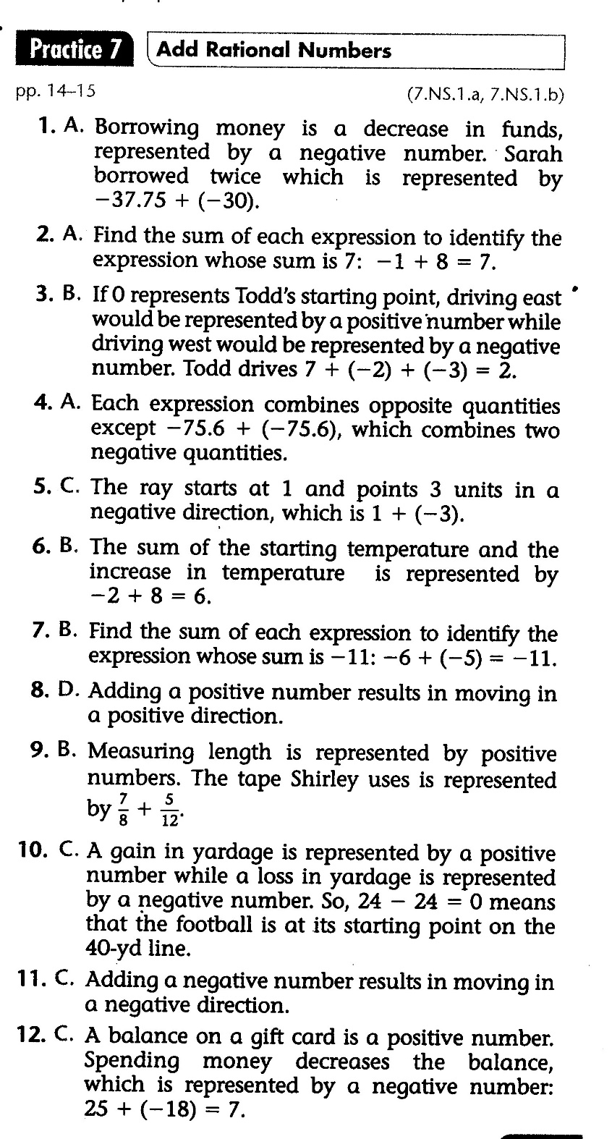
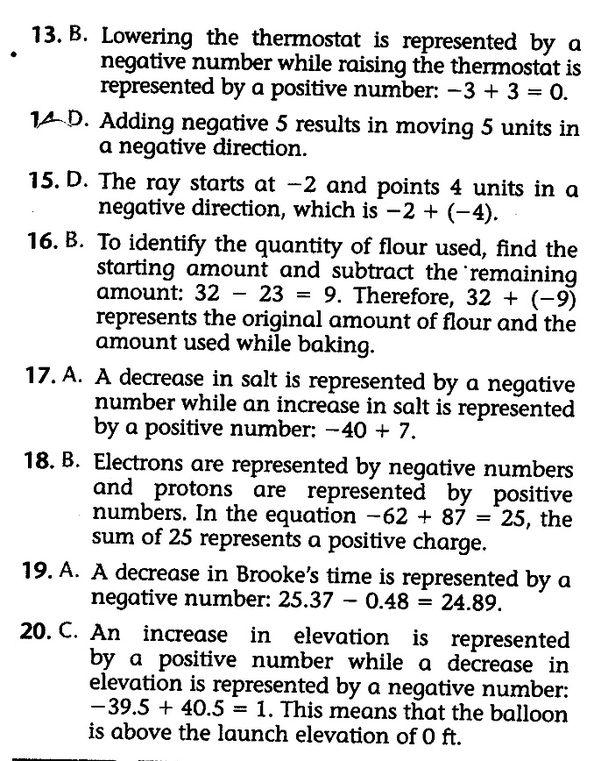
Math-D Practice-7 Key

