Slide 1
TABE MATH - D
Unit - 1
Lesson - 2
Order Whole Numbers
Revised: March 10, 2024
Nolan Tomboulian

Slide 2
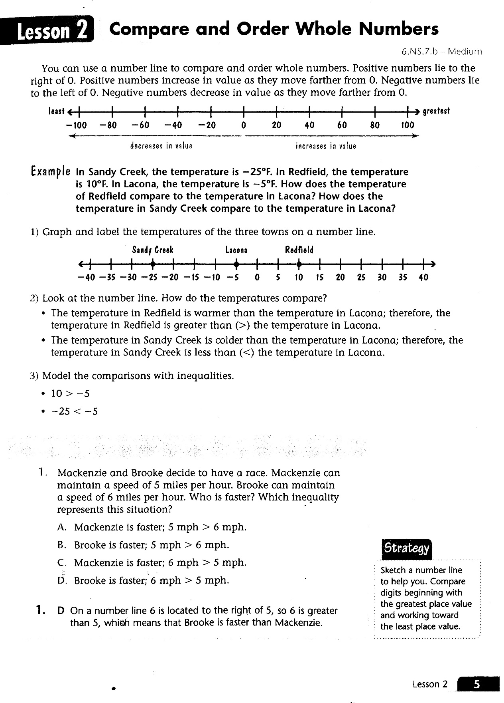

Slide 3
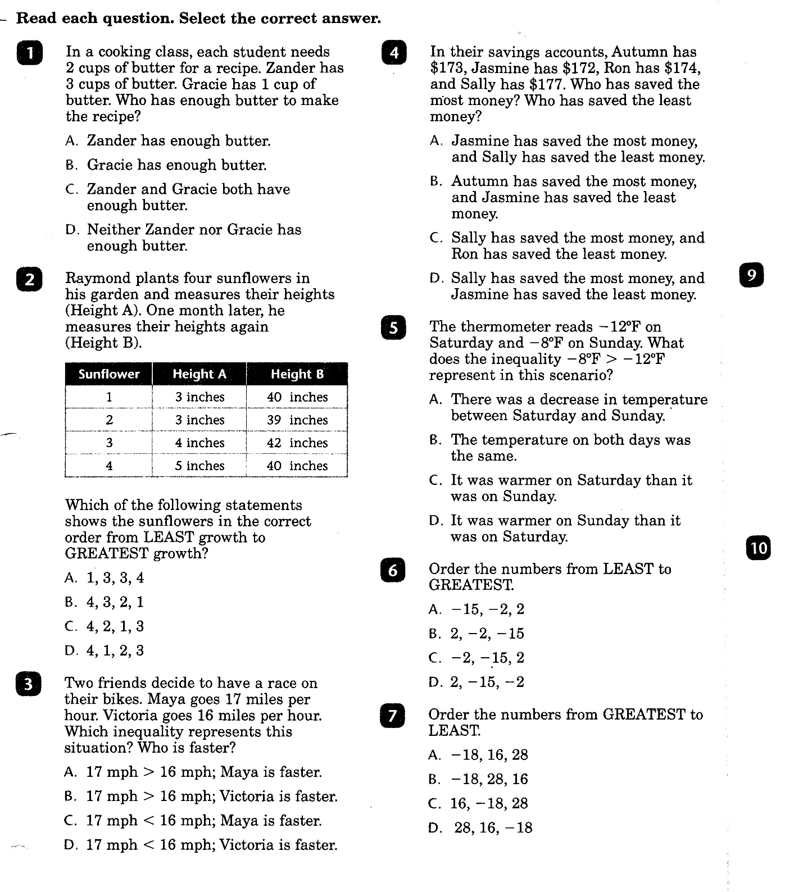

Slide 4
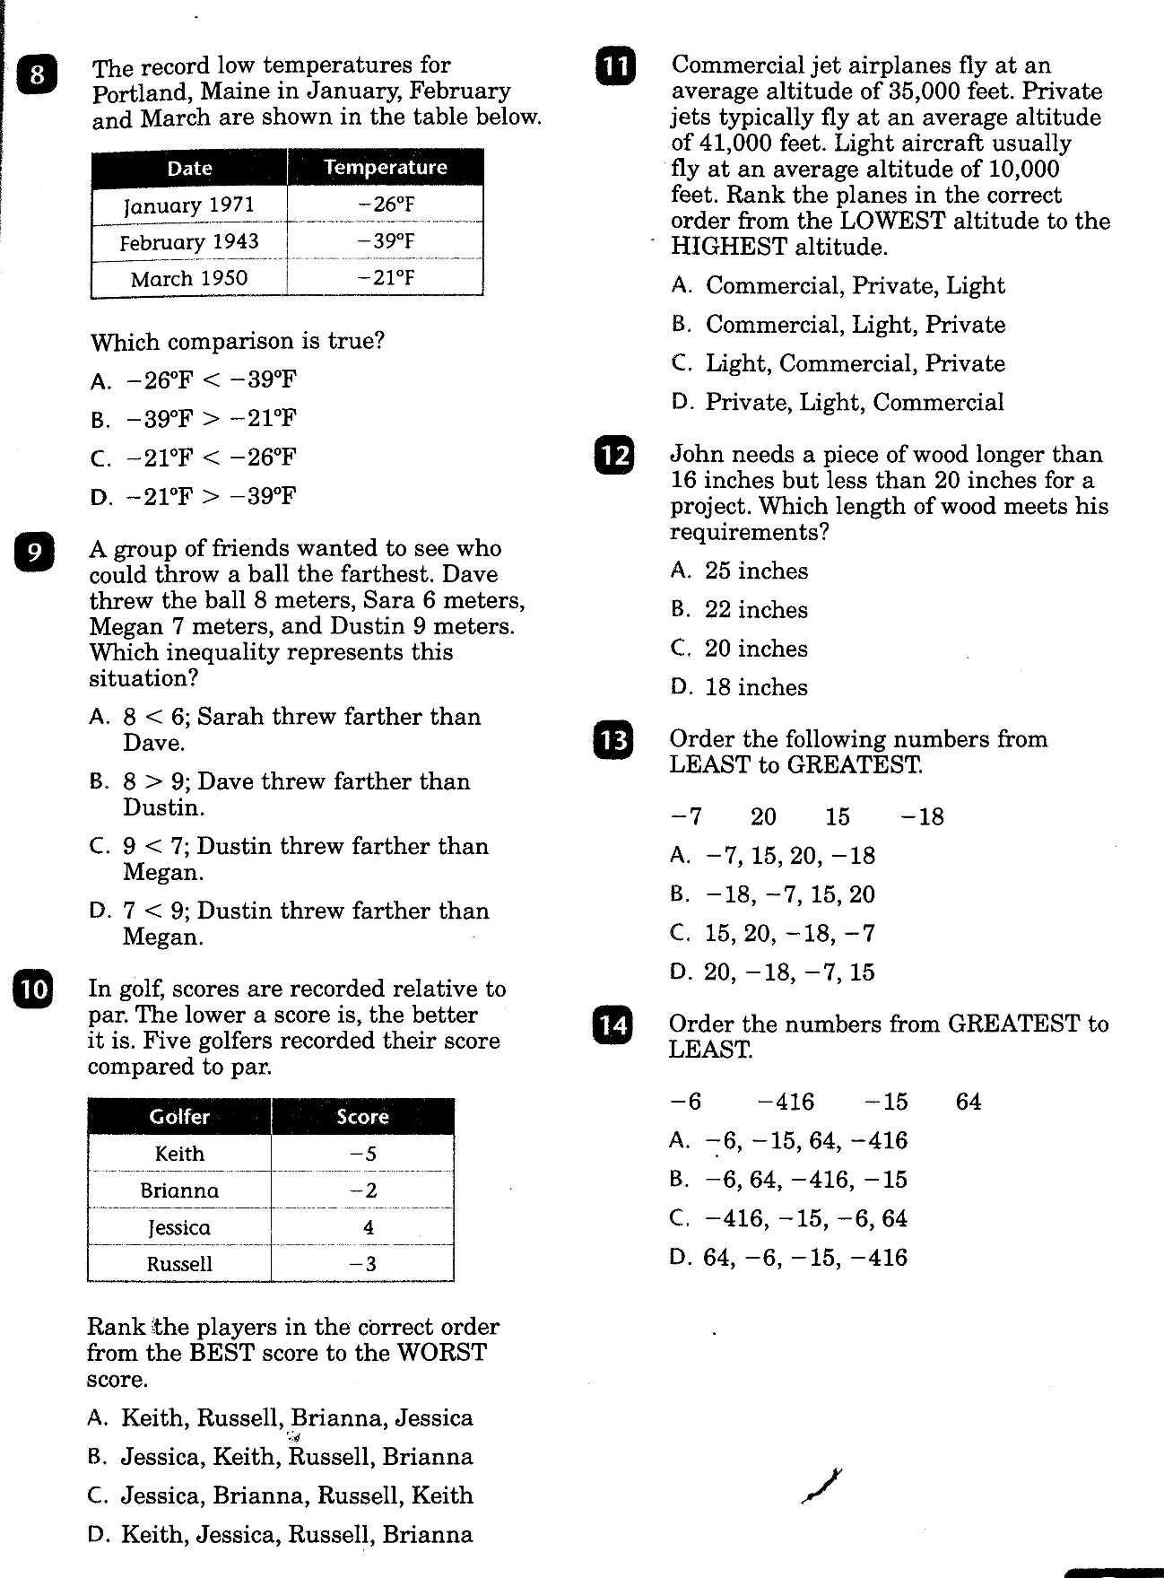

Slide 5
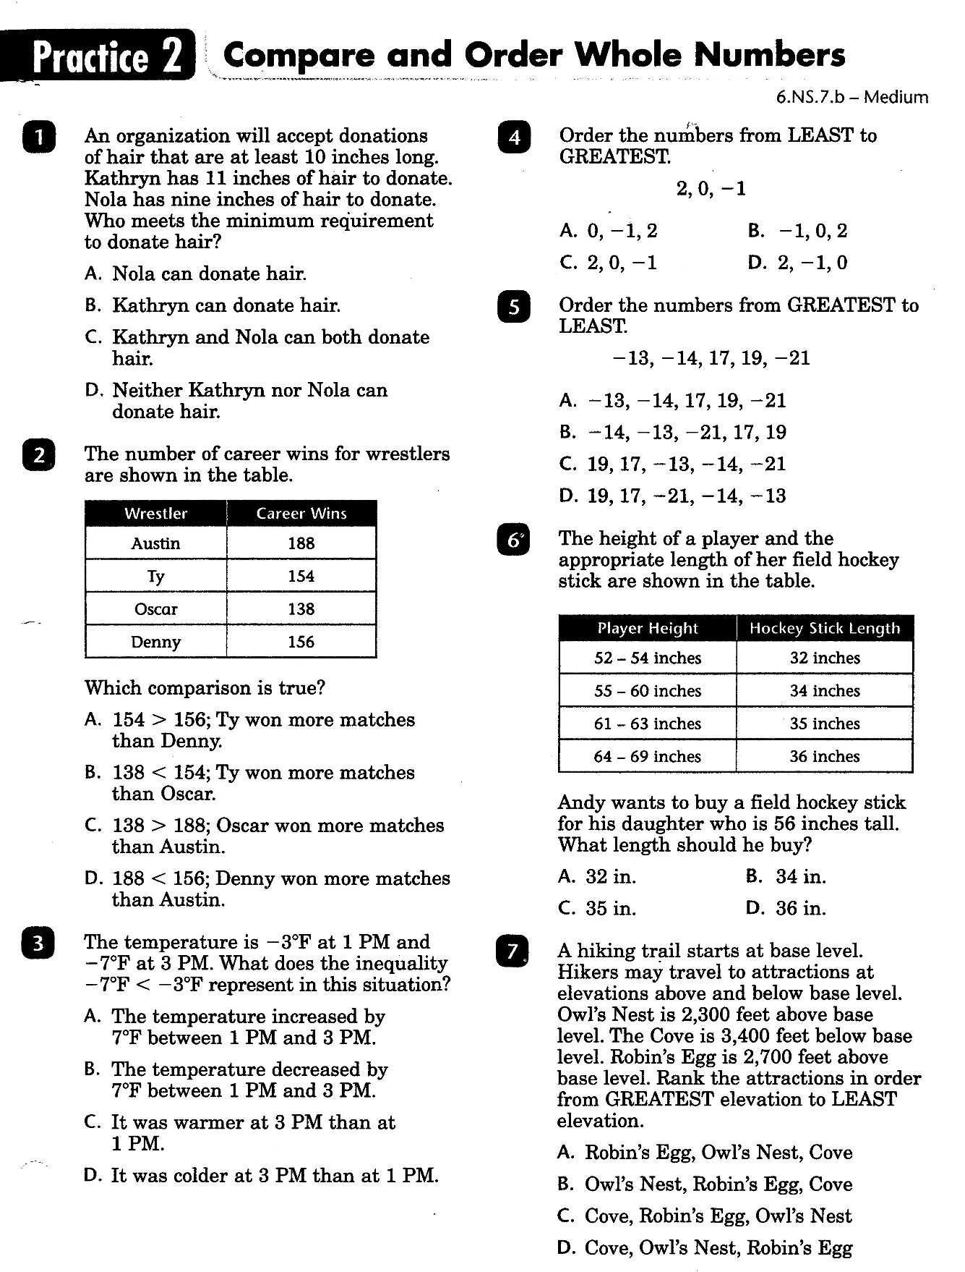

Slide 6
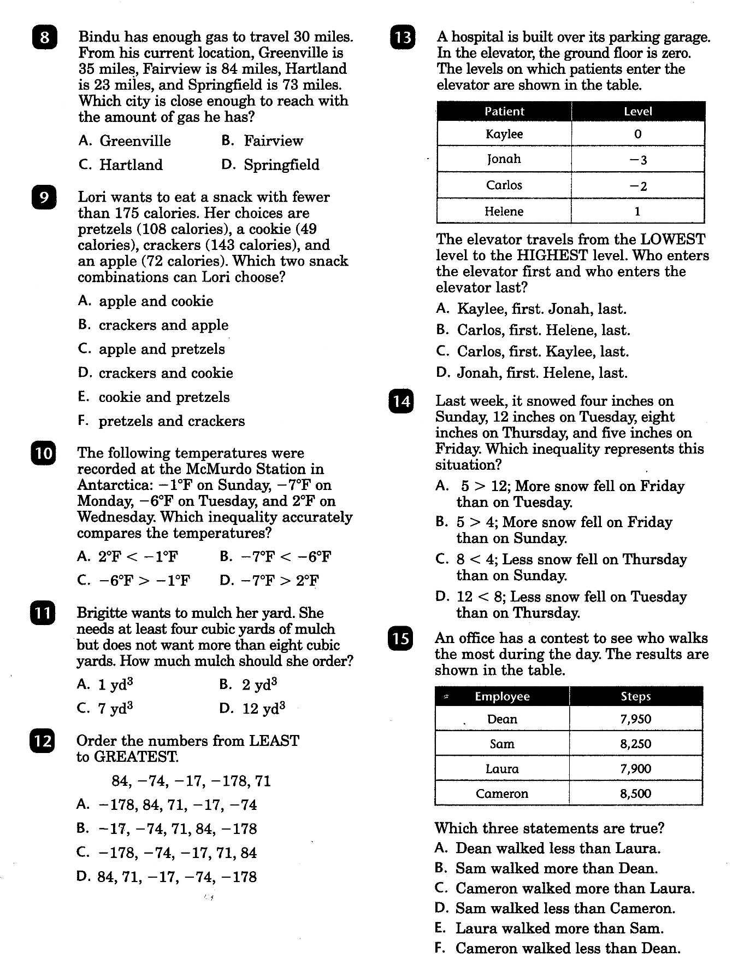

Slide 7
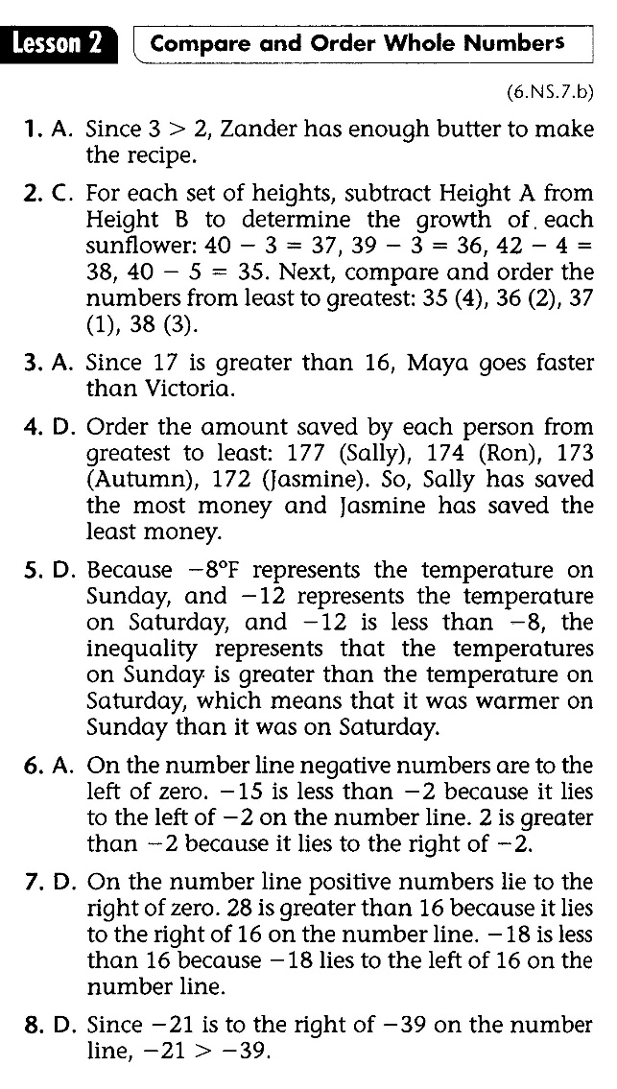
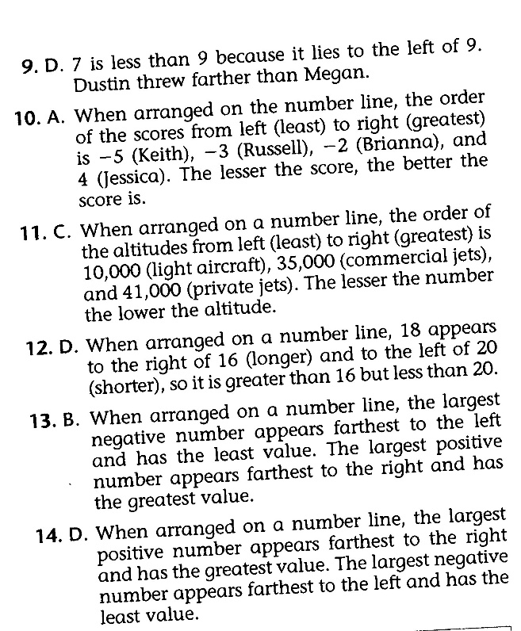
Math-D Lesson-2 Key

Slide 8
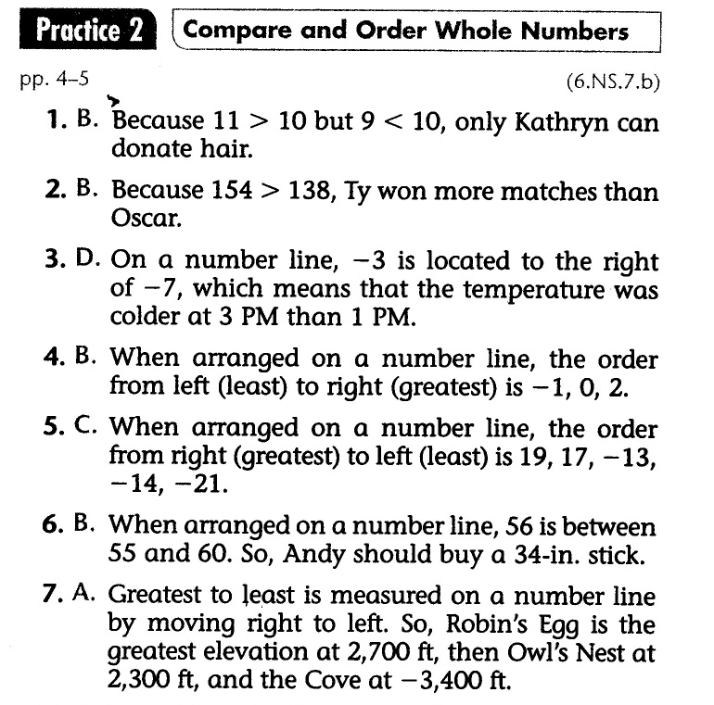
Math-D Practice-2 Key

