Slide 1
TABE ELA-E PAXEN Unit-1 Usage Lesson-06 Verb Tenses
Some graphics may not have copied well during the Scan Process

Slide 2
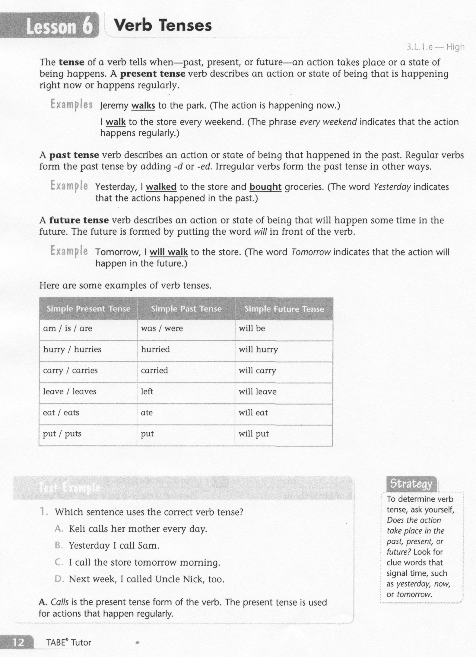
ELA-E-06 Verb Tenses

Slide 3
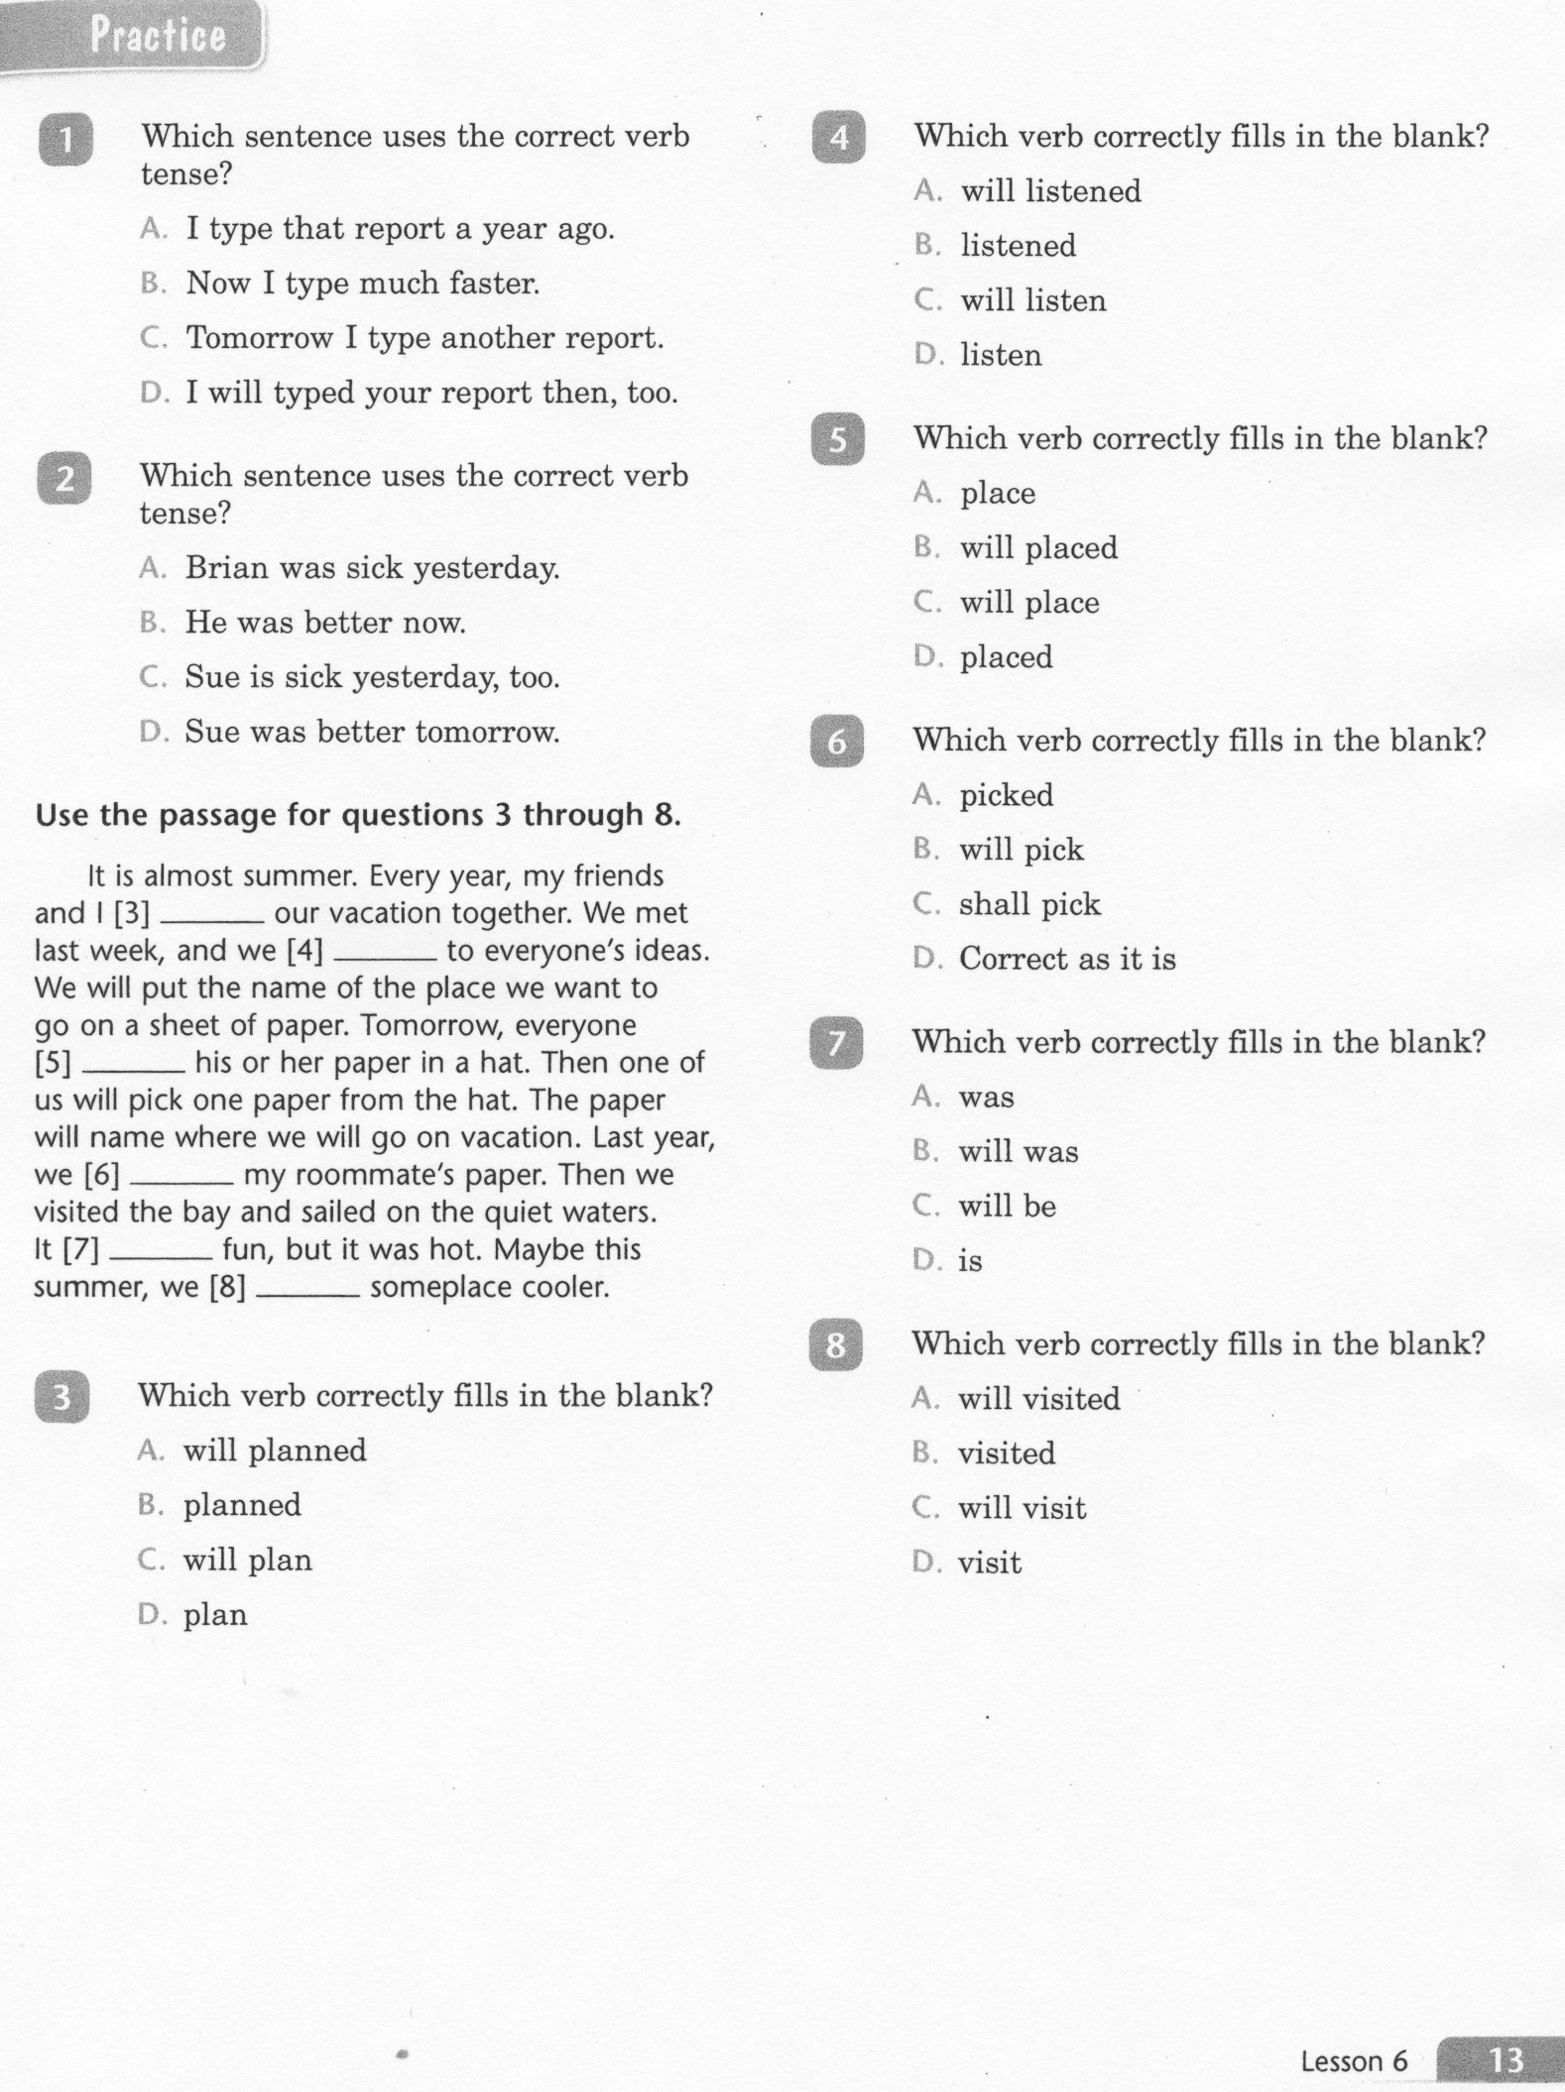
ELA-E-06 Verb Tenses

Slide 4
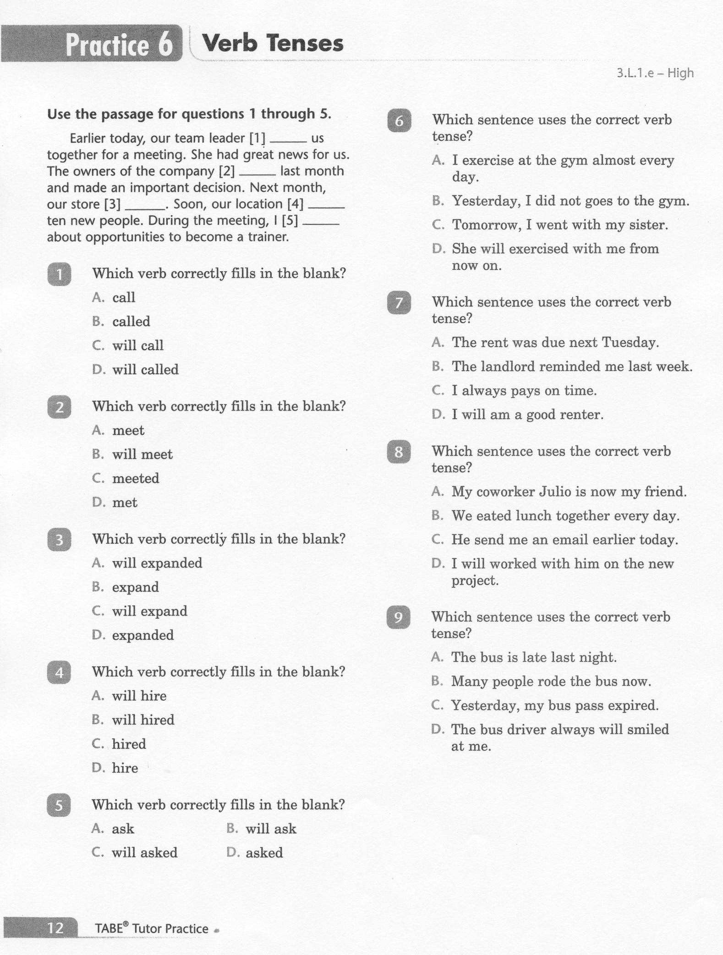
ELA-E-06 Verb Tenses

Slide 5
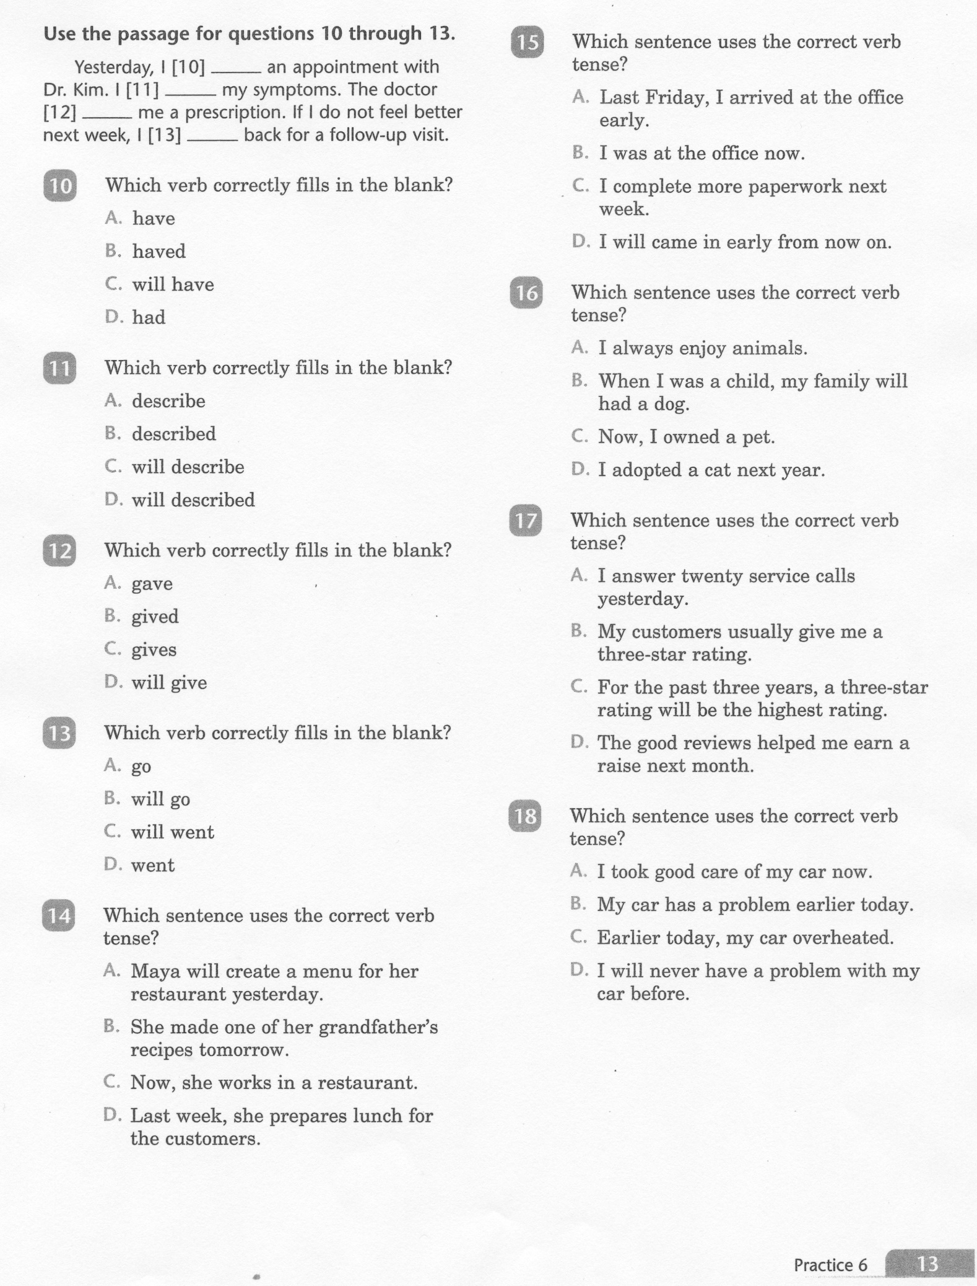
ELA-E-06 Verb Tenses

Slide 6
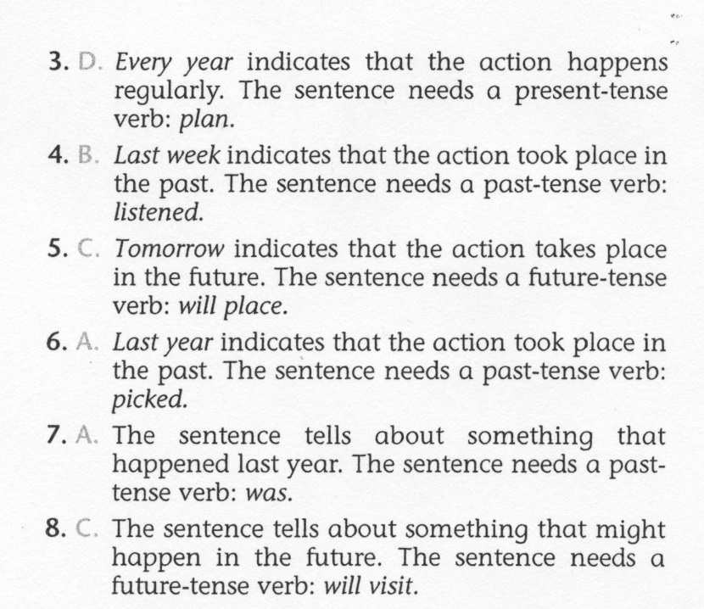
ELA-E-06 Verb Tenses

Slide 7
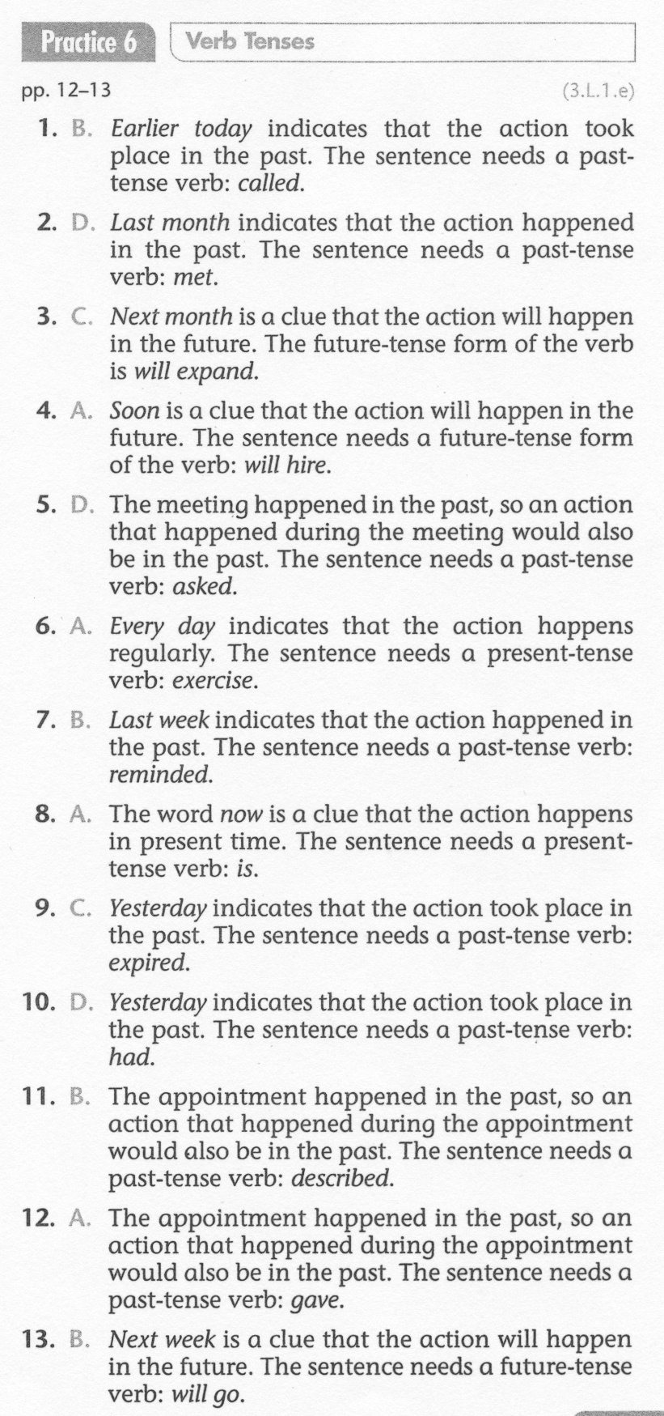
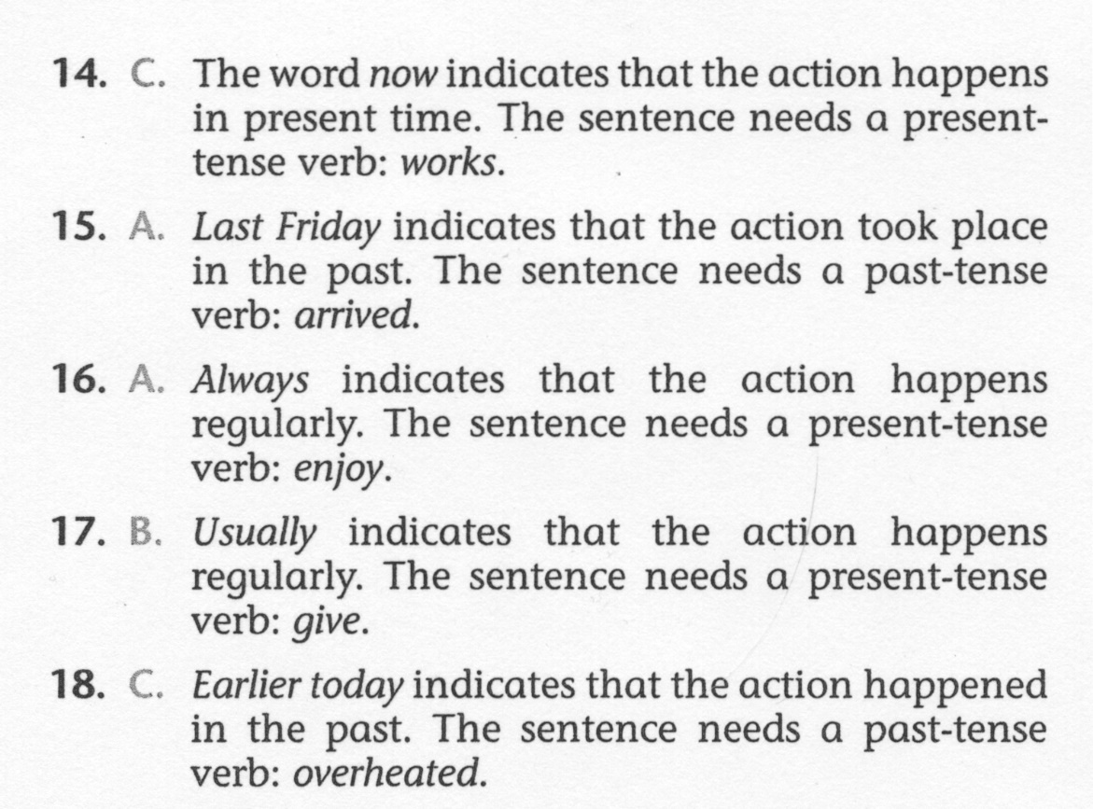
ELA-E-06 Verb Tenses

