Slide 1
Excel 2010
Backstage View
Nolan Tomboulian
252-675-0176
Tomboulian@Yahoo.com
Tomboulian.Info

Slide 2
Excel 2010
Backstage View
Nolan Tomboulian
252-675-0176
Tomboulian@Yahoo.com
Tomboulian.Info

Slide 3
Backstage View
Clicking the [FILE] Tab
brings up the Options for
Workbook File Management.
This was under the Microsoft
Office Button in 2007
The <default> option selected is {RECENT}

Slide 4
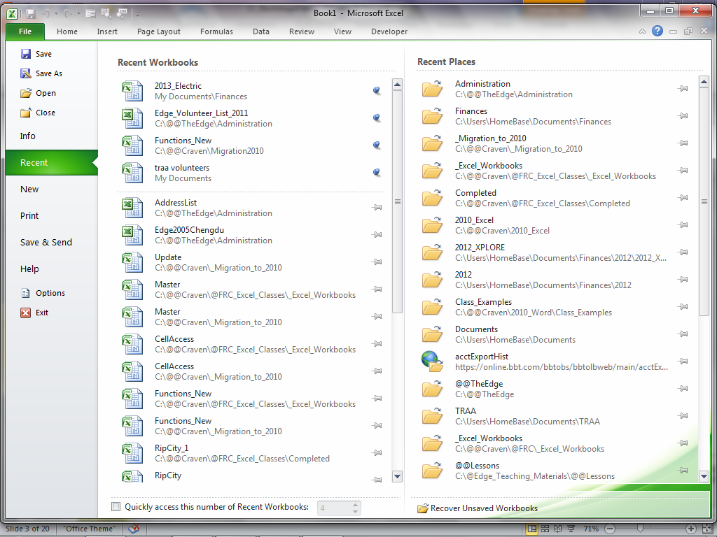
Backstage View Samples from EXCEL 2010
Quick Access Toolbar
File Name
Ribbon Tabs {minimized}
Expand Ribbon
Pinned files.
Keep files active!
Most recently used files
Recover “unsaved” workbooks

Slide 5
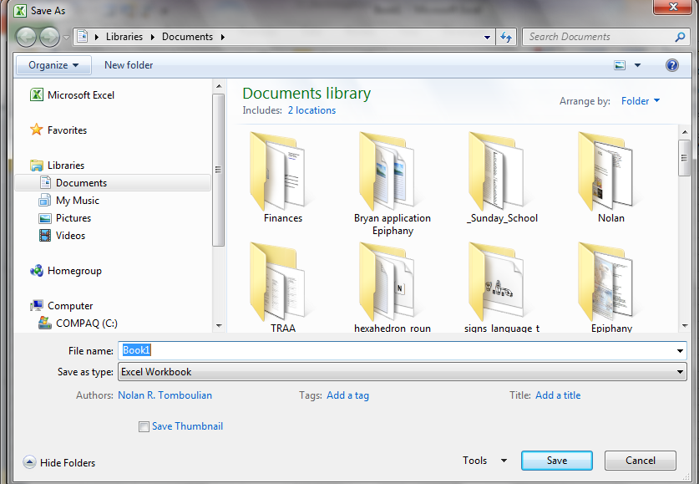
Backstage View SAVE
The 1st time you {SAVE} a Workbook, it will give you the SAVE AS screen
File
Type
Optional File Tag Information and Icon View

Slide 6
Backstage View SAVE AS (Changed the File Type)
Because of the expanded number of File formats, the ICON based Save-as from MS-2007 has been replaced with the drop-down dialog box.
If a workbook contains a MACRO, the new security requires the file to be saved as a Macro-Enabled Workbook

Slide 7
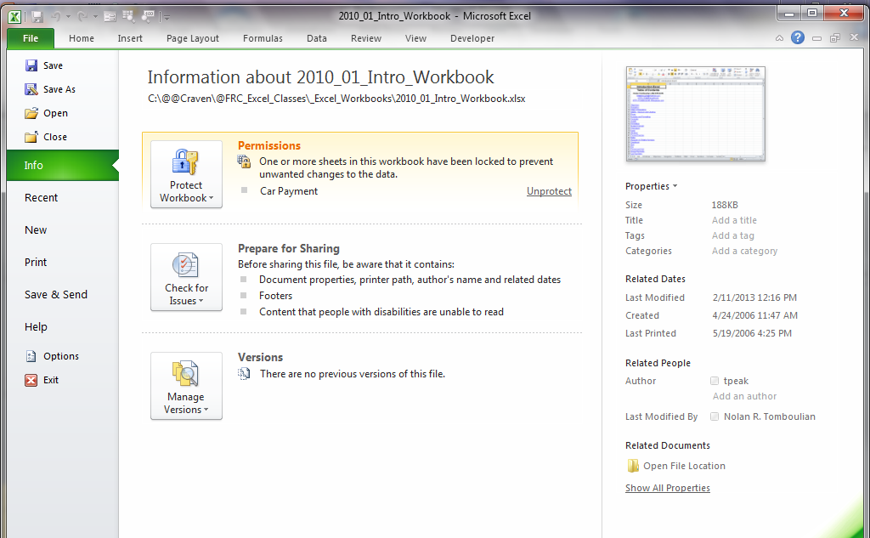
Backstage View INFO - Versions
Versions are valid until you Close the file.
(Administrator may have disabled option)

Slide 8
Backstage View INFO Permissions (Protect)
This is just a “Toggle” that can be turned on or off
You must remember the password..
It is CasE sENSItive.
Needs a “SERVICE”
Any changes to the workbook erases the Signature.

Slide 9
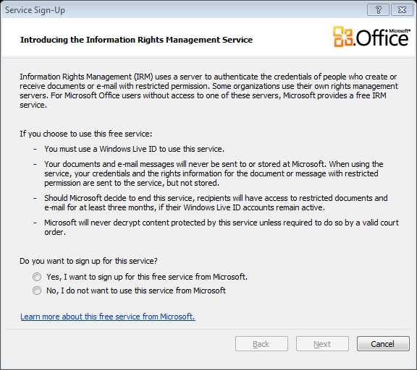
Backstage View INFO Permissions Restrict
(Requires an outside service)

Slide 10
Prepare for Sharing

Slide 11
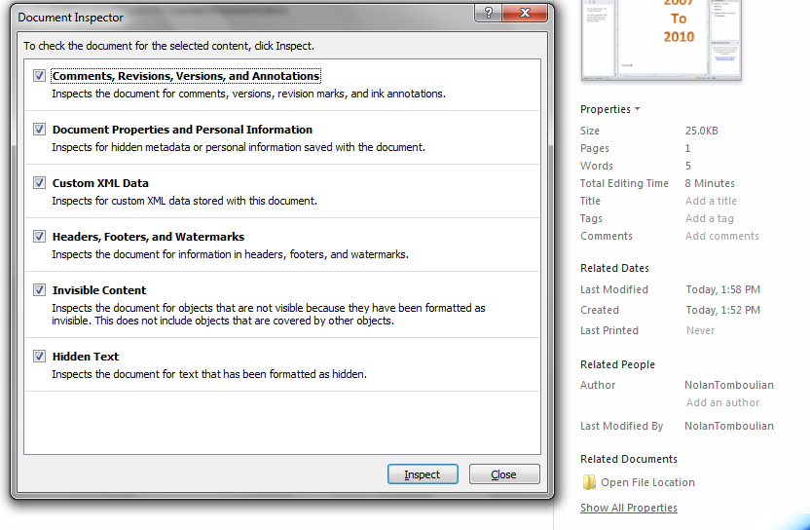
INFO - Prepare for Sharing / Inspect

Slide 12
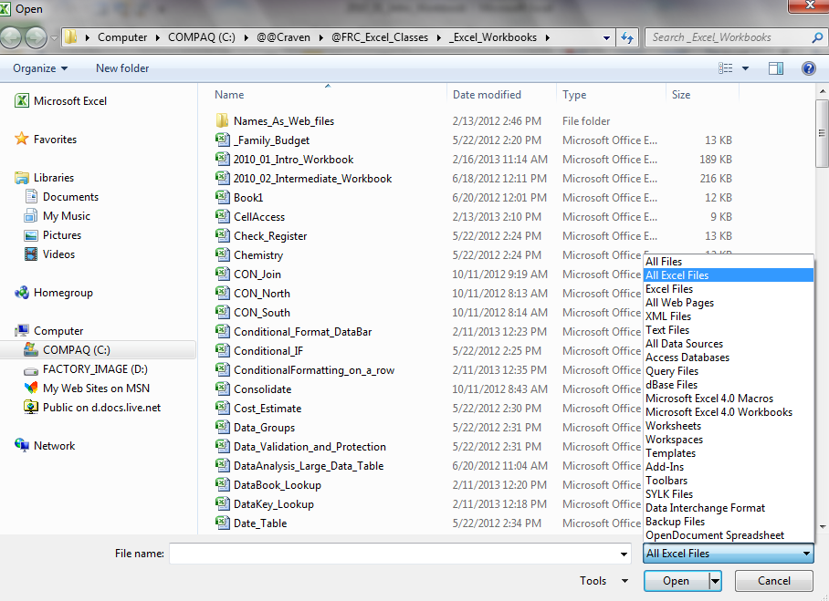
Backstage View OPEN
The DEFAULT TYPE for EXCEL is a XLSX but you can select the Type to filter and display other file formats.

Slide 13
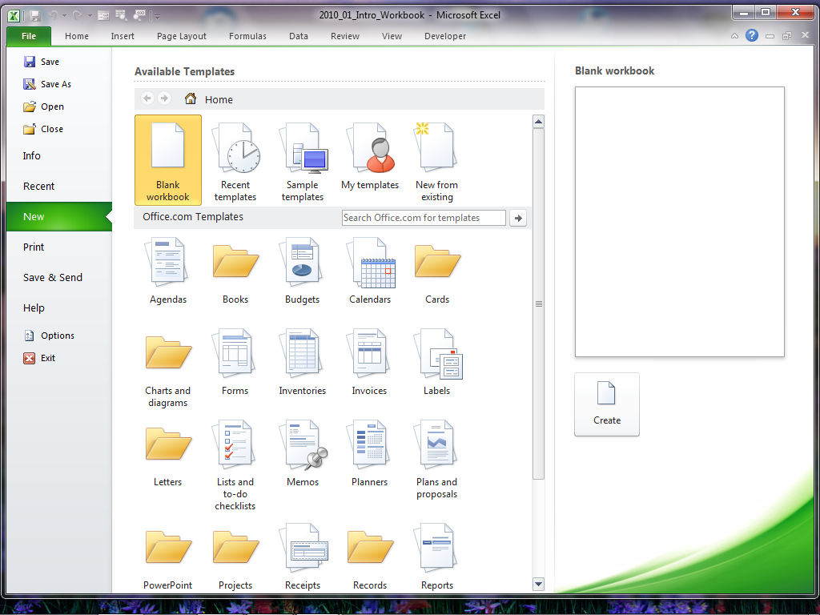
Backstage View NEW
Like an OPEN and SAVE AS
Many Template categories
Must <click> here

Slide 14
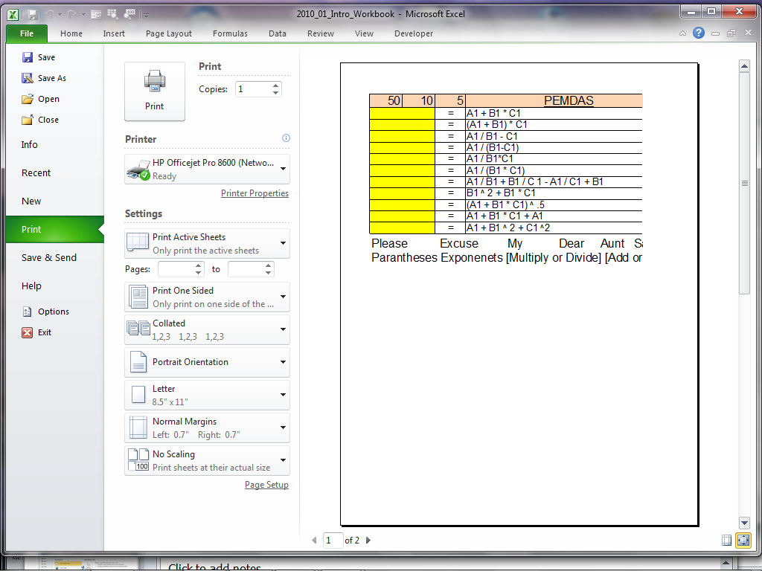
BackstageView PRINT
Press to Print
Print Preview
Quick Page Setup Options
Specific Printer Options
Page Selection
Zoom Slider

Slide 15
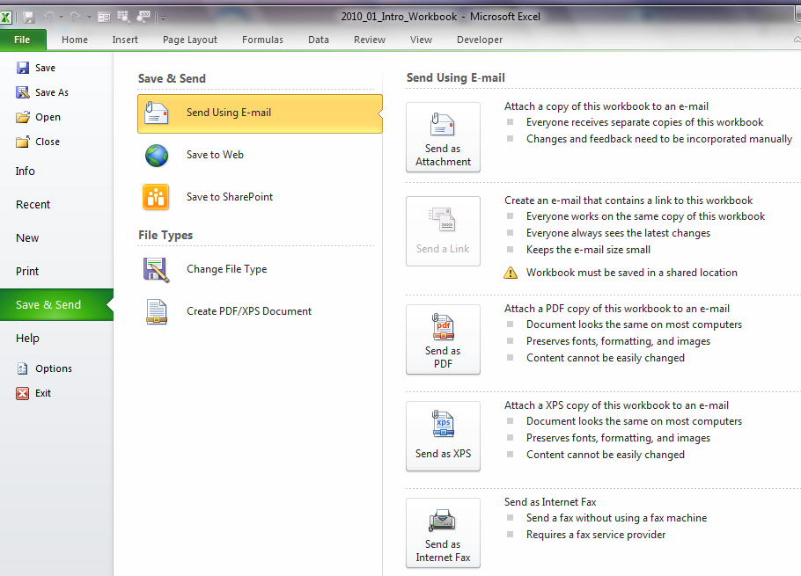
BackstageView SAVE and SEND
Requires
A
WINDOWS LIVE
SKY-DRIVE
ACCOUNT
You can be in the document when you use this.
Requires OUTLOOK to be installed.

Slide 16
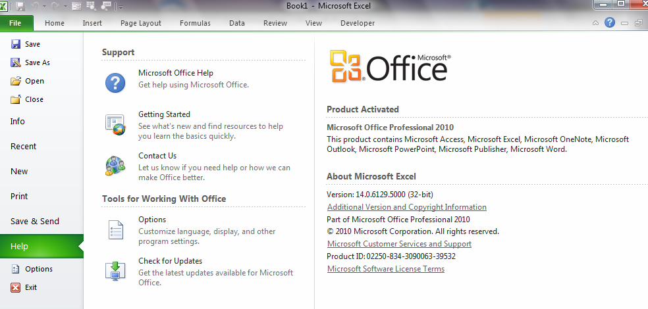
BackstageView HELP

Slide 17
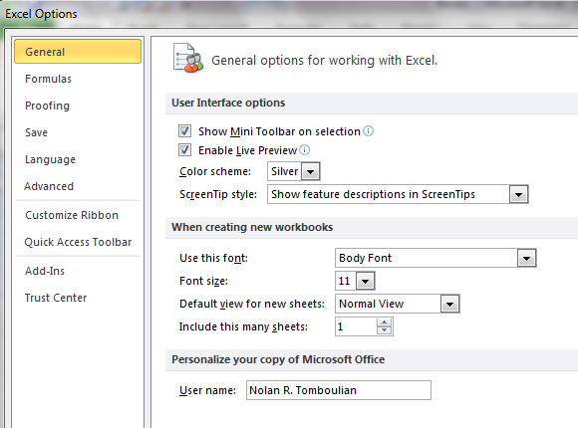
Backstage View Options General
Suggest to leave Mini Tool Bar, Live Preview and Screen Tips on (Checked)
Silver – Blue - Black
The normal
default is 3 Sheets!
User Name change is made to ALL MS Office products

Slide 18
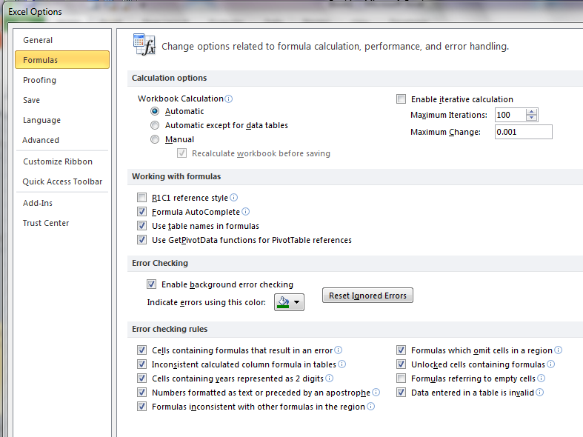
Backstage Options Formulas

Slide 19
Backstage Options Formulas

Slide 20
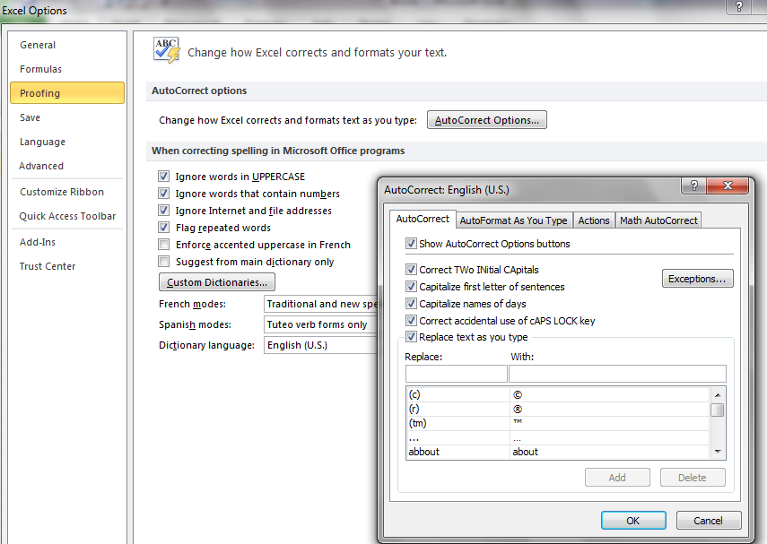
Backstage View Proofing

Slide 21
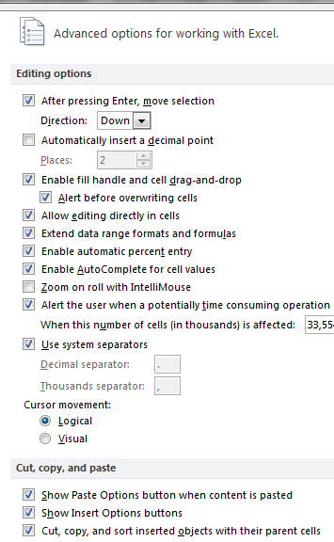
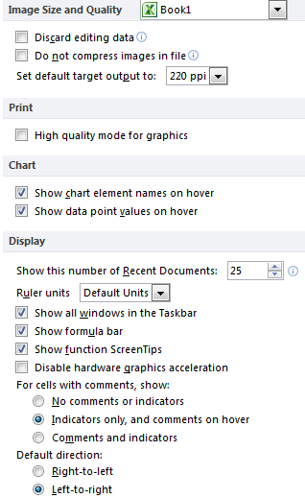
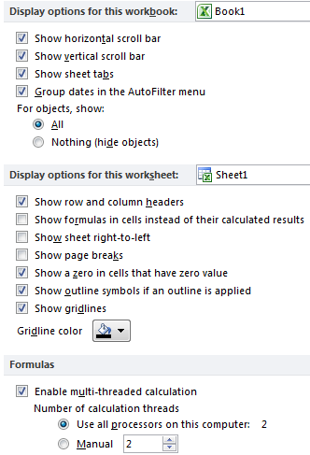
Backstage View Advanced

Slide 22
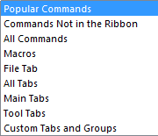
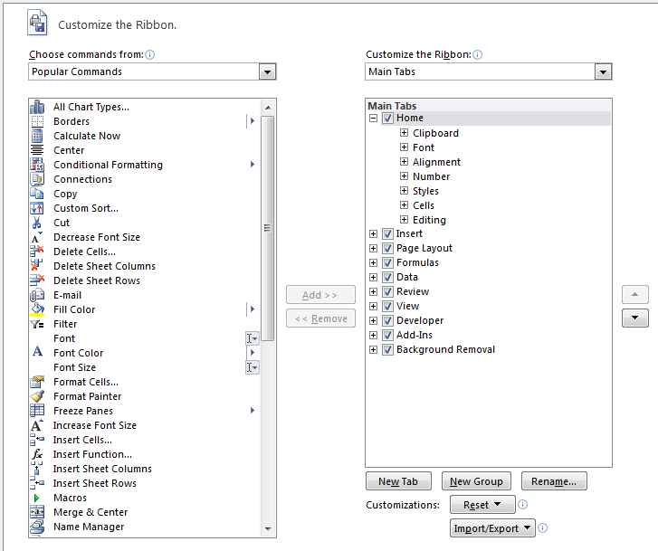
Backstage View Customize Ribbon and QAT
You cannot change the [FILE] Tab
Commands must be added at a {GROUP} level.
You define an Icon for the Group

Slide 23
Notes

Slide 24
Blank Page for duplex printing

