Slide 1
Printing & Page Breaks
Nolan Tomboulian
Tomboulian@yahoo.com
Tomboulian.Wikispaces.com

Slide 2
Defining the Print Area
By default, all parts of the active worksheet containing text, formulas, or values are printed
You can select the cells you want to print, and then define them as a Print Area
Select the range
Go to the Page Layout tab - Page Setup group
Click the Print Area button, and then click Set Print Area

Slide 3
Inserting Page Breaks
Excel prints as much as fits on a page and then inserts a page break to continue printing the remaining worksheet content on the next page
Manual Page Breaks specify exactly where you want the page breaks occur
You Can see where page breaks are currently set in the Page Layout or Page Break Preview View

Slide 4
Setting and Removing Page Breaks
To set a page break:
Select the first cell below the row where you want to insert a page break
Go to the [Page Layout] Tab –
{Page Setup group}
Click the Breaks button,
and then click Insert Page Break

Slide 5
Setting and Removing Page Breaks
To remove a page break:
Select any cell below or to the right of the page break you want to remove
Go to the [Page Layout] tab –
{Page Setup group}
Click the Breaks button, and then click Remove Page Break (or click Reset All Page Breaks to remove all the page breaks from the worksheet)

Slide 6
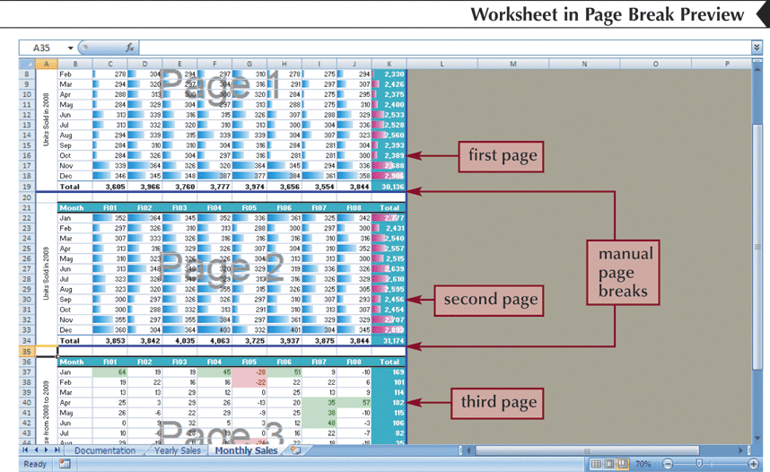
Setting and Removing Page Breaks

Slide 7
Adding Print Titles
You can repeat information, such as the company name, by specifying which rows or columns in the worksheet act as Print titles, information that prints on each page
Go to the [Page Layout] tab – {Page Setup group} and click the Print Titles button
Click in the appropriate “repeat” box, move your pointer over the worksheet, and then select the rows and/or columns you want repeated
Click the OK button

Slide 8
Adding Headers and Footers
A header is the text printed in the top margin of each page
A footer is the text printed in the bottom margin of each page
Useful for adding information to printed worksheets such as page number, date printed, file owner, etc

Slide 9
Adding Headers and Footers
Scroll to the top of the worksheet
Click the left section of the header directly above cell A1 to display the Header & Footer Tools contextual tab
OR
Go to the Insert tab – Text group, and then click on the Headers & Footers button

Slide 10
NOTES

Slide 12
End Of Section
PRINTING

