Slide 1
Applying Formats STYLES & Paste Special
Nolan Tomboulian
Tomboulian@yahoo.com
Tomboulian.Wikispaces.com

Slide 2
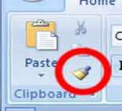
Copying Formats with the Format Painter
The Format Painter copies the formatting from one cell or range to another cell or range, without duplicating any of the data
Select the range containing the format you wish to copy
Click the Format Painter Button on the [Home] tab
<Left Click> 1 time to use 1 time
<Double Left Click> to use until you press <esc>
Click the cell to which you want to apply the format

Slide 3
Copying Formats with the Paste Options Button
The Paste Options button allows you to choose from several options when pasting.
You can choose:
just values
values and formatting
function values

Slide 4
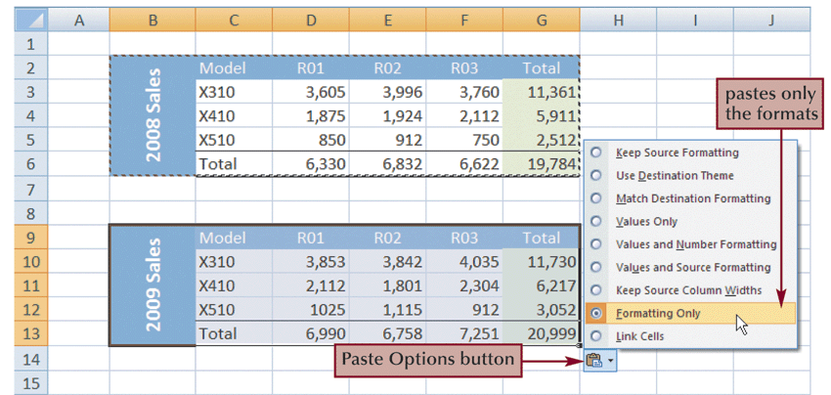
Copying Formats with the Paste Options Button

Slide 5
Paste Special
Paste Special is another way you can control what is pasted from the Clipboard
Provides many of the same options as the Paste Option button, but includes ability to quickly add summary functions to data and transpose data from rows to columns

Slide 6
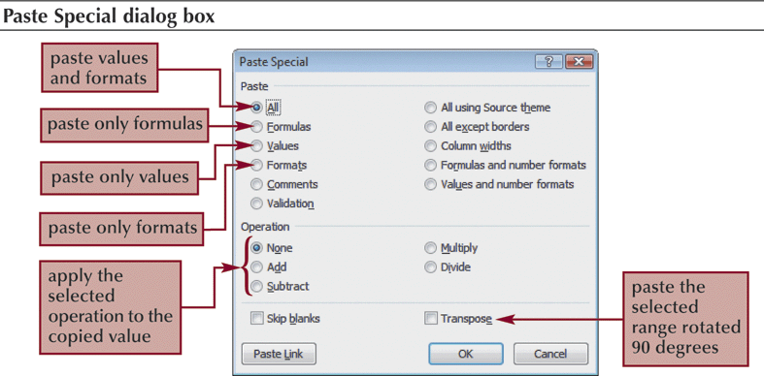
Paste Special

Slide 7
Applying Styles
A style is a collection of formatting that can be quickly applied to a cell or a range of cells
Can use the styles supplied with Excel or create your own
Some styles are connected to the workbook’s theme

Slide 8
Applying Styles
Select the cell or range to which you want to apply a style
Go to the [Home tab] – {Styles group} and click the Cell Styles Button
To see a <Live Preview> of a style on the selected cell or range, point to a style in the Cell Styles gallery
Click the style you want to apply to the selected cell or range

Slide 9
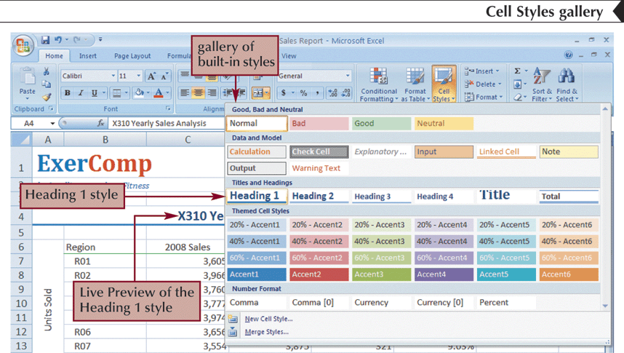
Applying Styles

Slide 10
End of Section
STYLES
and
Paste Special

Slide 11
Blank for Duplex Printing

Slide 12
Blank for Duplex Printing

