Slide 1
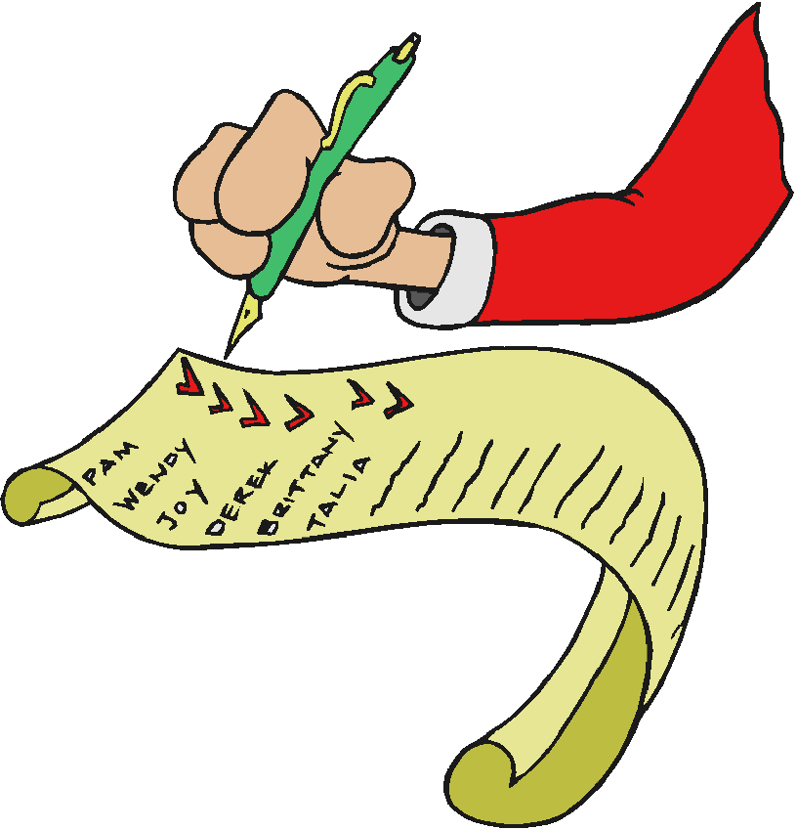
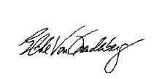
Class Administration Please Sign In
Please make sure you sign the attendance sheet at this time if you have not already done so.
MAKE SURE WE CAN READ IT!

Slide 2
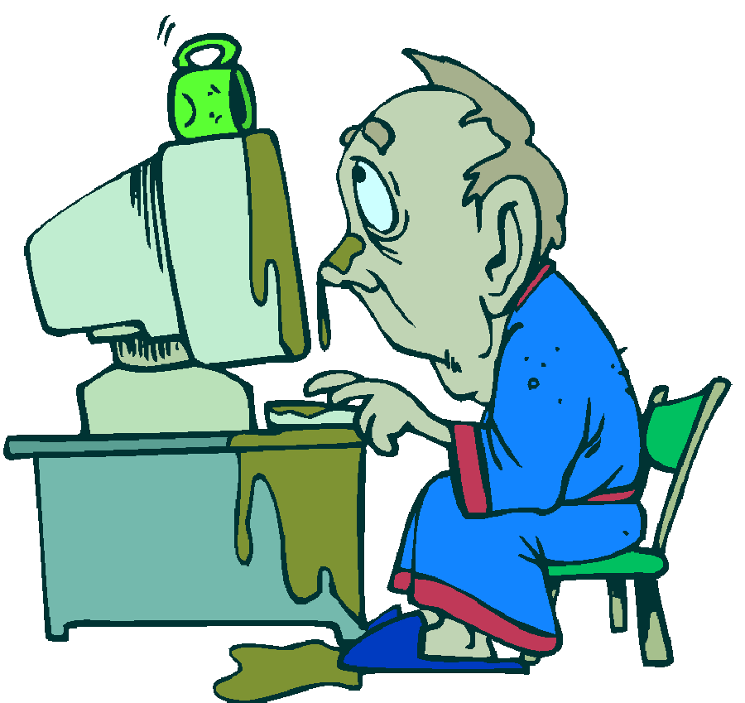
ADMINISTRATION
Turn off cell phones or switch to vibrate.
Respect each other in the classroom. One person talking at a time.
If you have a question, ask it. You might not be the only one who wants to know!
Because this is a computer lab – Be careful with your drinks!
There will be a 10 minute break each hour.
The class is scheduled from 5:30 PM -8:30 PM

Slide 3
ADMINISTRATION
Turn off cell phones or switch to vibrate.
Respect each other in the classroom.
One person talking at a time.
If you have a question, ask it.
You might not be the only one who wants to know!
Because this is a computer lab
Be careful with your drinks!
There will be a 10 minute break each hour.
Lunch will be 1 hour.
The class is scheduled from 7:30 AM -3:30 PM
Please remember to turn in the Evaluation (WITH COMMENTS)

Slide 4
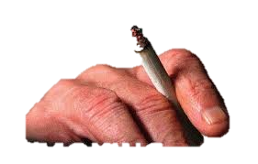
Restrooms .
Soda machines and vending machines are located in the student lounge across from the entrance.
The designated smoking area is on the Northeast side of the Redd building across the student parking lot against the fence line. There are red cones designating the smoking area. Please, clean-up after yourself.
In the event of a fire please exit the building using the nearest exit away from the fire.
Code Red drill.
Let’s have fun. You have a day away from the bump and grind of your daily routine.
Ask Questions – The class is for you!

