Slide 1
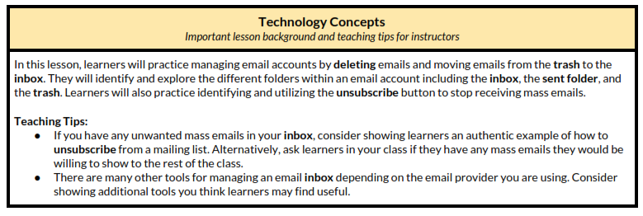
Unit-3-6 Email: Manage Folders
Learners will be skilled at…
In this lesson, learners will manage their Mail Folders

Slide 2
Unit 3-6 Email Manage Folders
Learning Goals:
10. Manage email:
Delete and retrieve messages
Identify spam
Unsubscribe from unwanted mailing lists (Filters)
Unit 3-6 Vocabulary:
delete
inbox
sent folder
trash
unsubscribe
folder
Sub-folder

Slide 3
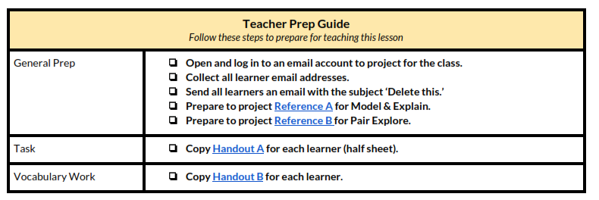
Unit 3-6 Email Manage Folders

Slide 4
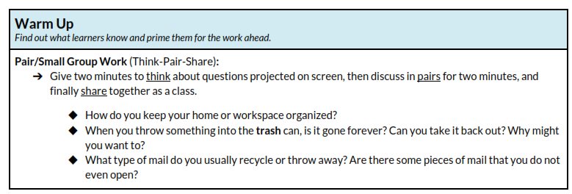
Unit 3-6 Email Manage Folders

Slide 5
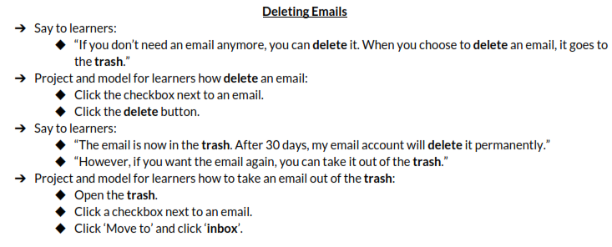
Unit 3-6 Email Manage Folders

Slide 6
Unit 3-6 Email Manage Folders

Slide 7
Unit 3-6 Email Unsubscribe
3-6 Reference A
Some emails APPEAR to have an UNSUBSCRIBE Link, but it can be false!
It is better to use the SPAM Blocker or Email Filter to block unwanted emails.

Slide 8
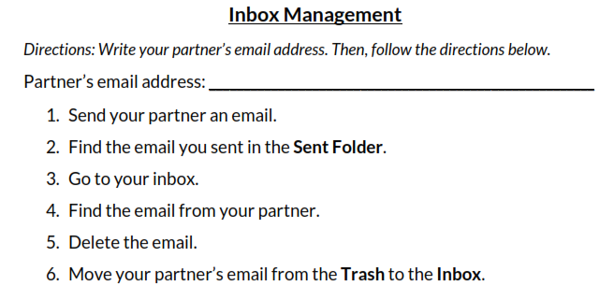
Unit 3-6 Email Manage Folders
3-6 Handout A

Slide 9
Unit 3-6 Email Manage Folders
Wrap-Up

Slide 10
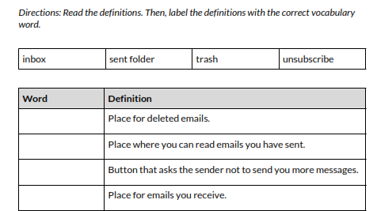
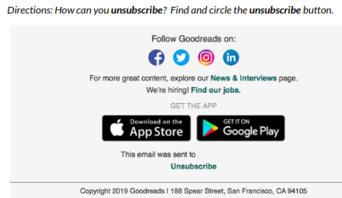
Unit 3-6 Email Manage Folders
3-6 Handout B

Slide 11
Mail Folders: AOL, Outlook, Gmail
AOL Does allow for FOLDERS
AOL Does Not allow for SUB-FOLDERS

Slide 12
Mail Folders: Outlook
AOL Does allow for FOLDERS
AOL Does Not allow for SUB-FOLDERS

Slide 13
Mail Folders: Gmail
AOL Does allow for FOLDERS
AOL Does Not allow for SUB-FOLDERS

