Slide 1
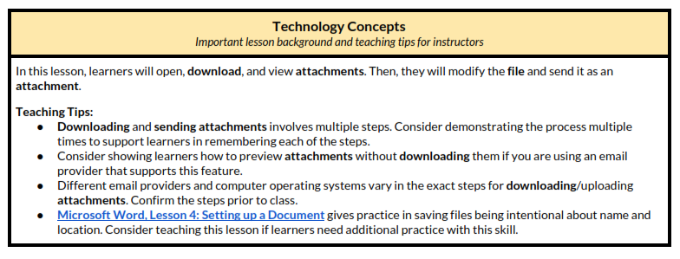
Unit-3-5 Email: Attachments
Learners will be skilled at…
In this lesson, learners will DOWNLOAD, PREVIEW, MODIFY, and ATTACH a file to an email.

Slide 2
Unit 3-5 Email Attachments
Learning Goals:
8. Add an attachment to an email.
9. Open and download an email attachment.
Unit 3-5 Vocabulary:
attachment
download
file (Image, Music, Video, Document, PDF, EXE Programs)
download
paper clip
review

Slide 3
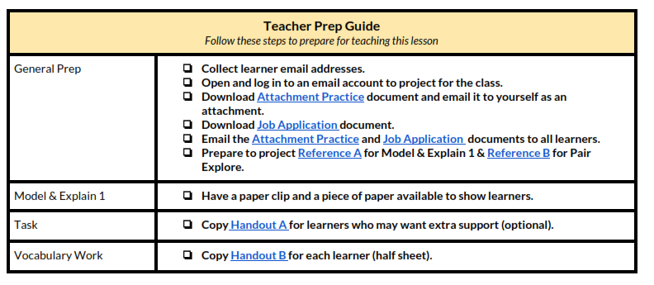
Unit 3-5 Email Attachment

Slide 4
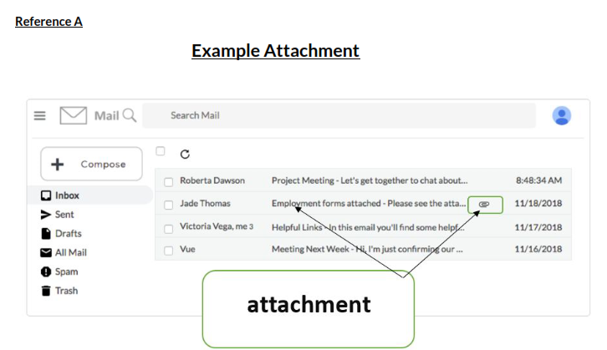
Unit 3-5 Email Attachment
3-5 Reference A

Slide 5
Unit 3-5 Email Attachment
3-5 Reference B

Slide 6
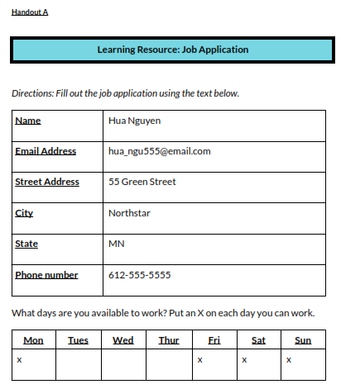
Unit 3-5 Email Attachment
3-5 Handout A

Slide 7
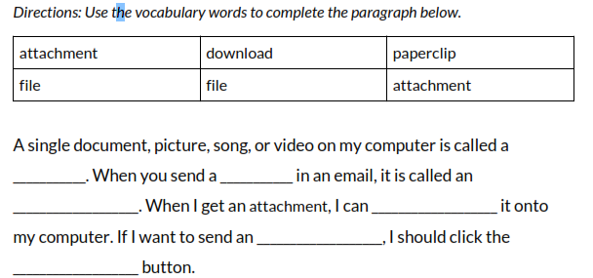
Unit 3-5 Email Attachment
3-5 Handout B
QUIZ

Slide 8
Unit 3-5 Email Attachment

