Slide 1
Internet Basics Unit: 2 – 6 Control Shortcuts

Slide 2
Warm-up: Thumbs Up / Thumbs Down
QUESTIONS I HAVE?.......

Slide 3
Unit 2-6 Internet Basic Skills Control Shortcuts
17. Use shortcut keys, or menu or mouse equivalents, to support user experience on the web (e.g., zoom, find text).
The main task in this lesson can be done using either
Wikipedia or Britannica. If you choose to use Wikipedia, consider having a conversation with learners about reputable sources on the internet.

Slide 4
Unit 2-6 Search Terms Vocabulary
Control (Ctrl) / Command (apple)
shortcut
search bar (URL)
Ctrl Plus (+) Zoom in
Ctrl Minus (-) Zoom out
Ctrl f (Find / Search)
Ctrl w (close current tab)
Ctrl t (New Tab)
Ctrl L (Jump to the Address (URL) bar
Ctrl <Shift> B: Open the Bookmark Bar
CTRL [HOME] Top of webpage

Slide 5
Reference 2-6-A
1. Open en.wikipedia.org OR britannica.com
​
2. Search for ‘Chile’ or choose another country
3. Make the text bigger. (Ctrl +)
4. Use Ctrl F to find:
◆ Population
◆ Capital city
◆ Language

Slide 6
Unit 2-6 Handout-A Research
Chile:
Mexico:
Thailand:

Slide 7
Unit 2-6 Handout-A Research (page 2)
Egypt:
________:
________:

Slide 8
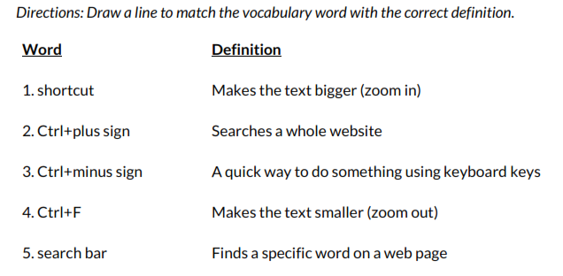
Unit 2-6 Handout-C Vocabulary Quiz

Slide 9
https://www.ctc.ca.gov/site-information/accessibility/key-chrome
Action | Shortcut
Search with your default search engine | Type a search term + Enter
Search using a different search engine | Type a search engine name and press Tab
Add www. and .com to a site name, and open it in the current tab | Type a site name + Ctrl + Enter
Add www. and .com to a site name, and open it in a new window | Type a site name + Ctrl + Shift + Enter
Open a new tab and perform a Google search | Type a search term + Alt + Enter
Jump to the address bar | Ctrl + l or Alt + d or F6
Search from anywhere on the page | Ctrl + k or Ctrl + e
Remove predictions from your address bar | Down arrow to highlight + Shift + Delete
Move cursor to the address bar | Ctrl + F5

