Slide 1
TABE Math-E Unit-1 Working With Whole Numbers REVIEW
Revised: October 16, 2023
Nolan Tomboulian

Slide 2
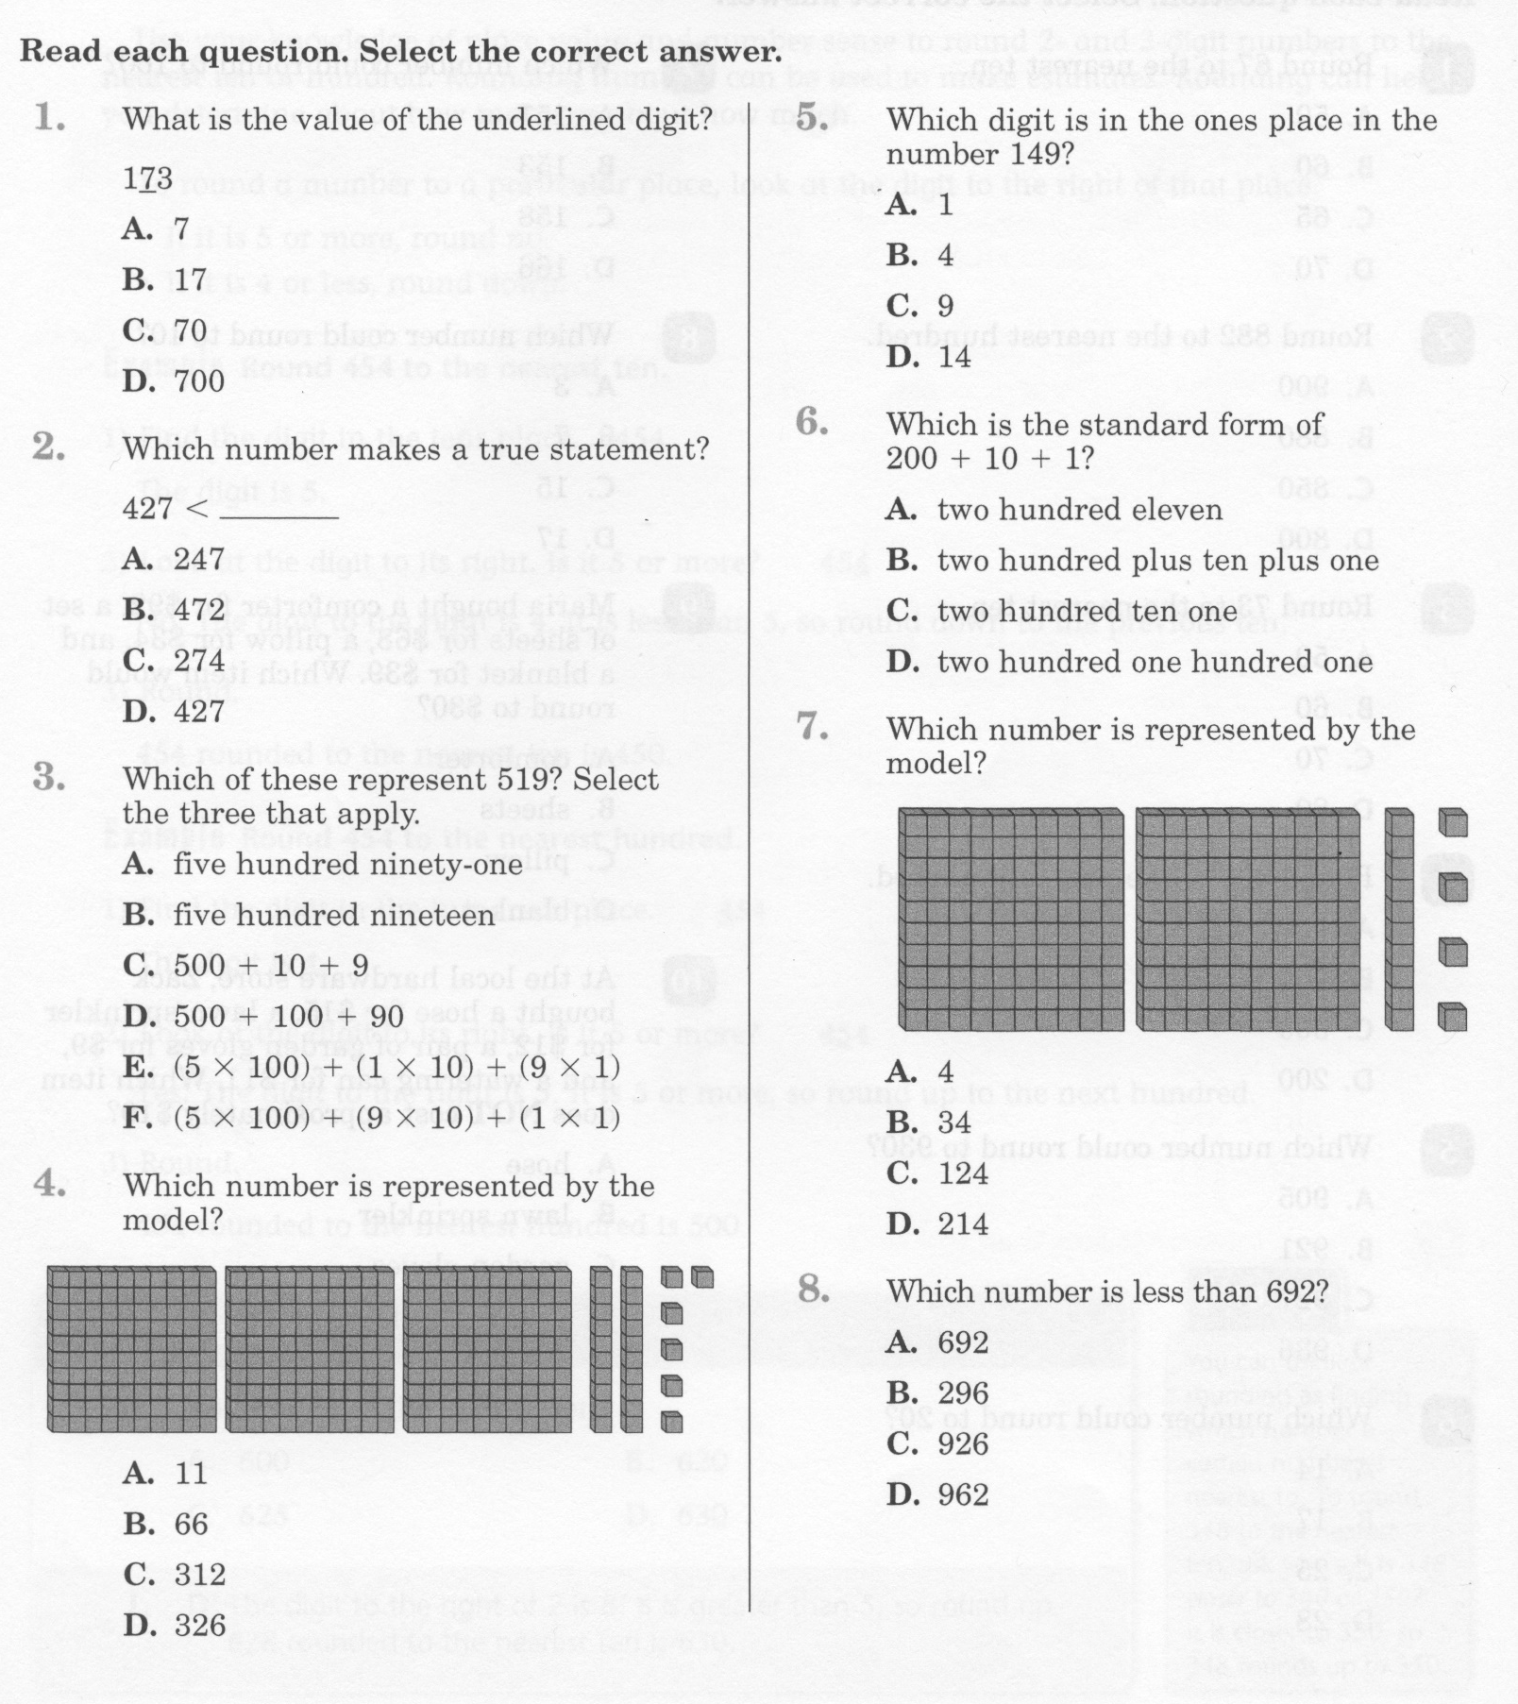
Math-E - Unit-1 – Review

Slide 3
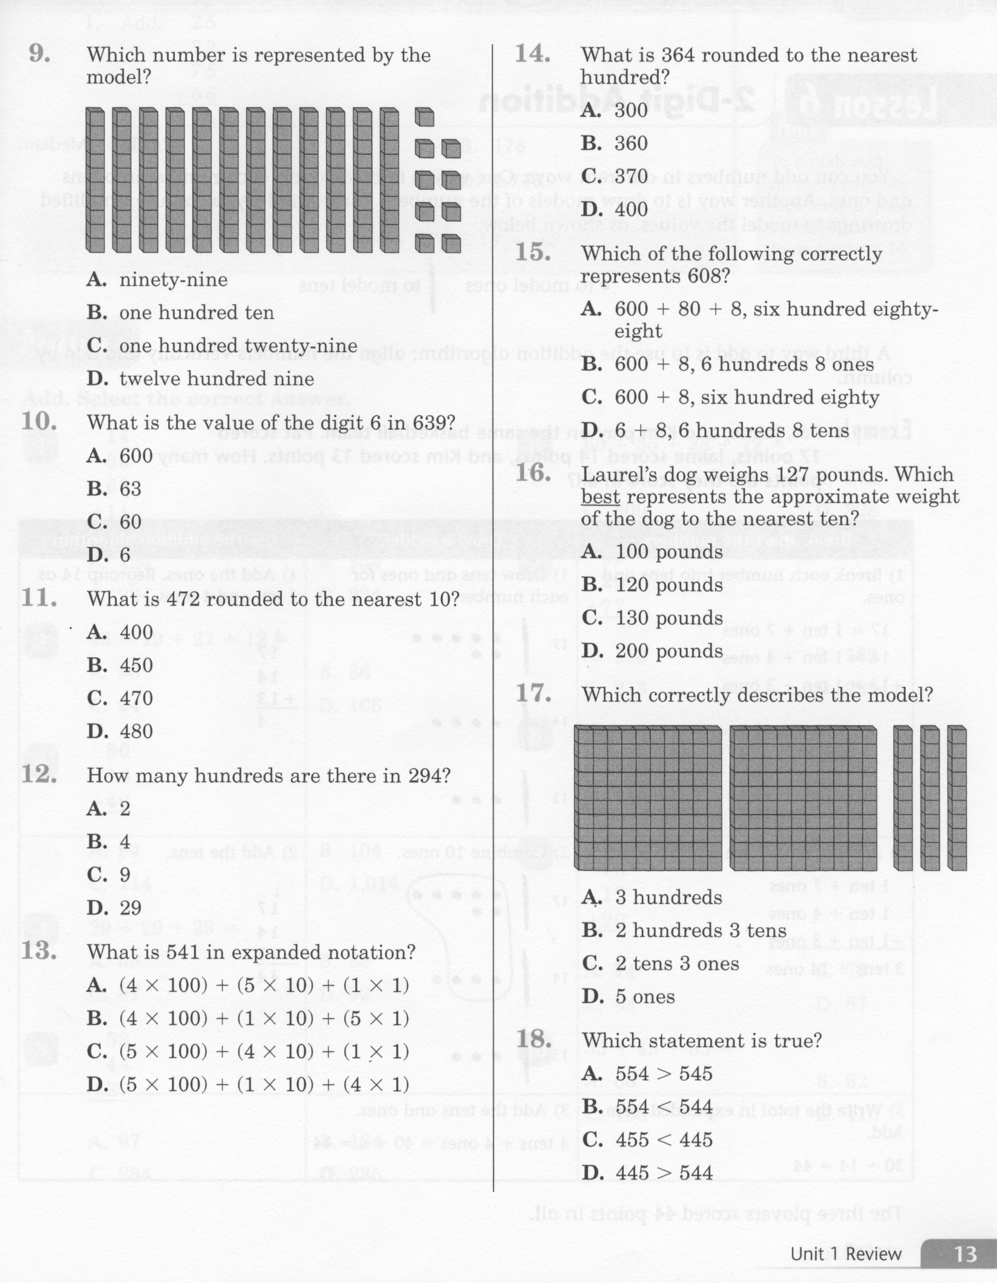
Math-E - Unit-1 - Review

Slide 4
Math-E - Unit-1 – Review

Slide 5
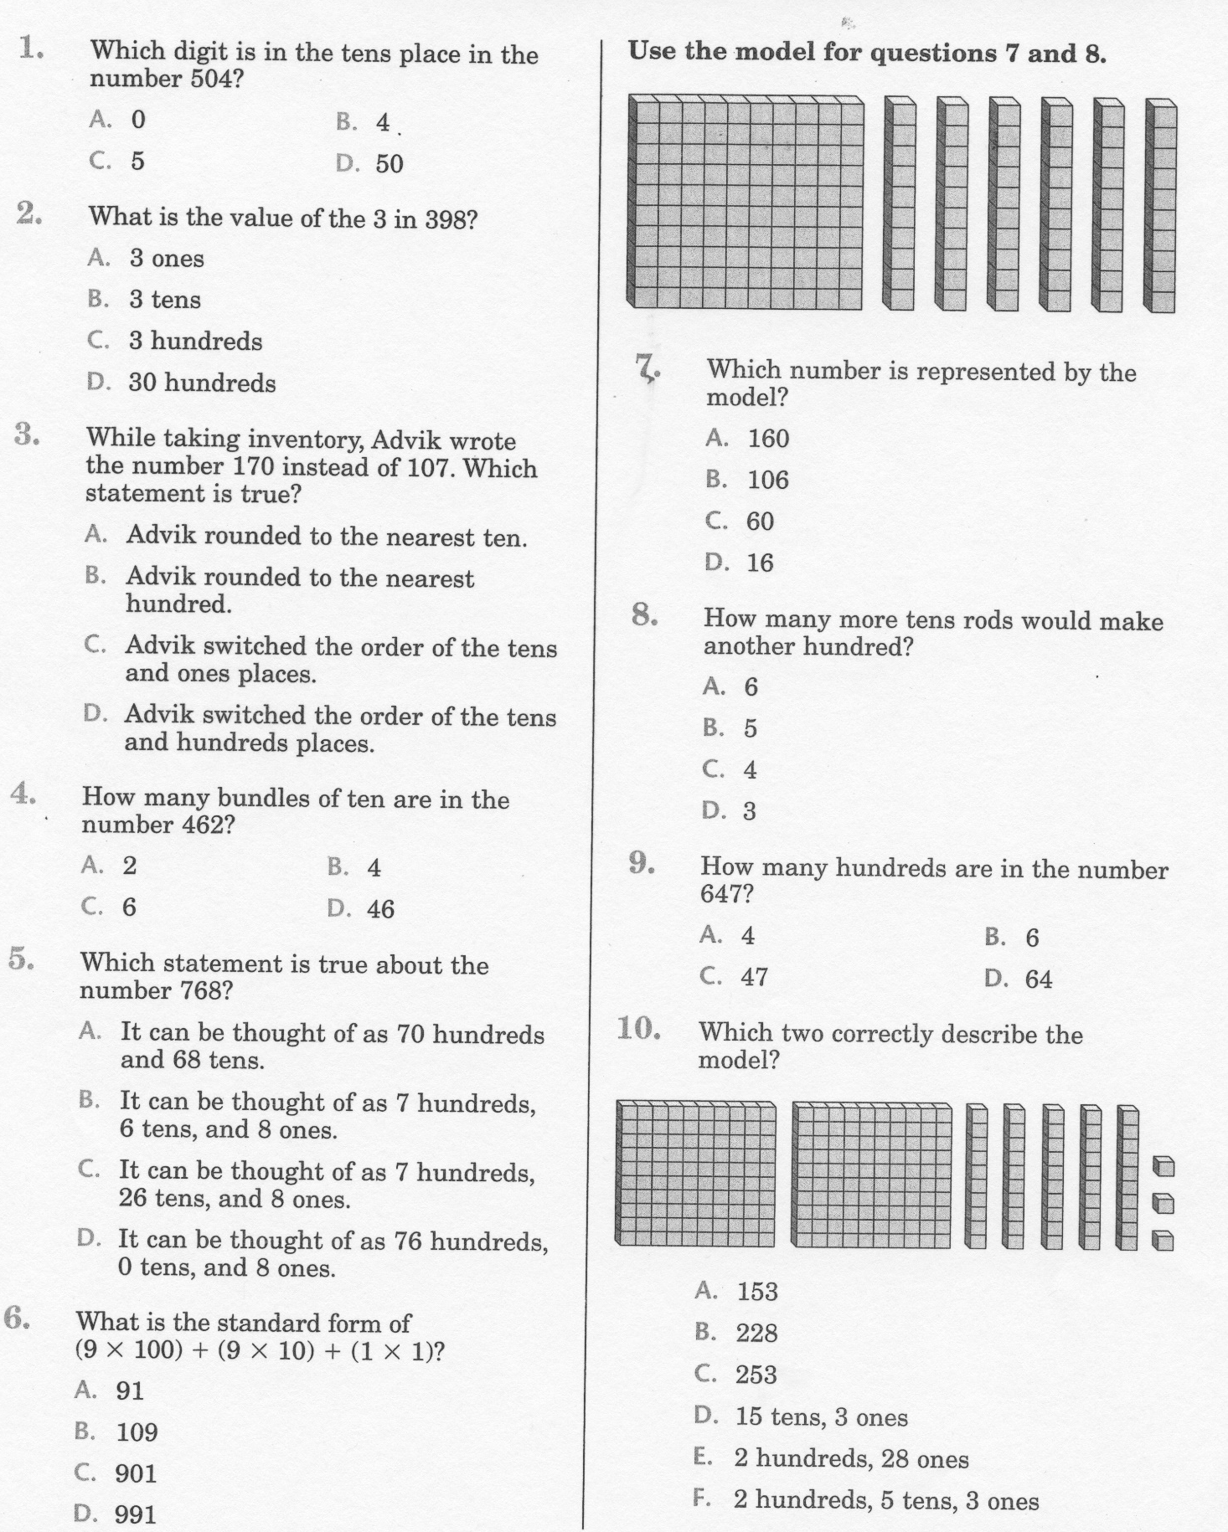
Math-E - Unit-1 – Practice

Slide 6
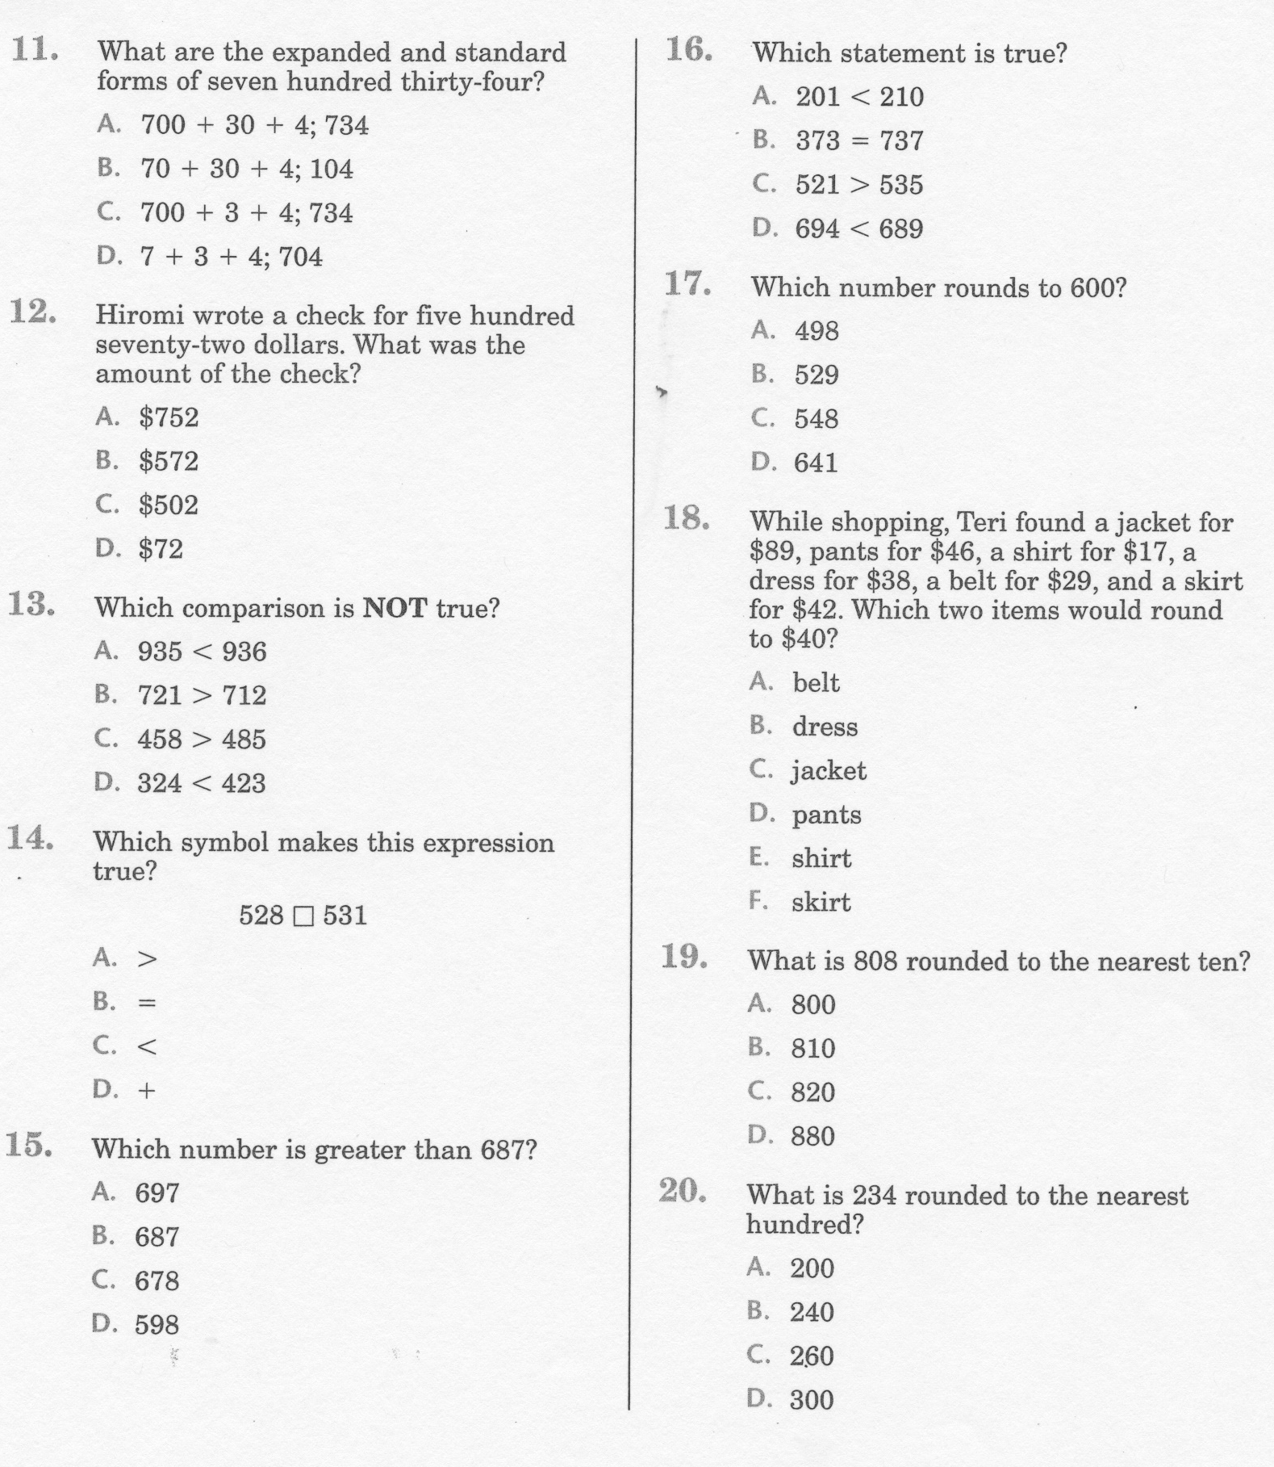
Math-E - Practice-01 – Practice

Slide 7
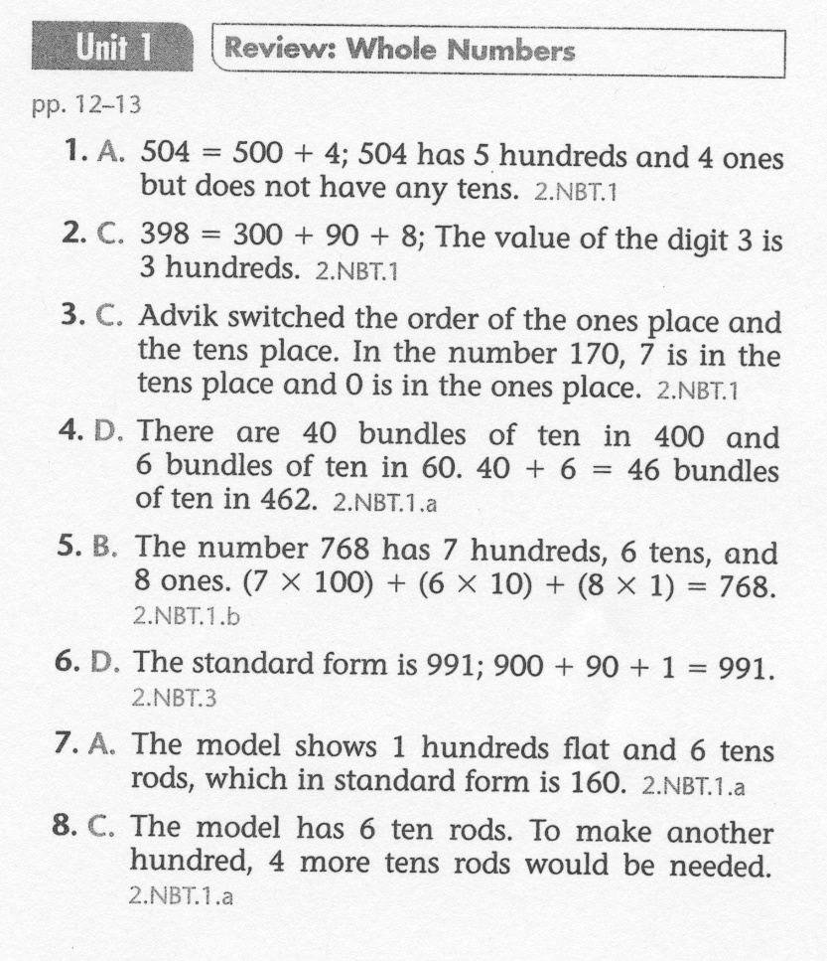
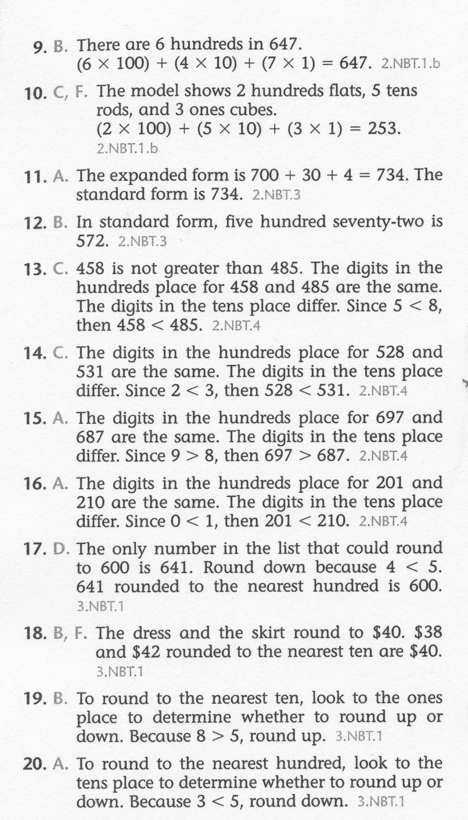
Math-E - Unit-1 – Review

