Slide 1
TABE Math-E PAXEN Unit-6 Geometry Lesson 48 Decompose Area
Revised: November 4, 2023
Nolan Tomboulian
Some graphics may not have copied well during the scan process.

Slide 2
Math-E - Lesson 48 – Decompose Area

Slide 3
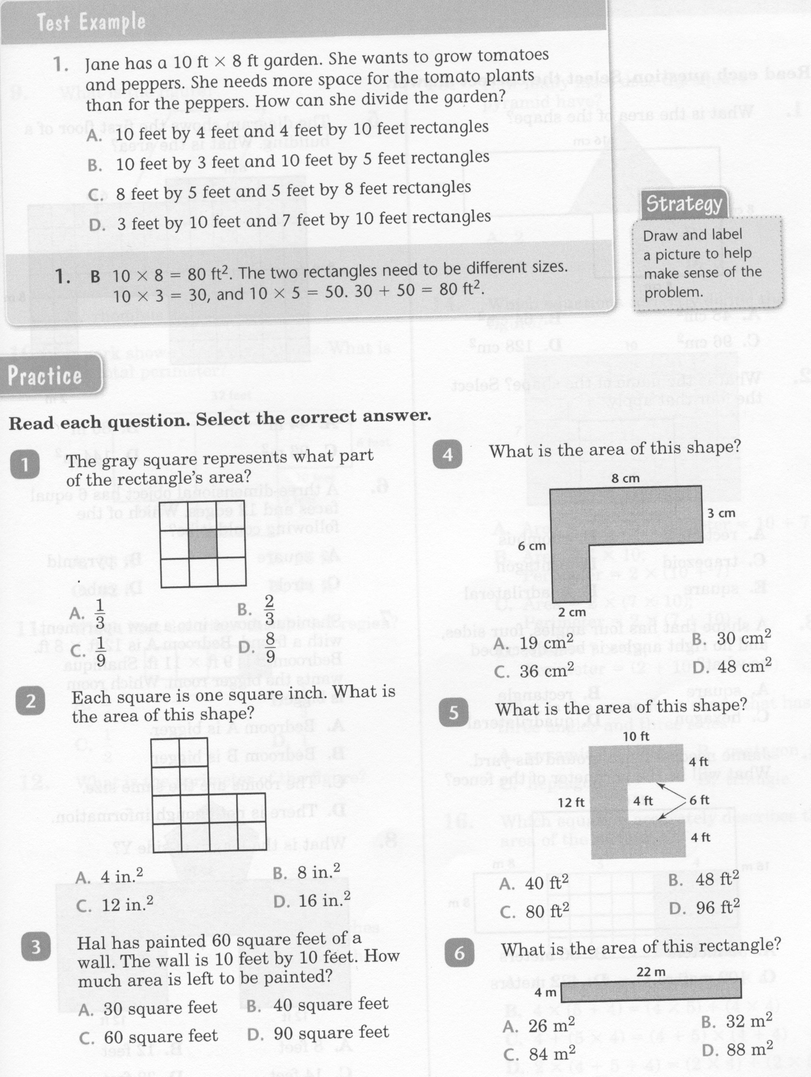
Math-E - Lesson 48 – Decompose Area

Slide 4
Math-E - Lesson 48 – Decompose Area

Slide 5
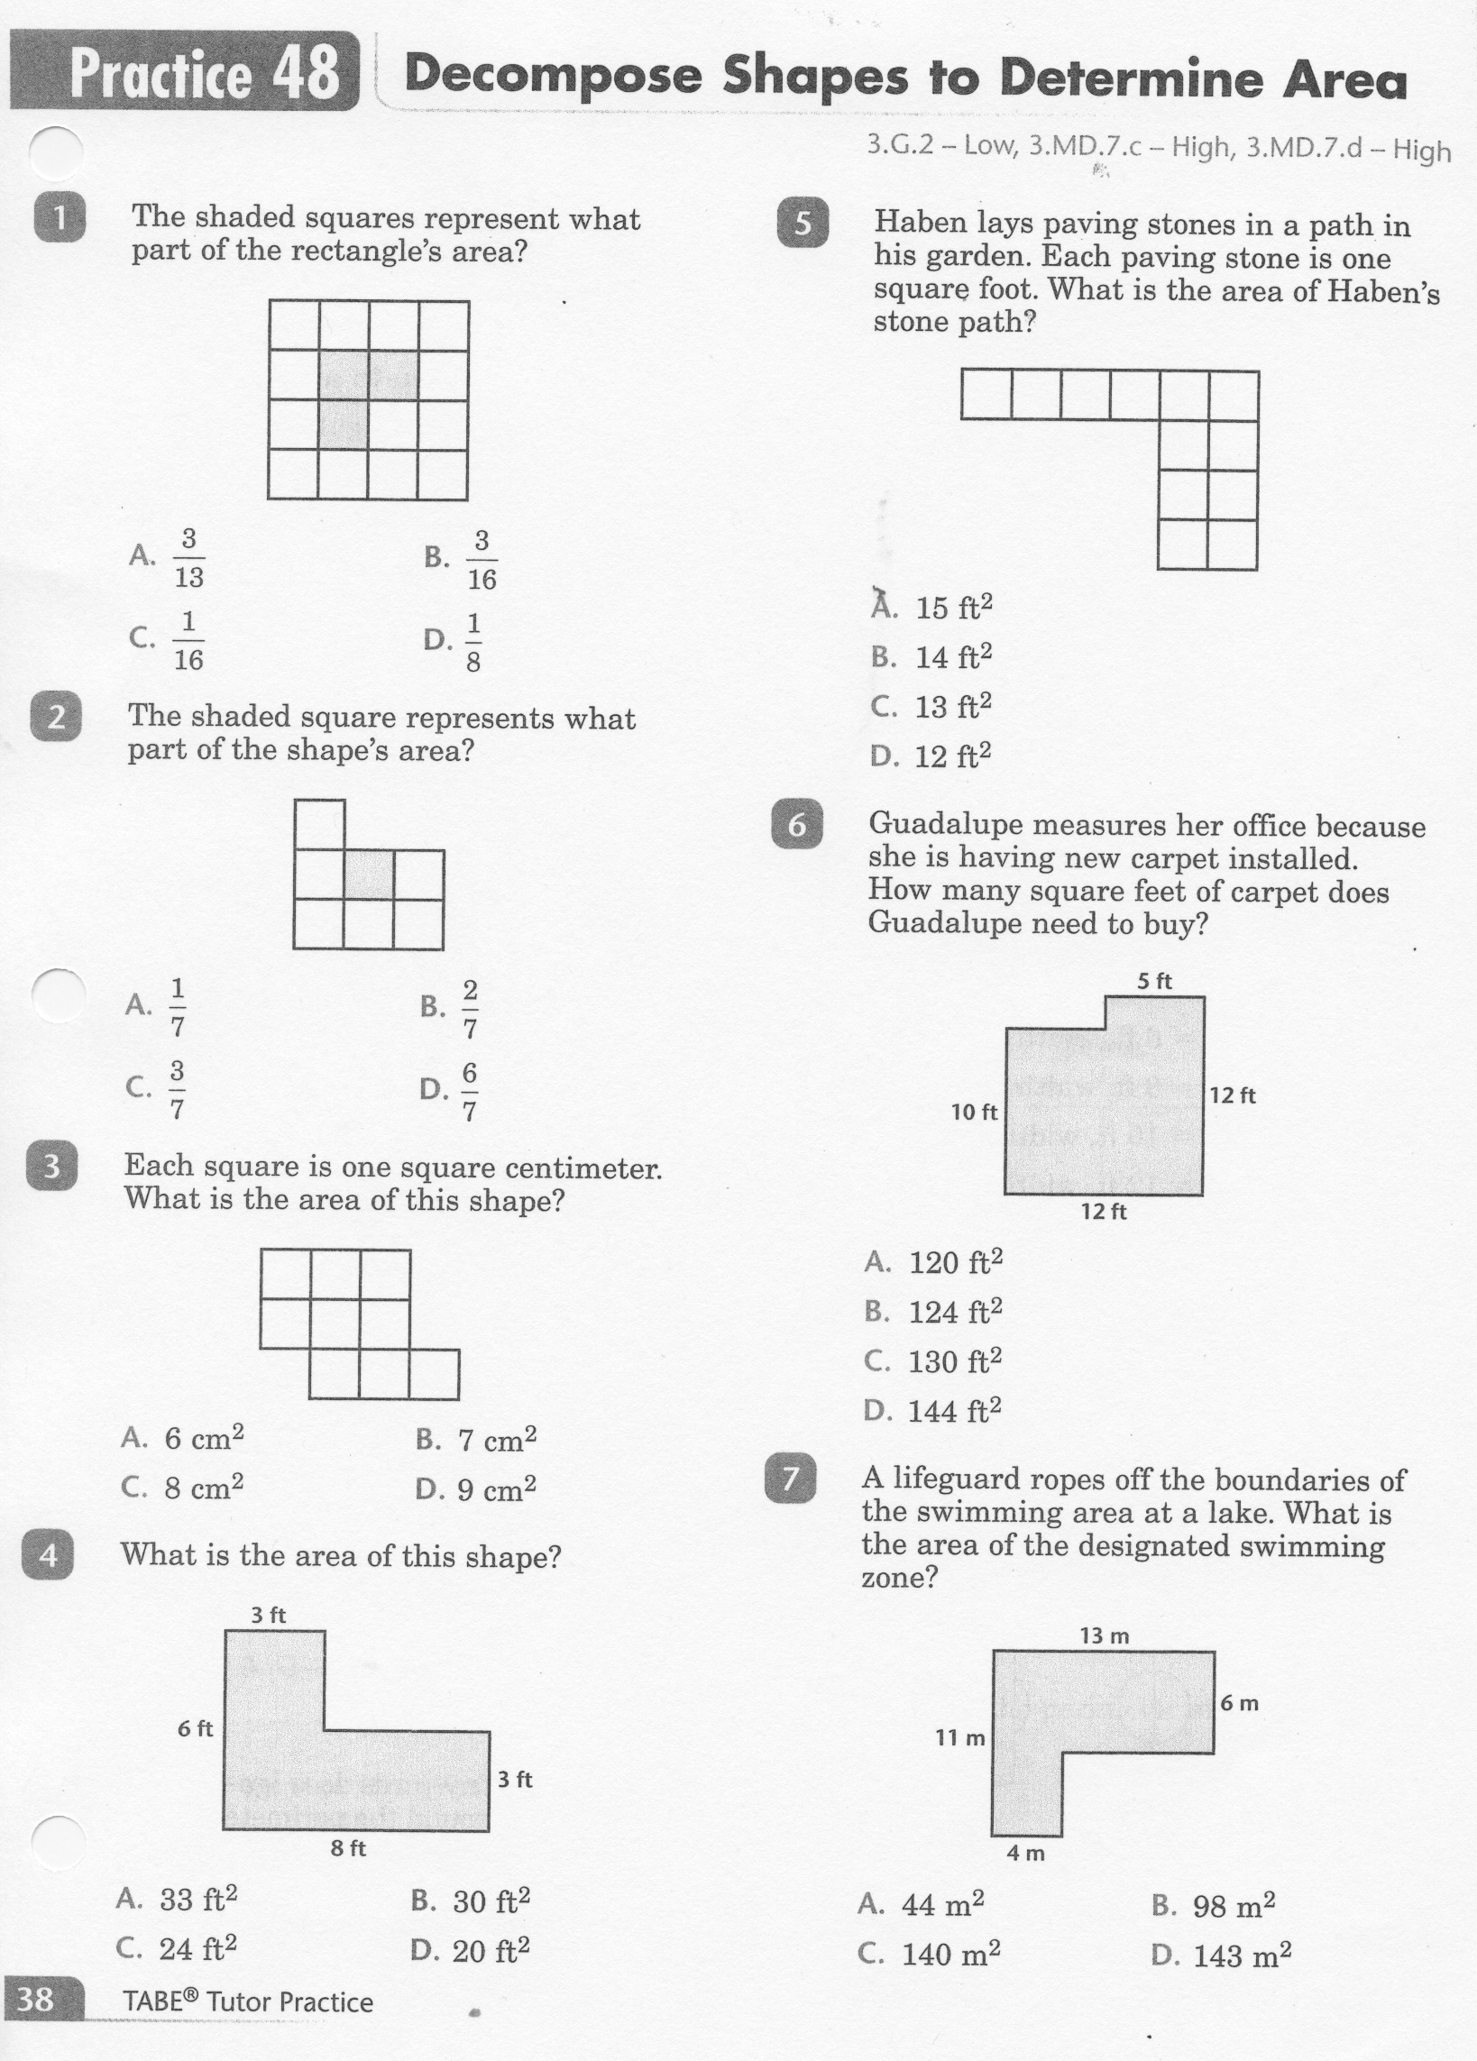
Math-E - Practice 48 – Decompose Area

Slide 6
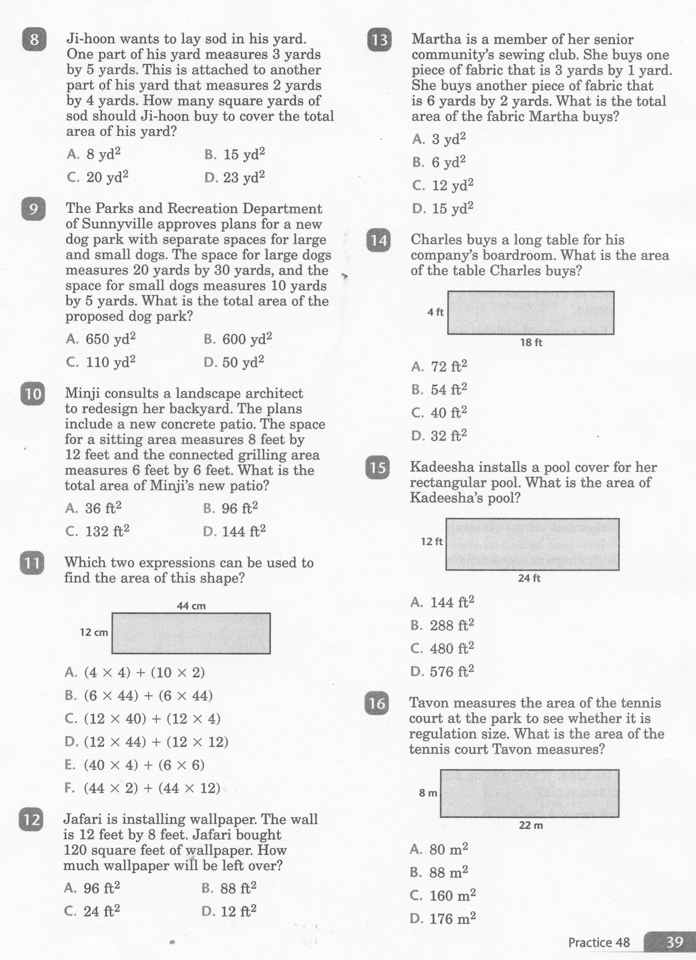
Math-E - Practice 48 – Decompose Area

Slide 7
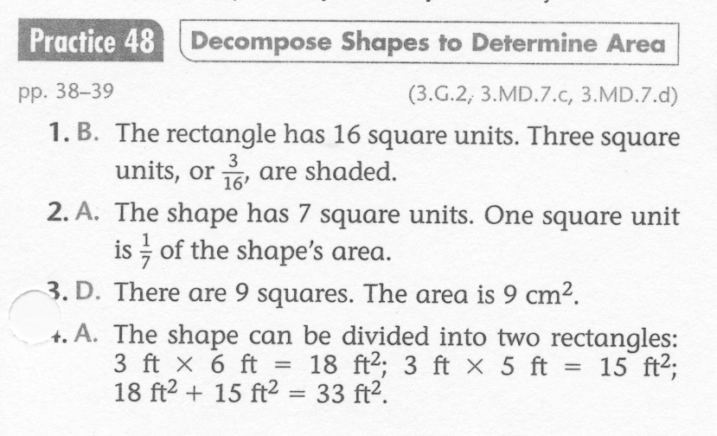
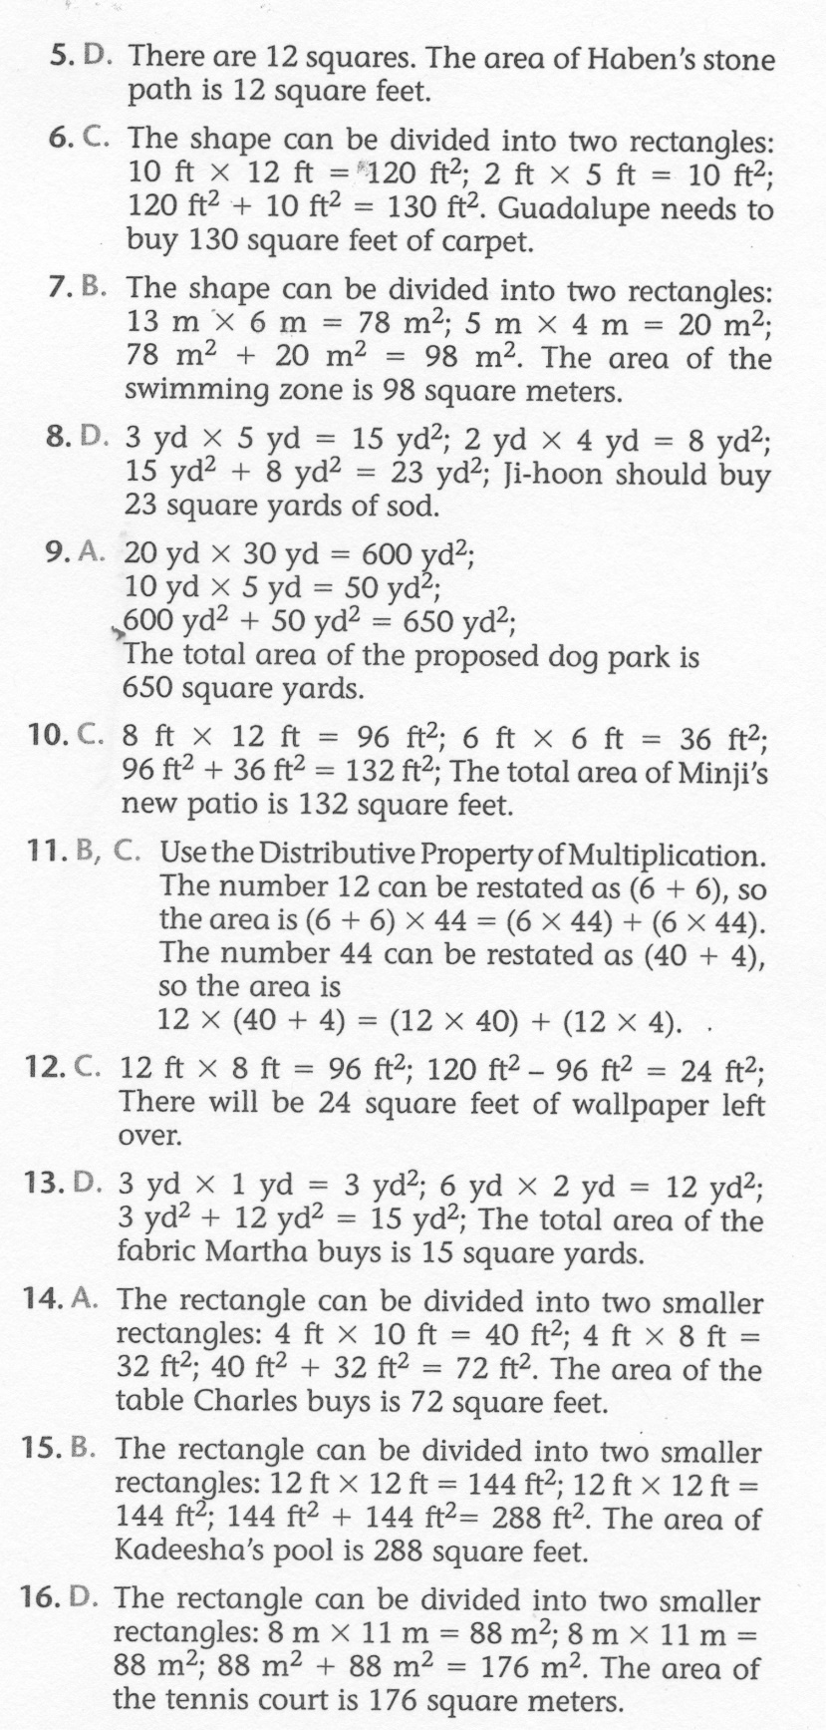
Math-E - Practice 48 – Decompose Area

