Slide 1
TABE Math-E PAXEN Unit-6 Geometry Lesson 44 3 Dimensional Shapes
Revised: November 4, 2023
Nolan Tomboulian
Some graphics may not have copied well during the scan process.

Slide 2
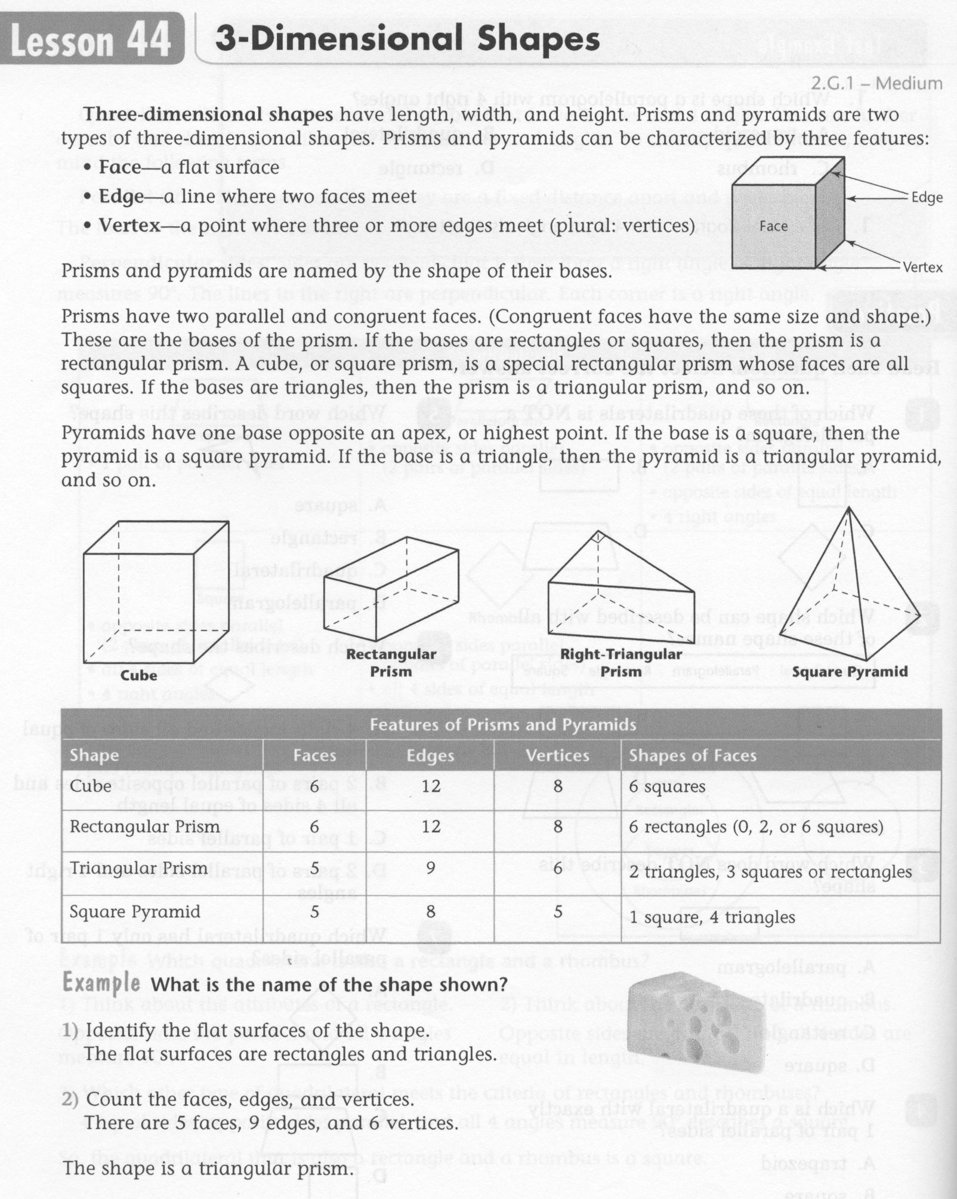
Math-E - Lesson 44 – 3-Dimensional

Slide 3
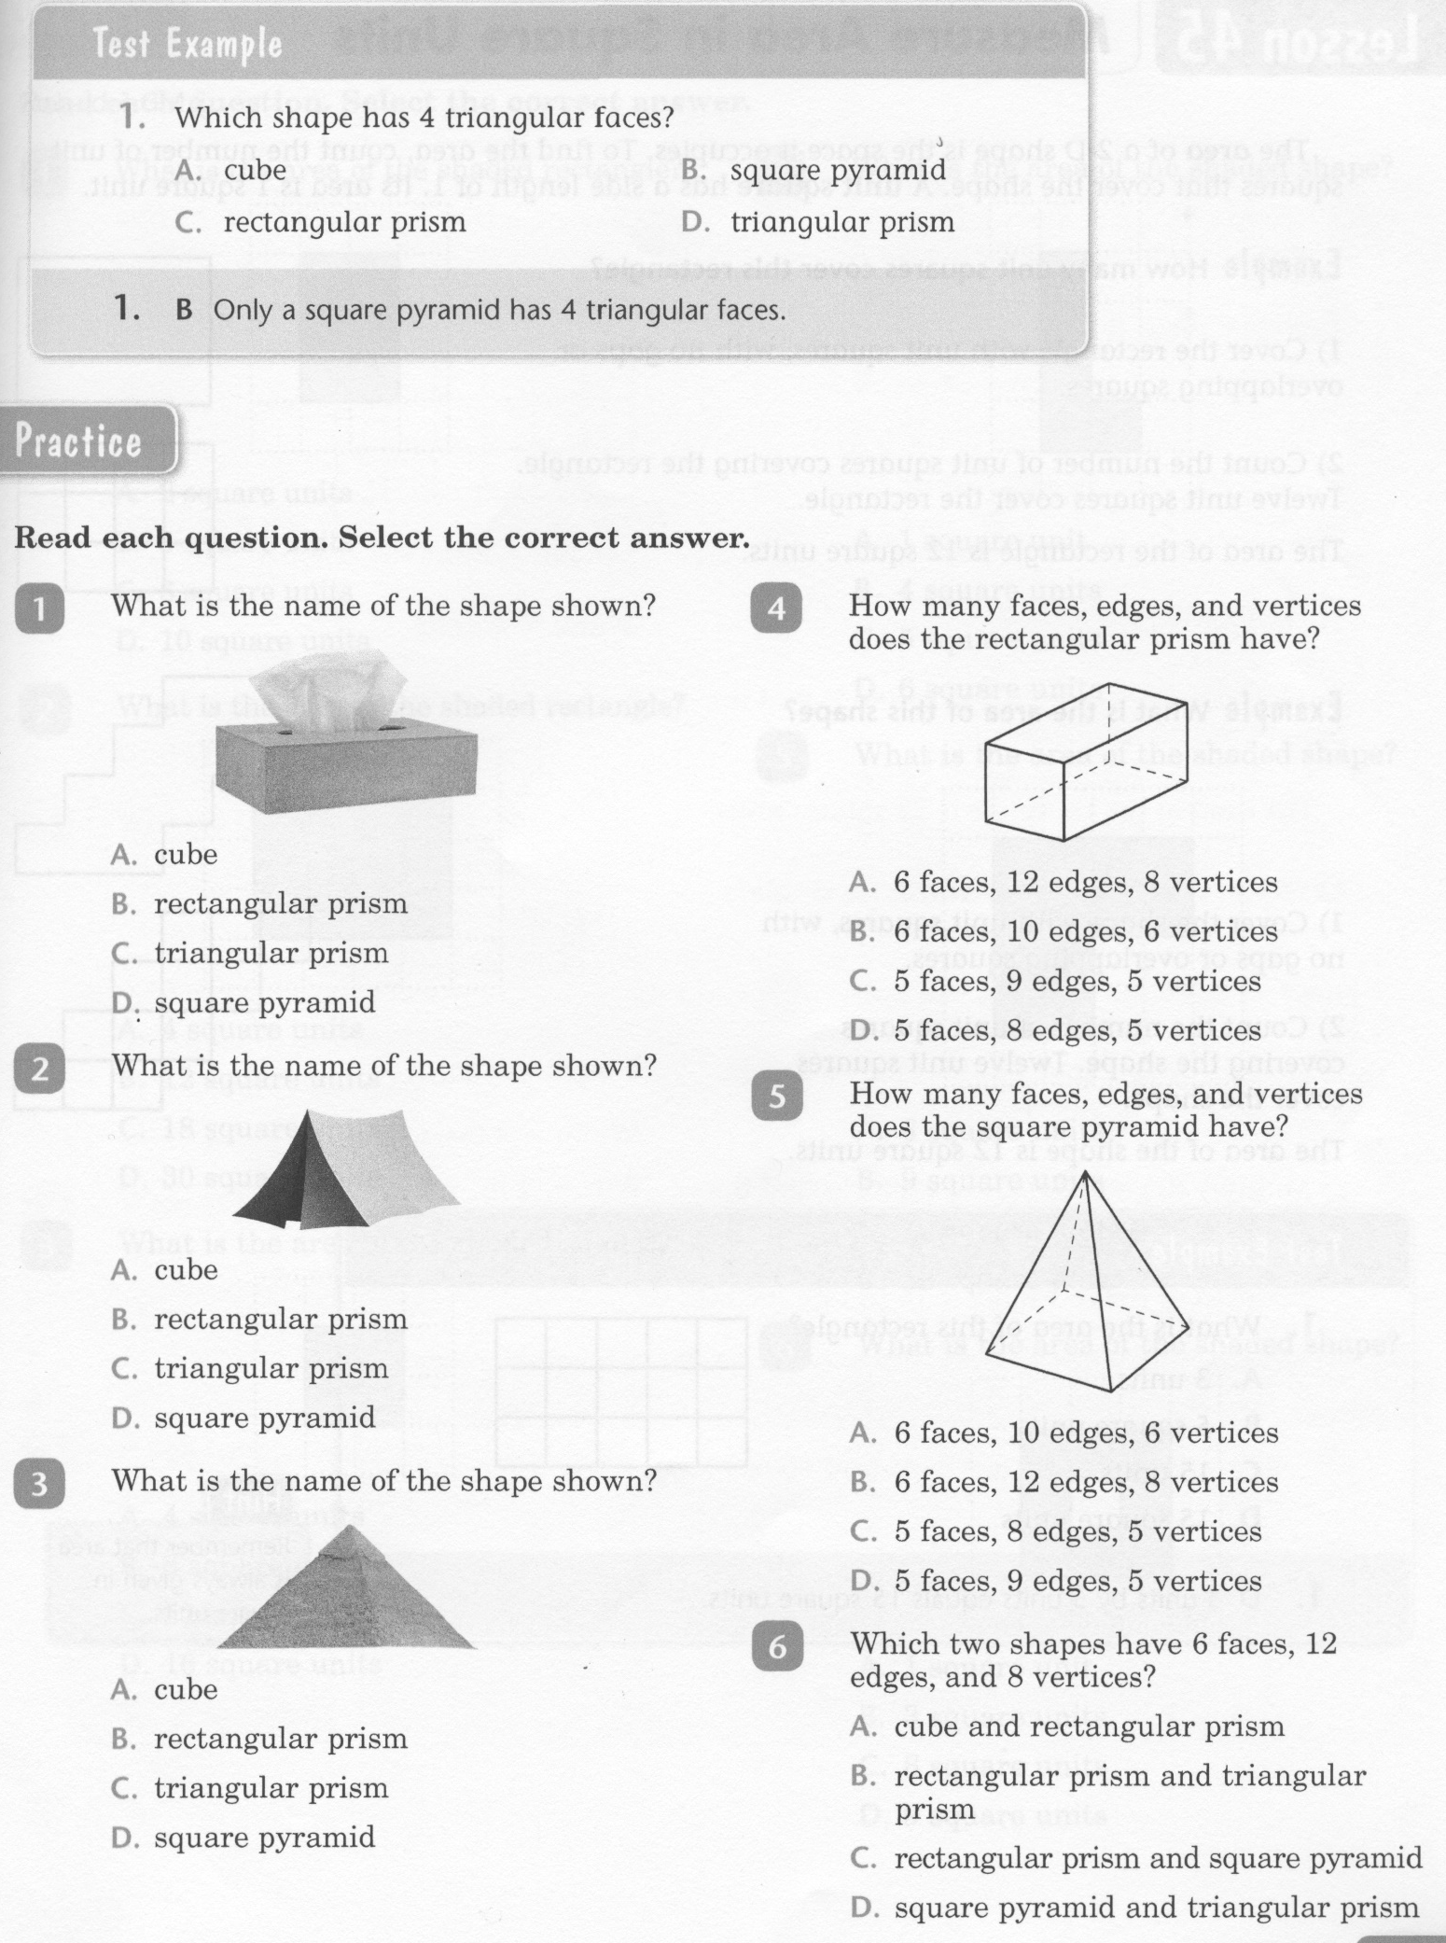
Math-E - Lesson 44 – 3-Dimensional

Slide 4
Math-E - Lesson 44 – 3-Dimensional

Slide 5
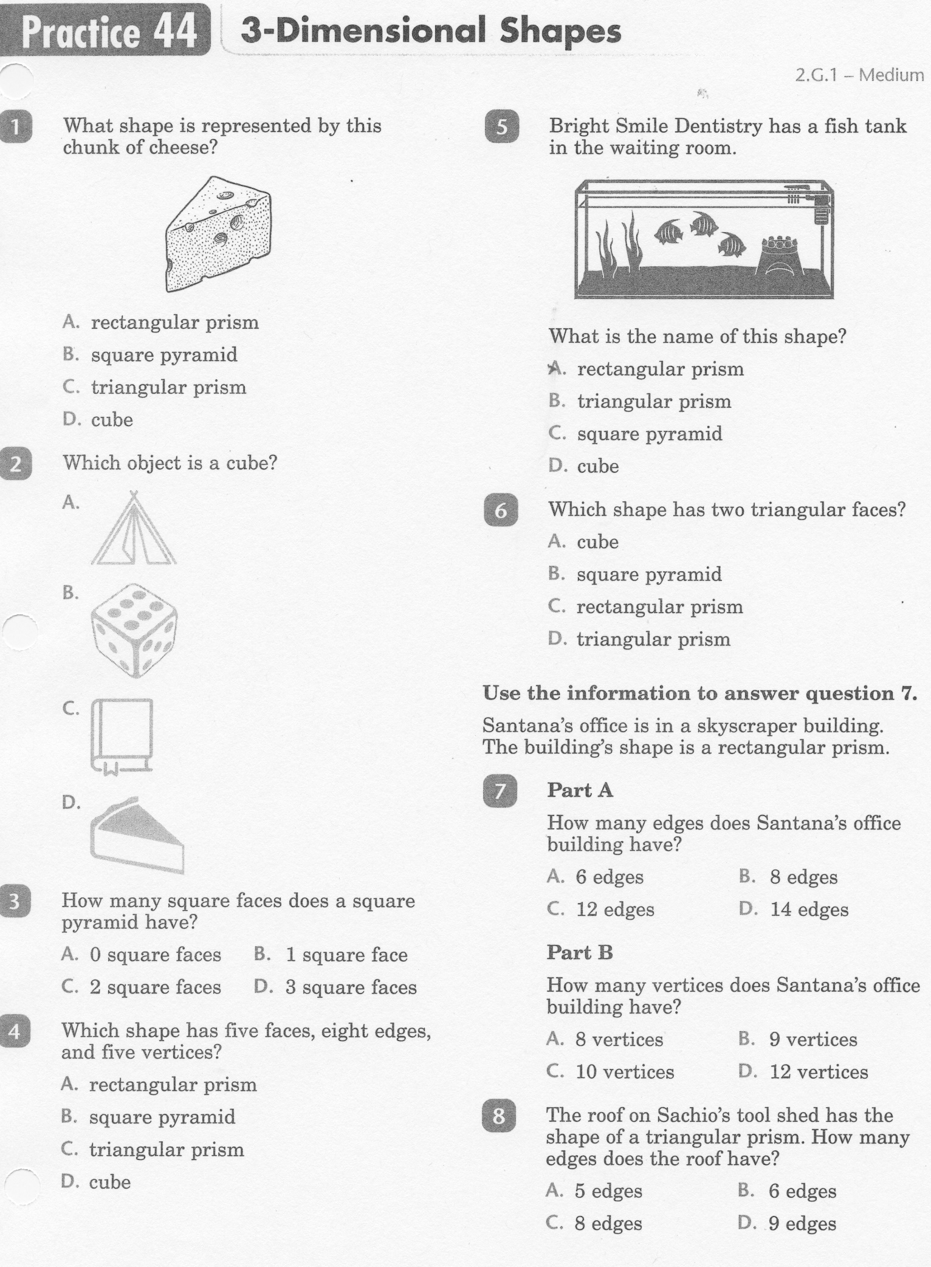
Math-E - Practice 44 – 3-Dimensional

Slide 6
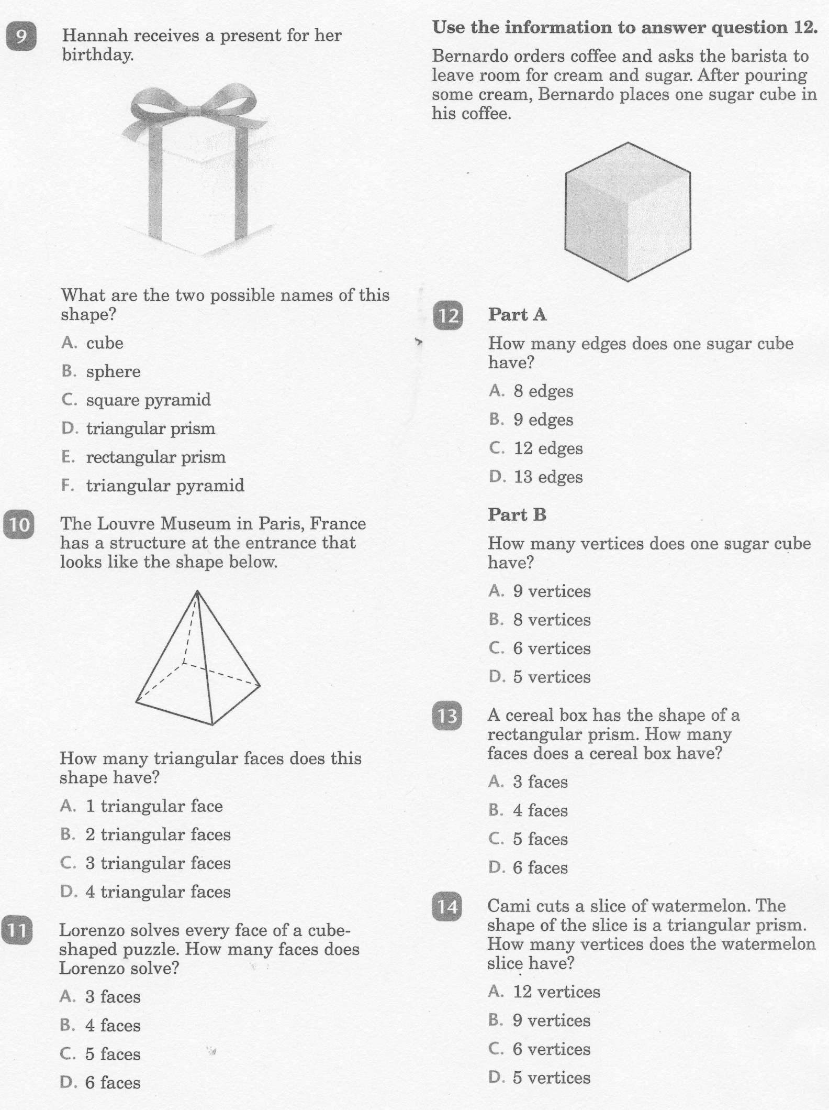
Math-E - Lesson 44 – 3-Dimensional

Slide 7
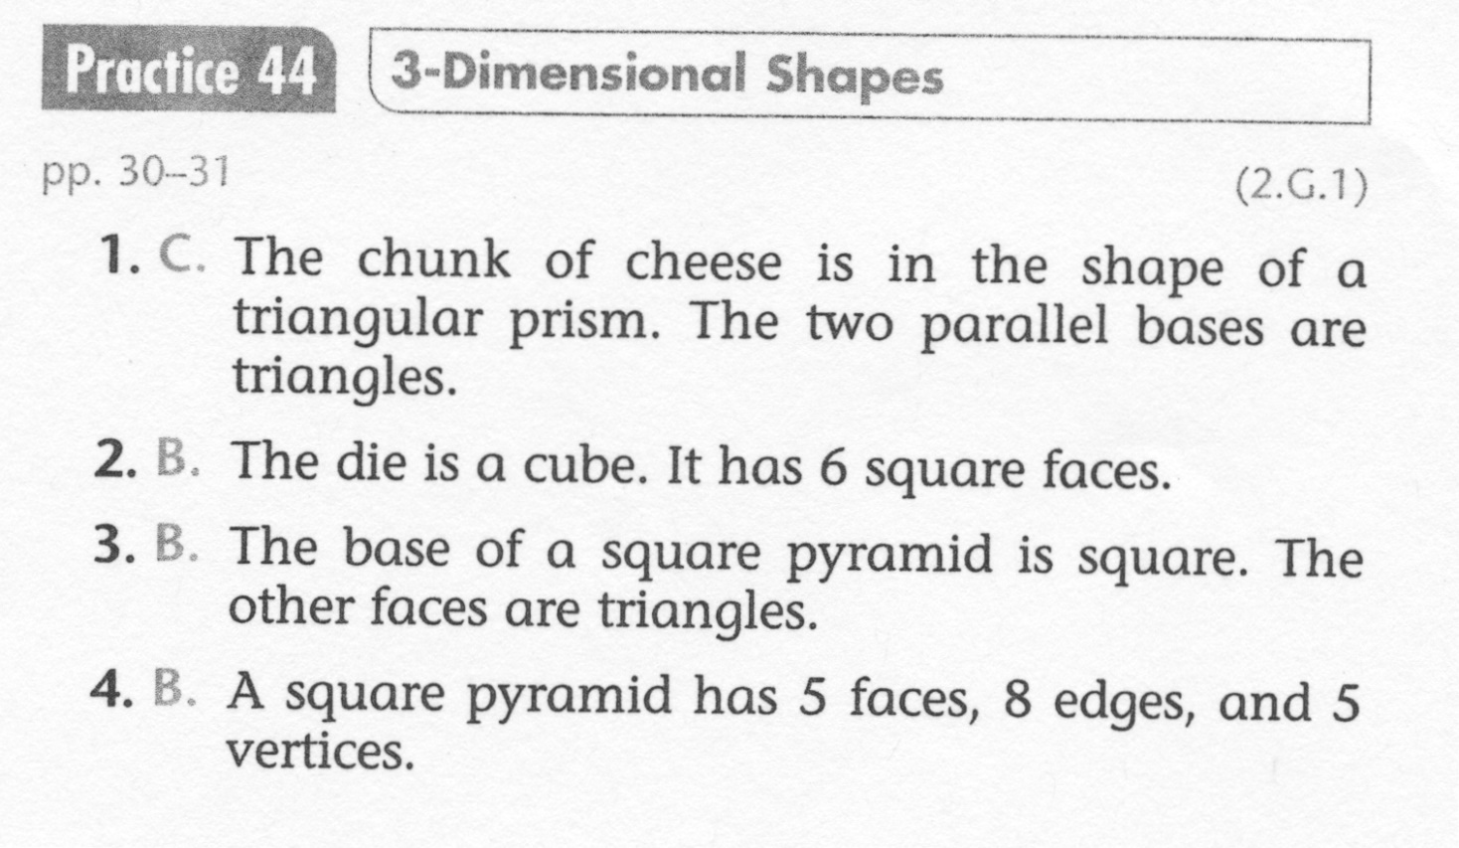
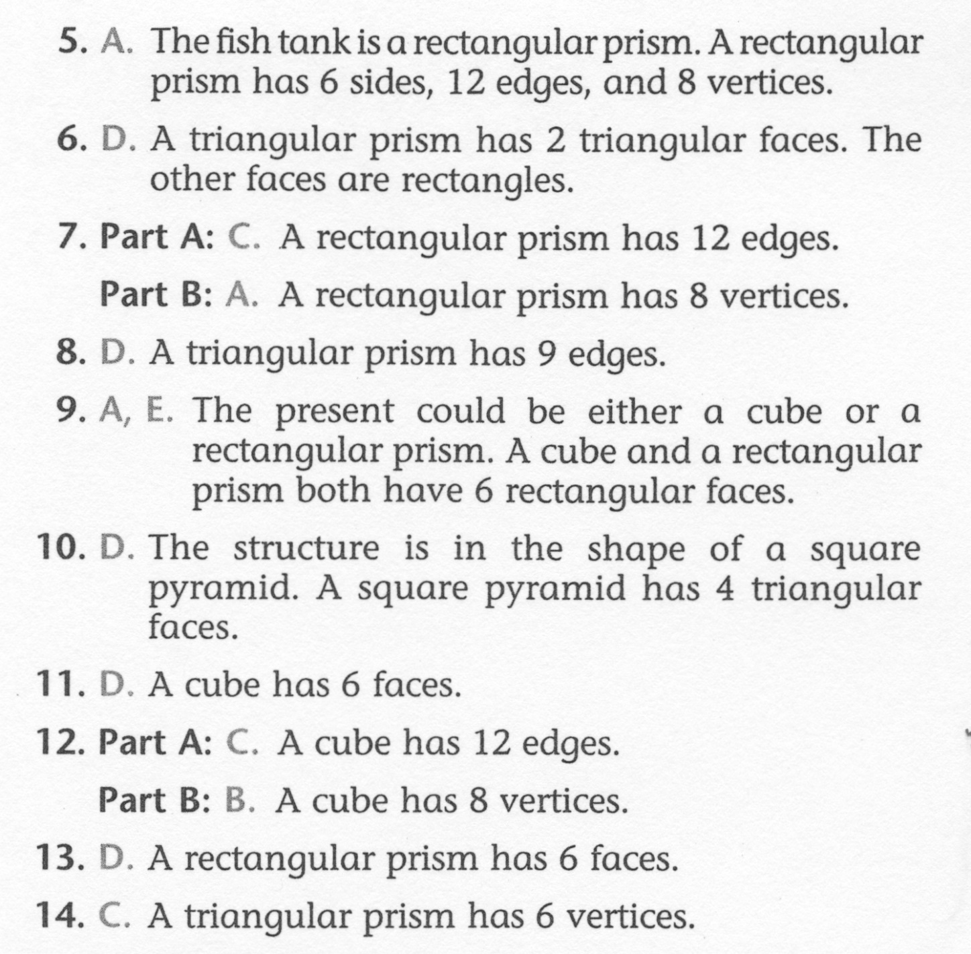
Math-E - Lesson 44 – 3-Dimensional

