Slide 1
TABE Math-E PAXEN Unit-5 Measurement and Data Lesson 36 LINE PLOTS
Revised: October 16, 2023
Nolan Tomboulian
Some graphics may not have copied well during the scan process.

Slide 2
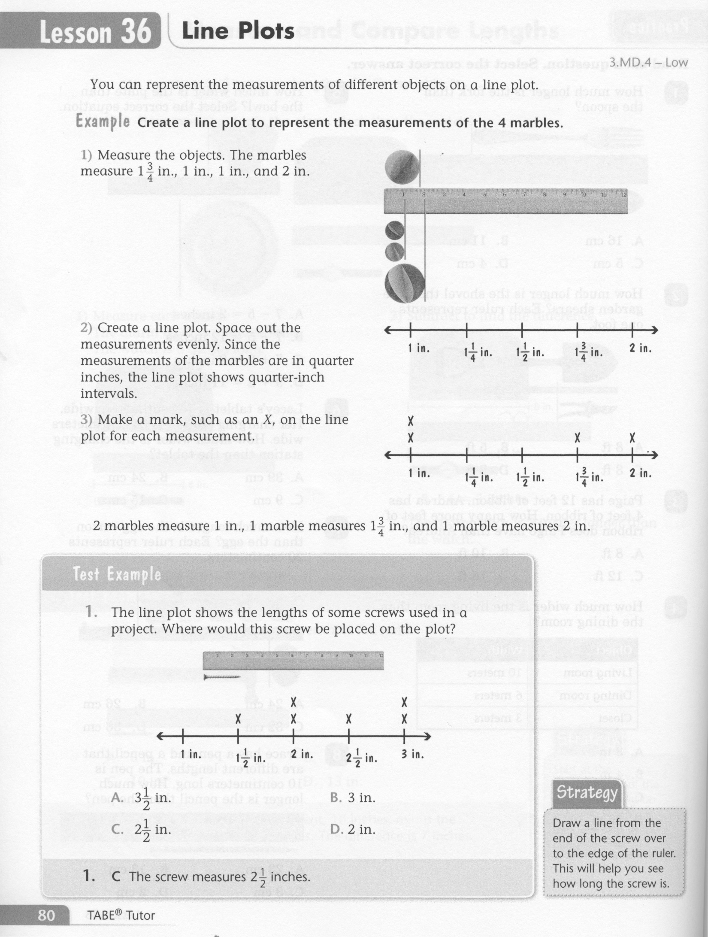
Math-E - Lesson 36 – Line Plots

Slide 3
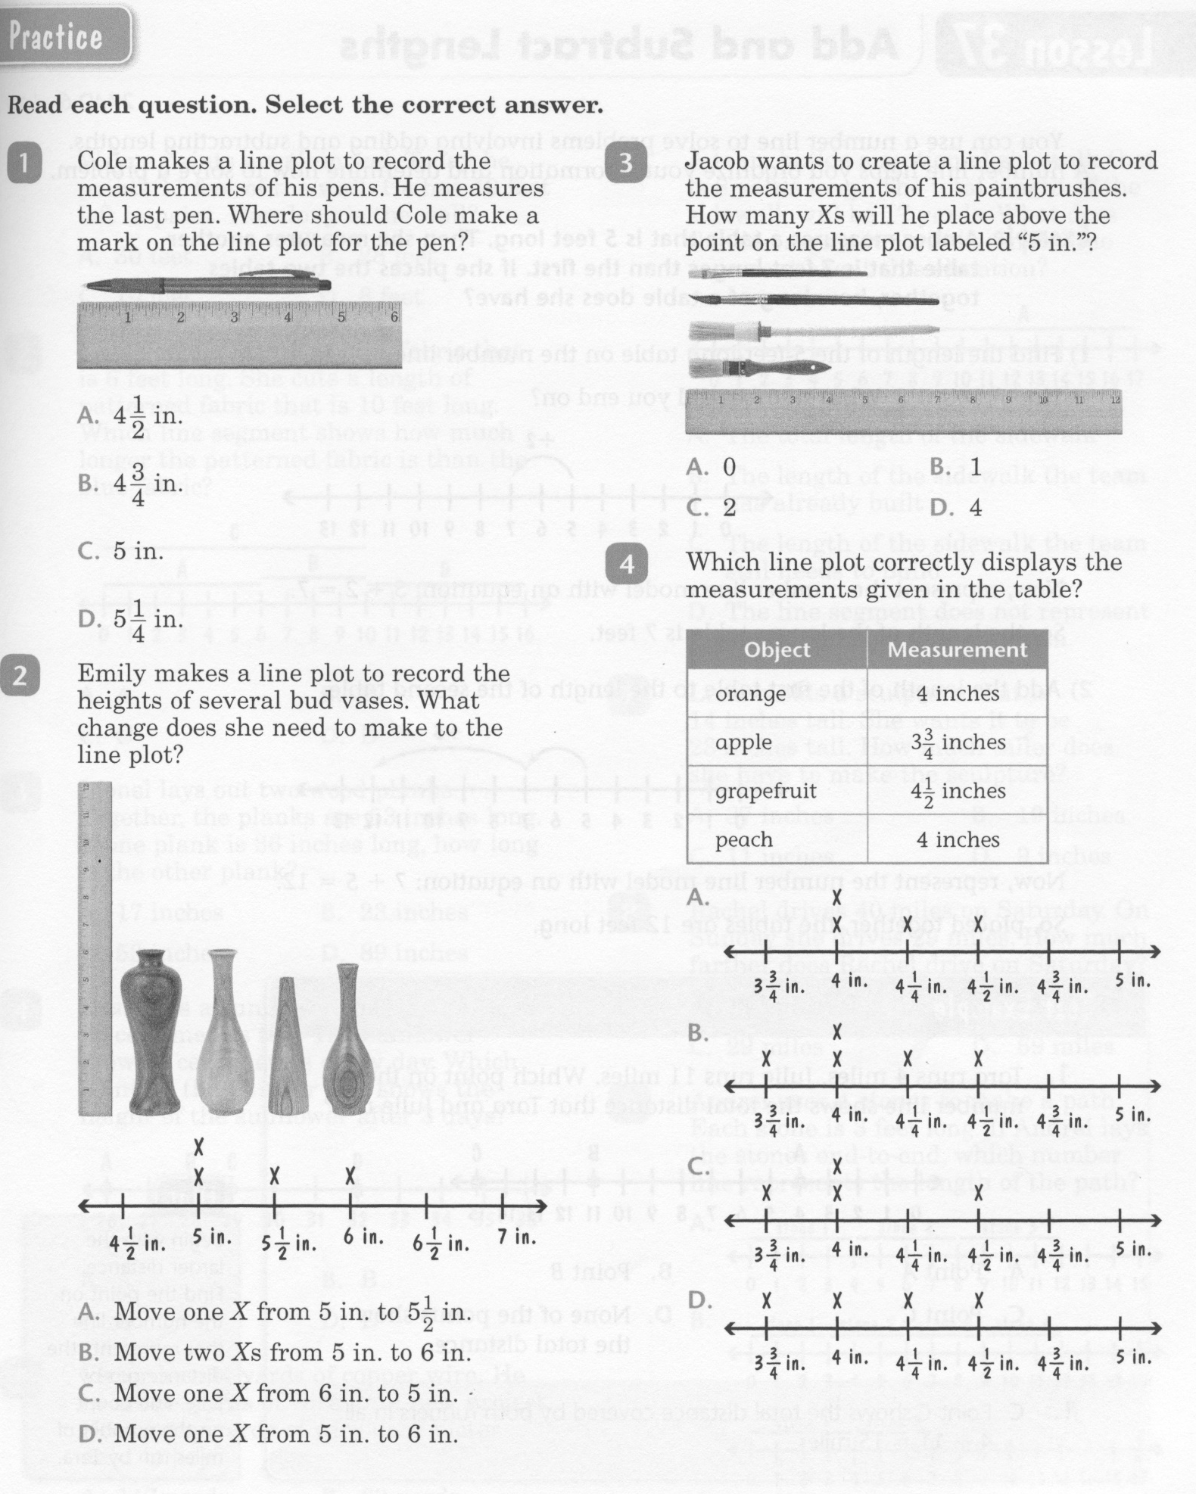
Math-E - Lesson 36 – Line Plots

Slide 4
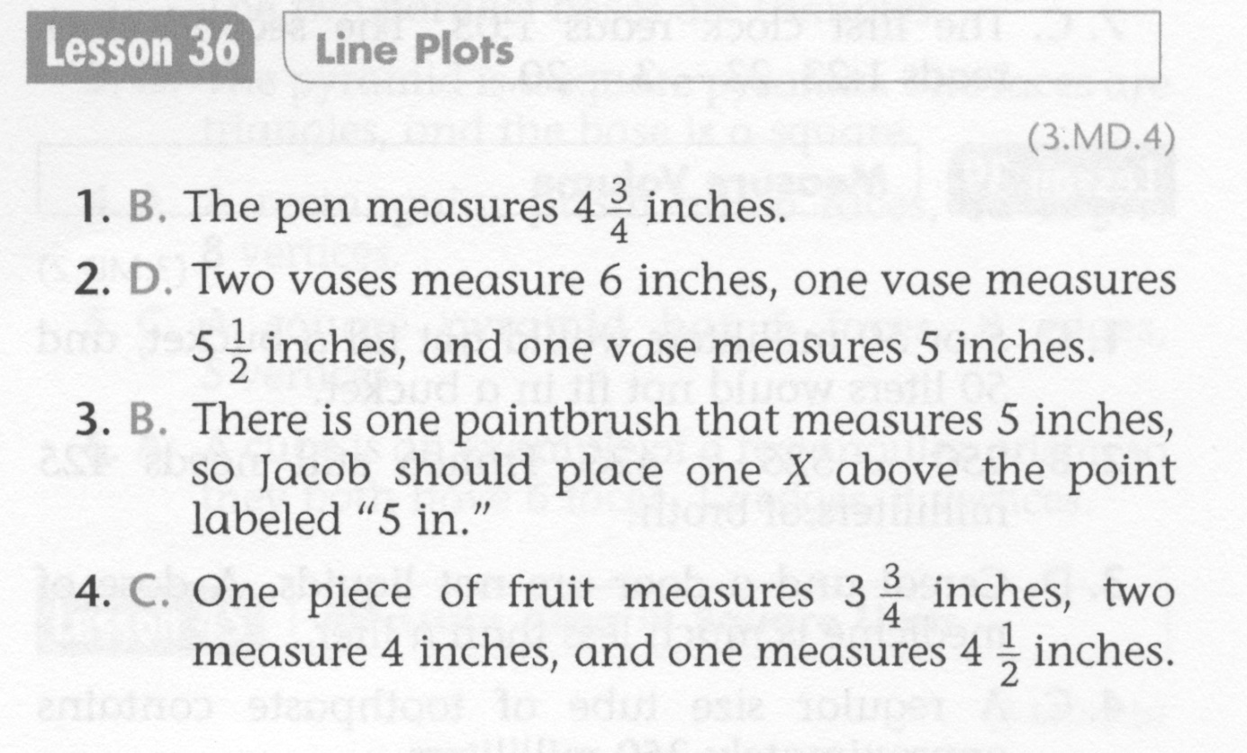
Math-E - Lesson 36 – Line Plots

Slide 5
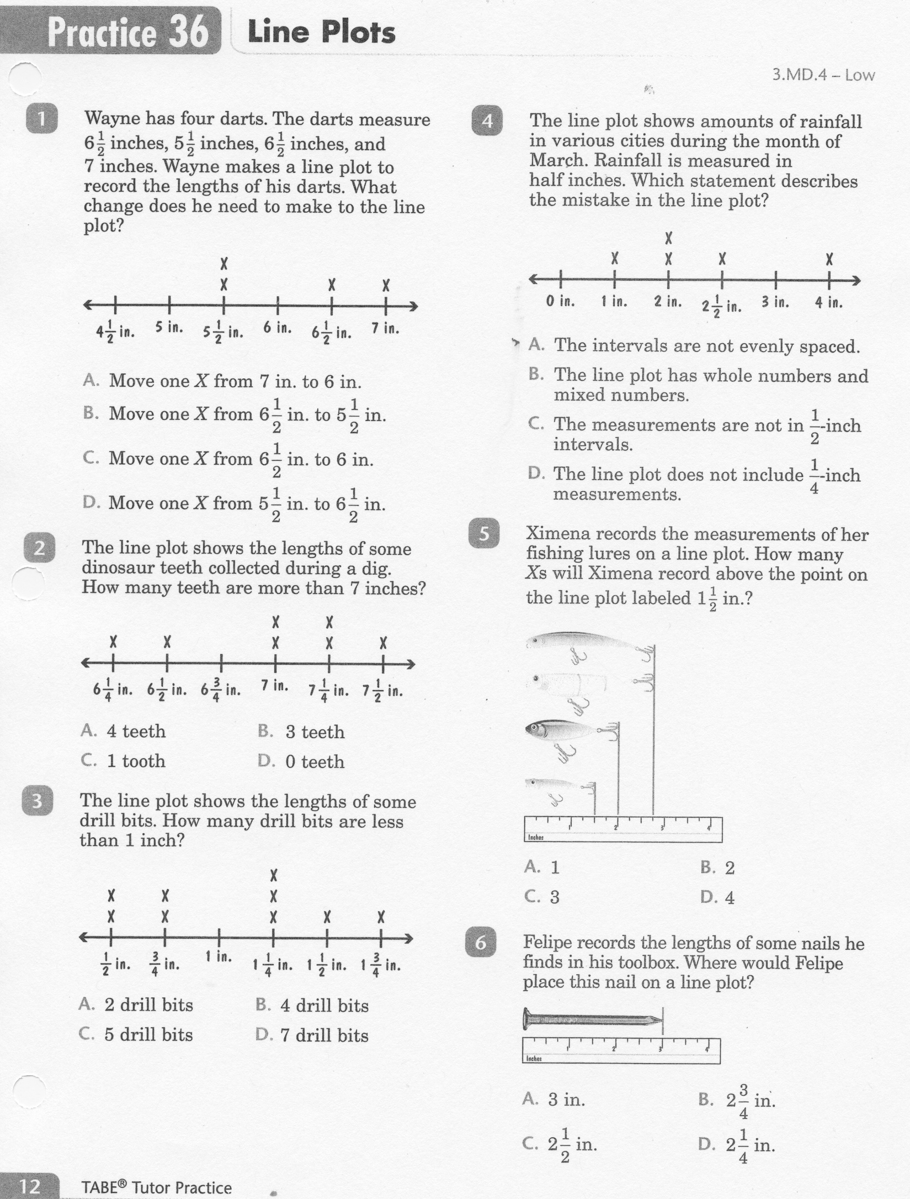
Math-E - Practice 36 – Line Plots

Slide 6
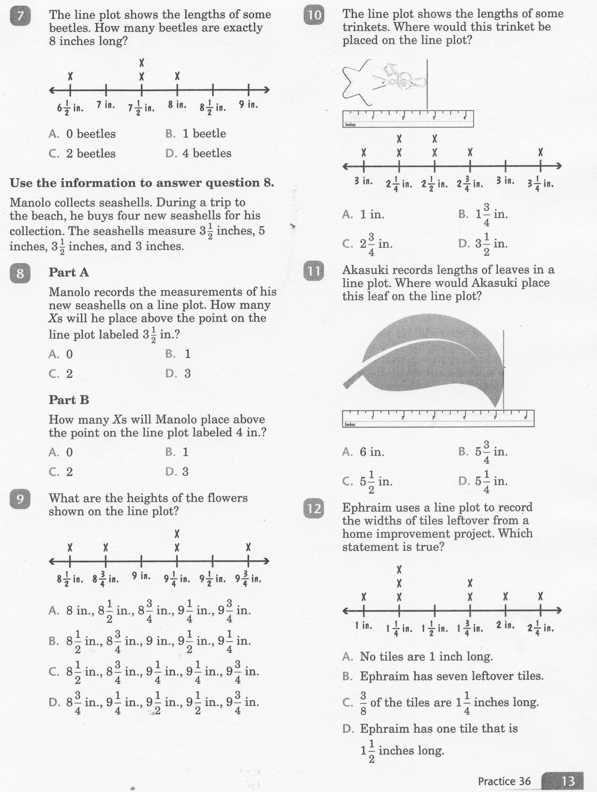
Math-E - Practice 36 – Line Plots

Slide 7
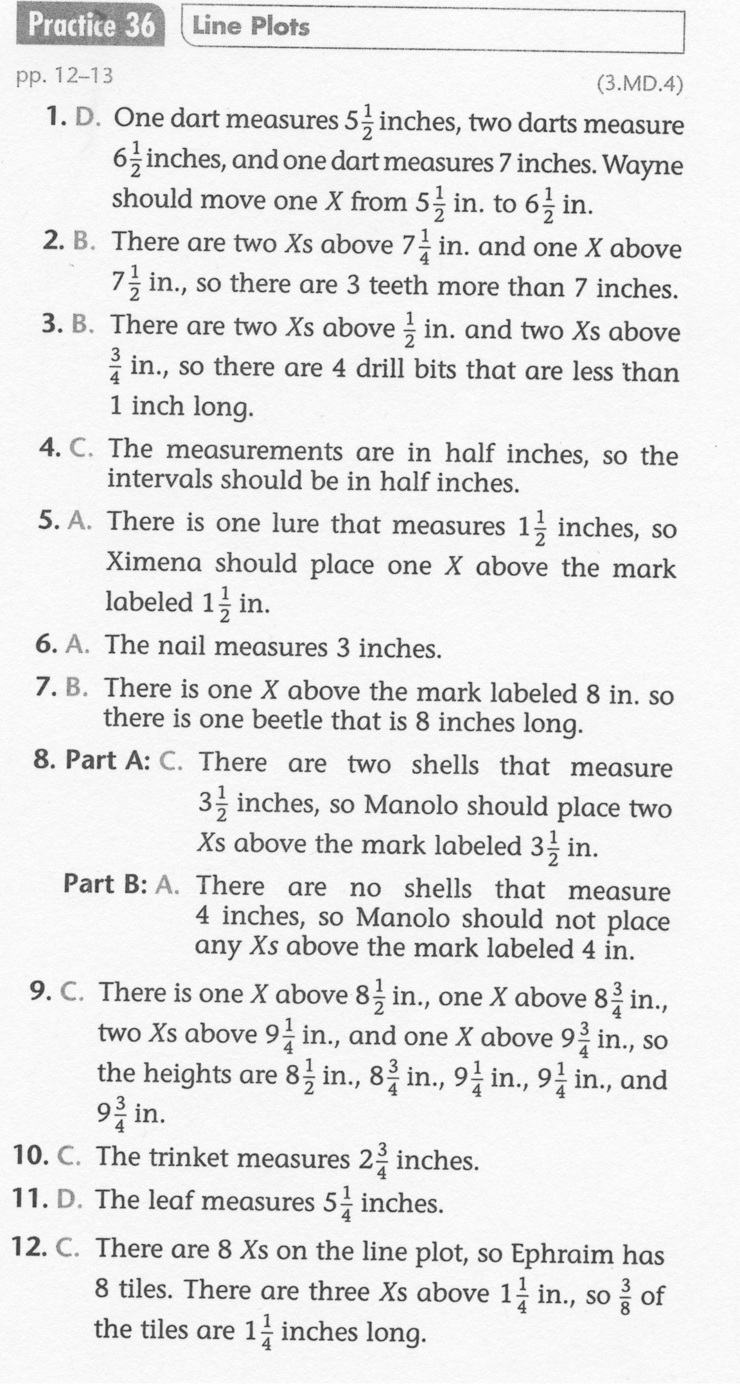
Math-E - Practice 36 – Line Plots

