Slide 1
TABE Math-E PAXEN Unit-5 Measurement and Data Lesson 31 Standard Units Feet and Inches
Revised: October 16, 2023
Nolan Tomboulian
Some graphics may not have copied well during the scan process.

Slide 2
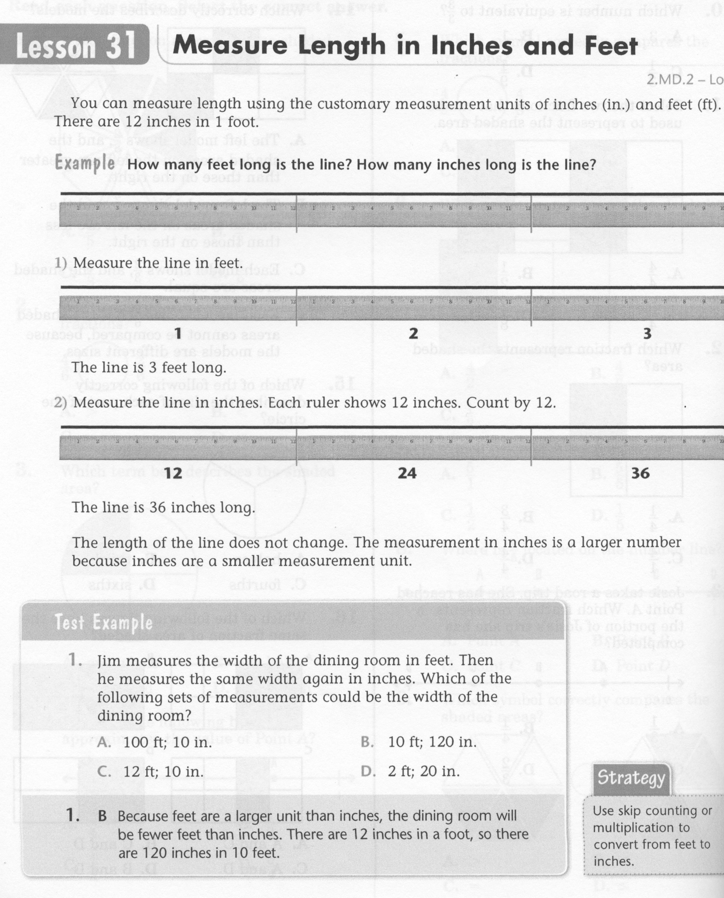
Math-E - Lesson 31 – Measurements

Slide 3
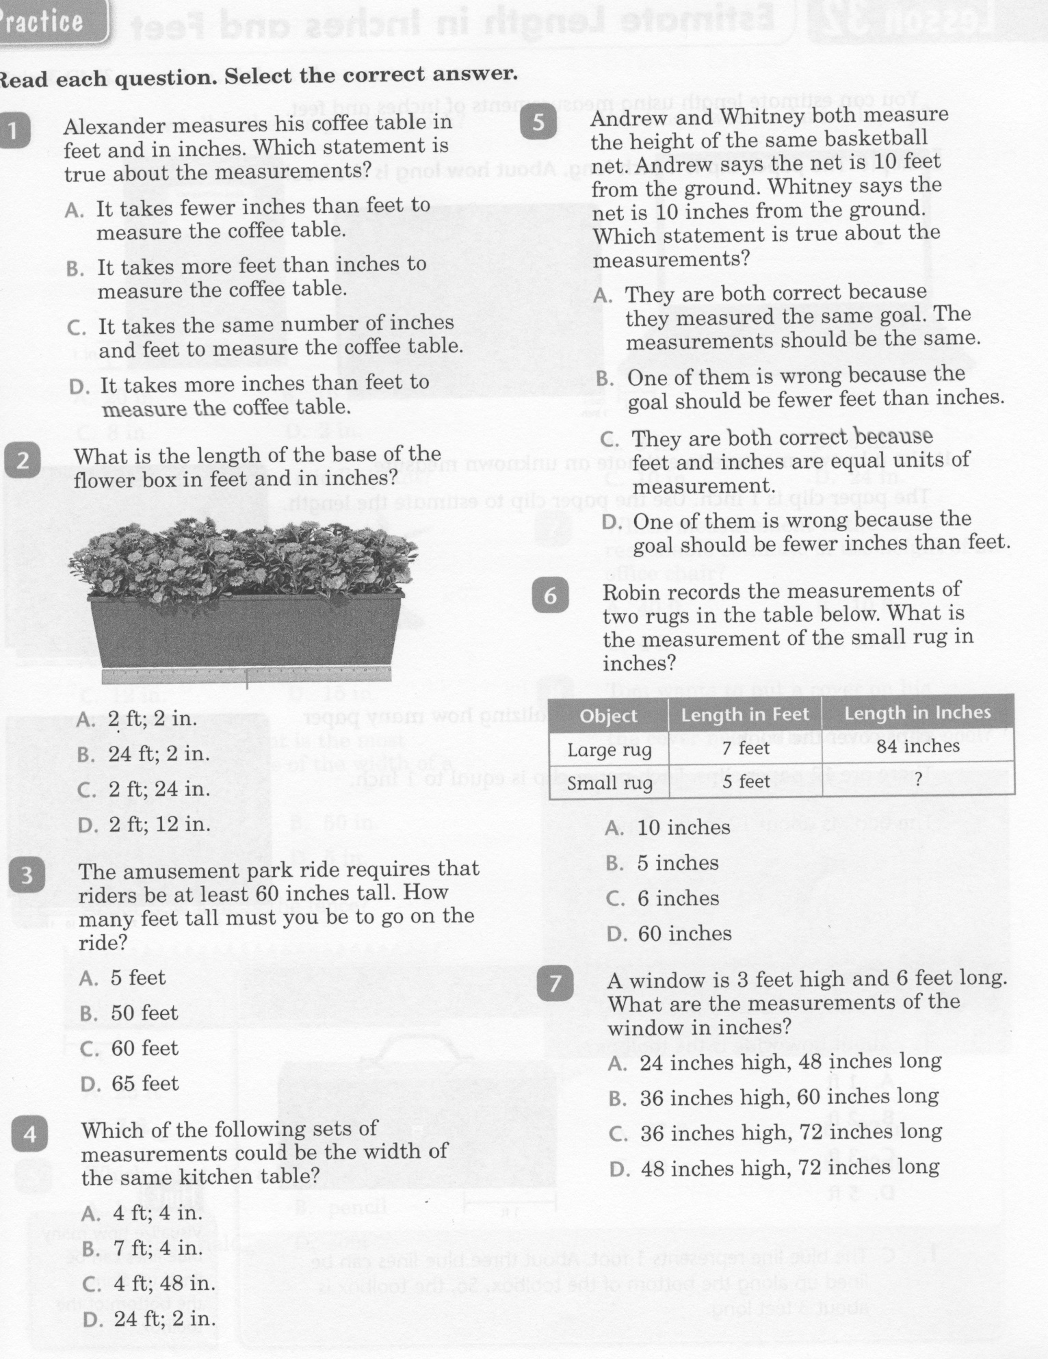
Math-E - Lesson 31 – Measurements

Slide 4
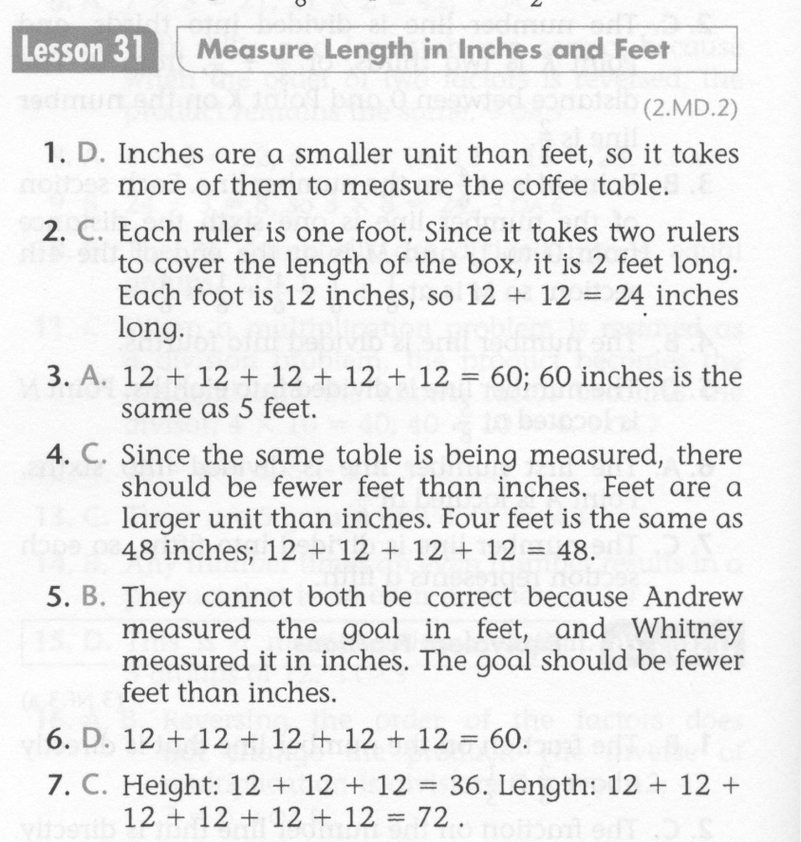
Math-E - Lesson 31 – Measurements

Slide 5
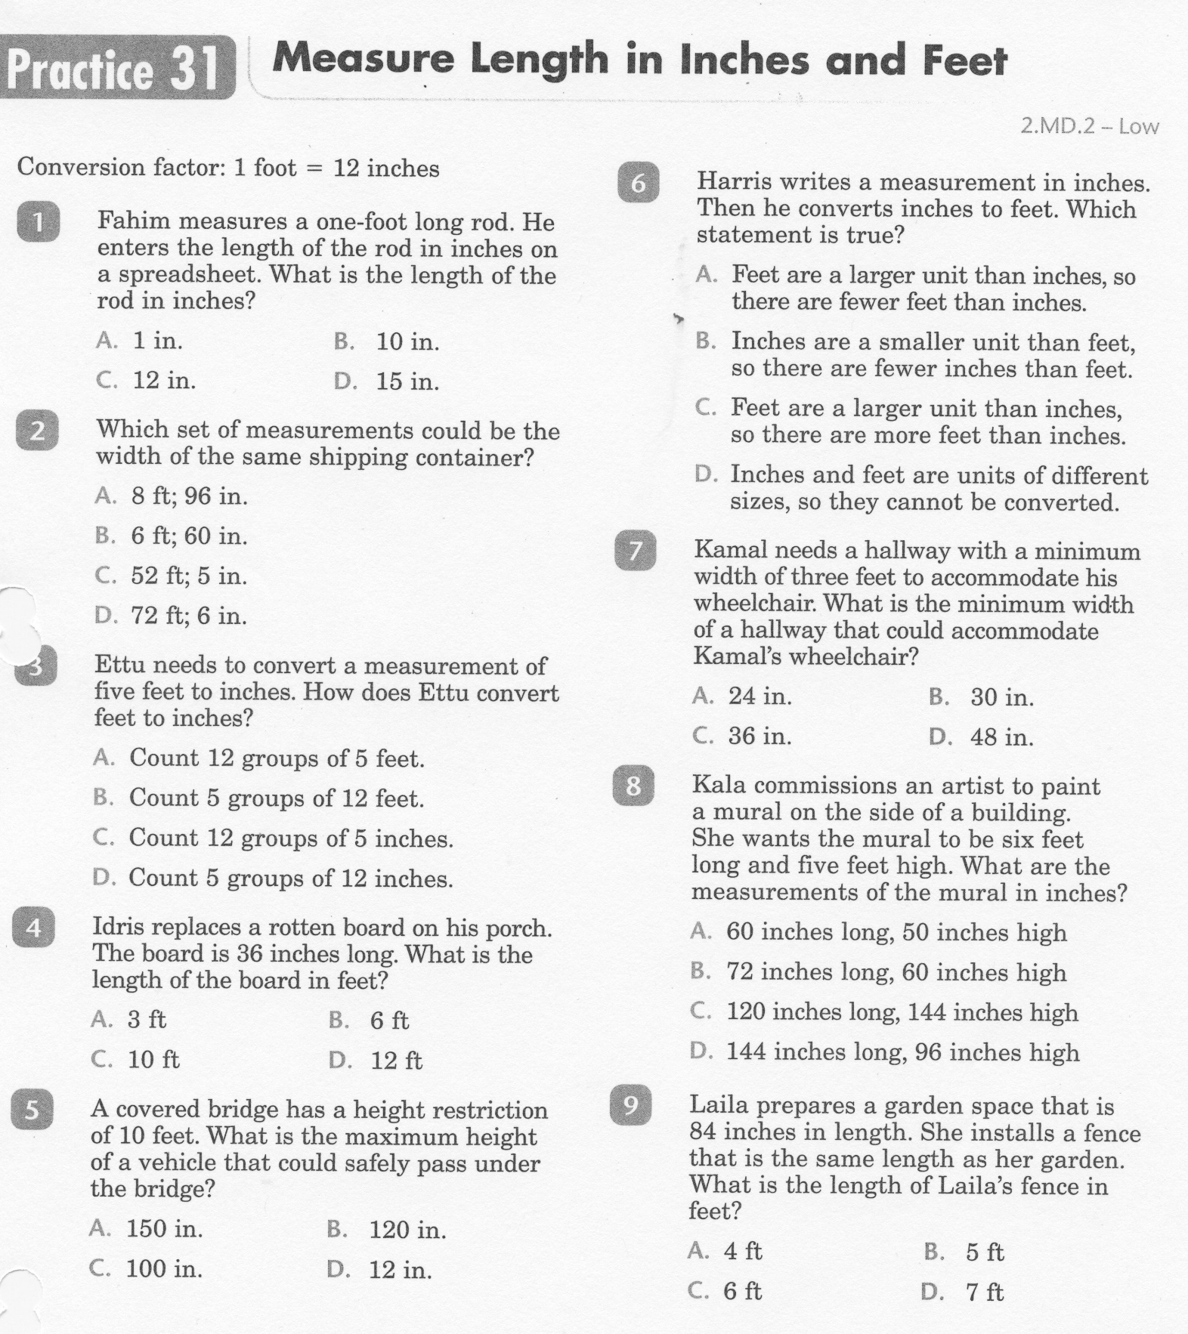
Math-E - Practice 31 – Measurements

Slide 6
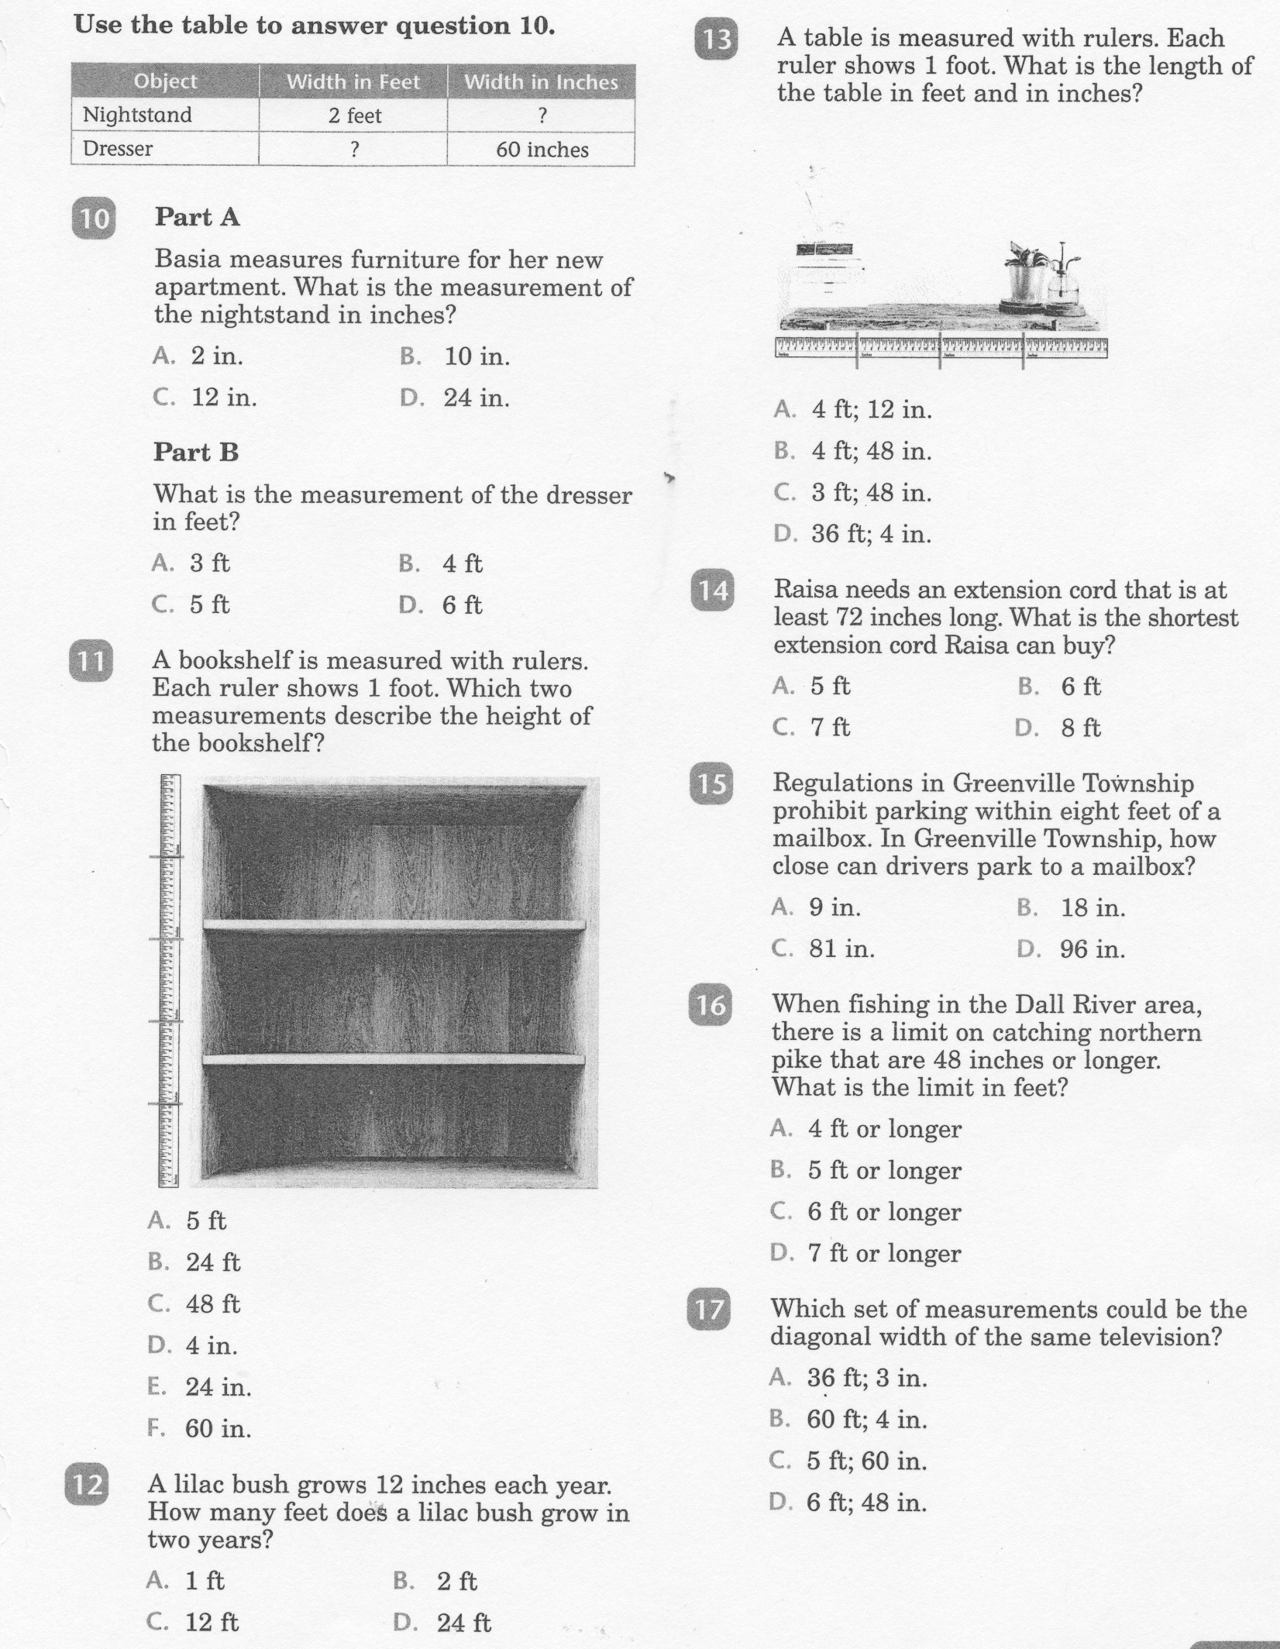
Math-E - Practice 31 – Measurements

Slide 7
Math-E - Practice 31 – Measurements

