Slide 1
TABE Math-E PAXEN Unit-4 Fractions Lesson 28 Fractions to a Whole
Revised: October 16, 2023
Nolan Tomboulian
Some graphics may not have copied well during the scan process.

Slide 2
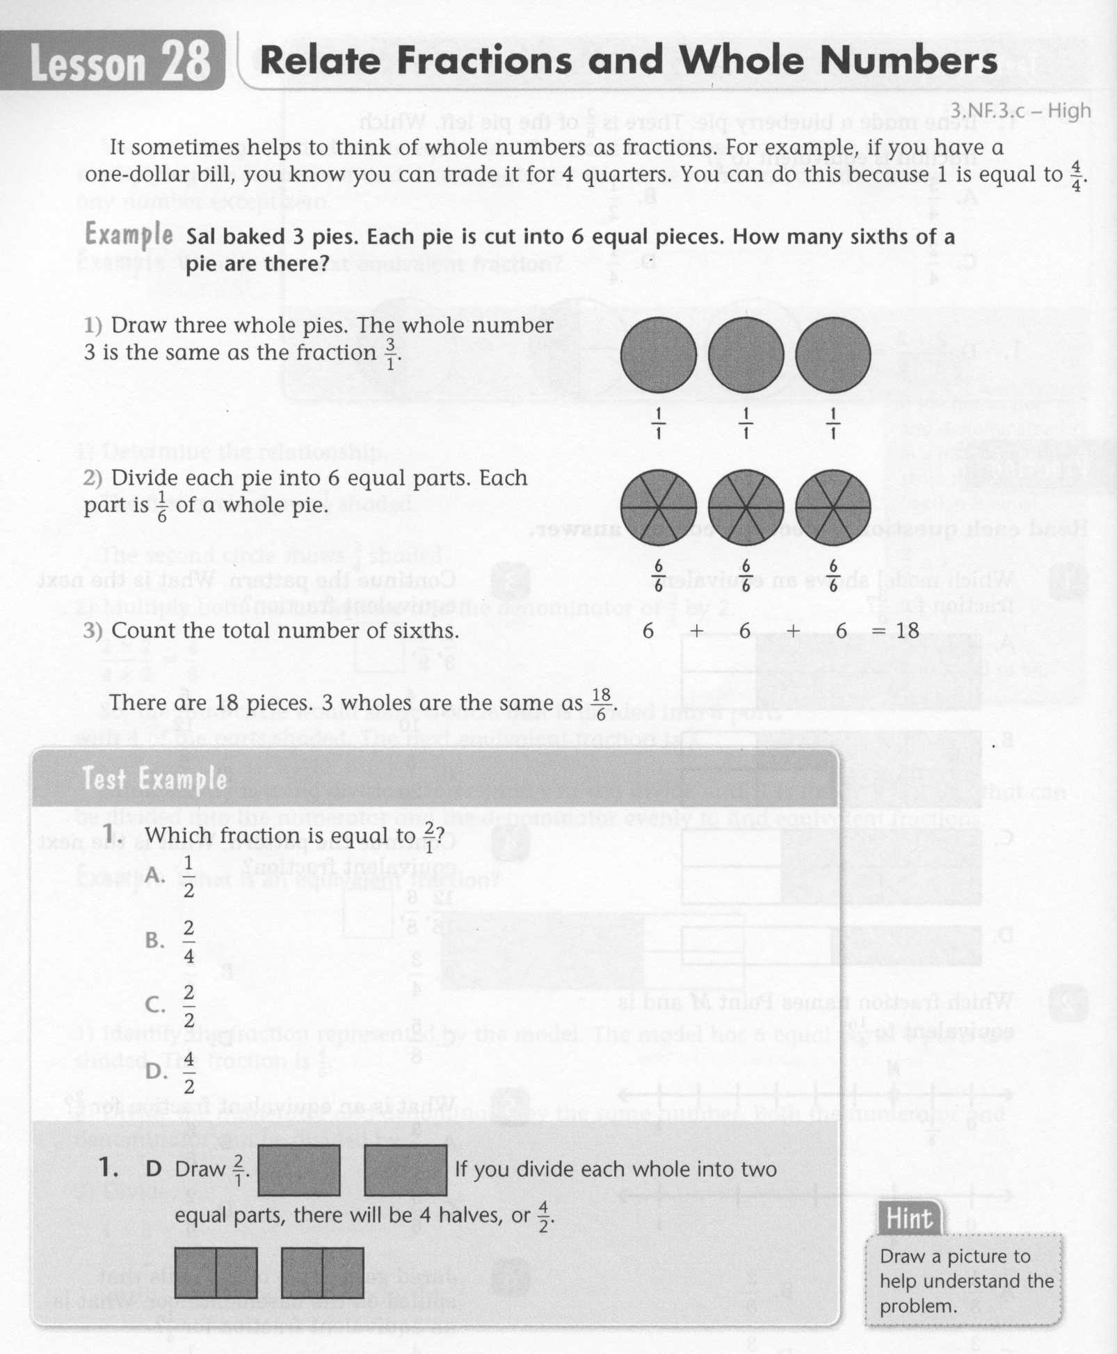
Math-E - Lesson 28 – Fractions to a Whole

Slide 3
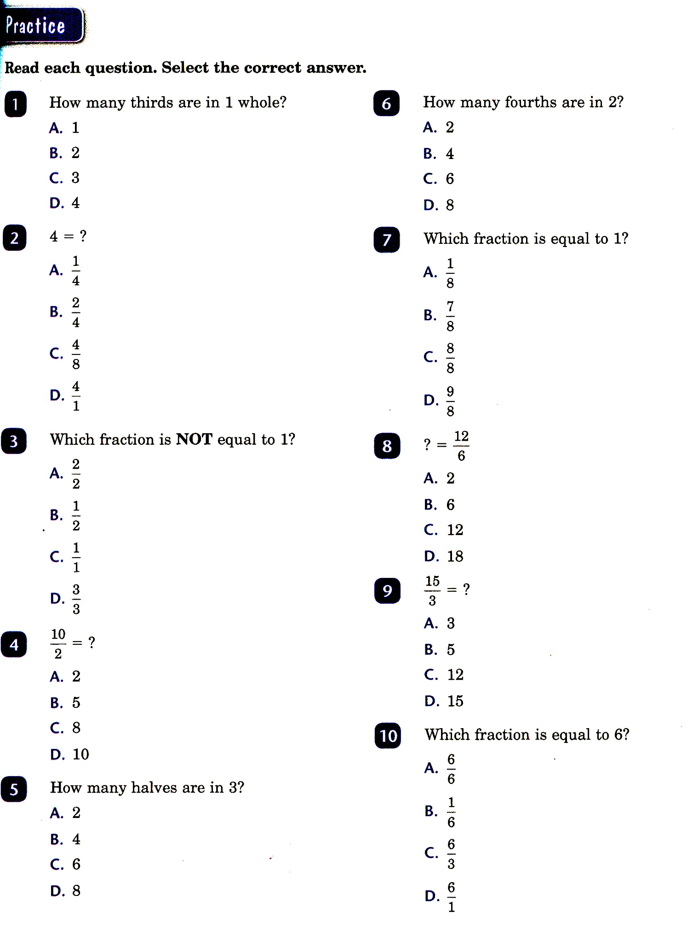
Math-E - Lesson 28 – Fractions to a Whole

Slide 4
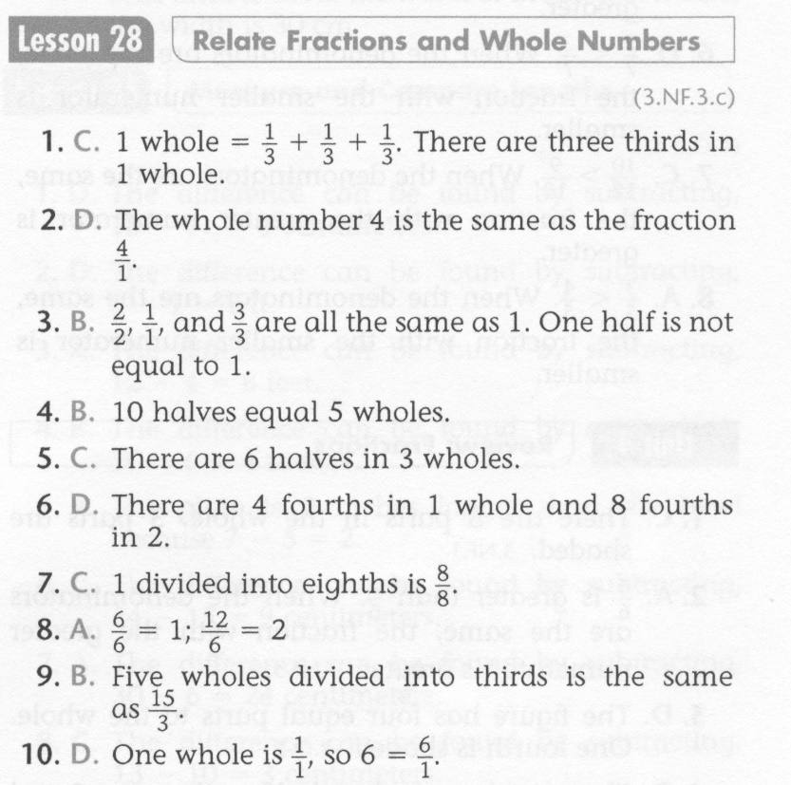
Math-E - Lesson 28 – Fractions to a Whole

Slide 5
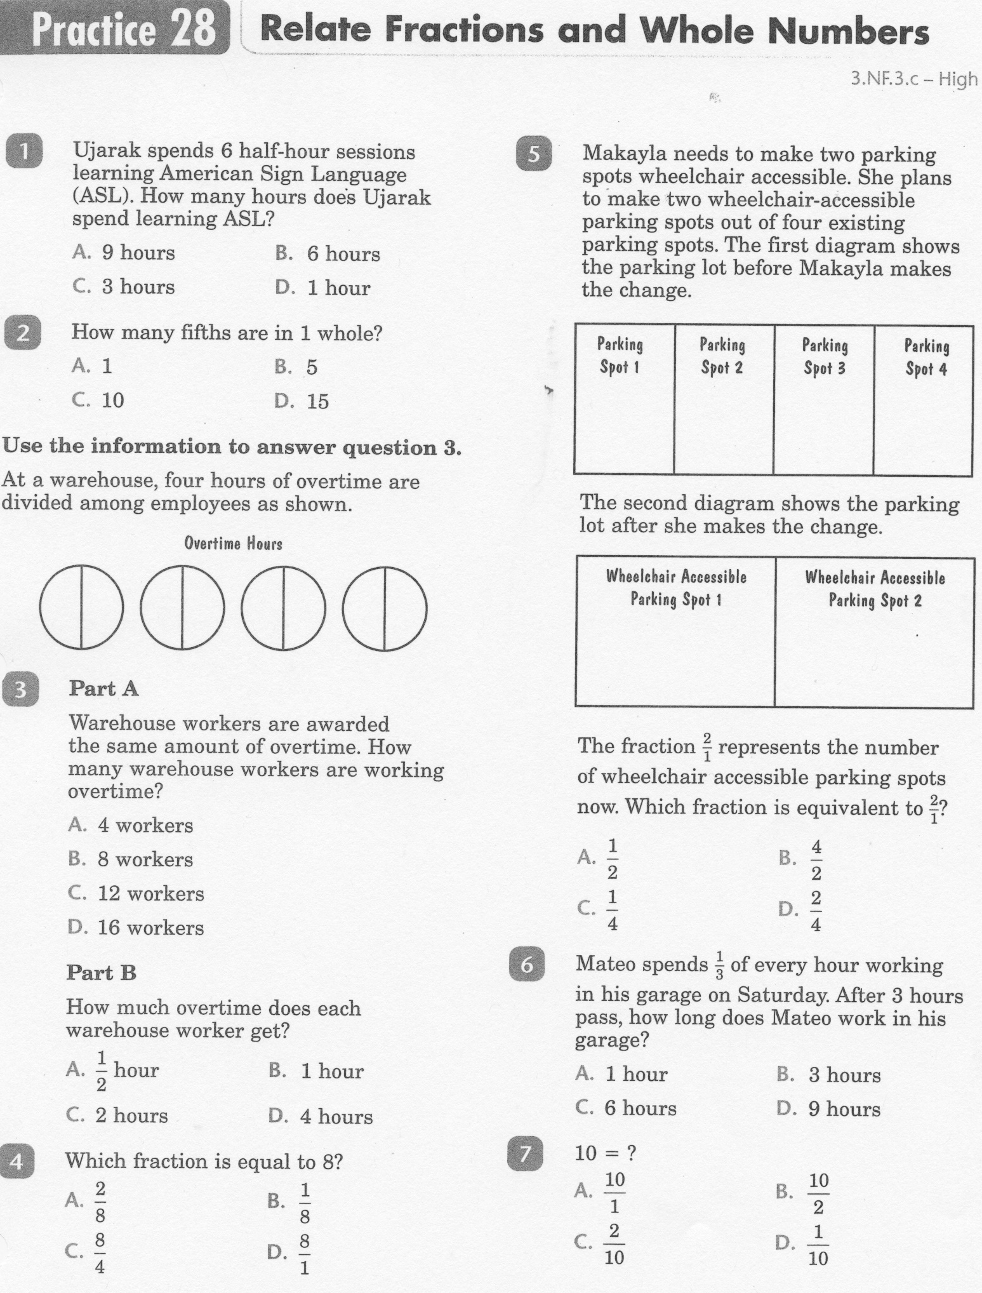
Math-E - Lesson 28 – Fractions to a Whole

Slide 6
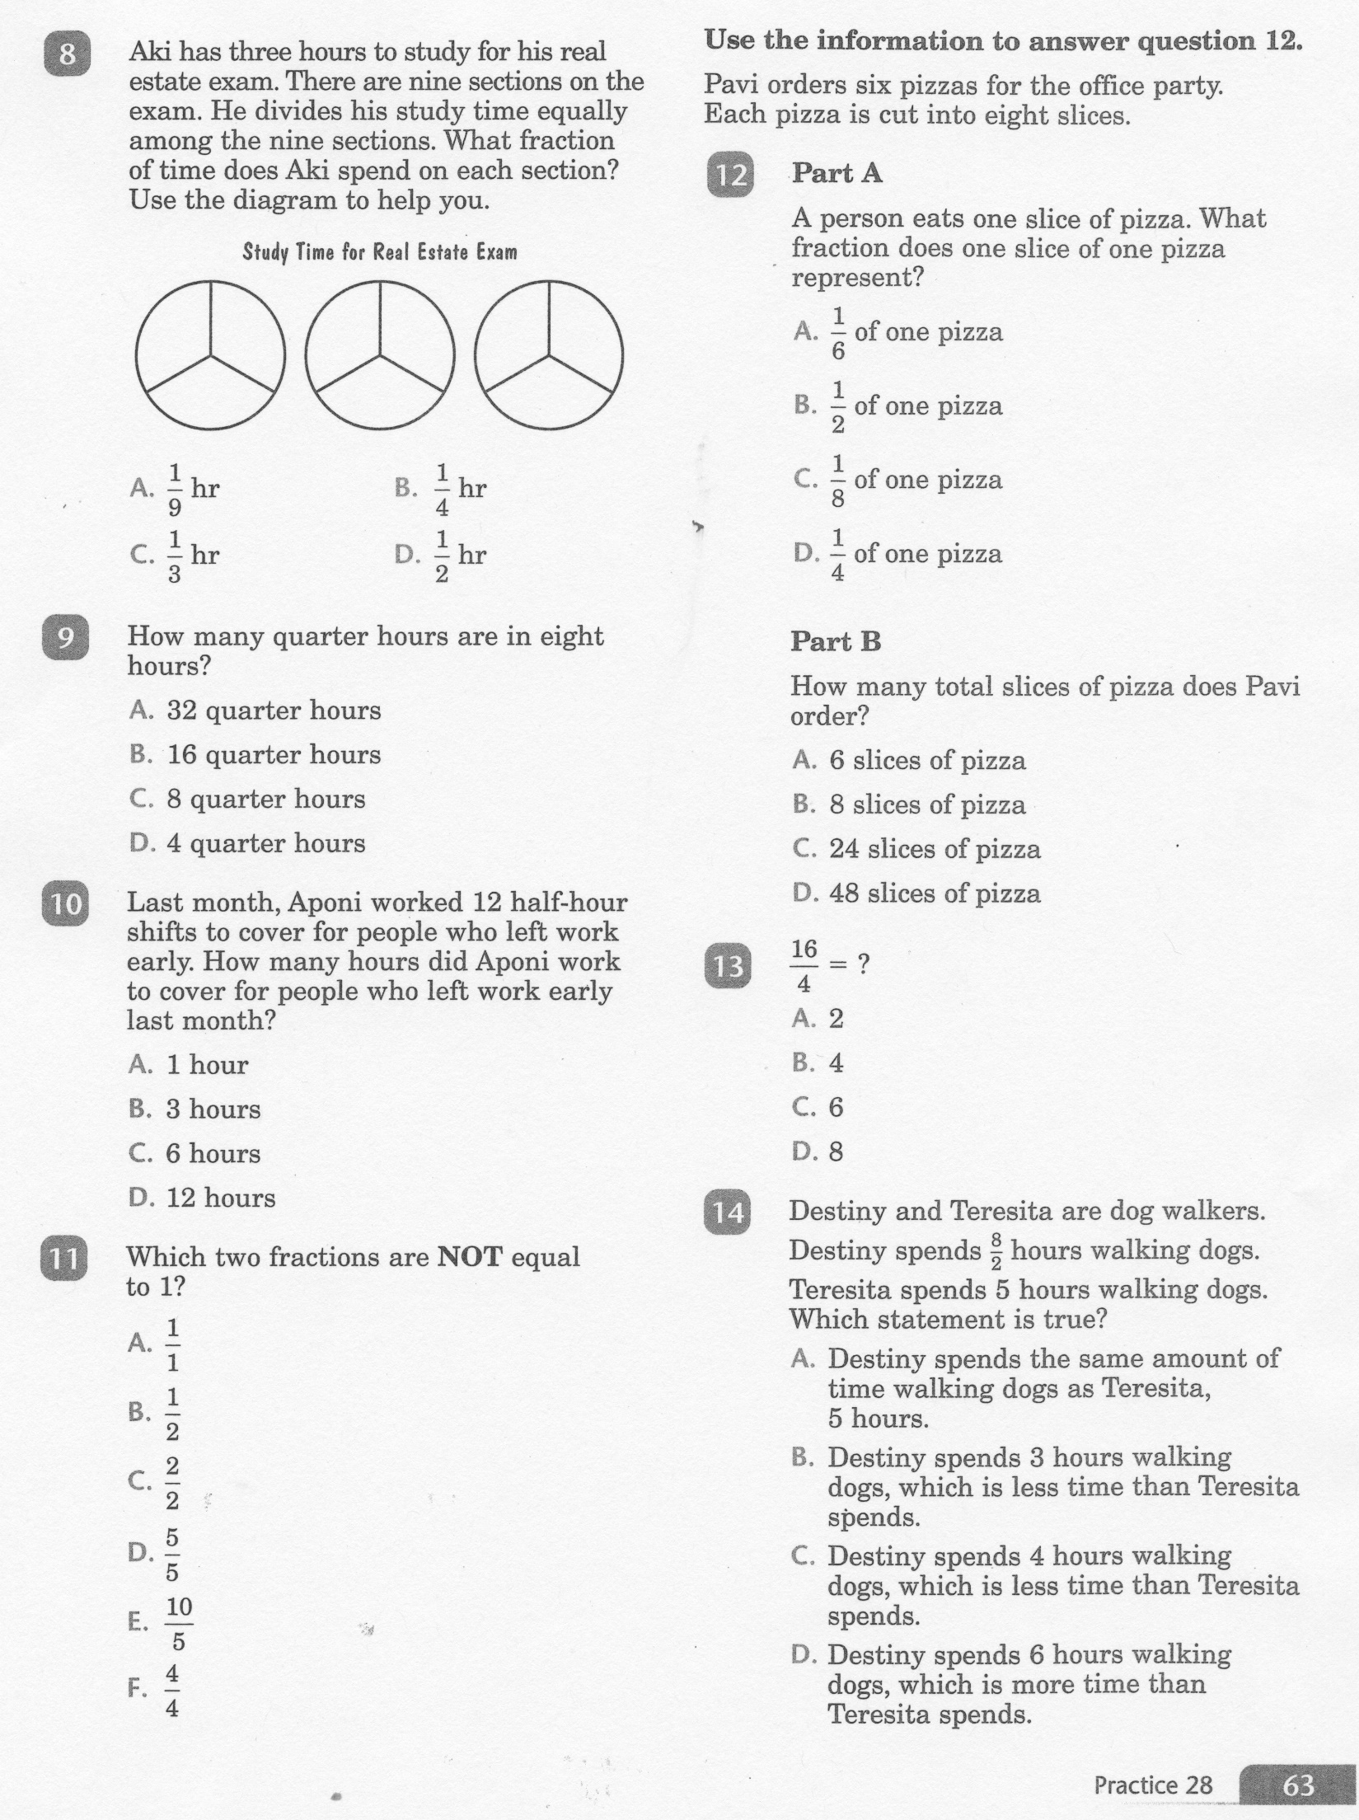
Math-E - Lesson 28 – Fractions to a Whole

Slide 7
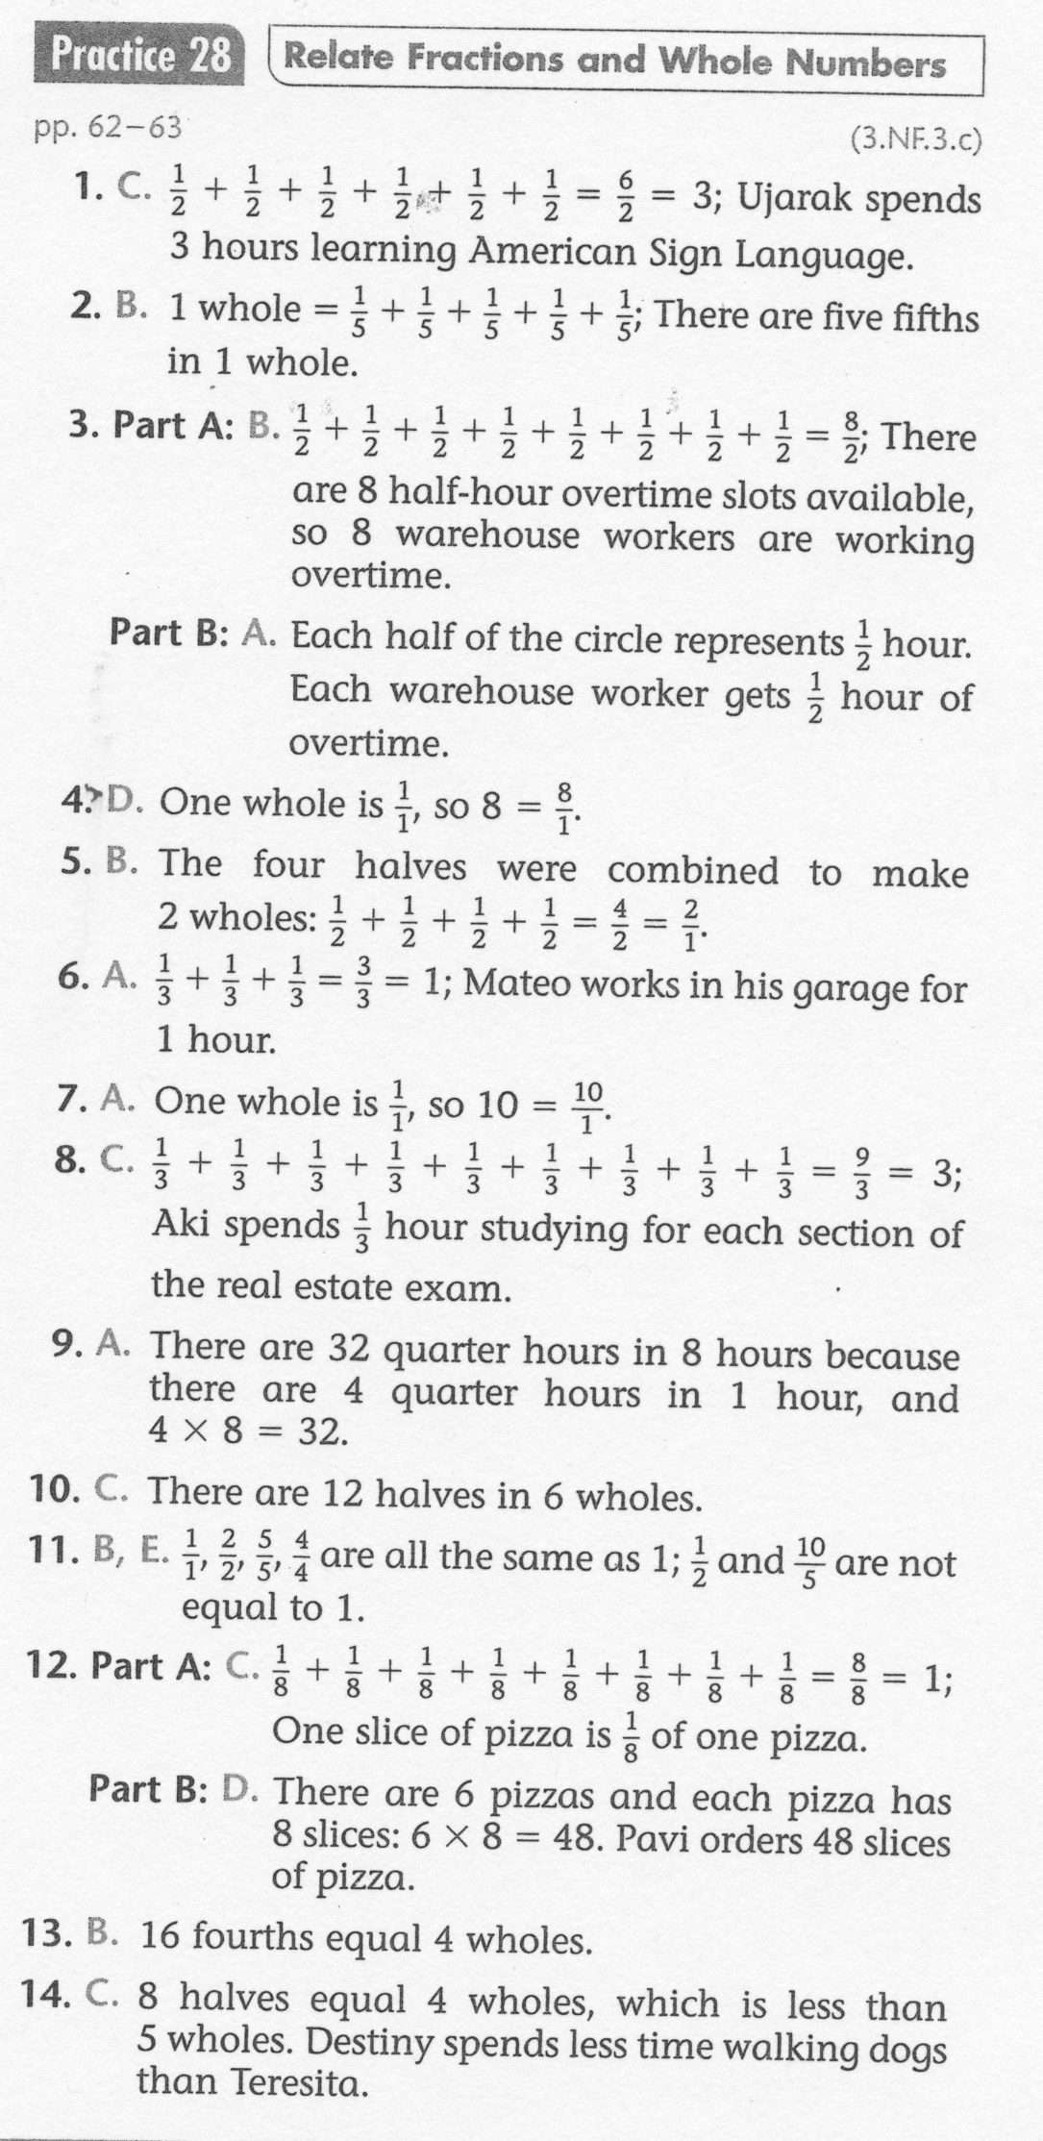
Math-E - Lesson 28 – Fractions to a Whole

