Slide 1
TABE Math-E PAXEN Unit-3 Multiply and Divide Whole Numbers Lesson 16 Multiplication With Commutative and Associative Property
Revised: October 16, 2023
Nolan Tomboulian
Some graphics may not have copied well during the scan process.

Slide 2
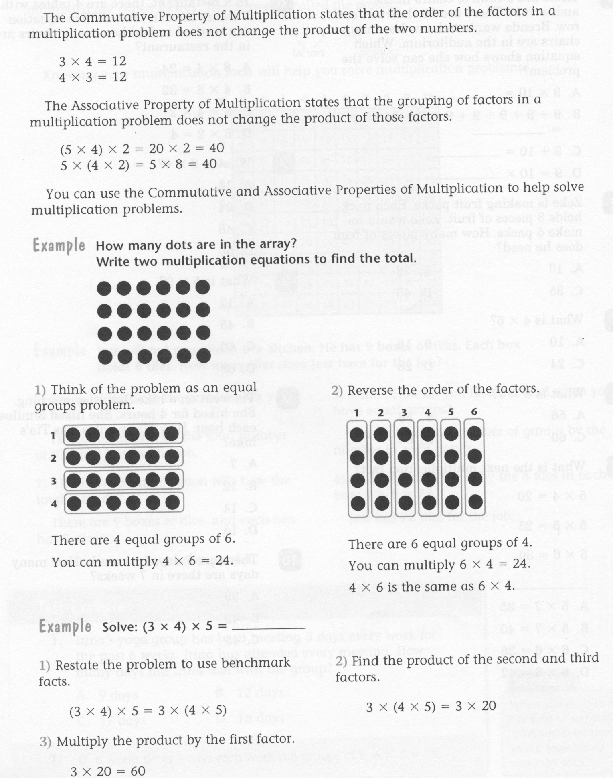
Math-E - Lesson 16 – Commutative

Slide 3
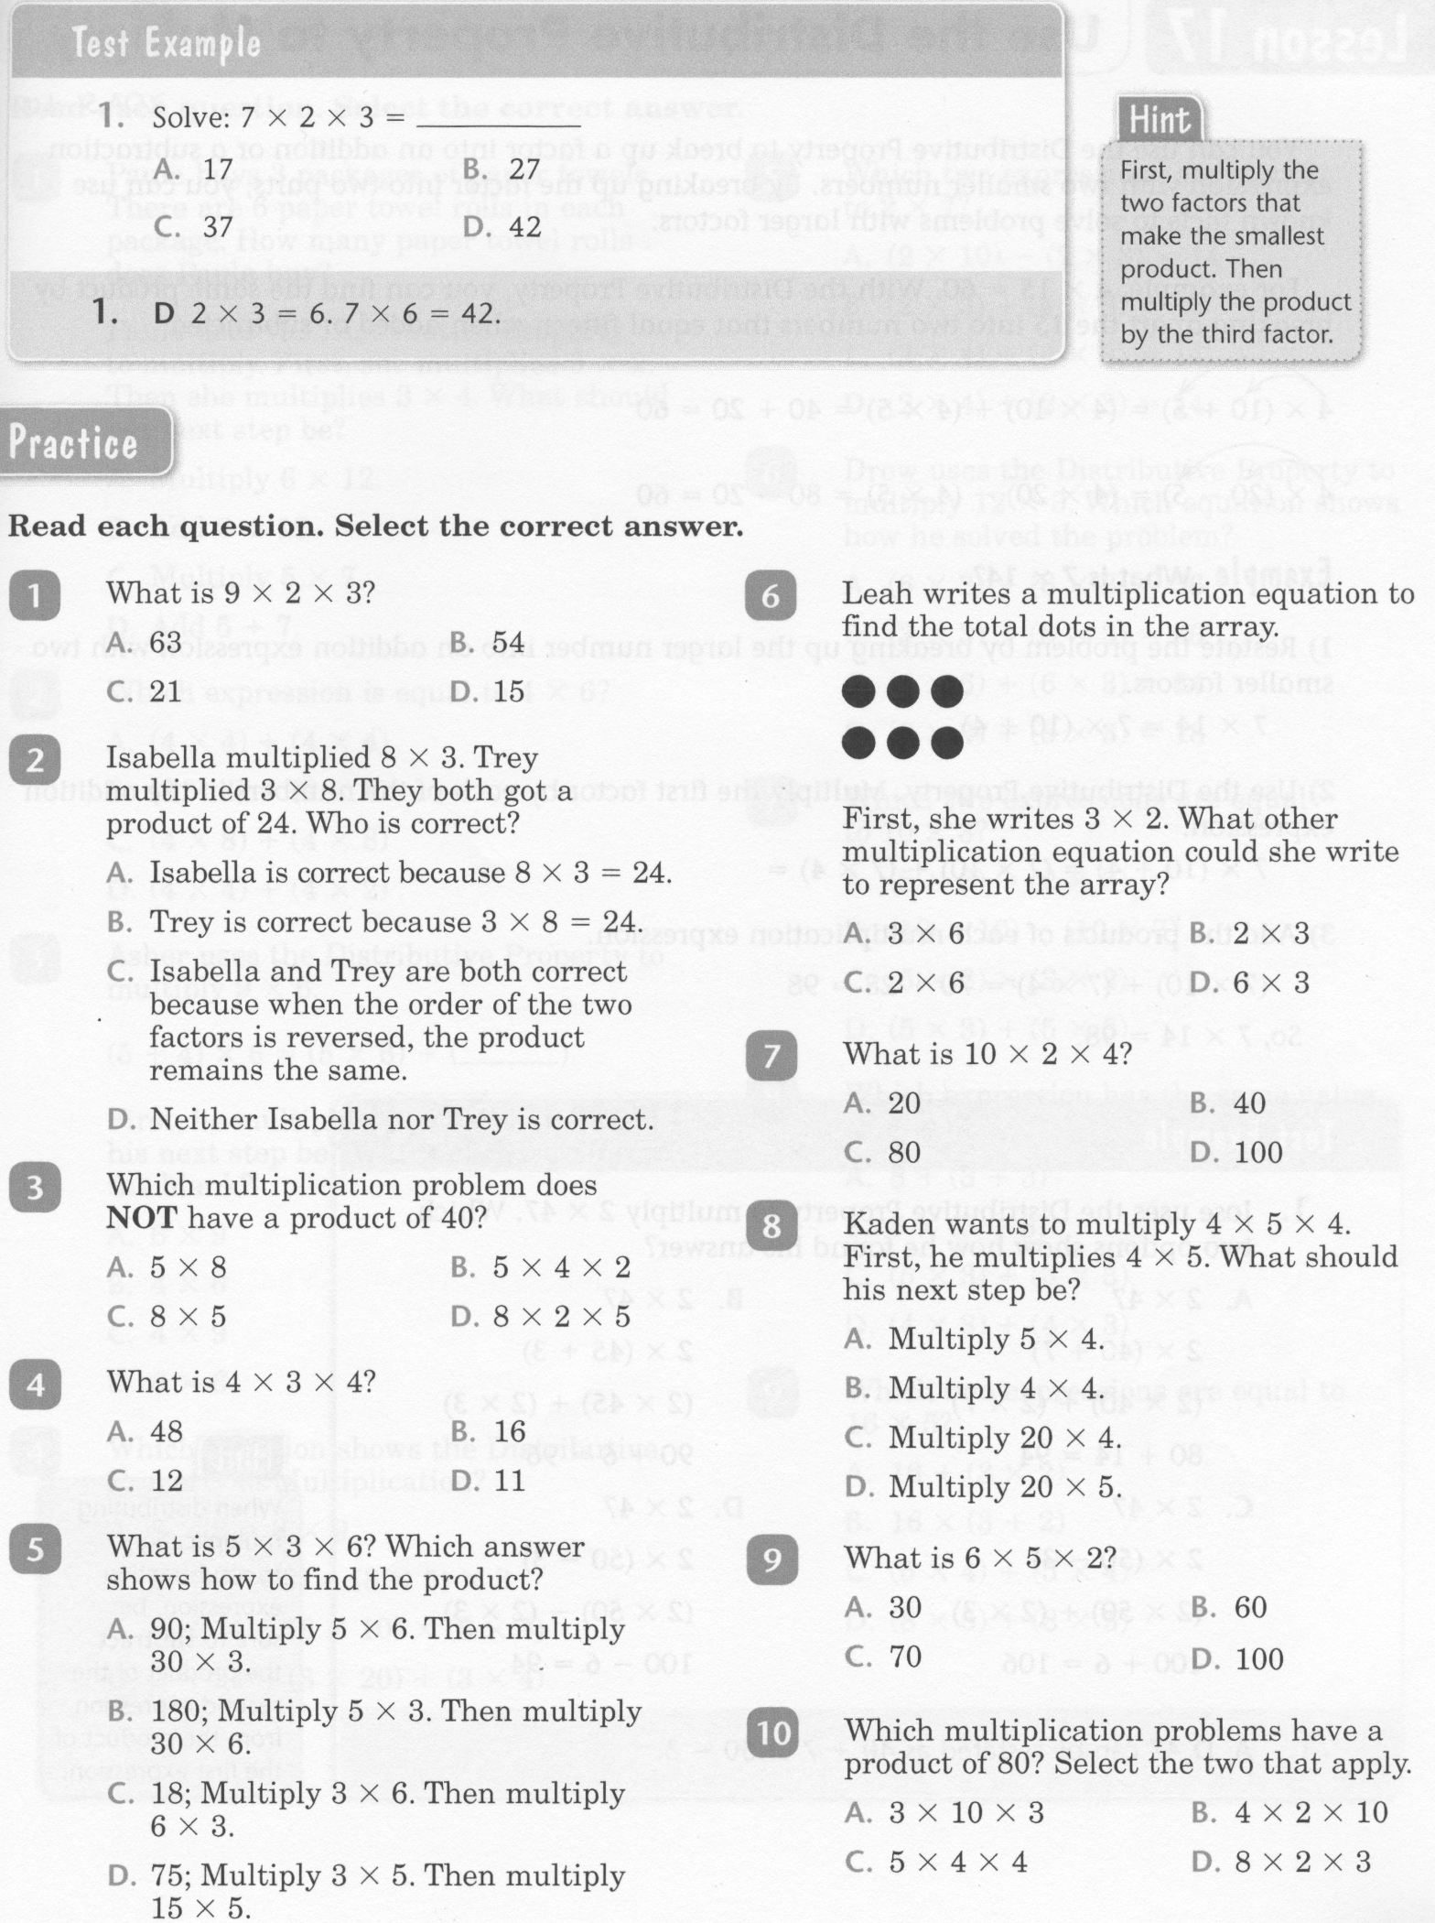
Math-E - Lesson 16 – Commutative

Slide 4
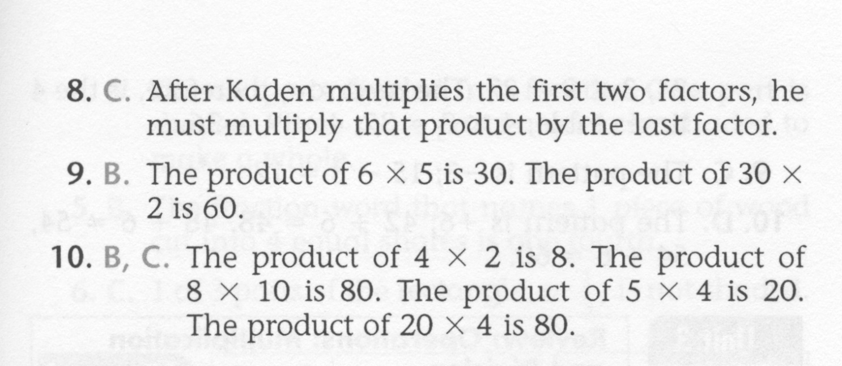
Math-E - Lesson 16 – Commutative

Slide 5
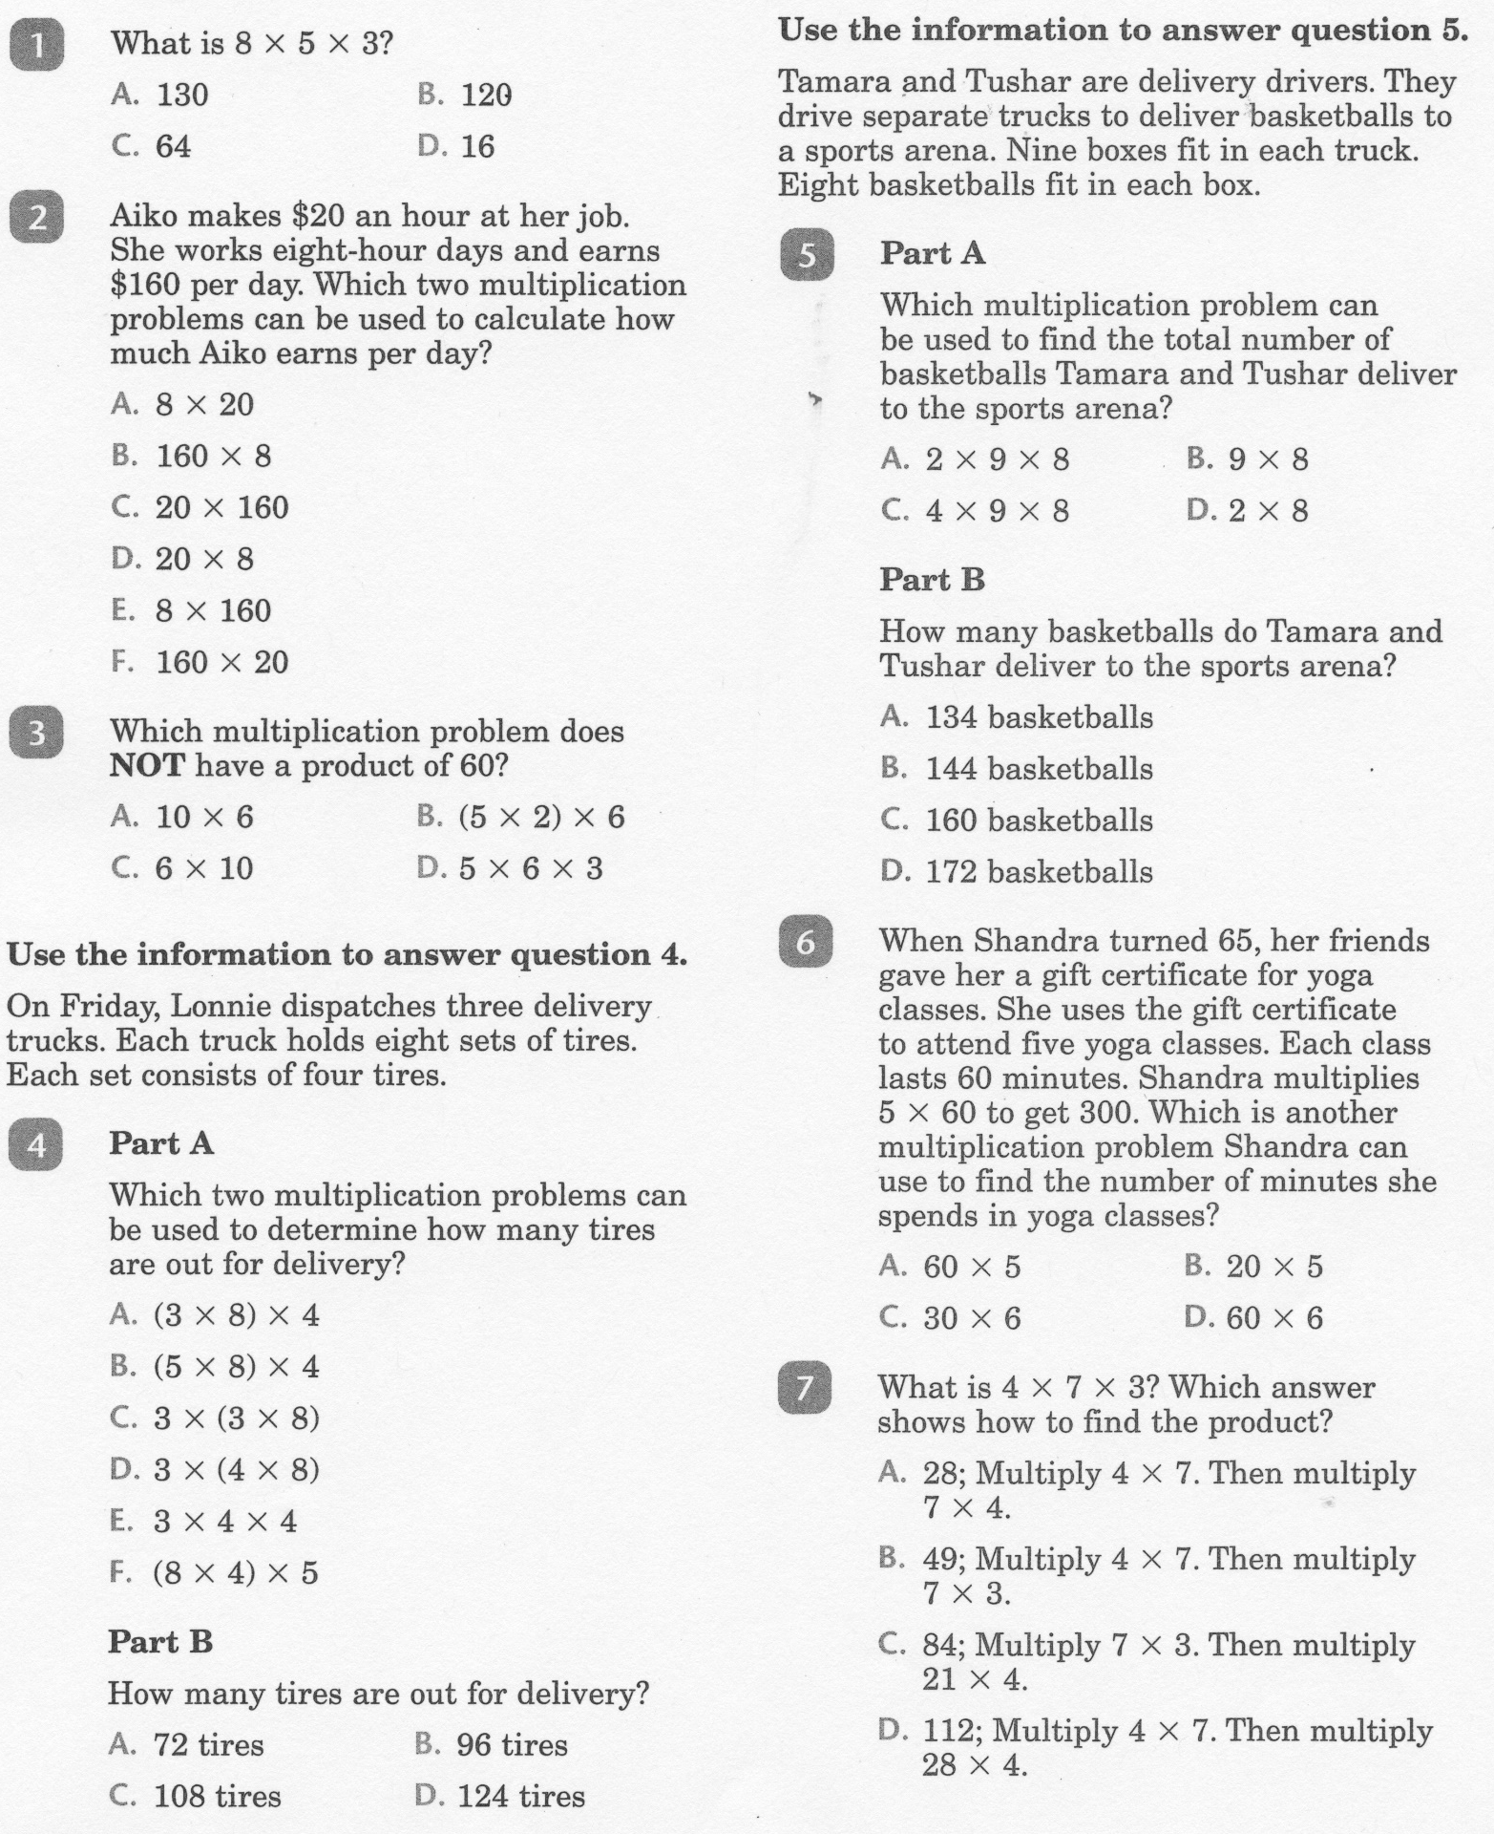
Math-E - Practice 16 - Commutative

Slide 6
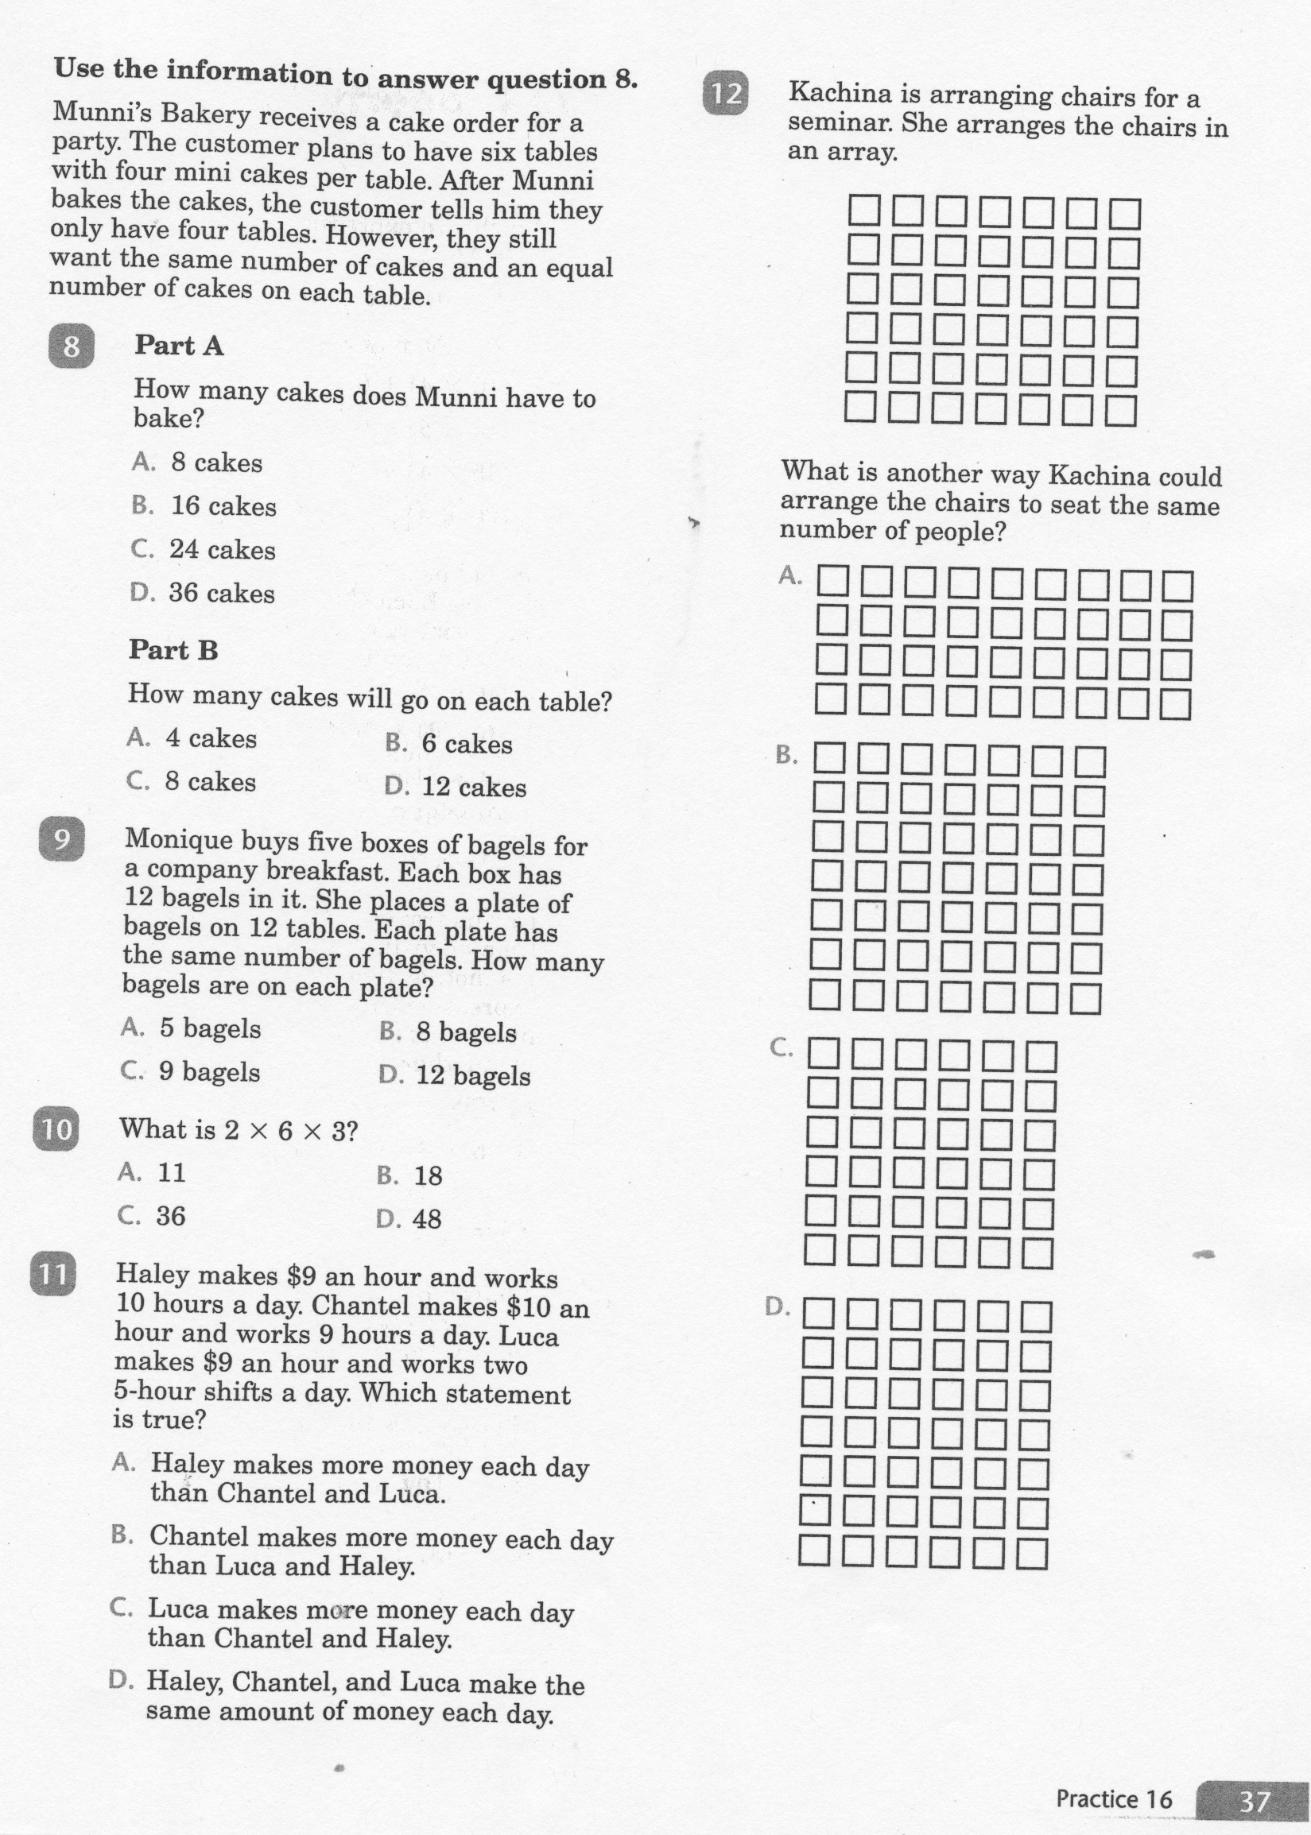
Math-E - Practice 16 - Commutative

Slide 7
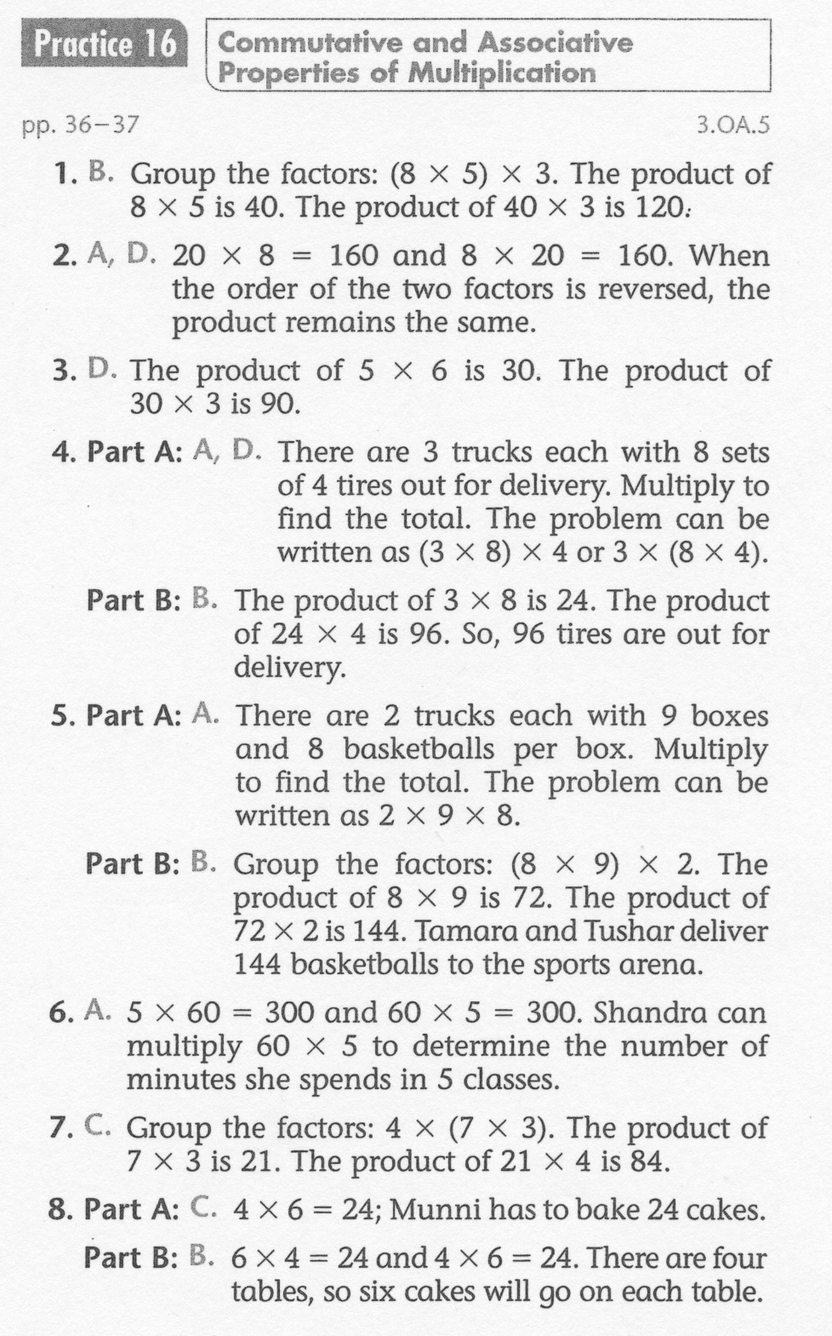
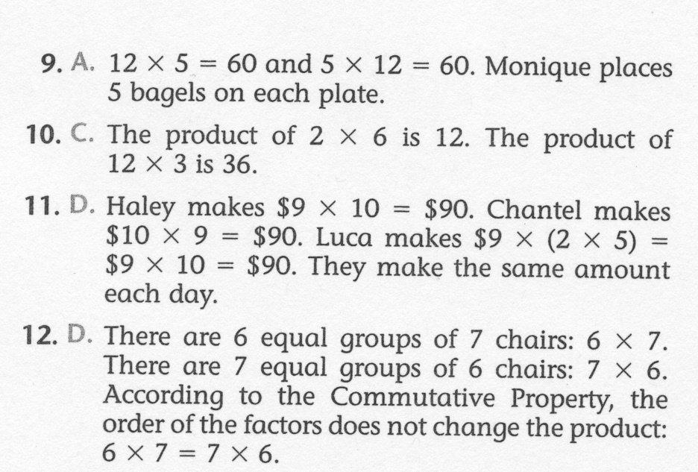
Math-E - Practice 16 – Commutative

