Slide 1
TABE Math-E PAXEN Unit-1 Working With Whole Numbers Lesson-05 Rounding
Revised: October 16, 2023
Nolan Tomboulian
Some graphics may not have copied well during the scan Process

Slide 2
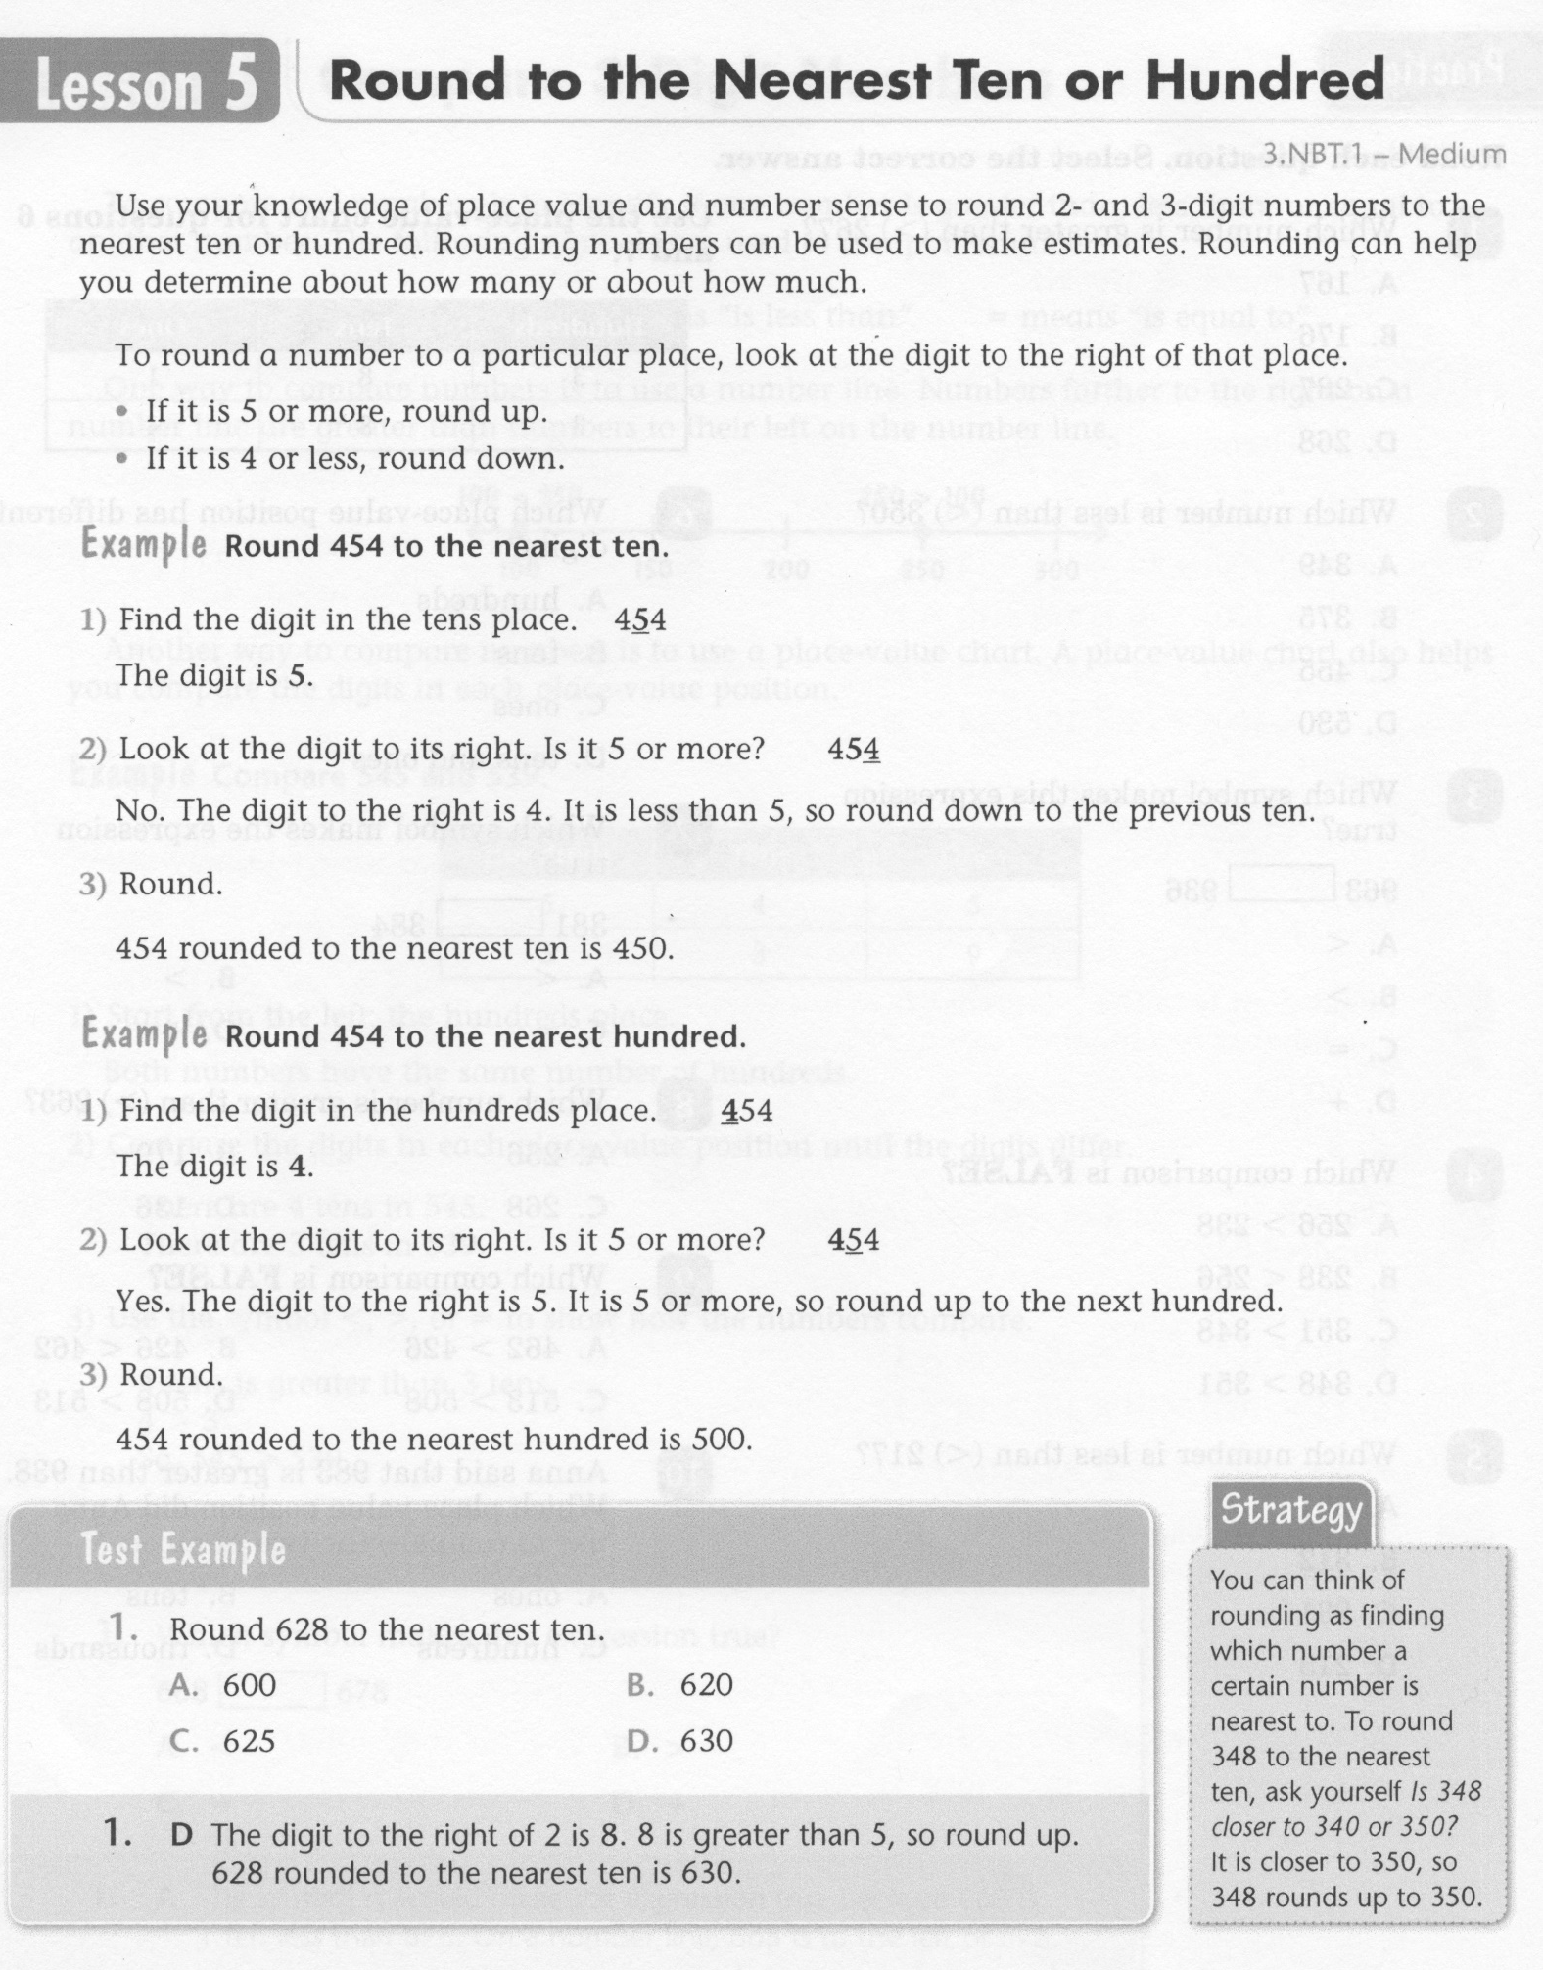
Math-E - Lesson-05 – Rounding

Slide 3
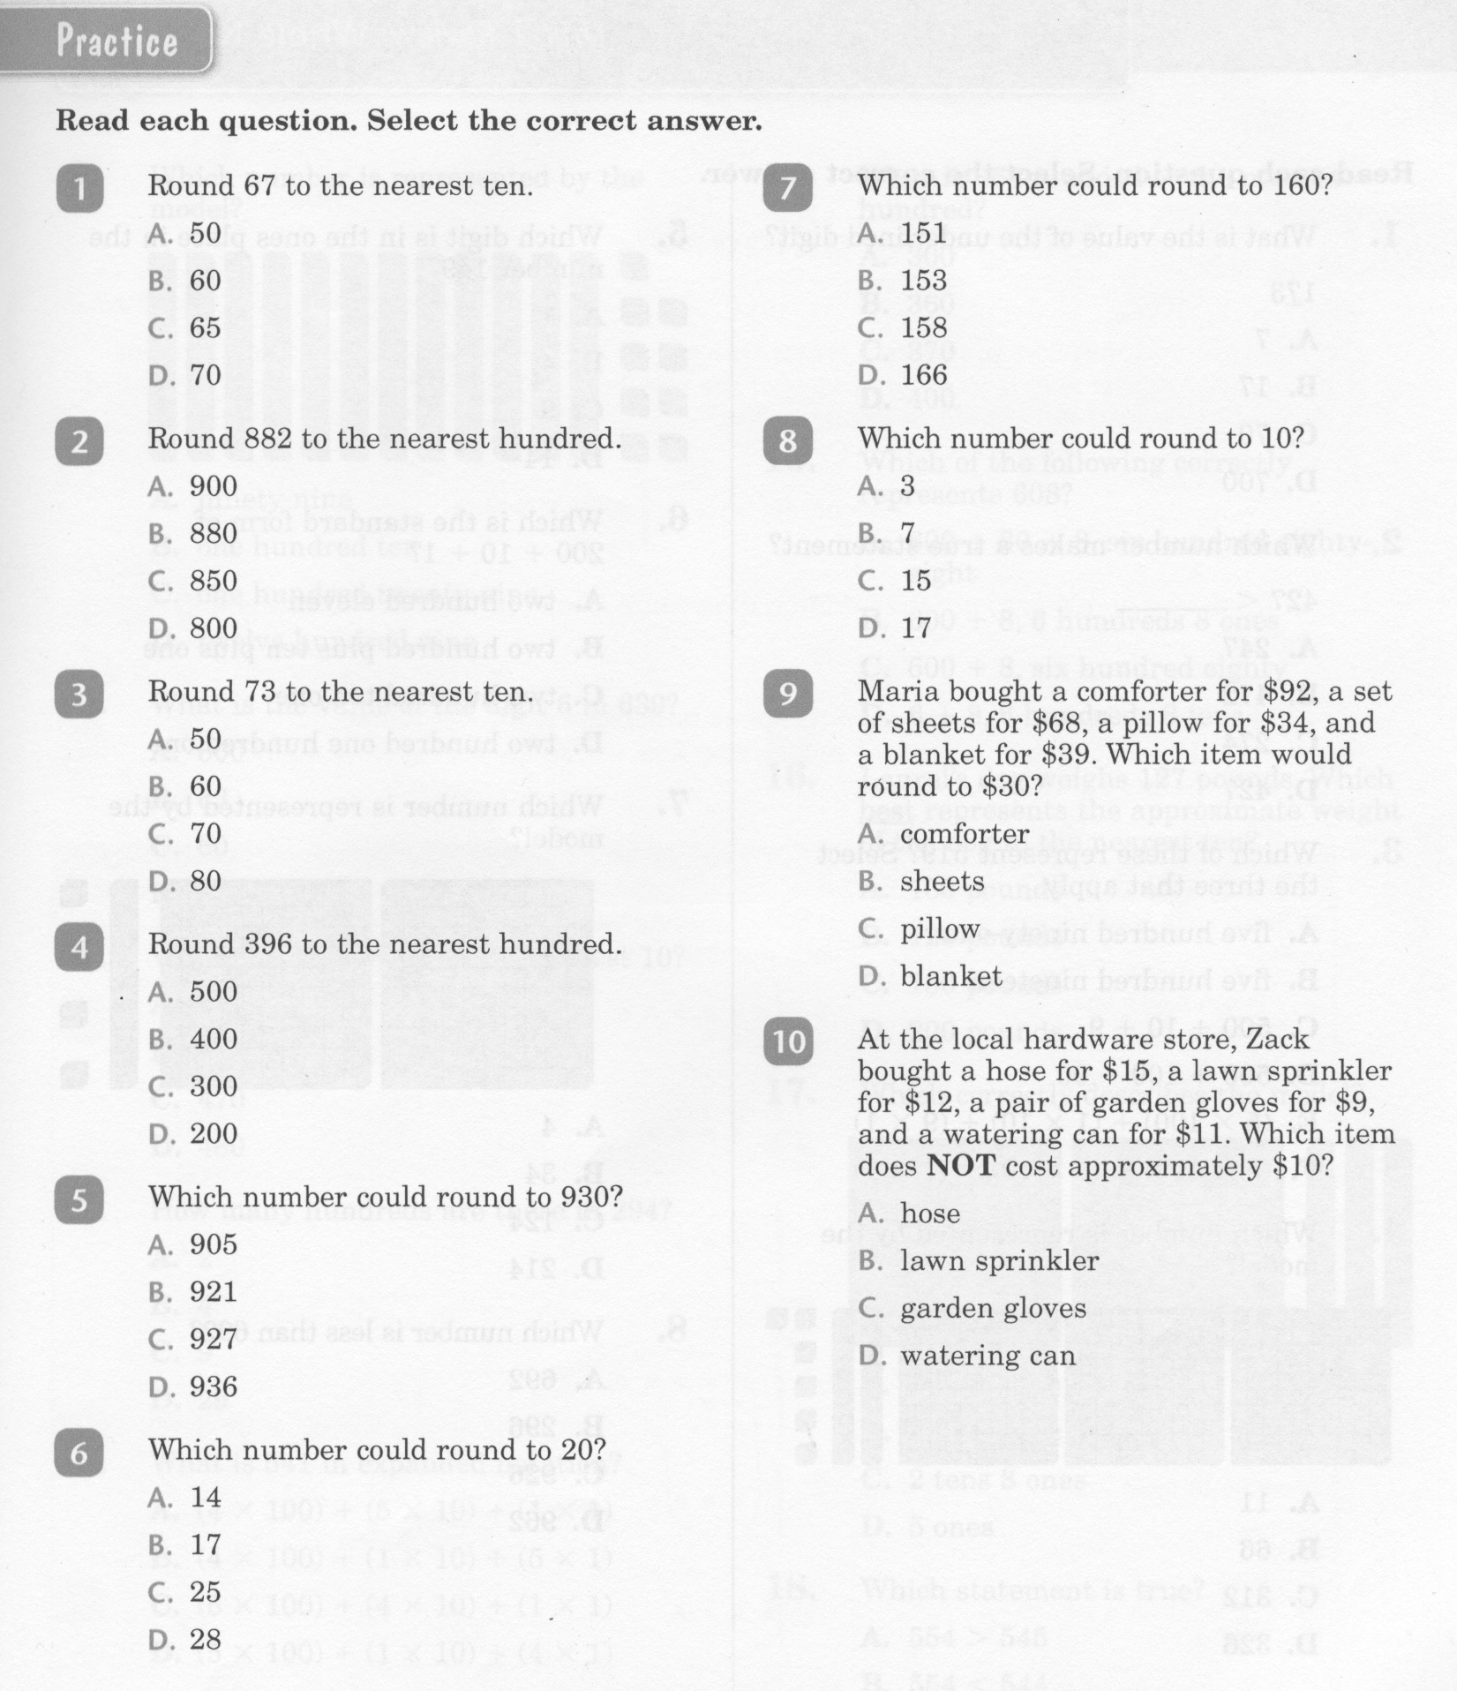
Math-E - Lesson-05 – Rounding

Slide 4
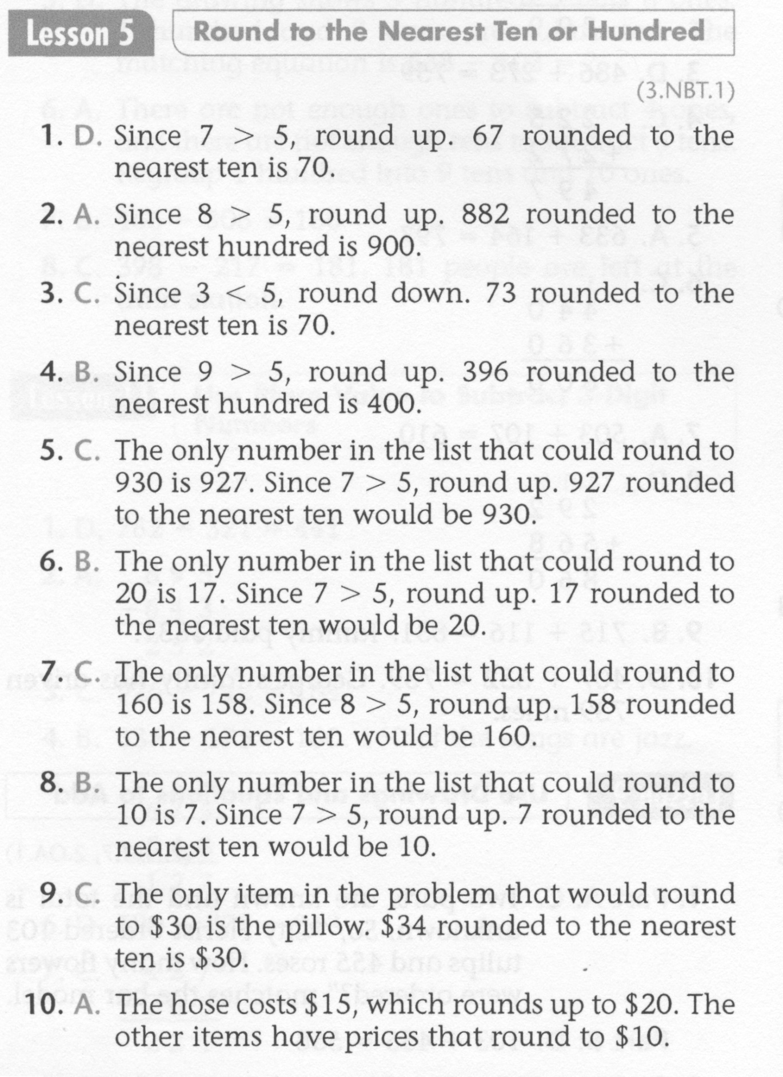
Math-E - Lesson-05 – Rounding

Slide 5
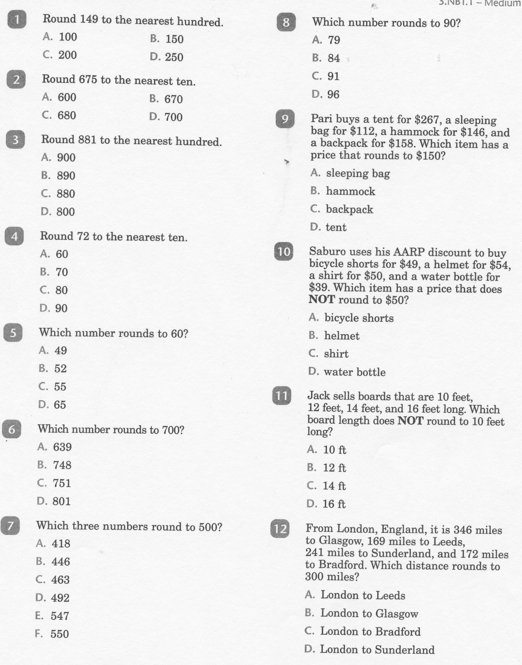
Math-E - Practice-05 – Practice

Slide 6
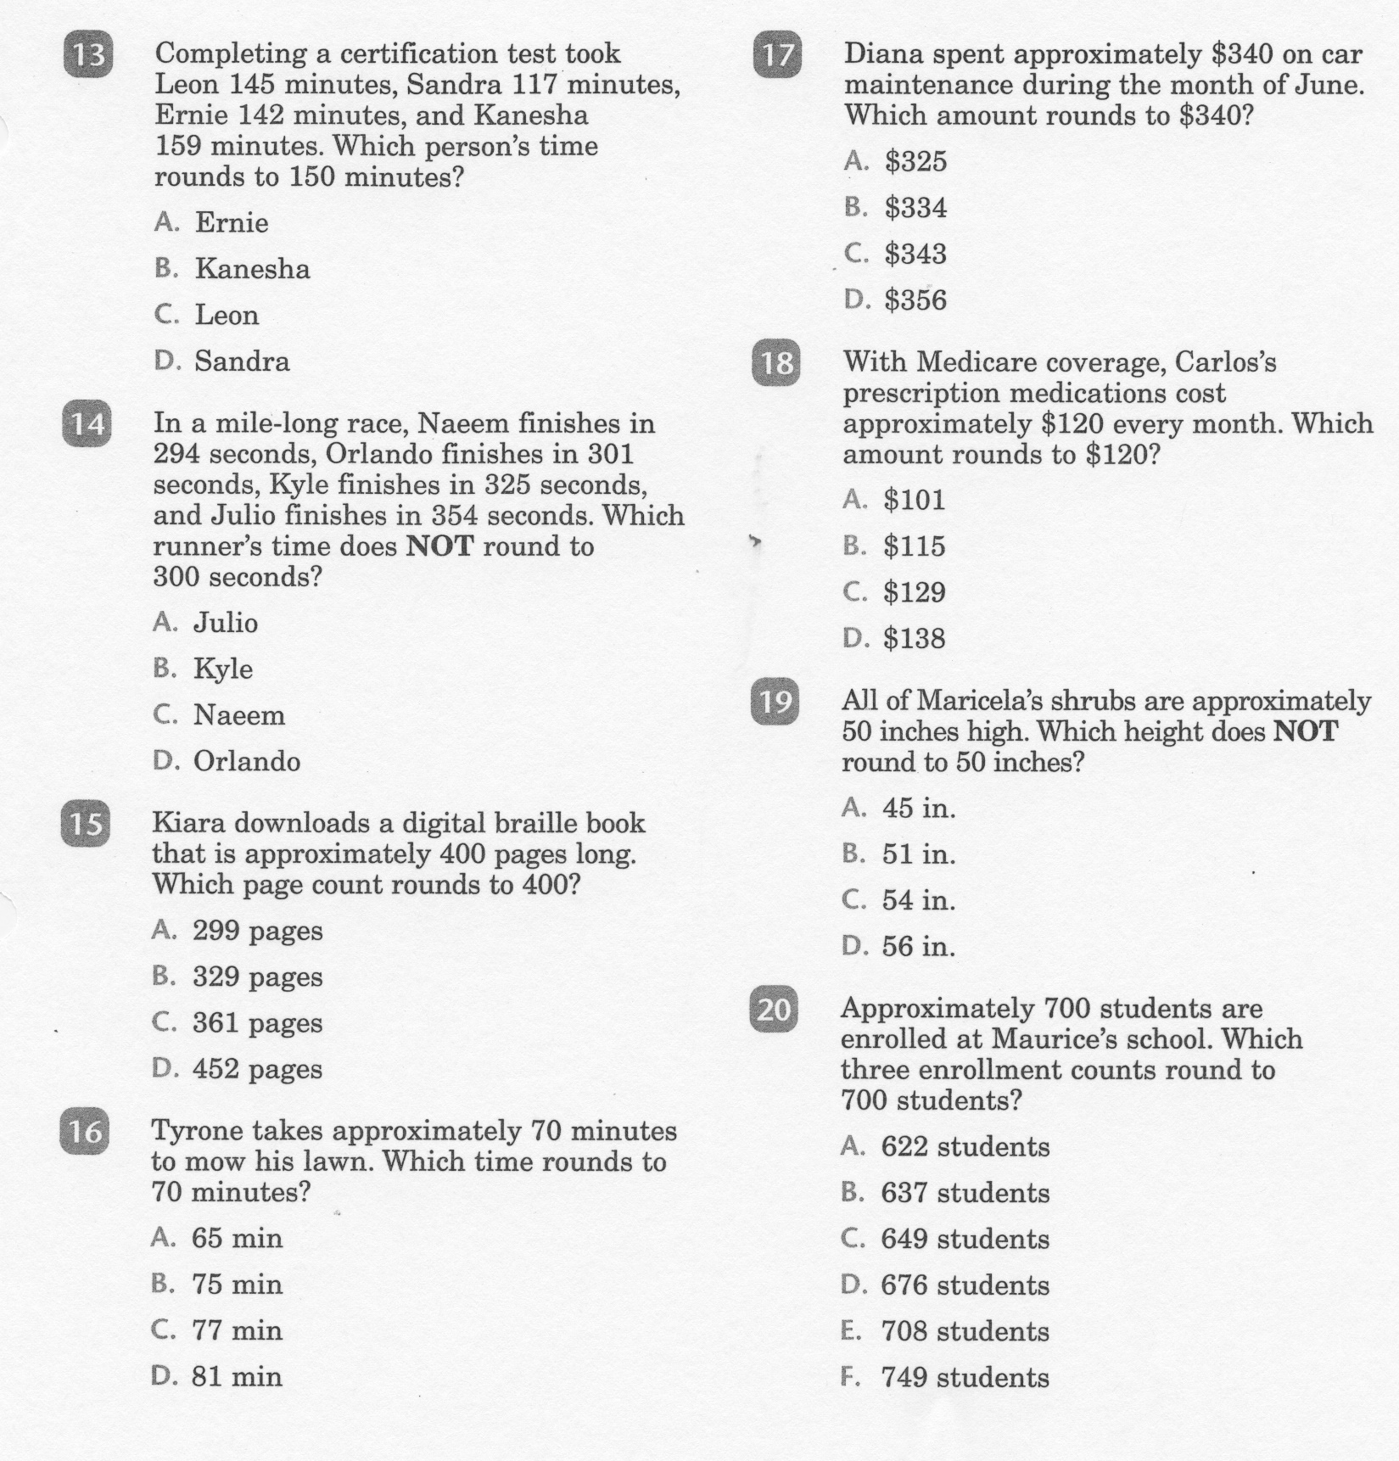
Math-E - Practice-05 – Practice

Slide 7
Math-E - Practice-05 – Rounding

