Slide 1
TABE MATH - D
Unit - 1
Lesson - 4
|ABSOLUTE VALUE |
Distance from Zero
Revised: March 10, 2024
Nolan Tomboulian

Slide 2
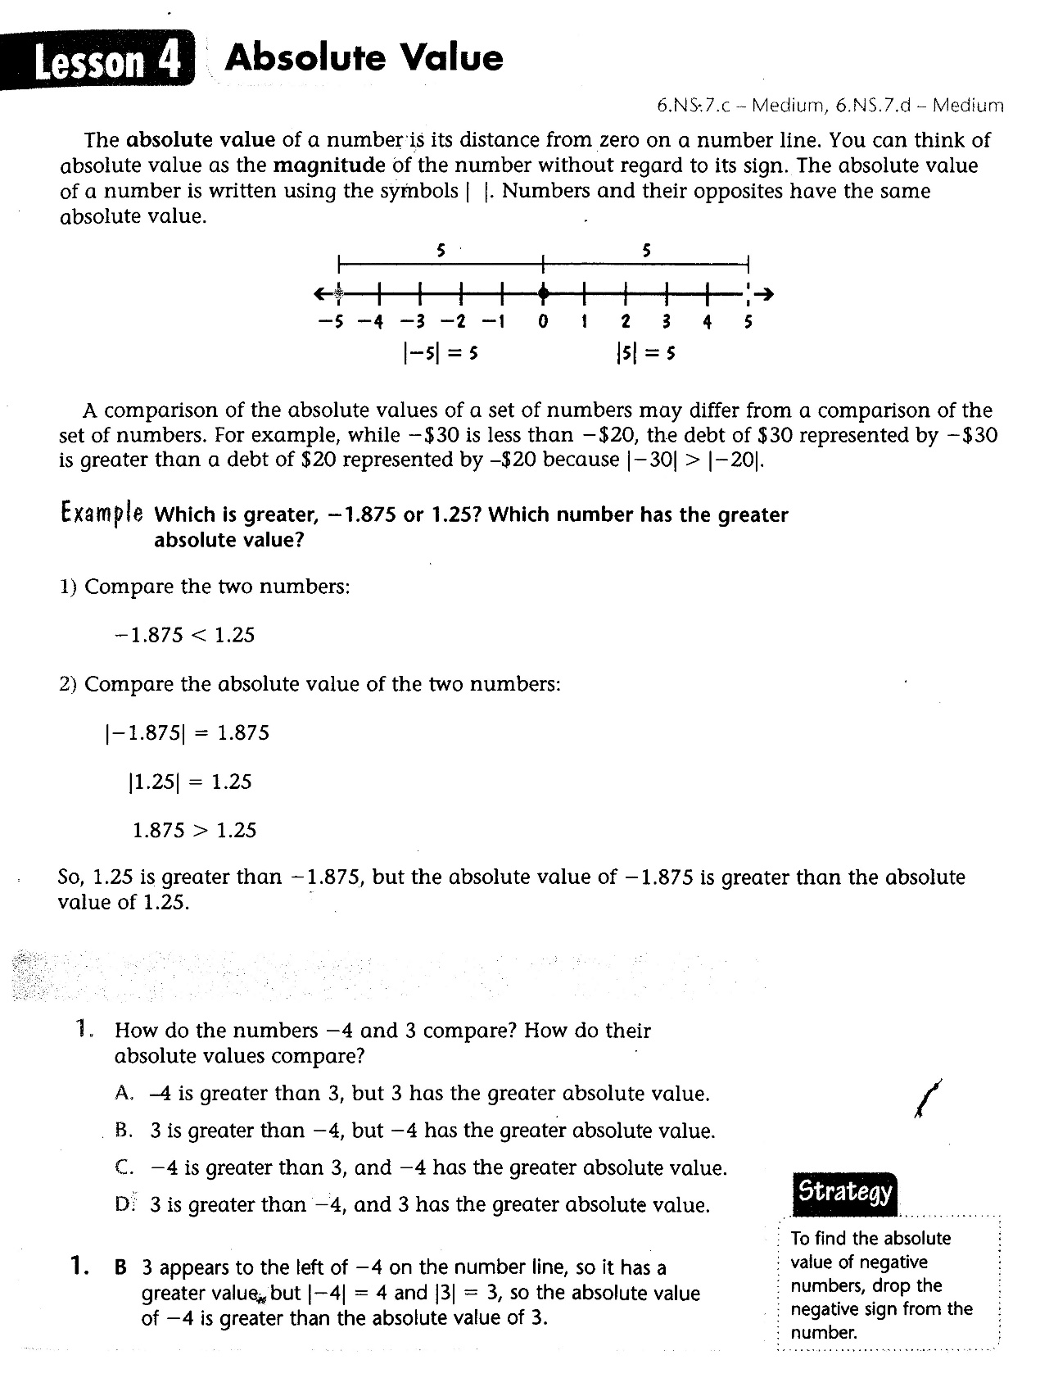

Slide 4
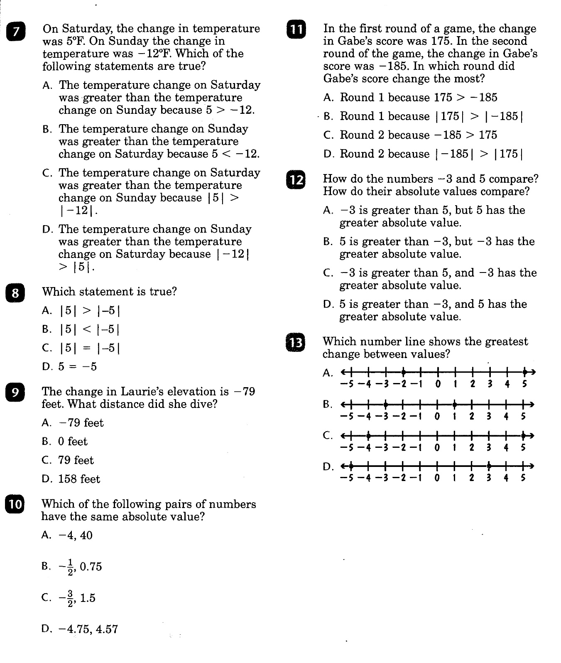

Slide 5
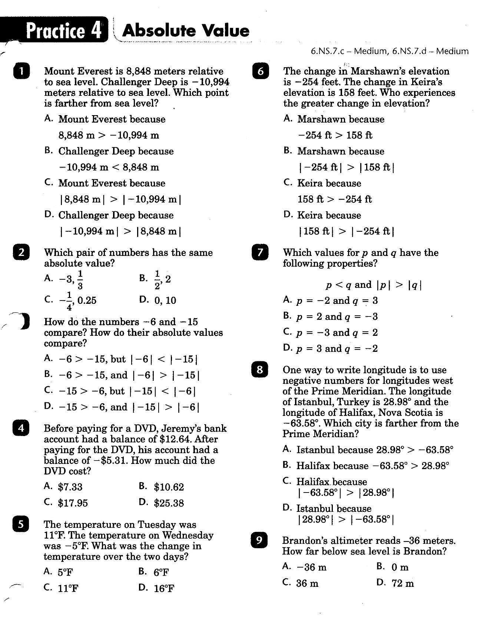

Slide 6
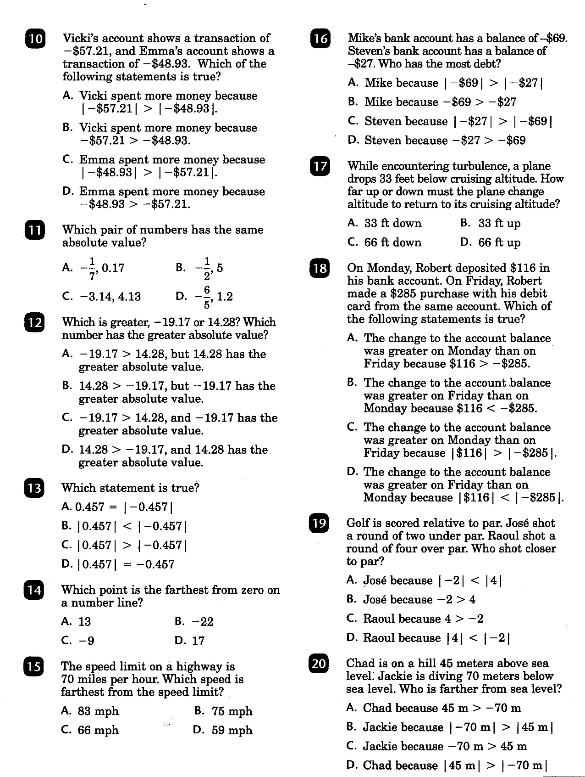

Slide 7
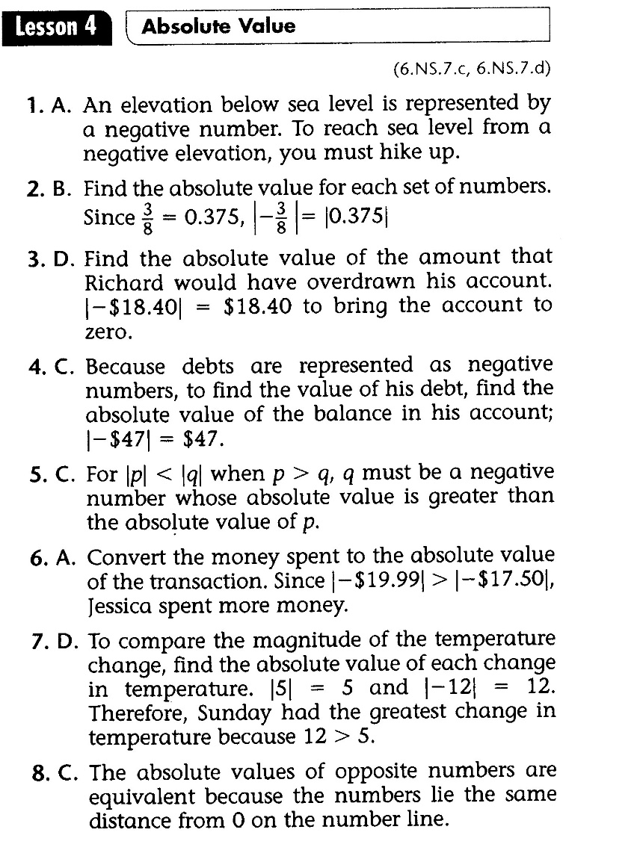
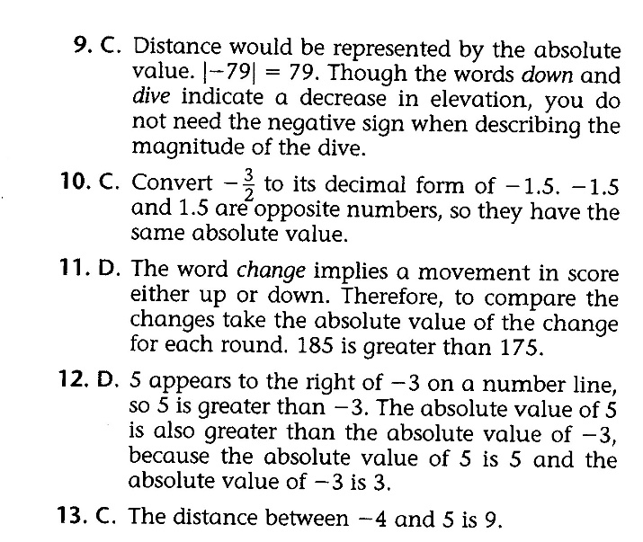
Math-D Lesson-4 Key

Slide 8
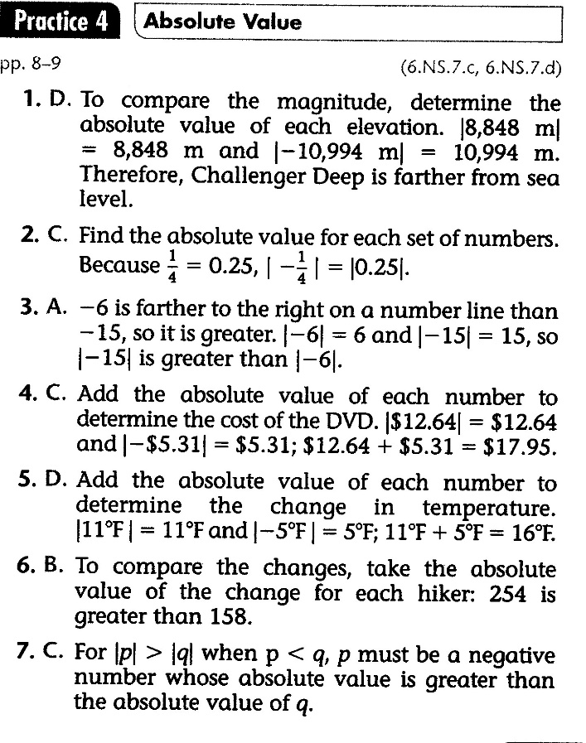
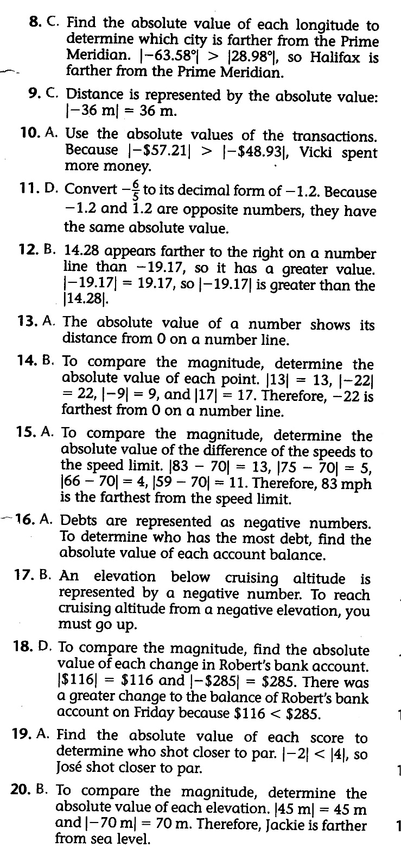
Math-D Practice-4 Key

