Slide 1
TABE MATH - D
Unit - 1
Lesson - 1
Positive and Negative
Numbers
Revised: March 10, 2024
Nolan Tomboulian

Slide 3
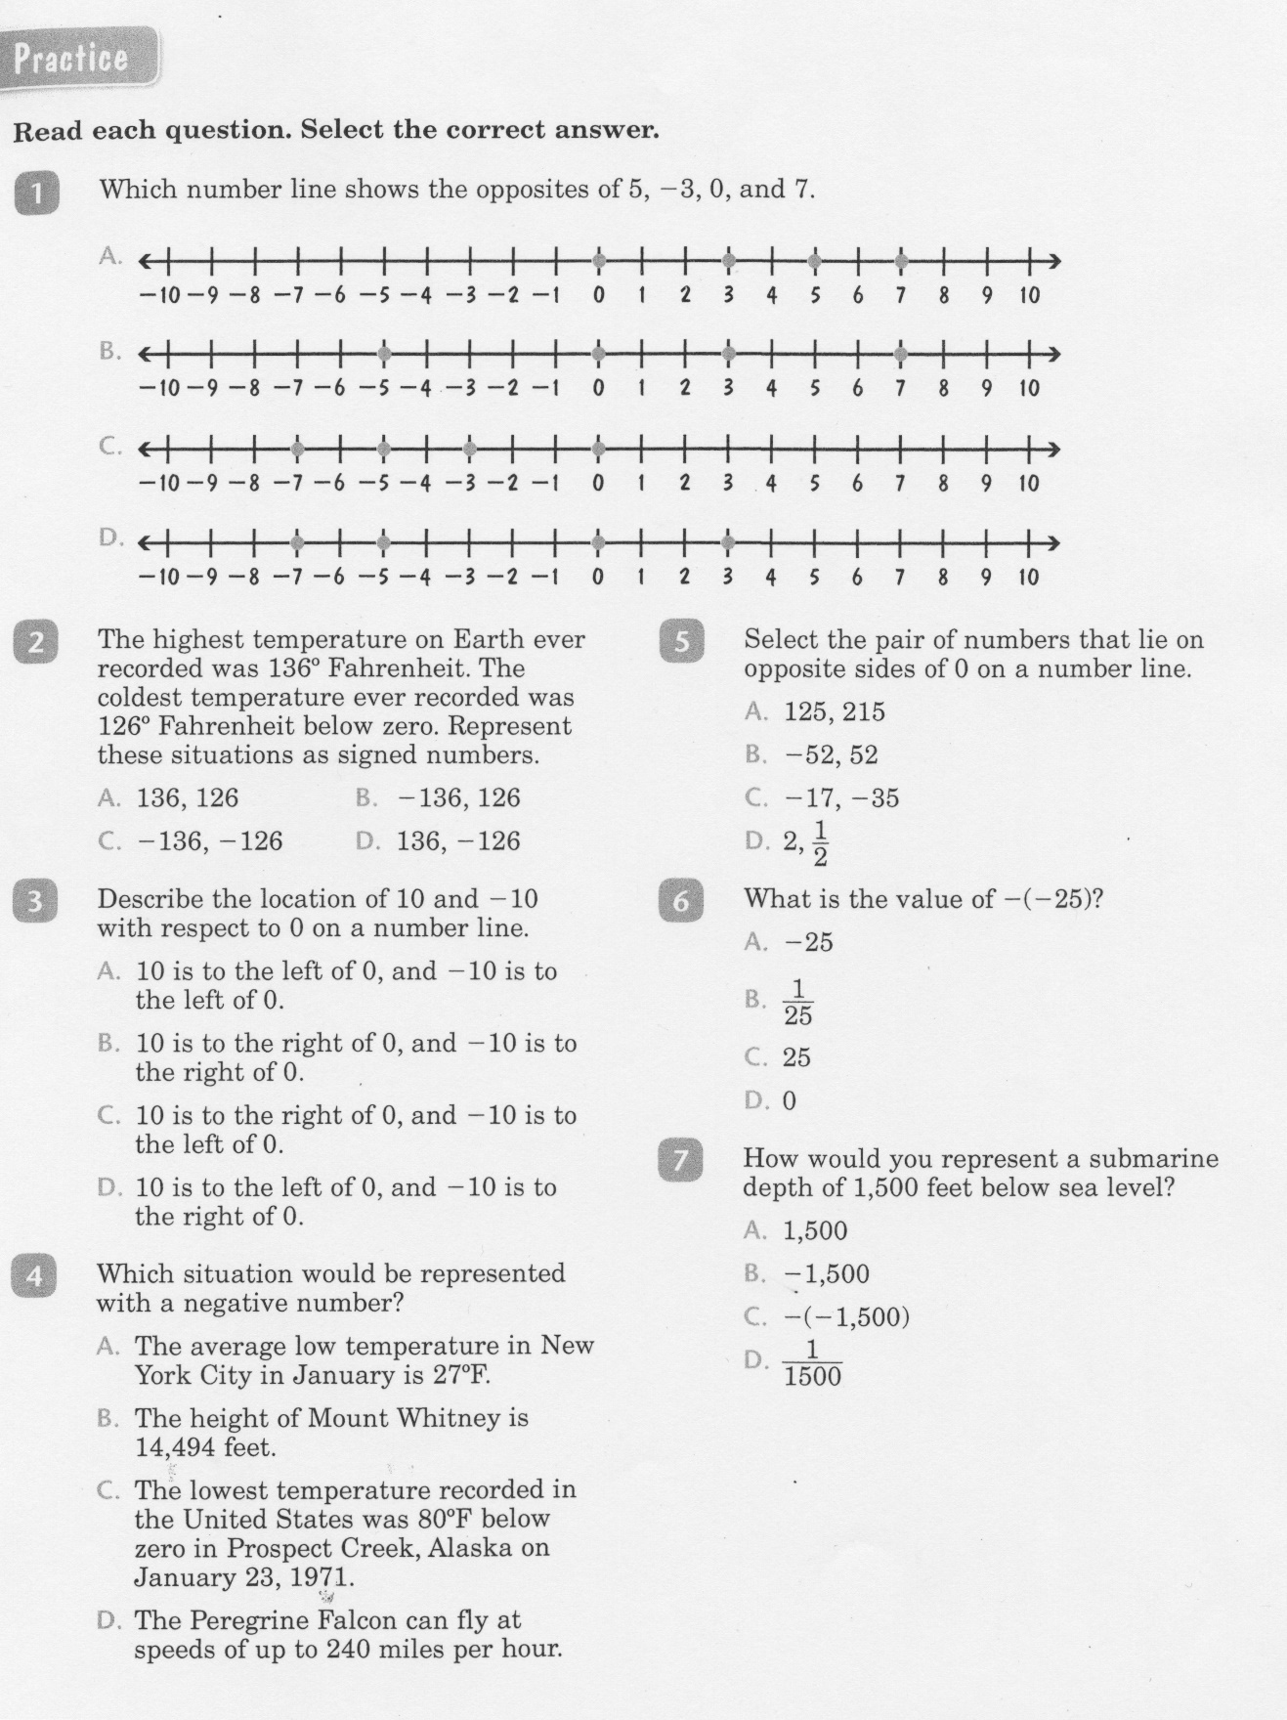

Slide 4
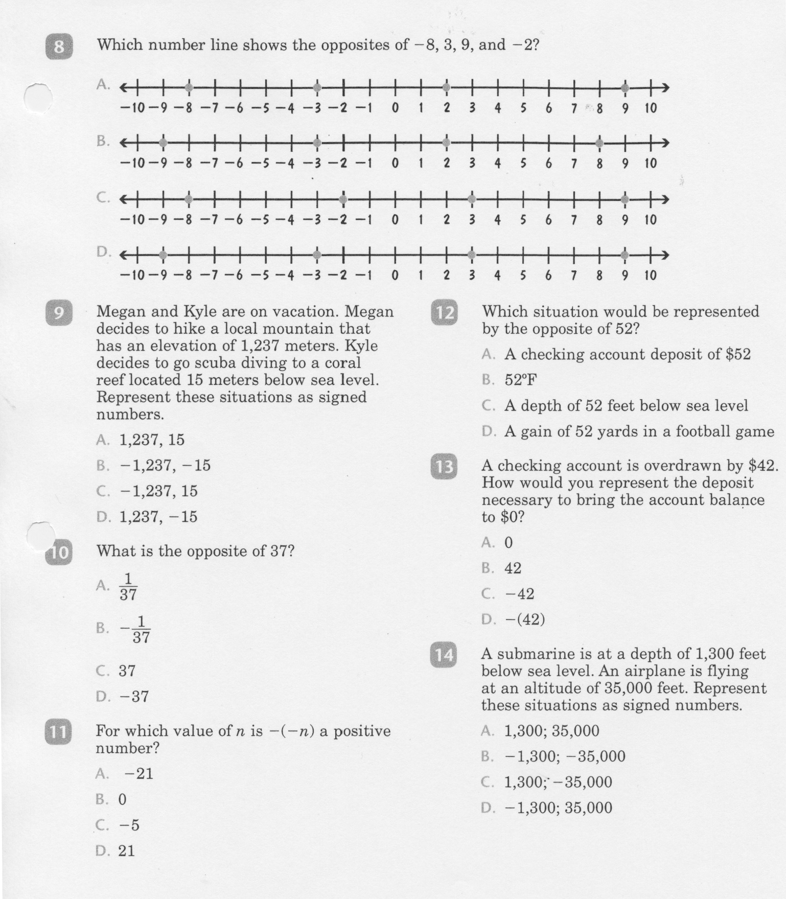

Slide 5
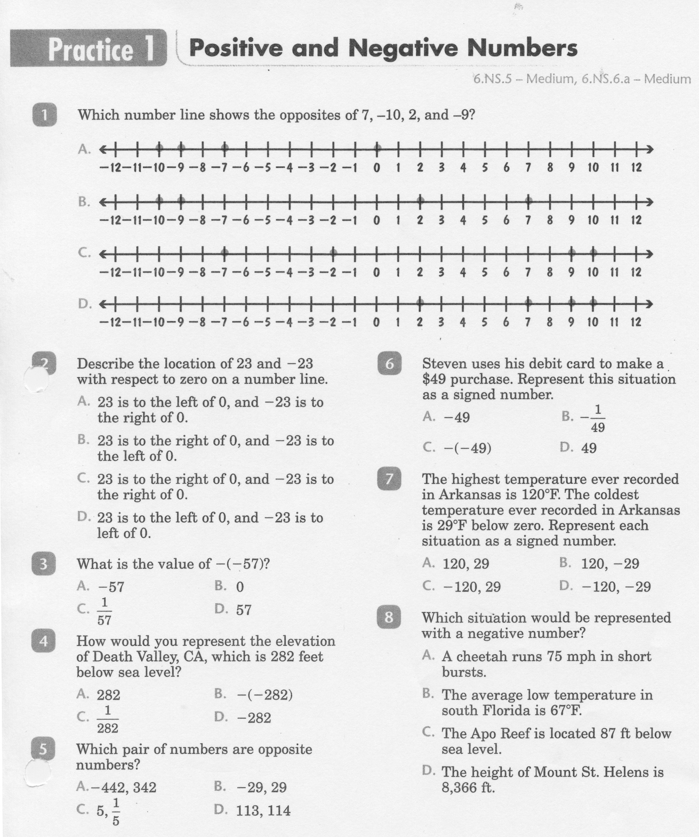

Slide 6
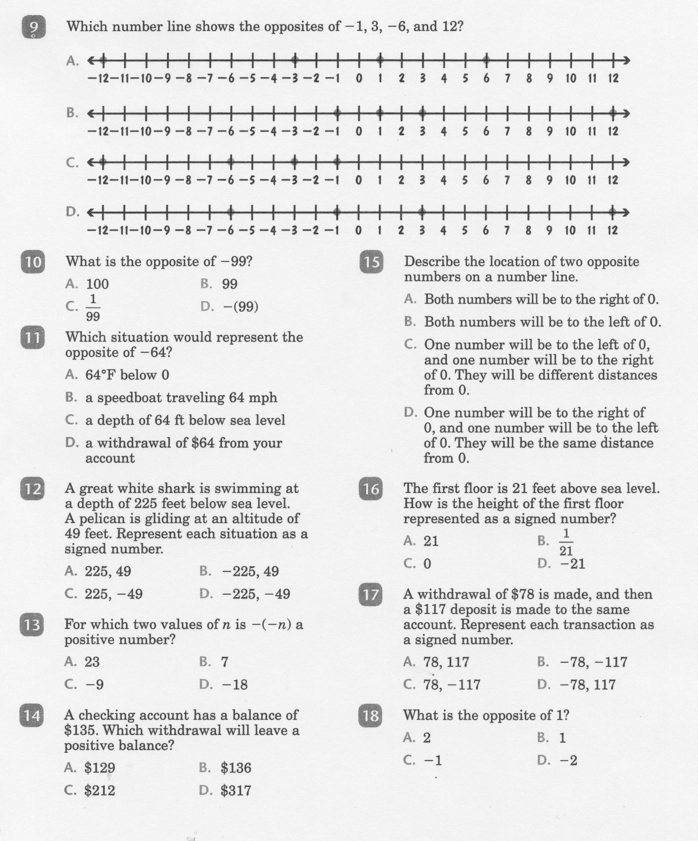

Slide 7
Math-D Lesson-1 Key

Slide 8
Math-D Practice-1 Key

