Slide 1
TABE ELA-E PAXEN Unit-4 Vocabulary and Word Use Lesson-27 Descriptive Words
Some graphics may not have copied well during the Scan Process

Slide 2
ELA-E-27 Descriptive Words

Slide 3
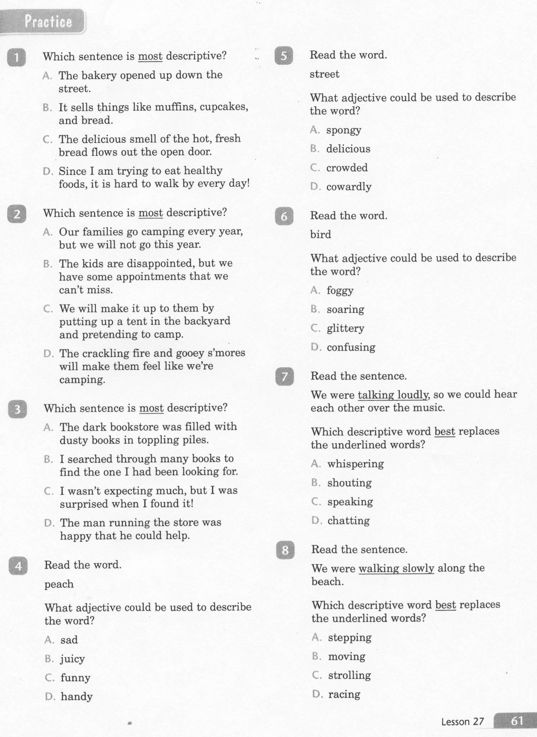
ELA-E-27 Descriptive Words

Slide 4
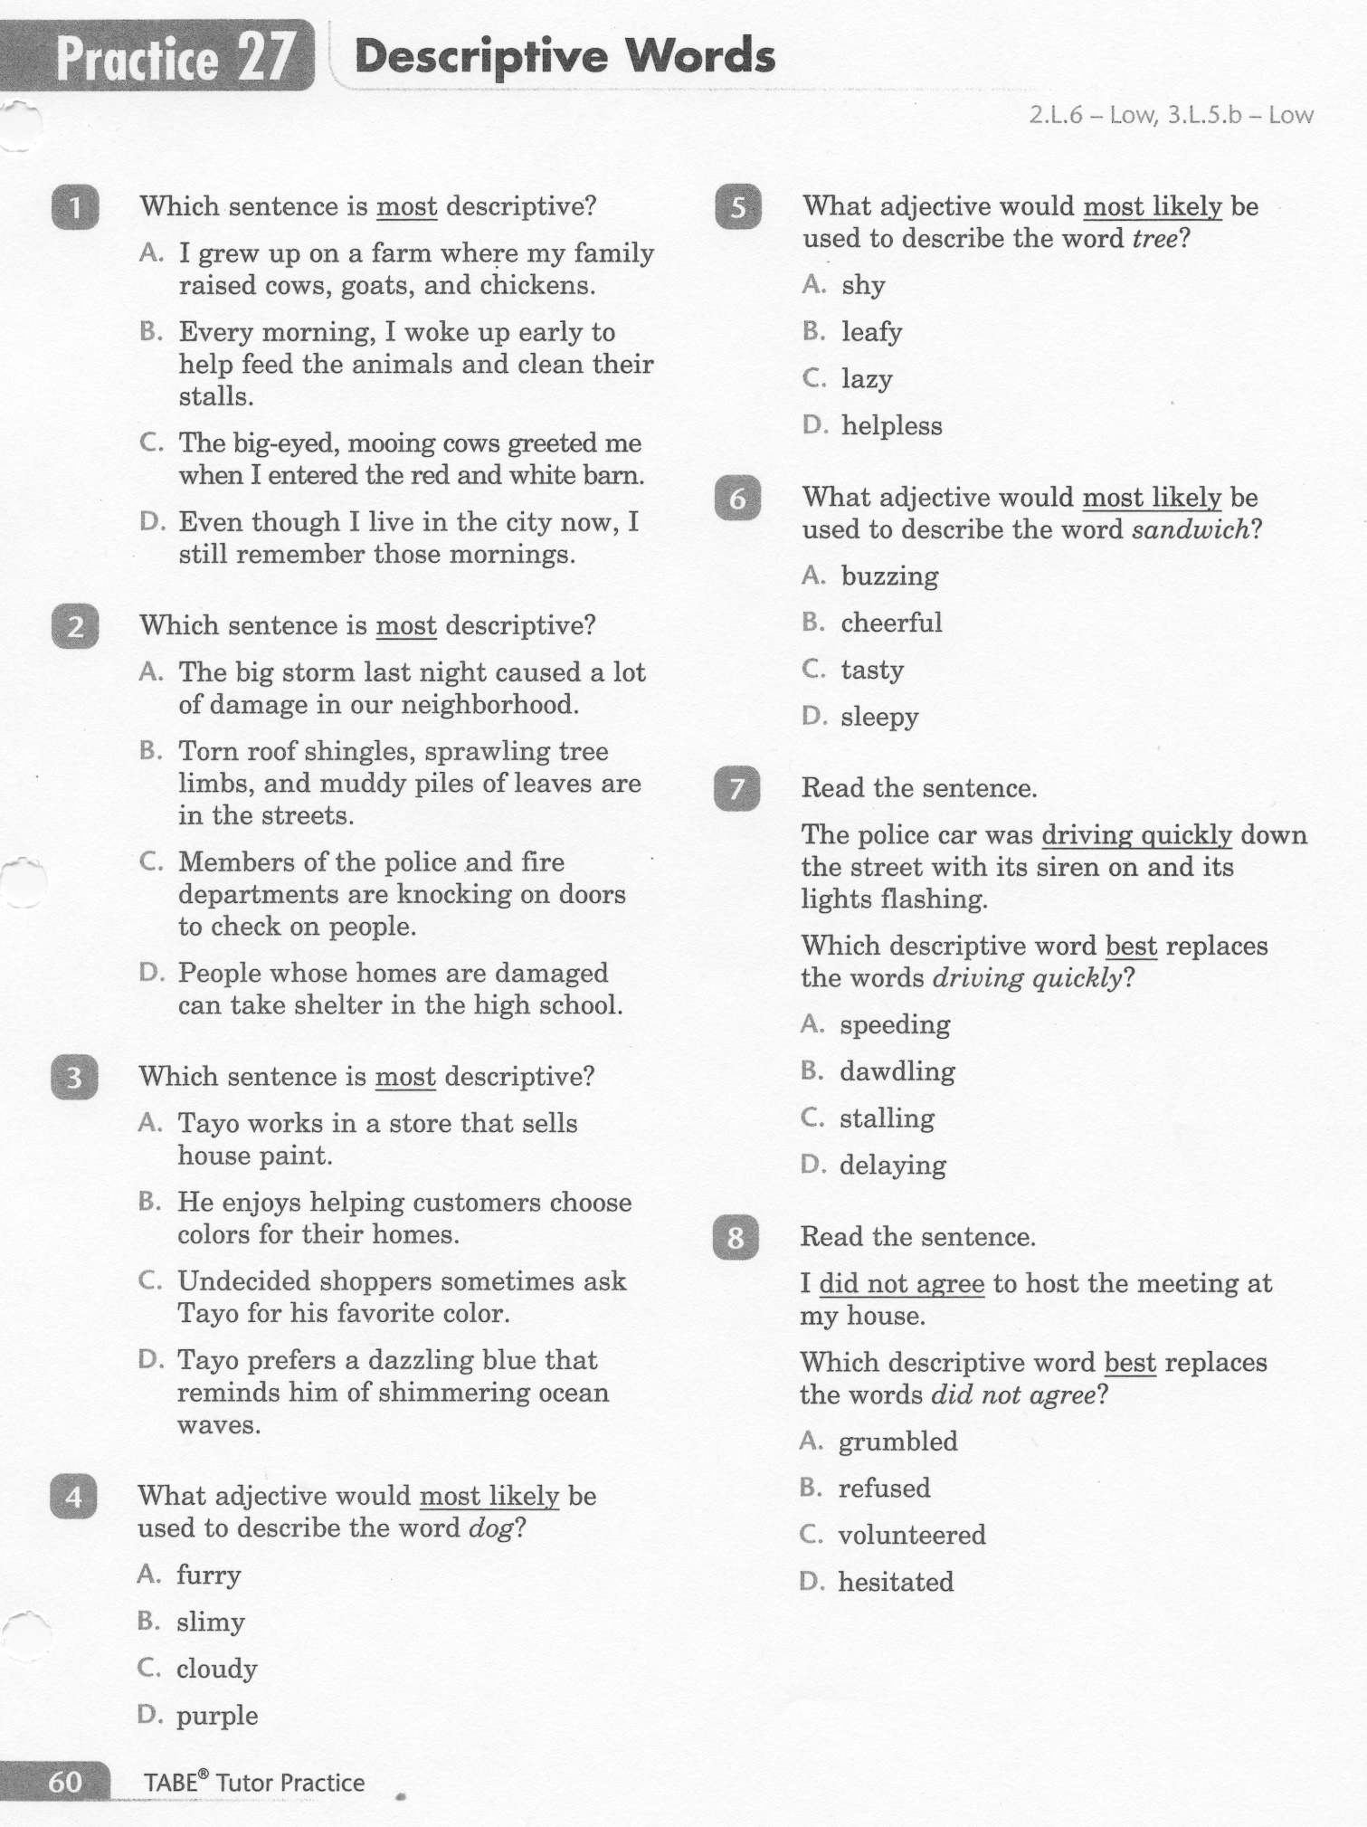
ELA-E-27 Descriptive Words

Slide 5
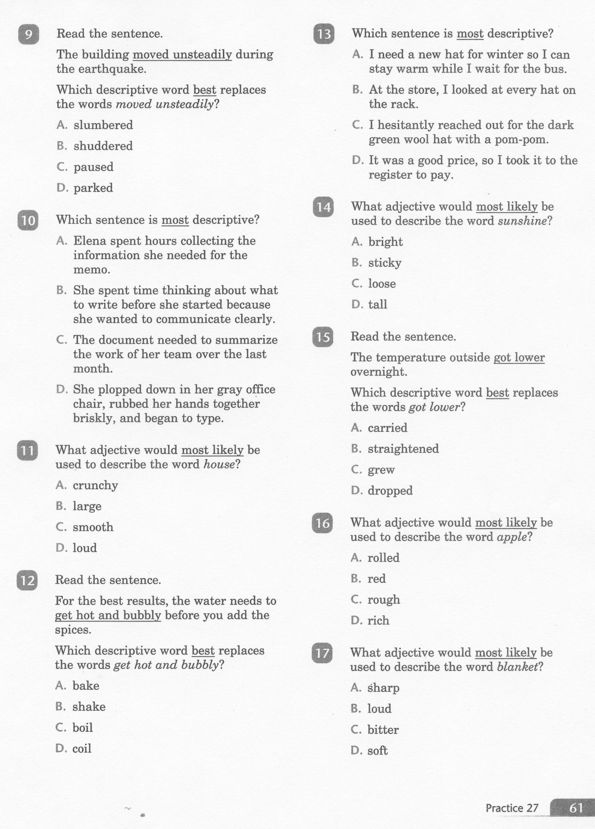
ELA-E-27 Descriptive Words

Slide 6
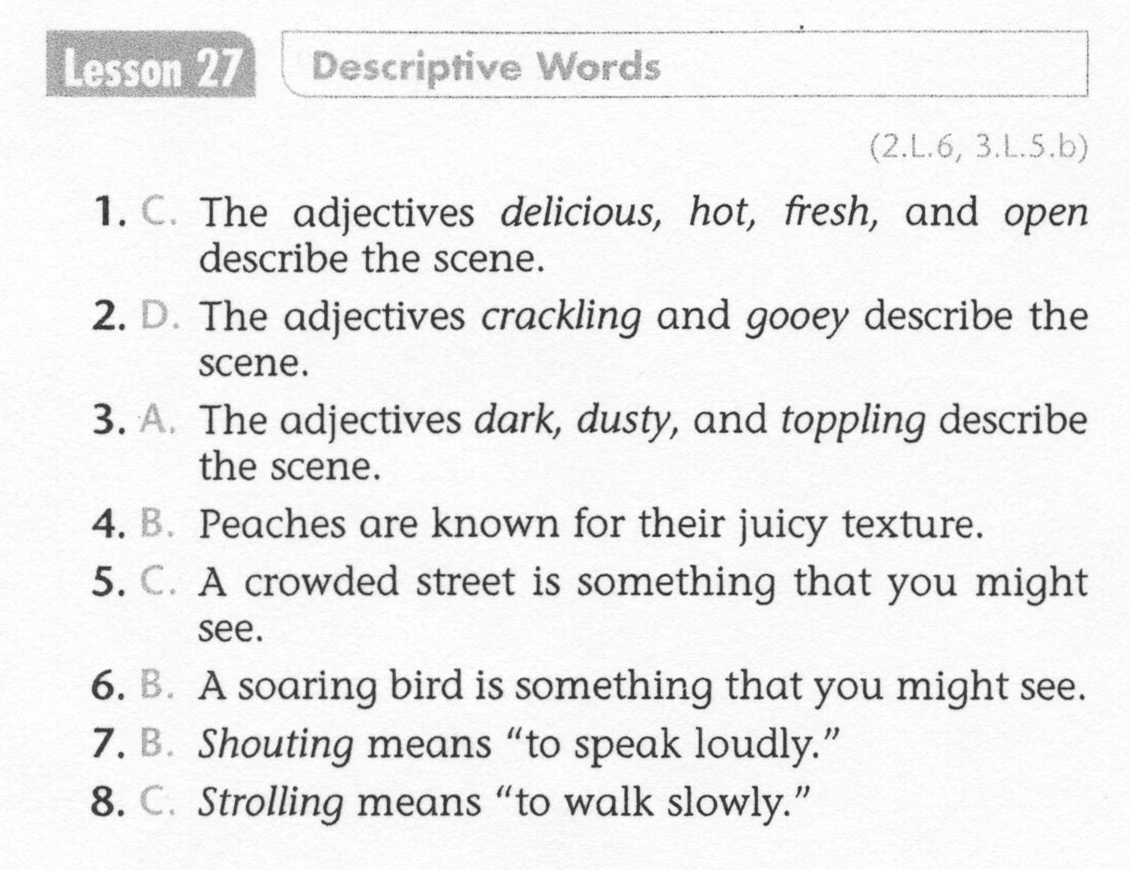
ELA-E-27 Descriptive Words

Slide 7
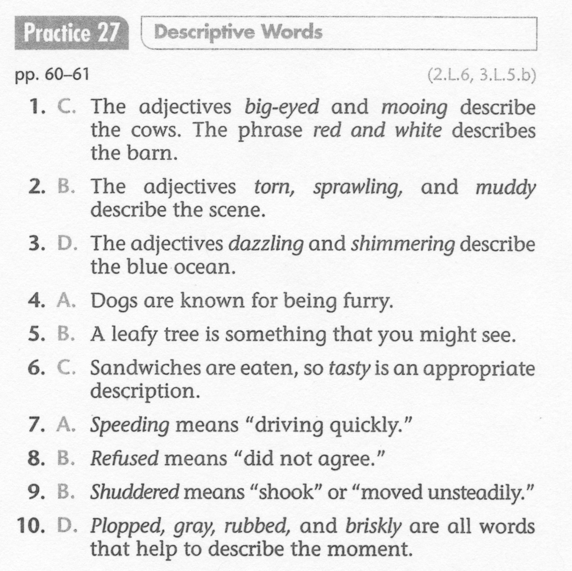
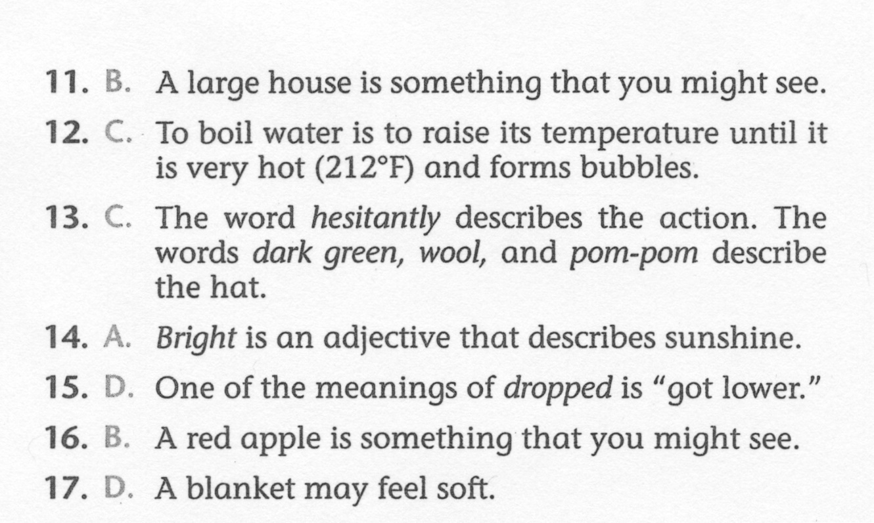
ELA-E-27 Descriptive Words

