Slide 1
TABE ELA-E PAXEN Unit-4 Vocabulary and Word Use Lesson-23 Roots and Prefixes
Some graphics may not have copied well during the Scan Process

Slide 2
ELA-E-23 Roots and Prefixes

Slide 3
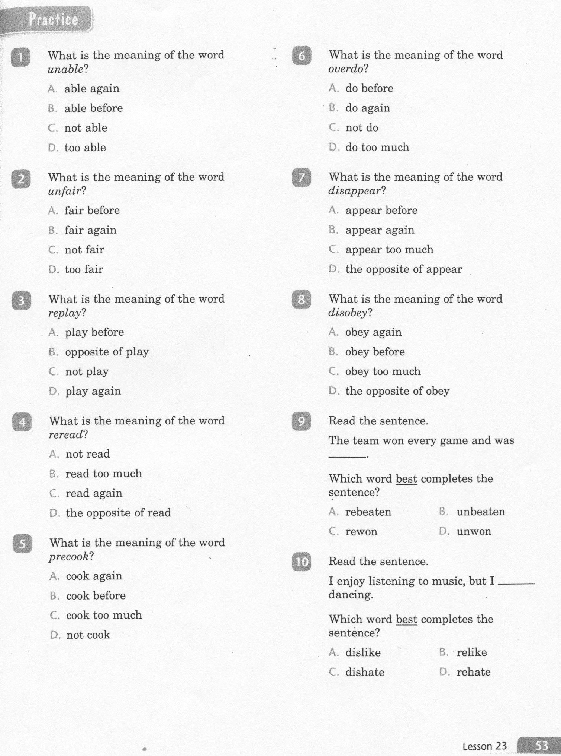
ELA-E-23 Roots and Prefixes

Slide 4
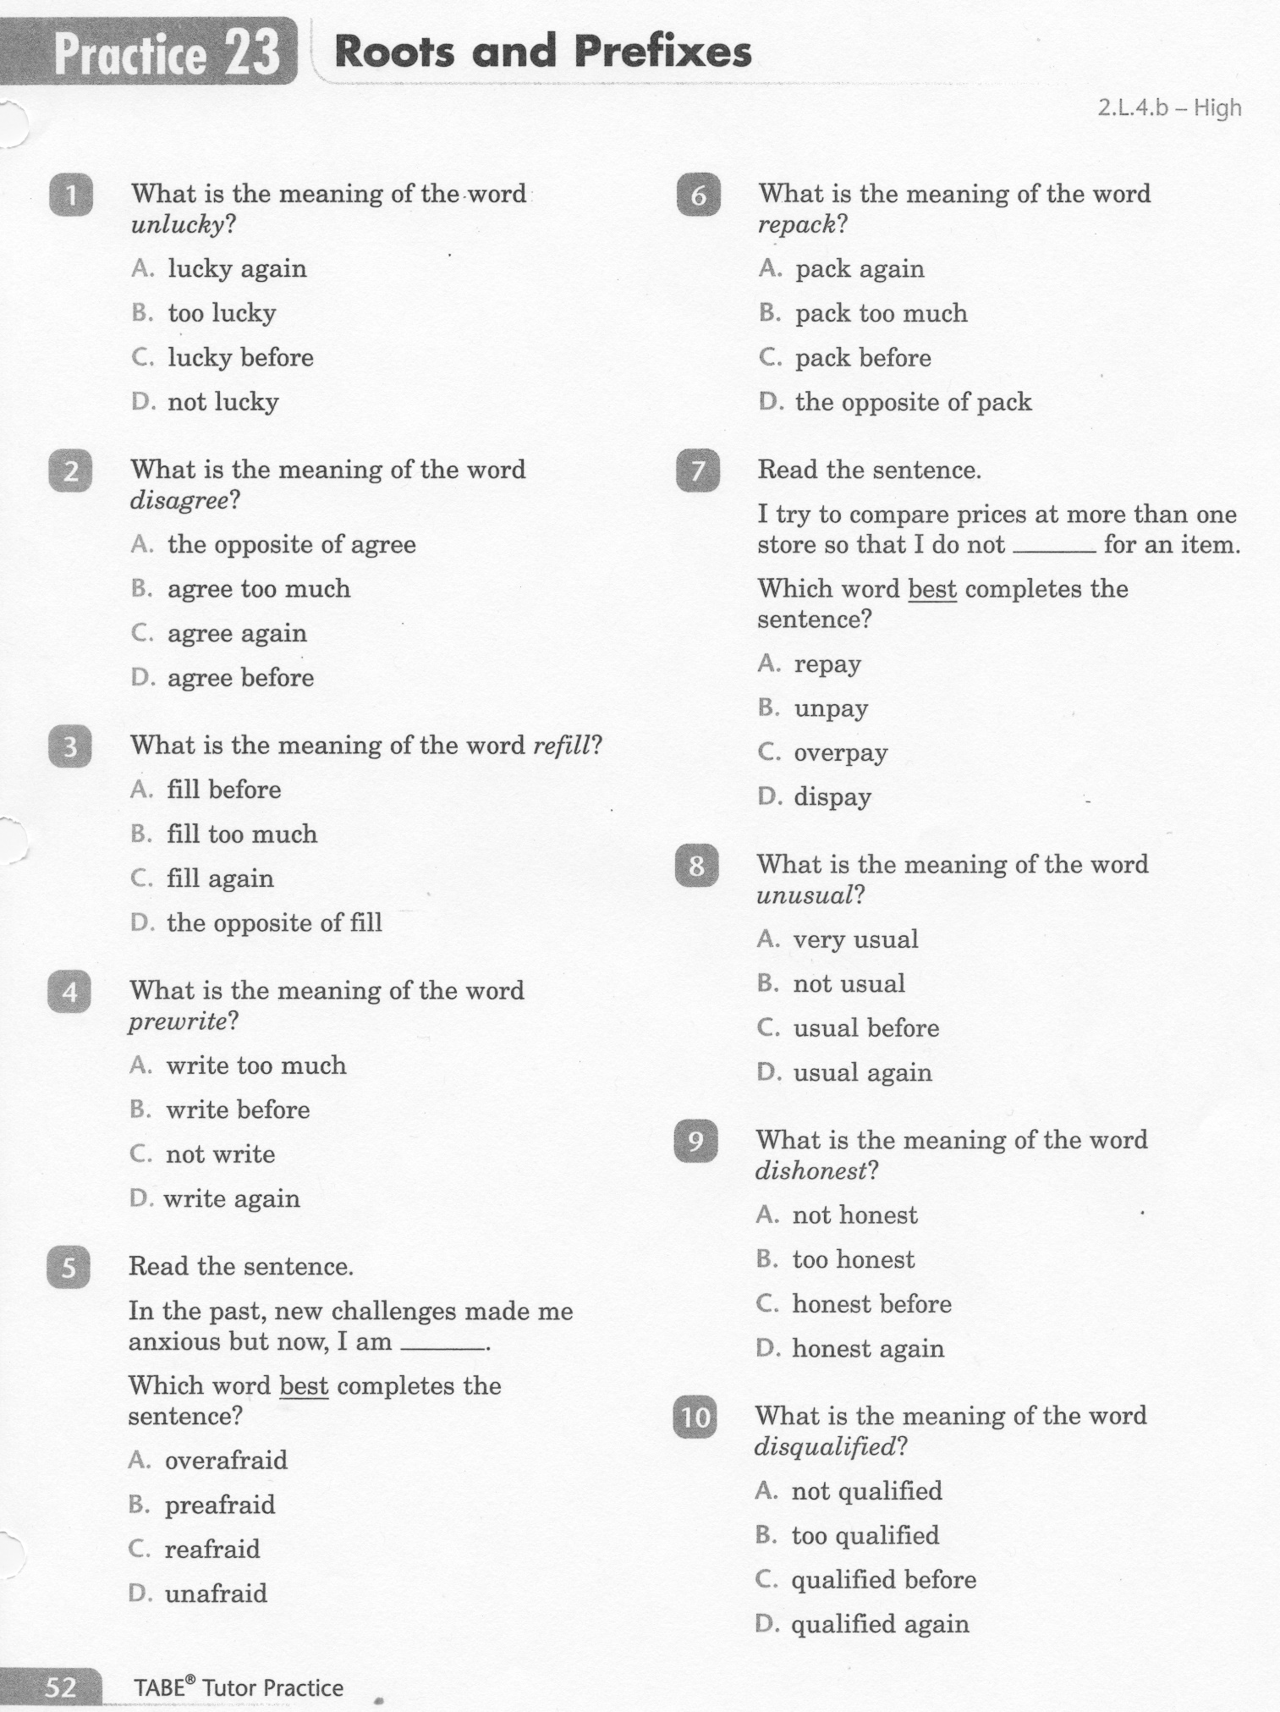
ELA-E-23 Roots and Prefixes

Slide 5
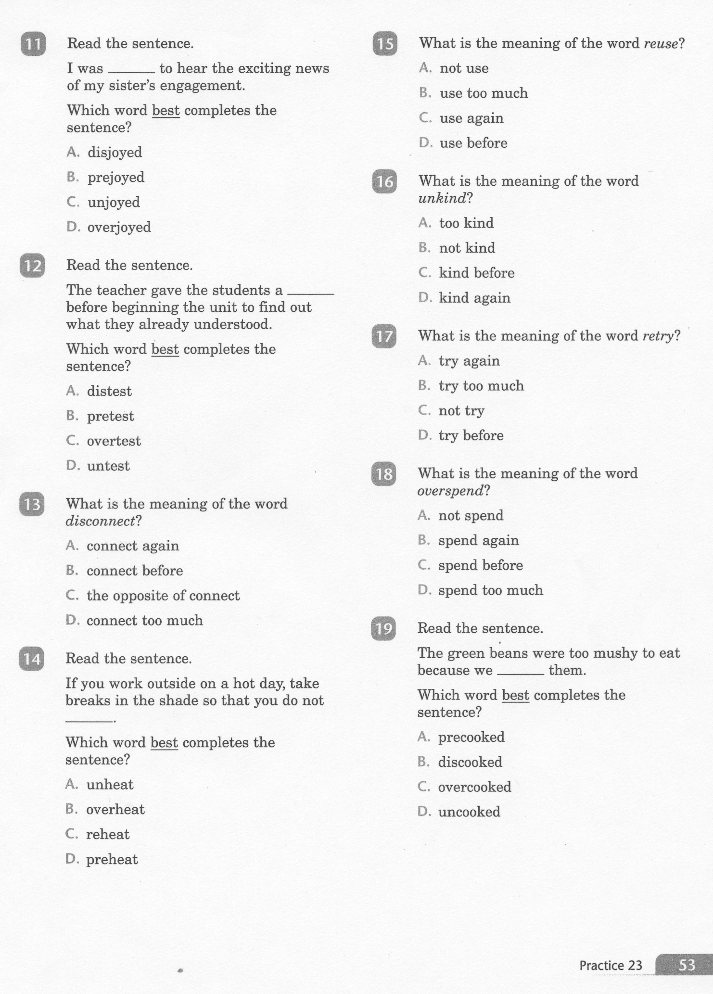
ELA-E-23 Roots and Prefixes

Slide 6
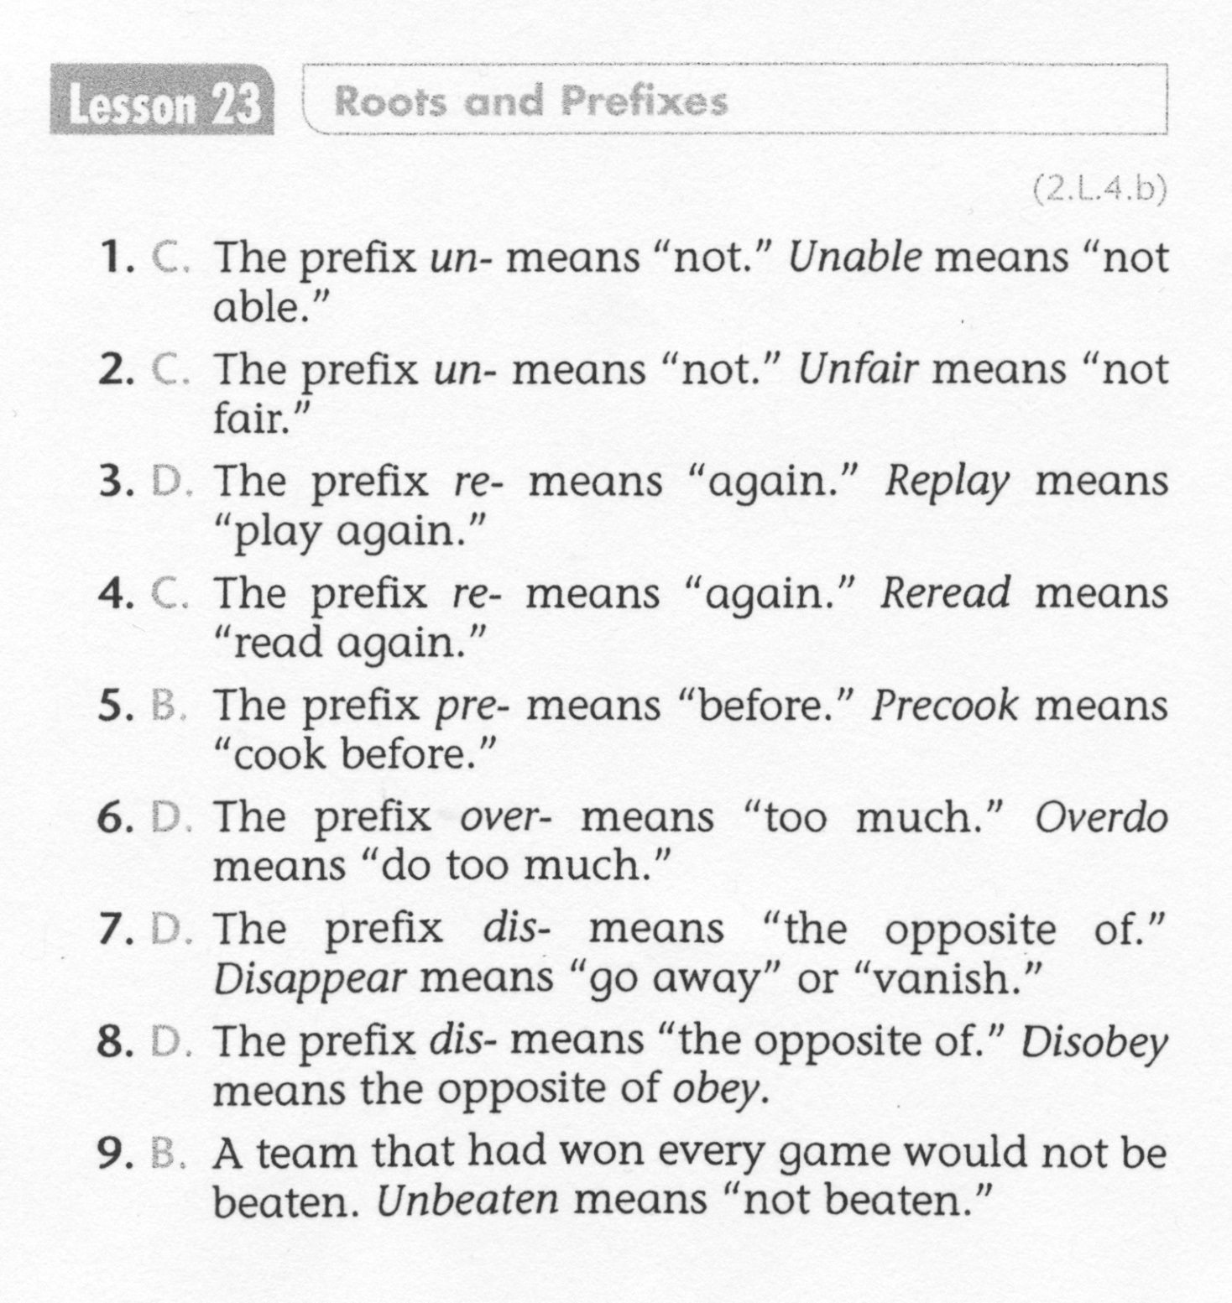
ELA-E-23 Roots and Prefixes

Slide 7
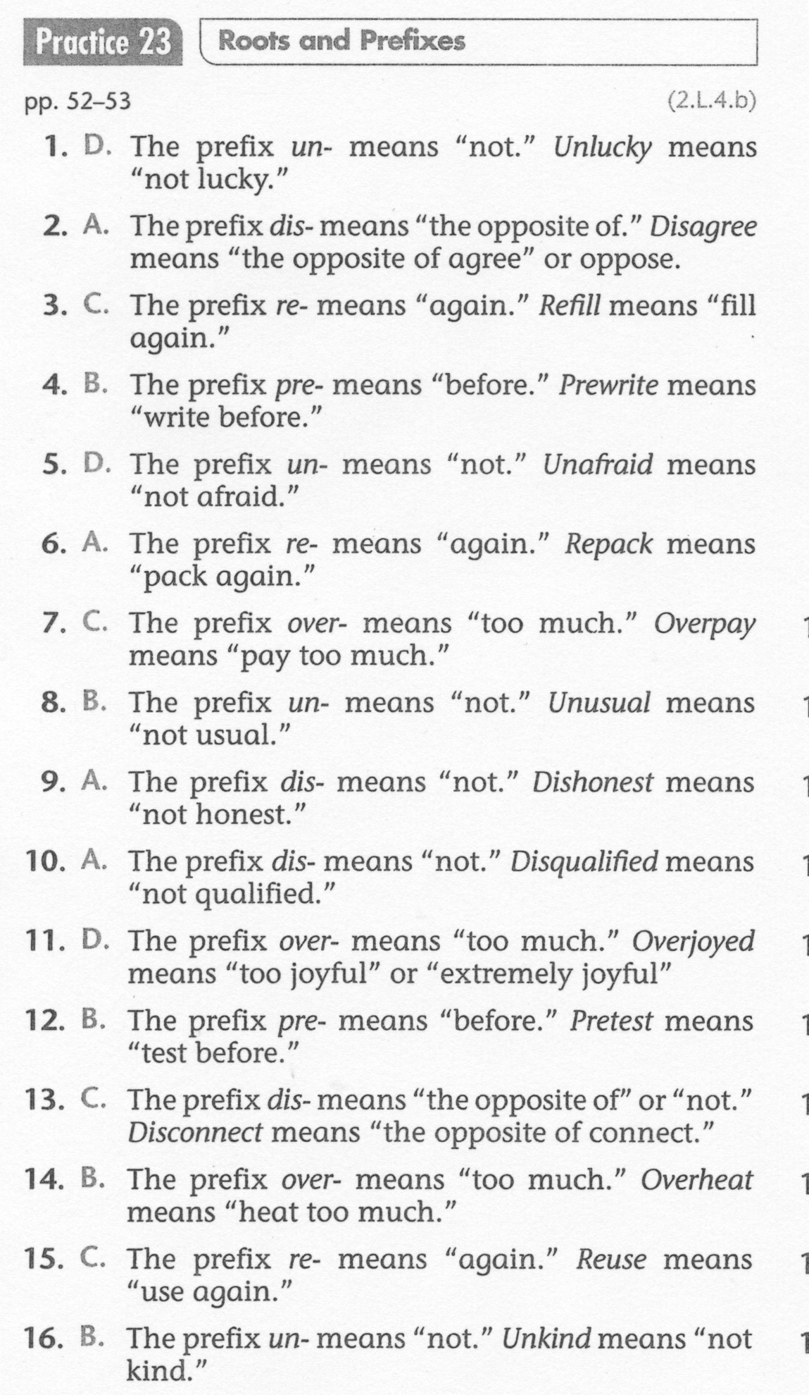
ELA-E-23 Roots and Prefixes

