Slide 1
TABE ELA-E PAXEN Unit-1 Usage Lesson-12 Pronoun Agreement
Some graphics may not have copied well during the Scan Process

Slide 2
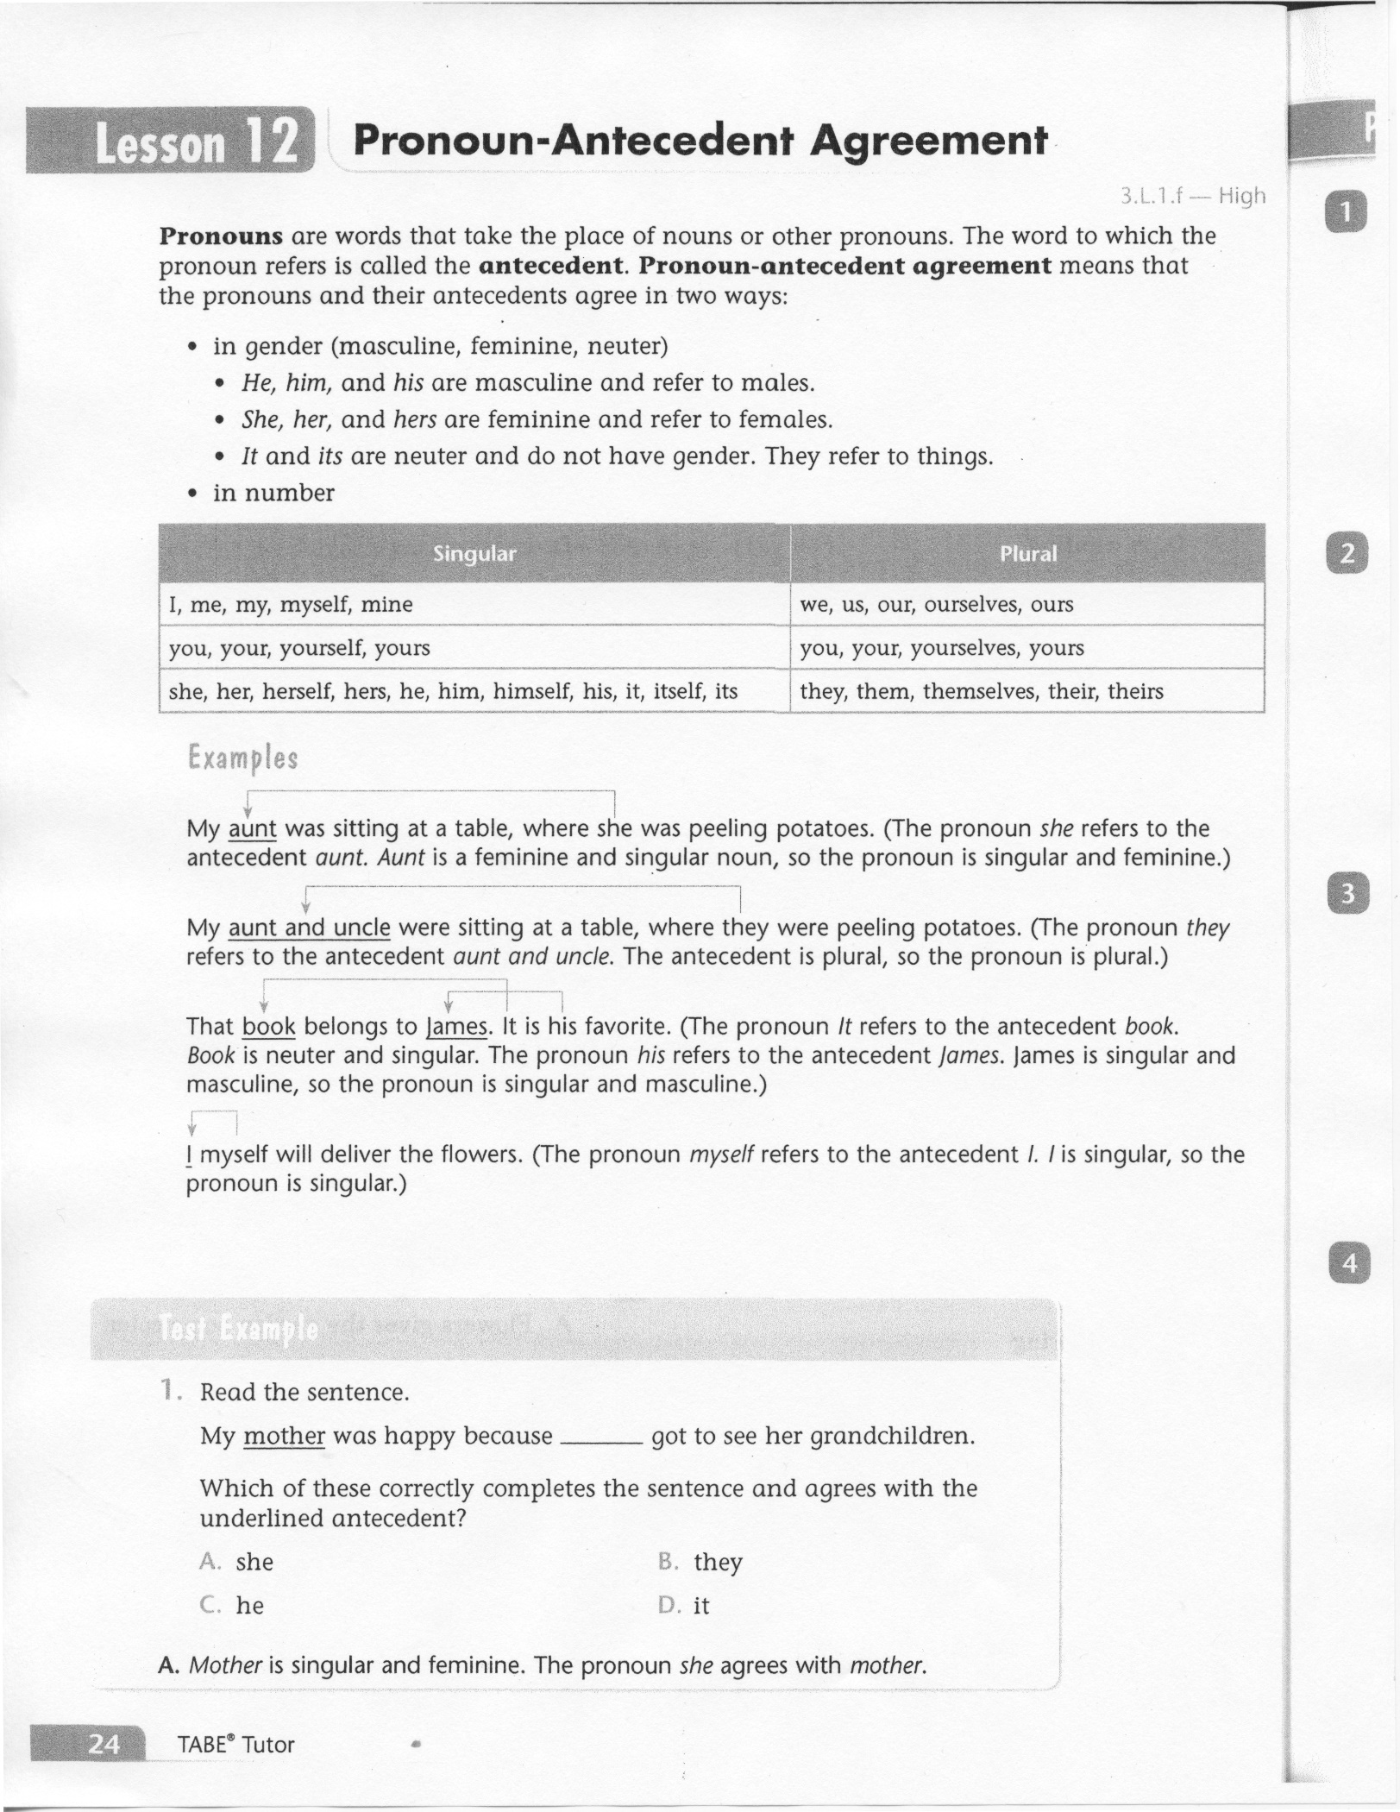
ELA-E-12 Pronoun Agreement

Slide 3
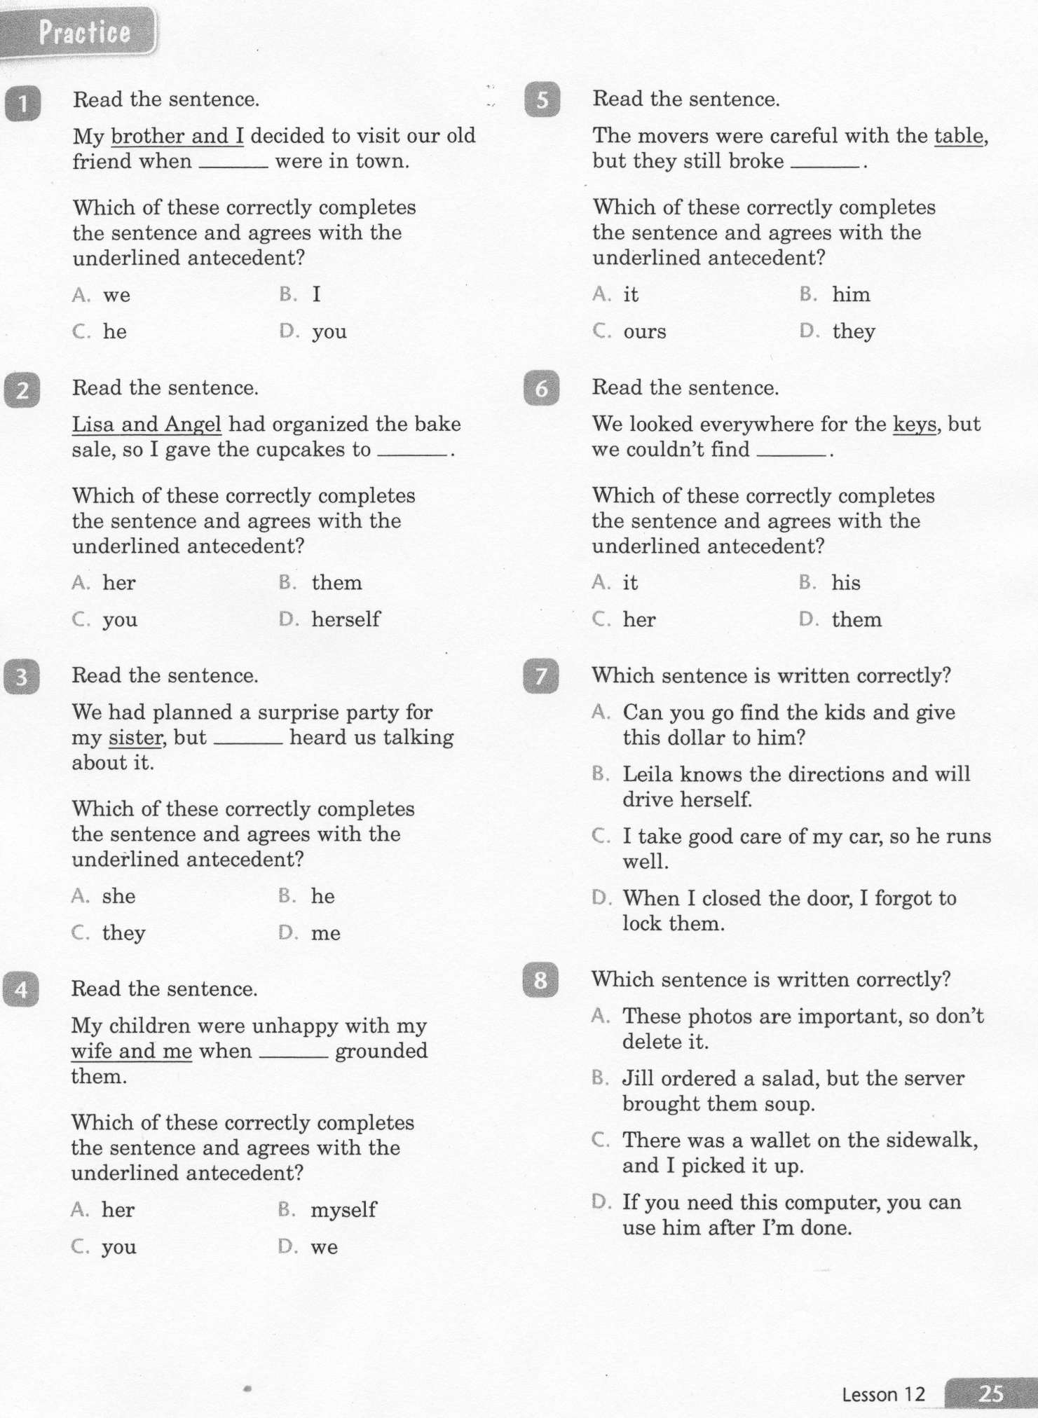
ELA-E-12 Pronoun Agreement

Slide 4
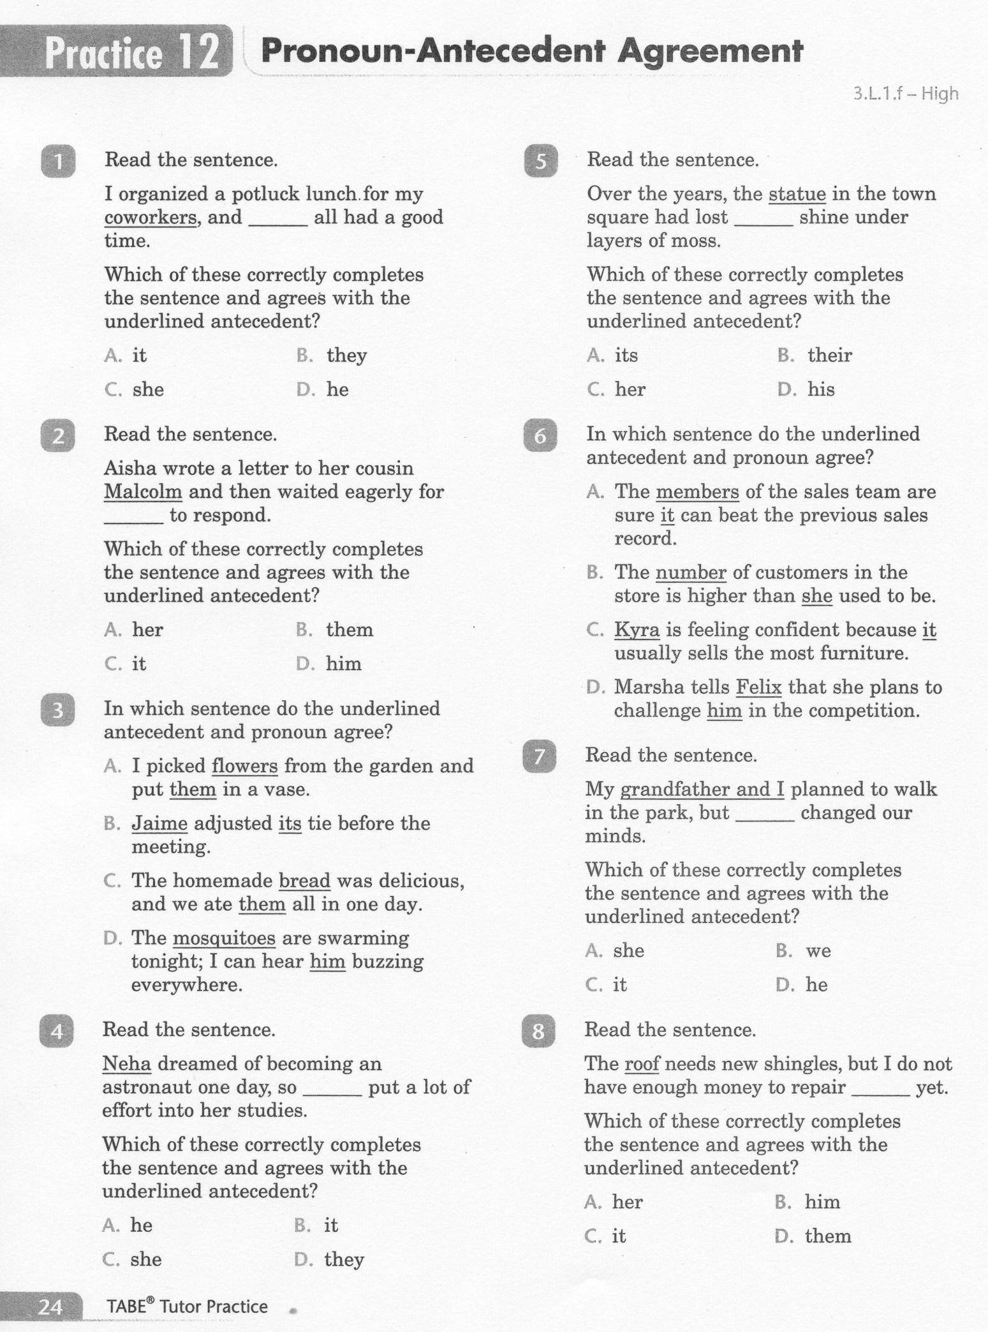
ELA-E-12 Pronoun Agreement

Slide 5
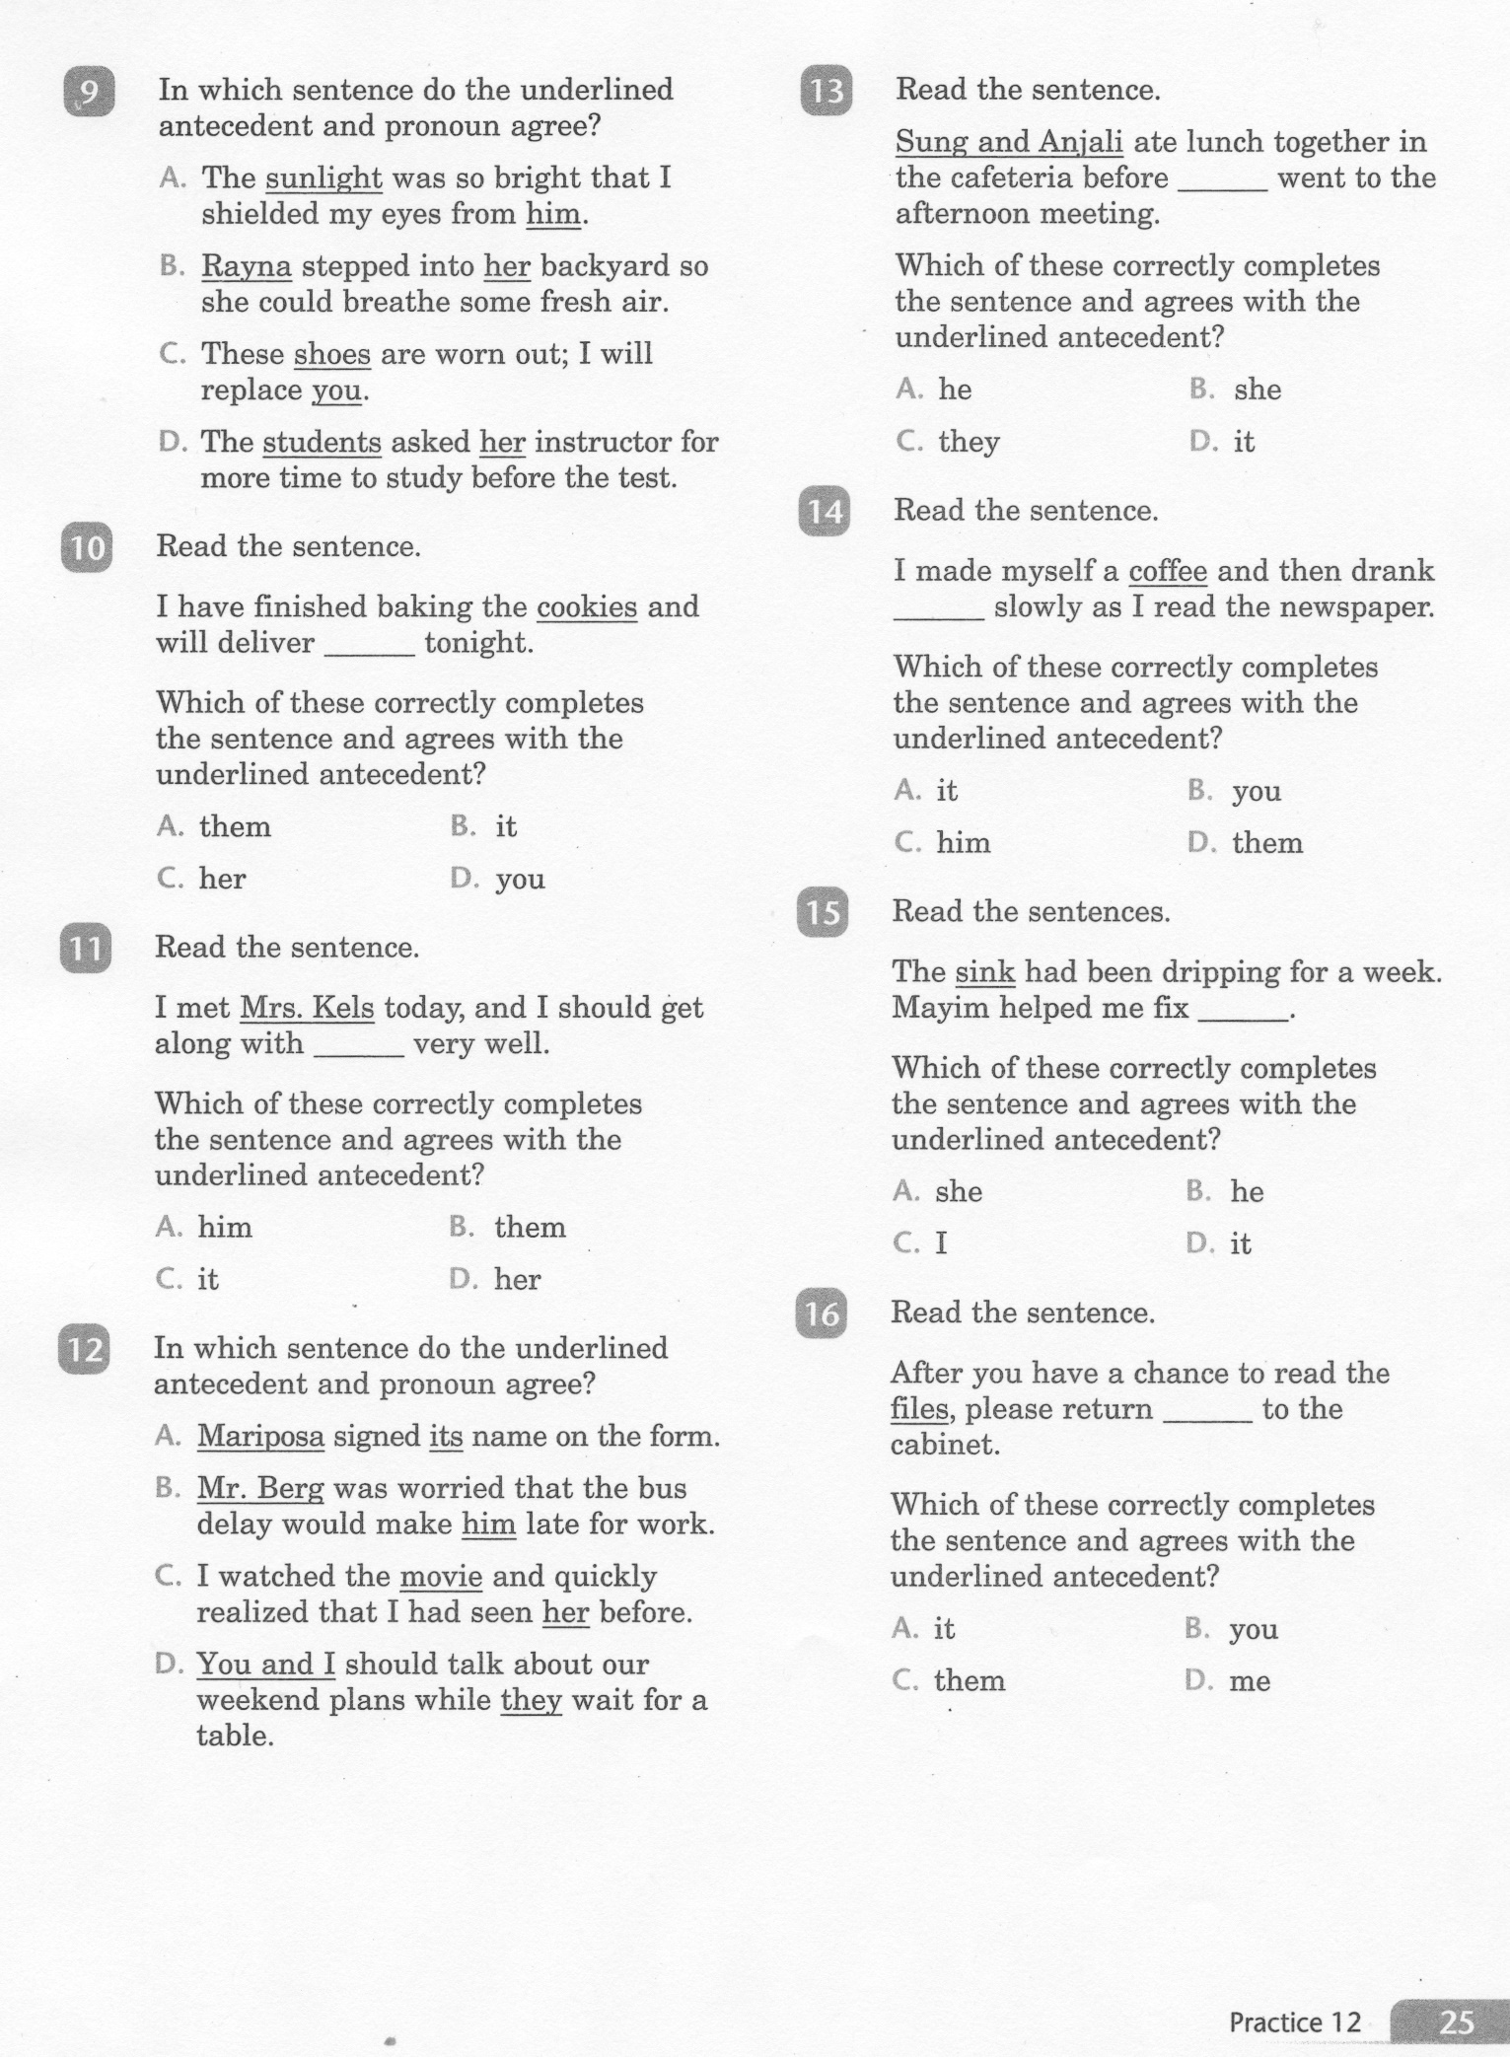
ELA-E-12 Pronoun Agreement

Slide 6
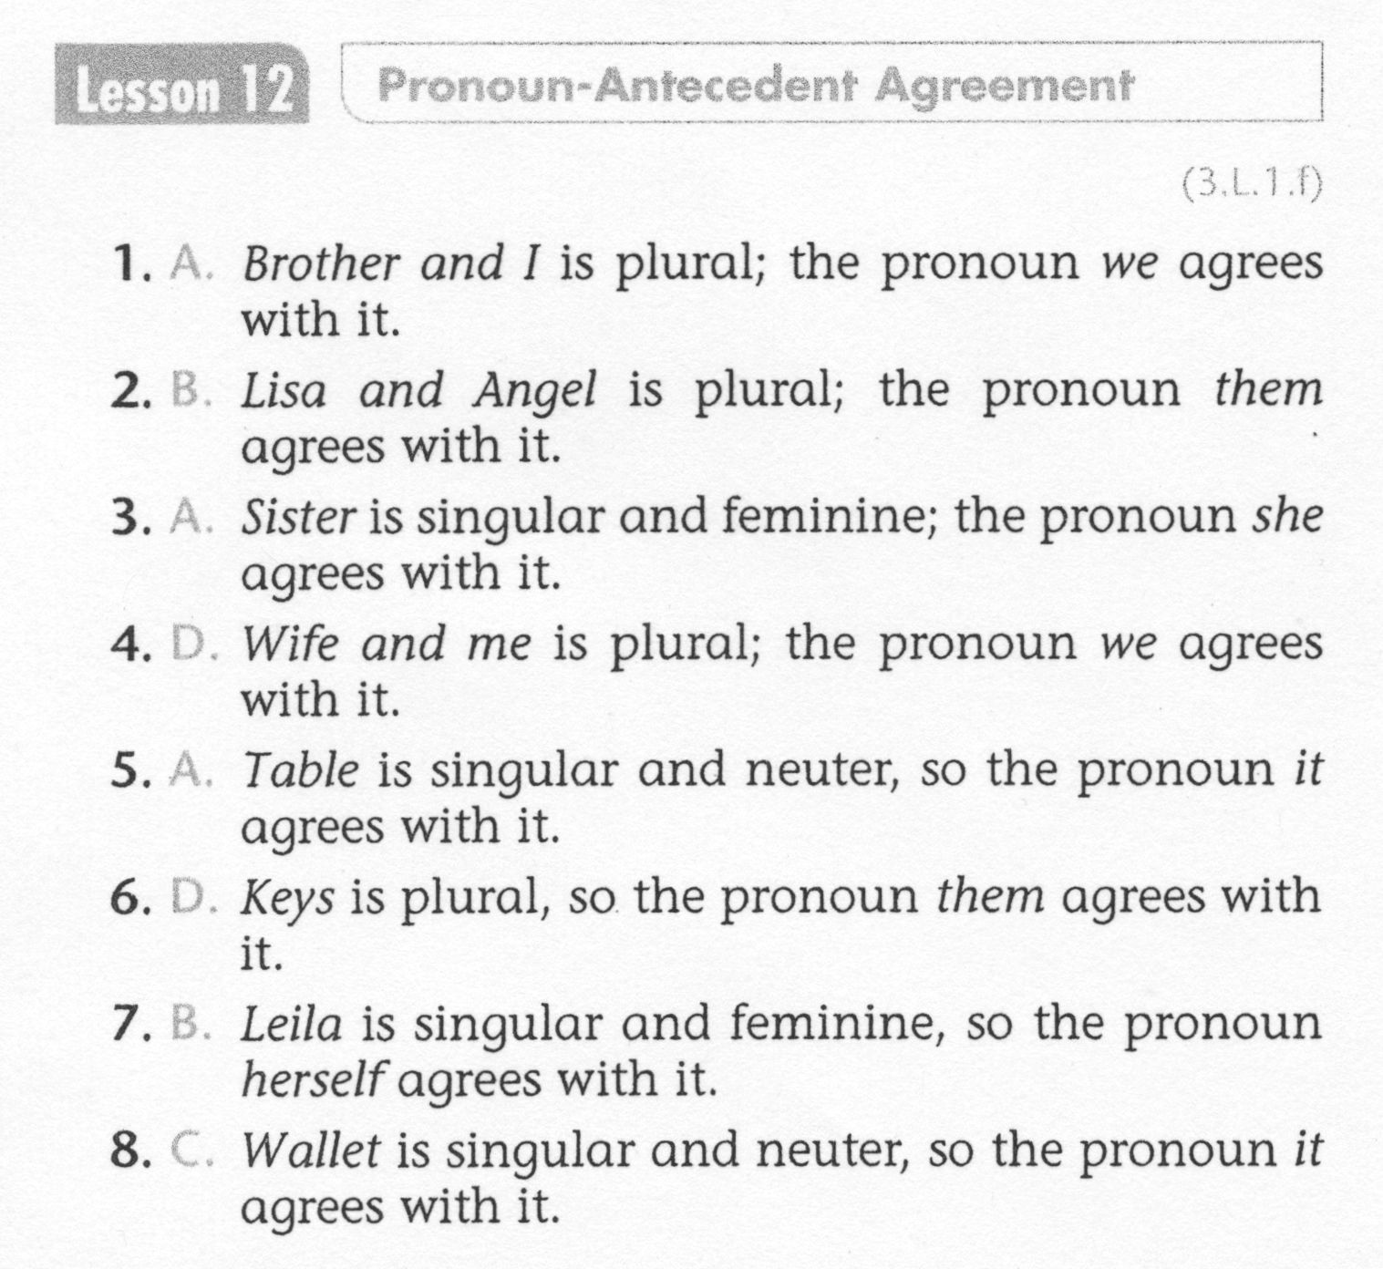
ELA-E-12 Pronoun Agreement

Slide 7
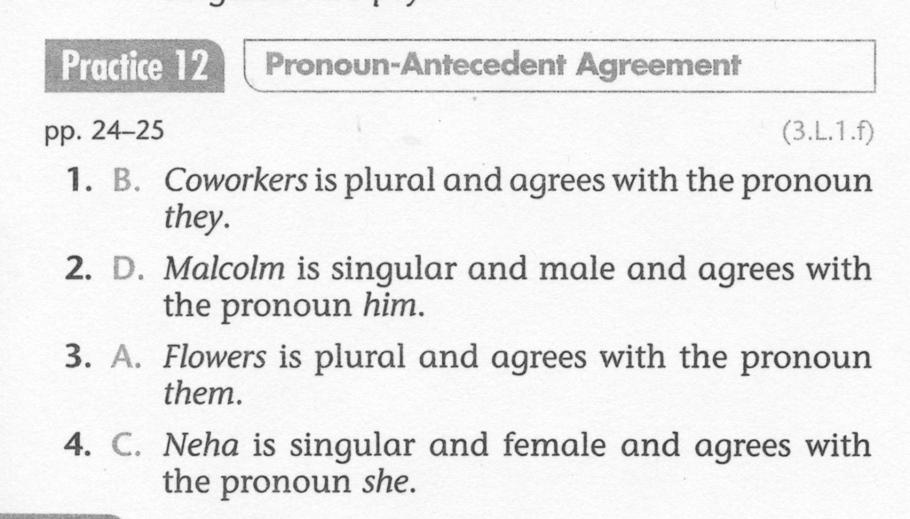
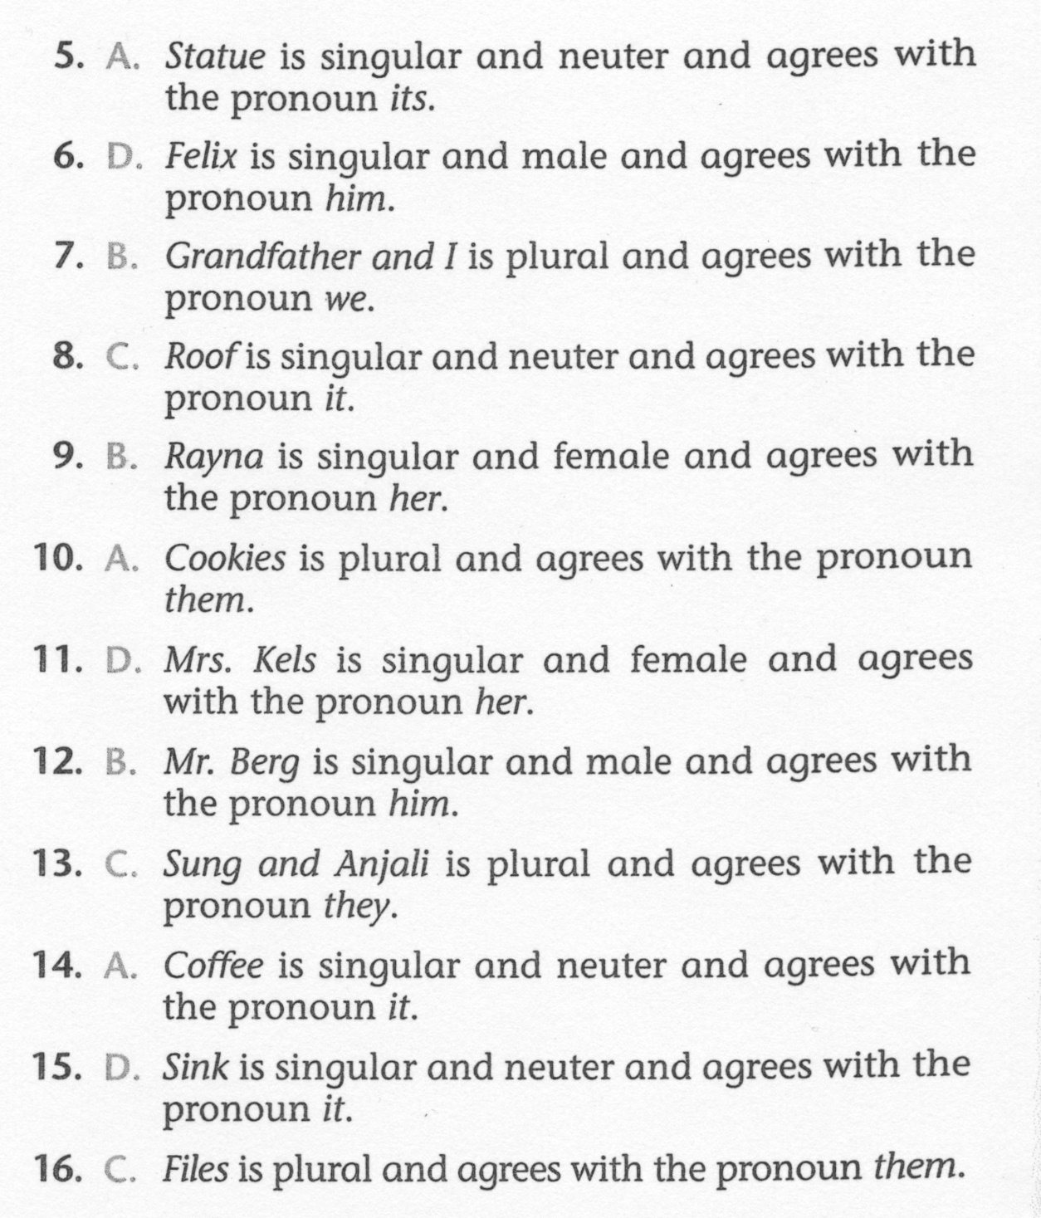
ELA-E-12 Pronoun Agreement

