Slide 1
Workbook Formatting
Nolan Tomboulian
Tomboulian@yahoo.com
Tomboulian.wikispaces.com
How Things Look
Cell Color Font Color
Cell Borders Font Size
Cell Size Font Style
Numeric or Date Display (Edit Masks)
Direction of Text in the Cell (alignment)

Slide 2
Formatting Workbooks
Formatting is the process of changing a workbook’s appearance by defining the Cell and Data ATTRIBUTES:
Fonts, Styles, Colors, Alignment and decorative features like Borders and Fill
Can change the formatting of a text selection, a cell, a worksheet, or an entire workbook
You can modify the Cells, Rows, Columns and the contents within a cell

Slide 3
Formatting Workbooks
Easier to read
Draw attention to important data
Professional appearance
Provide continuity between worksheets
Only add enough formatting to achieve these goals
Too much formatting detracts from the workbook
If it is going to be printed, Be mindful that some colors won’t look good!

Slide 4
Formatting Text
The appearance of text is determined by its typeface, which is the specific design used for the characters:
Font: Times New Roman, Ariel,
Font Effects: bold, underline, italics
Font Color: Red, BLUE, GREEN
Font Size: Measured in Points
72 Points = 1 inch

Slide 5
CELL STYLES (Pre-Defined or Customizable)

Slide 6
Working with Color
Color is usually applied in one of two ways:
Font Color
Fill Color
Theme colors are the 12 colors that belong to the workbook’s theme
Standard colors are also available
Can create custom colors
Apply a color by selecting a cell or range of cells, clicking the Font Color or Fill Color button arrow, and then selecting a desired color
Some color combinations look good on the screen but are bad when the spreadsheet is printed!
(and it uses more ink!)

Slide 7
Formatting Text Selections
The Mini Toolbar appears when you select text and contains buttons for commonly used formats
The Mini Toolbar option may be turned off with the [FILE] {Options}

Slide 8
Formatting Data
By default, numeric values appear in the General Number Format, which, for the most part, displays numbers exactly as you enter them.
The {Number group} on the [Home] tab has buttons for applying common numeric formats.
Dollar Style Button
Notice the sub-menu options dialog
Percent Style button
Comma Style button
Decrease Decimal button
Increase Decimal button
Number Format button

Slide 9
Formatting Data

Slide 10
Formatting Dates and Times
Although DATES and TIMES in Excel appear in “normal” formats, they are actually numbers
Measure the interval between the specified date and time and January 1, 1900 at 12:00 a.m.
Excel uses this system to make date and time calculations easy to perform
Can create Custom Formatting to make Edit Masks to display data in various formats:
Leading Zeros, Phone-Numers, SSN,

Slide 11
Aligning Cell Content
Alignment refers to the position of values within a cell.
(It used to be called Justify)
In addition to Left, Right, and Center, you can change the vertical and horizontal attributes:
(Top, Middle, Bottom)
Data may be also be rotated to an angle within the cell
Alignment buttons are located on the [Home] tab
May also Indent, Wrap or Merge Cells
(Merged Cells Cannot be sorted)

Slide 12
Indenting Cell Content
You increase or decrease the indentation each time you click a button in the Alignment group on the [Home] tab

Slide 13
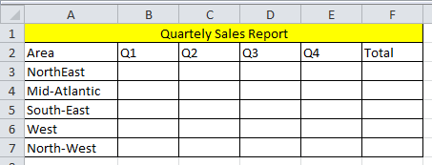
Merging Cells
One way to align text over several columns or rows is to merge, or combine, several cells into one cell.
Useful for a “Heading” over a range of cells
There must not be any data in the adjacent cells being merged!

Slide 14
Merging Cells
Select the range of cells you want merged.
Click the Merge & Center button in the Alignment group
or
Click the Merge & Center dialog Box and select Merge Across. This creates the same effect as Merge & Center without centering the text
You can also Merge a range of cell Rows and Columns to make a “Block”
Remember the cells being merged must be empty or it will Erase the contents.

Slide 15
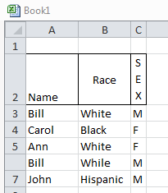
Rotating Cell Content
To save space or to provide visual interest to a worksheet, you can rotate the cell contents so they appear at any angle or orientation
Select the range
In the Alignment group, click the Orientation button and choose the desired rotation

Slide 16
Rotating Cell Content

Slide 17
Adding Cell Borders
You can add Borders to the left, top, right, or bottom of a cell or range, around an entire cell, or around the outside edges of a range using the Border Dialog

Slide 18
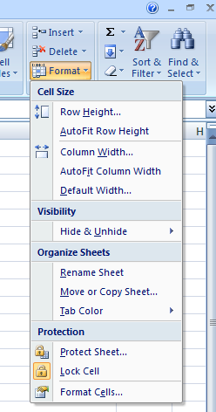
Format Cells Dialog Box
The Format Cells dialog box provides access to all formatting options related to cells
The Format Cells dialog box has six tabs, each focusing on a different set of formatting options
Can also access with a <Right Click>

Slide 19
Format Cells Dialog Box

Slide 20
Changing Column Width and Row Height
Column Widths and Row Heights can be adjusted to fit data, create visual space, etc
The default column width is 8.38 standard-sized characters
Row heights are expressed in “Points” {72=1 inch}
Autofit eliminates any empty space by matching
the column to the width of the longest cell entry
the row to the height of the tallest cell entry

Slide 21
Changing Column Width and Row Height
Position the cursor on the border between column or row headers
When the cursor changes to a resize cursor, left click and drag to resize the column or row
or
<Double Left Click> to Auto Size the Cell to fit the contents
or
Select one or more columns or rows
Go to the [Home] Tab – Cells group and click on the Format button, and then click Column Width or Row Height
Type the desired column width or row height and then click the OK button

Slide 22
Changing Column Width and Row Height
Autofit a column or row automatically resizes the row or column to fit the largest cell value
Autofit by placing the cursor in the same position as manual resizing, then
<double-left-click> (rather than dragging)

Slide 23
Entering Multiple Lines of Text Within a Cell
Type the first line of text
For each additional line of text, press the <Alt><Enter> keys and then continue typing
Pressing <enter> in Excel terminates data input and moves <Down> a row. (default setting)
Pressing <Tab> in Excel terminates data input and moves <Right> a Column. (default setting)
<Alt><Enter> puts a “hard coded” <return> (Line Feed)
You can also format a cell to have the text “WRAP” in the cell – But WRAP will “break” the line when the cell is full, not where you want it.

Slide 24
FORMATTING CELLS

